Slide 1
“Meet the Experts” Fall Freebie Biggest GME Mistakes of 2014
PARTNERS IN MEDICAL EDUCATION, INC.
Co-Presented by:
Catherine Henderson, DrPH, LFACHE
Christine Redovan, MBA
Candace C. DeMaris, MAIS

Slide 2
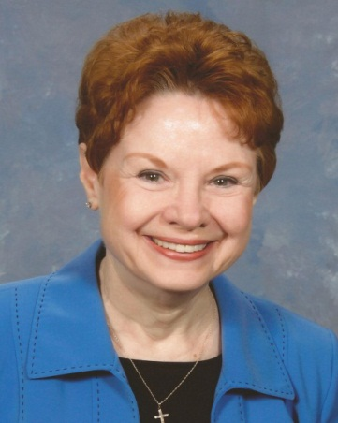
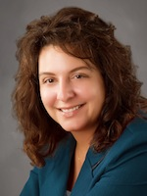
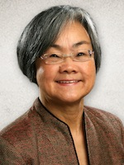
Partners® Consulting Team
Catherine
Henderson, DrPH, LFACHE
Consultant
25+ years experience in GME, nursing leadership, hospital administration, and medical staff development
Assisted over 30 institutions, and 100 programs in 36 specialties, improve GME quality and accreditation outcomes.
Christine
Redovan, MBA
Consultant
10+ years GME Operations, Accreditation and Management success
Focused on continual readiness and offering timely and useful GME resources
Candace
DeMaris, MAIS
Consultant
25+ years experience throughout the spectrum of Medical Education
Expertise in the area of GME finances – including the financial feasibility of starting new programs and demonstrating the value of established programs

Slide 3
Biggest GME Mistakes Part 1
Catherine Henderson, DrPH, LFACHE
GME Consultant

Slide 4
Failure to Take ACGME Online Surveys Seriously
“Residents didn’t understand the question.”
“The results aren’t right!”
“That’s just a few unhappy residents. They’re out to get us.”
Are you SURE the findings are not valid? SHOULD the residents understand the questions?
The surveys are key indicators in NAS
What to do about negative surveys

Slide 5
Lack of Program Director Involvement in the Annual Update
What would we do without Program Coordinators?!
Is the ADS update a Program Coordinator responsibility?
The changing role of the ADS update
Showcase your program. This is NOT just filling out a form!

Slide 6
Failure to Keep Up with the Changes
How many jobs do you have?
The importance of lifelong learning – especially now
Why waste time and energy working to comply perfectly with outdated requirements?

Slide 7
Feeling Relieved: the General Competencies Went Away
Sorry. They didn’t.
The six general competencies are the foundation for the NAS milestone assessments.
How skilled are your faculty in teaching and evaluating the competencies?
How much do your resident evaluations tell you?

Slide 8
Ignoring the Self-Study Requirements
“We aren’t due for years!”
“I’m waiting until ALL the requirements are announced.”
“What’s a ‘self-study’?”
Start now!
The relationship of the APE and the Self-Study
Why the long view is important

Slide 9
Biggest GME Mistakes Part 2
Christine Redovan, MBA
GME Consultant

Slide 10
Policies
Do you have them?
Are they updated…
…to reflect current requirements
…with new PD or DIO signatures
…with a date
Do they contradict GME policy?
Did you post the new ones?

Slide 11
Resident Forums
Required by ACGME
Open to all residents
Ability to meet without administration
Resident concerns brought to GMEC
Follow through with response

Slide 12
Follow Up
GMEC Minutes and Action Plans
Ensure accountability and follow up
Who, what, when
Use a tracking system
Citation Responses
What you did
How you are monitoring
Status today

Slide 13
Communication
DIO
GMEC
PD
C-Suite
Residents
Coordinators
GME Office
Be consistent
Use the phone
Speak up at meetings
Confirm and clarify
Don’t use texting language in emails

Slide 14
Asking For Help
GME is a team sport
Don’t be afraid or intimidated
No question is too silly/stupid/basic
We have all been in the same position at one time or another
Questioning is learning

Slide 15
Biggest GME Mistakes Part 3
Candace C. DeMaris, MAIS
GME Consultant

Slide 16
Not paying attention to the ACGME Requirements
Common, Specialty-Specific, Institutional
Must vs. Should
Core, Detail, Outcome
Mistakes from the field…
Notes:
Categorization: Core, detail, outcome (structure, detail, process, resource)
CPR’s - call rooms, EMR, library, PD, faculty,
Specialty-Specific – Additional requirements for PD, specific requirements for curriculum,
Institutional requirements – No more SPI’s

Slide 17
In addition to the ACGME requirements…
Glossary of Terms
Policies and Procedures
FAQ’s
RRC Bulletins
E-Communications
“Revised for Comment”
Slides for Faculty Development
WebADS
Resident Survey

Slide 18
Not paying attention to CMS rules and regulations
Laws
Administrative Rules
Fiscal Intermediary interpretation
Mistakes from the field…
Notes:
FTE cap
Rotation assignments
Non-patient care rotations
IME and DGME formula
New for 2015

Slide 19
No documentation or inadequate documentation
“Not documented” means “not done”
No data is a data point!
Notes:
Minutes, Resident and Faculty Scholarly Activity, Annual Improvement Activities, Procedure Logs

Slide 20
No documentation or inadequate documentation
Consider…
Minutes
Annual Improvement Activities
Schedules
Resident Clinical Experience, Evaluations, Performance, Corrective Action
Scholarly Activity
Agreements with Participating Sites

Slide 22
Partners’ Online Education
Upcoming Live Webinars
Annual Institutional Review (AIR)
Tuesday, November 18, 2014
12:00 pm – 1:30 pm EST
Self-Study Visits
Thursday, December 4, 2014
12:00 pm – 1:30 pm EST
Program Accreditation Under NAS
Wednesday, December 10, 2014
12:00 pm – 1:30 pm EST
Visit our website to see our full schedule!
www.PartnersInMedEd.com
On- Demand Webinars
Self-Study Visits
Introduction to GME for
New Program Coordinators
Navigating NAS: Keep Your
Eyes on the Dashboard
Annual Program Evaluation
Annual Institutional Review
GME Financing – The Basics
GMEC – What’s New?
Contact us today to learn
our Education Passports
can save you time & money!
724-864-7320

Slide 23
Partners in Medical Education, Inc. provides comprehensive consulting services to the GME community. For more information, contact us at:
Phone: 724-864-7320
Fax: 724-864-6153
Email: Info@PartnersInMedEd.com
www.PartnersInMedEd.com

