Slide 1
Direct Observation Why? What? How? February 19, 2015
PARTNERS IN MEDICAL EDUCATION, INC.
Presented by:
Heather Peters, M.Ed., PhD
Christine Redovan, MBA
GME Consultants
Notes:
Partners in Medical Education, Inc.
1

Slide 2
Introducing Your Presenters…
Heather Peters, M.Ed, Ph.D
Seasoned speaker at ACGME & sub-specialty national meetings
Institutional and Program accreditation experience
3 decades in education; Masters of Education in curriculum & evaluations, PhD concentration in post-secondary education & adult learning theories
Christine Redovan, MBA
Seasoned Director of Medical Education and GME Operations
Accreditation and Management success for both ACGME & AOA Programs
Successful Continued Accreditation & New Start-Up Implementation
Focused on continual readiness and offering timely and useful GME resources
Presented by Partners in Medical Education, Inc. - 2015
2

Slide 3
Goals & Objectives
Understand the importance of direct observation
Learn the use of direct observations in resident evaluation
Utilize templates to develop your own direct observation tools
Presented by Partners in Medical Education, Inc. - 2015
3
Notes:
3

Slide 4
What is Direct Observation?
Direct observation provides an opportunity to observe directly what is happening in a setting.
The number of households recycling
How parents deal with unruly toddlers
The suturing technique of a PGY 1
The ability of a resident to inform a patient of the risks associated with a medication or procedure
Presented by Partners in Medical Education, Inc. - 2015
4
Notes:
Partners in Medical Education, Inc.
4

Slide 5
Direct Observation is Everywhere!
Observation | Setting
Resident greets and establishes rapport with patient (professionalism); Resident explains to patient associated risks of prescribed medication (communication) | Clinic
Resident is able to fully close surgical incision (patient care); Resident respects surgical site (patient care, professionalism) | Operating Room
Resident includes patient in care plan (professionalism, communication); Resident presents complete patient information during hand-off (professionalism, communication, medical knowledge) | Hospital Floor
Resident does not talk loudly about patients (professionalism) | Cafeteria
Presented by Partners in Medical Education, Inc. - 2015
5
Notes:
Partners in Medical Education, Inc.
5

Slide 6
Why?
When you want direct information
The % of households actually participating in recycling
The ability of the resident to fully explain risks and answer patient questions
The actual skill of the resident in suturing
Presented by Partners in Medical Education, Inc. - 2015
6
Notes:
Partners in Medical Education, Inc.
6

Slide 7
Why?
When you are trying to understand on ongoing behavior process
The actual process of parents dealing with a toddler having a tantrum
The process the resident uses during patient hand-off
The steps the resident follows in suturing
Presented by Partners in Medical Education, Inc. - 2015
7
Notes:
Partners in Medical Education, Inc.
7

Slide 8
Why?
When there is physical evidence or outcomes that can be readily seen
Counting the number of houses with recycle bins at the curb
The patient signs the consent form
The incision was closed properly
Presented by Partners in Medical Education, Inc. - 2015
8
Notes:
Partners in Medical Education, Inc.
8

Slide 9
Why?
When written or other data collection does not provide “good” answers
Communication skills
Interactions with others
Treatment of the surgical incision site
Evaluation of system errors
Presented by Partners in Medical Education, Inc. - 2015
9
Notes:
Partners in Medical Education, Inc.
9

Slide 10
ACGME Expectations in NAS
Observation and documentation of residents clinical skills
Introduced in Outcomes Project
Refined in Next Accreditation System
Programs must know the resident is competent AND must know the resident can “do”.
Presented by Partners in Medical Education, Inc. - 2015
10
Notes:
Partners in Medical Education, Inc.
10

Slide 11
Direct Observation & Milestones
Milestones are part of NAS*:
Provide a rich descriptive, developmental framework for clinical competency committees
Guide curriculum development of the residency or fellowship
Support better assessment practices
Enhance opportunities for early identification of struggling residents and fellows
*http://www.acgme.org/acgmeweb/tabid/430/ProgramandInstitutionalAccreditation/ NextAccreditationSystem/Milestones.aspx
Presented by Partners in Medical Education, Inc. - 2015
11
Notes:
Partners in Medical Education, Inc.
11

Slide 12
Direct Observation & Milestones
Milestones are suited for direct observation evaluation
Anchored in behavioral descriptors that allow us to use observation as an assessment of the behavior we are evaluating
Presented by Partners in Medical Education, Inc. - 2015
12
Notes:
Partners in Medical Education, Inc.
12

Slide 13
Direct Observation
Observations are critical and essential for evaluation
The only way to really know if a resident can perform as expected
Feedback to resident is timely
Opportunity to correct poor performance at the time
Presented by Partners in Medical Education, Inc. - 2015
13
Notes:
Partners in Medical Education, Inc.
13

Slide 14
Direct Observation
Documentation of observation is critical and essential for accreditation
ACGME expectation
Program expectation
Resident expectation
Public expectation
Presented by Partners in Medical Education, Inc. - 2015
14
Notes:
Partners in Medical Education, Inc.
14

Slide 15
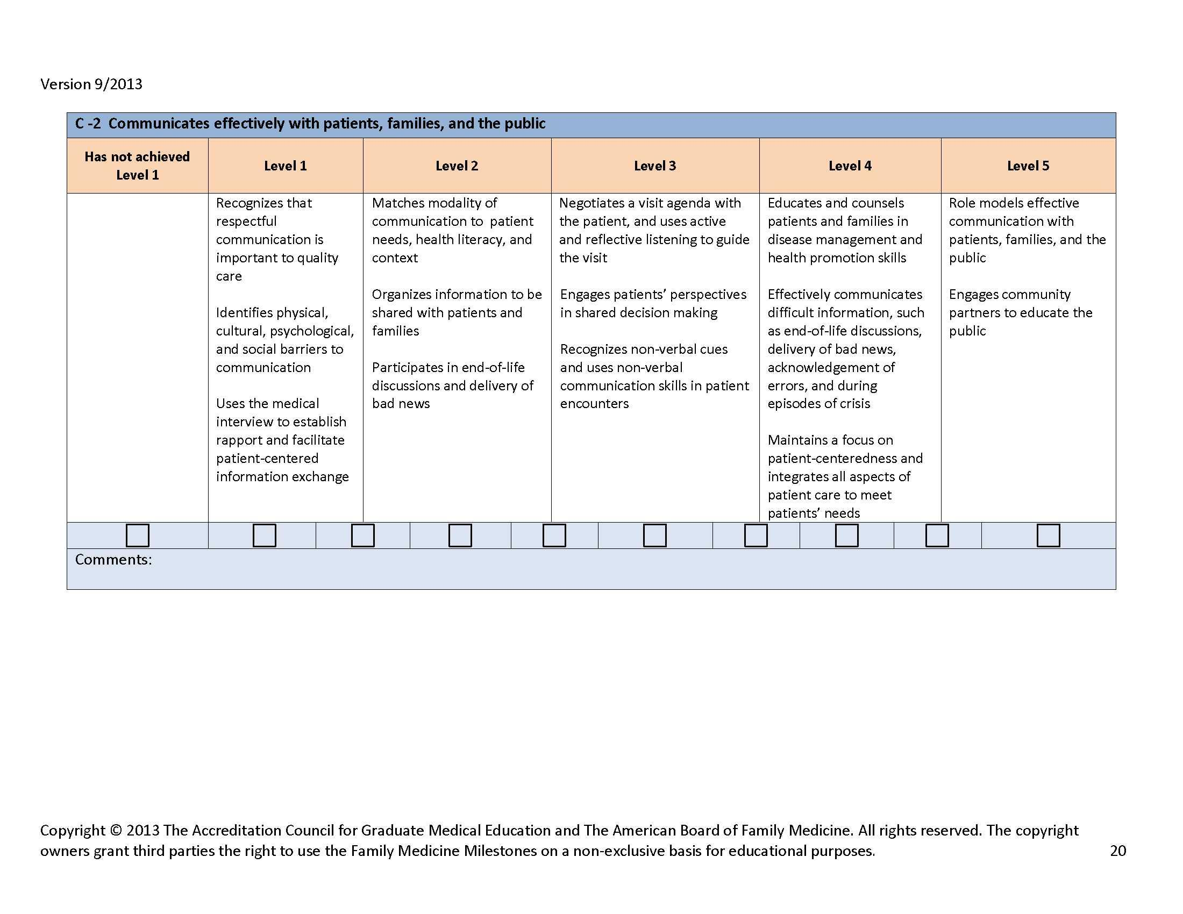
Family Medicine
Presented by Partners in Medical Education, Inc. - 2015
15
Notes:
Partners in Medical Education, Inc.
15

Slide 16
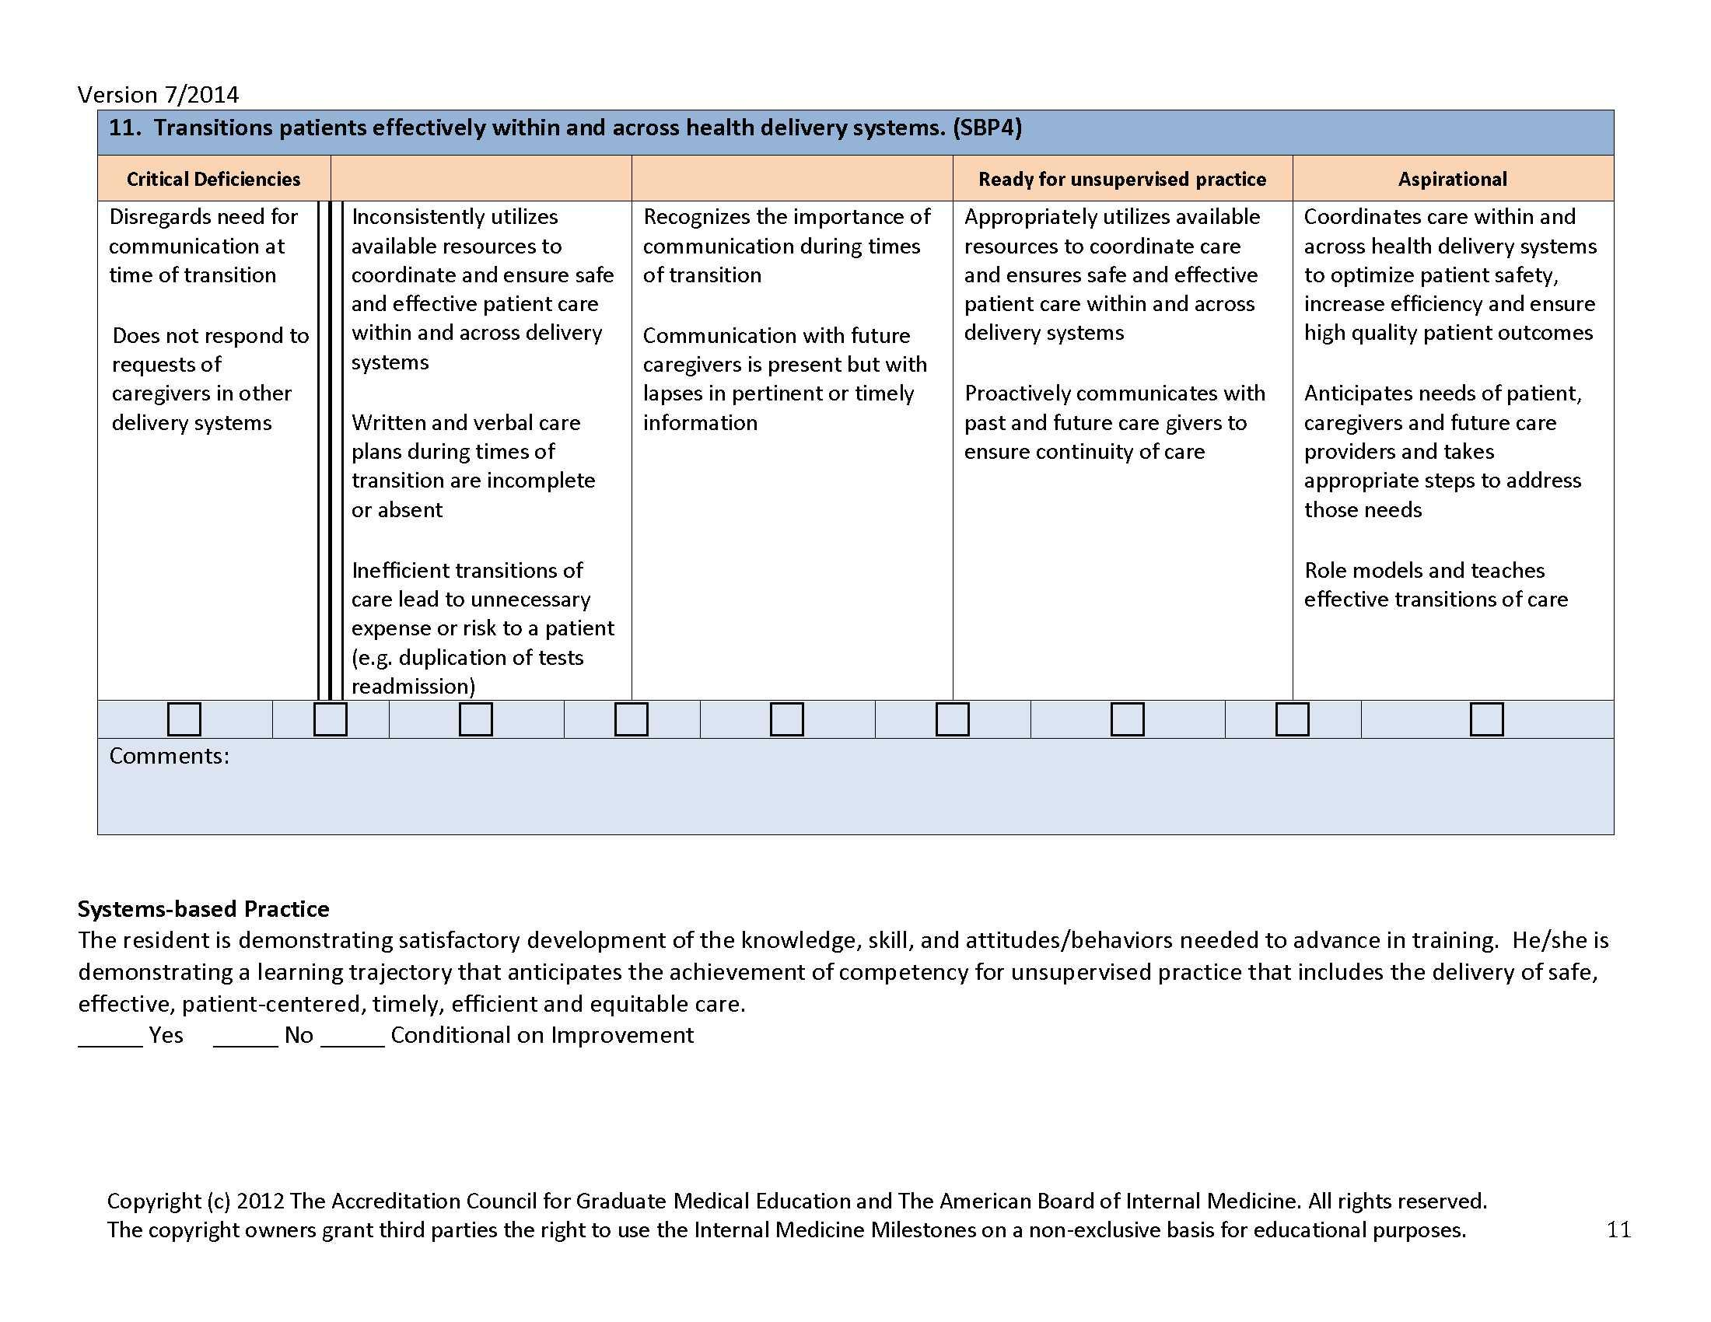
Internal Medicine
Presented by Partners in Medical Education, Inc. - 2015
16
Notes:
Partners in Medical Education, Inc.
16

Slide 17
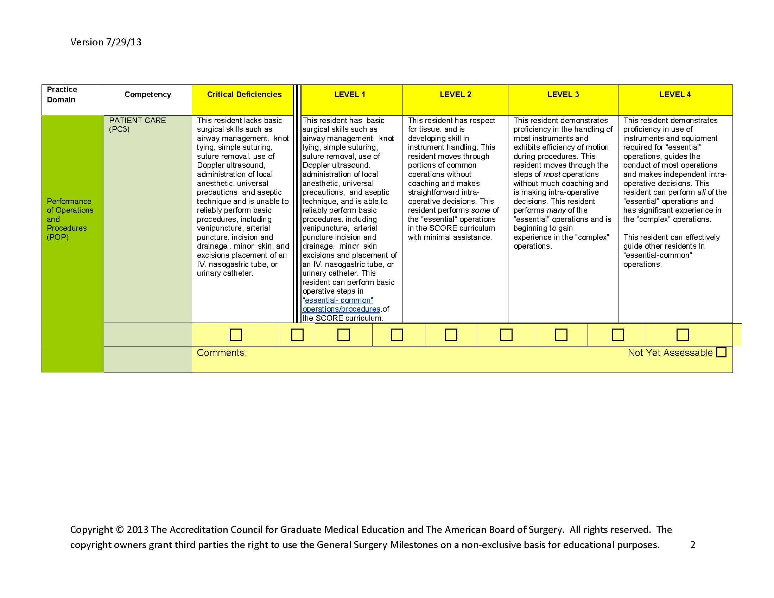
Surgery
Presented by Partners in Medical Education, Inc. - 2015
17
Notes:
Partners in Medical Education, Inc.
17

Slide 18
Benefits of Direct Observation
Allows residents to demonstrate application of what they learned to patient care
Framed around descriptions of expected behaviors
Confirmation of basic and advanced skills
Opportunity for immediate feedback and correction
Presented by Partners in Medical Education, Inc. - 2015
18
Notes:
Partners in Medical Education, Inc.
18

Slide 19
Questions
Presented by Partners in Medical Education, Inc. - 2015
19

Slide 20
Real-life samples
Direct Observation in GME
Presented by Partners in Medical Education, Inc. - 2015
20

Slide 21
Examples of Direct Observation Forms
Challenges to Direct Observation Processes
Presented by Partners in Medical Education, Inc. - 2015
21

Slide 22
Examples of Direct Observation Forms
Structured Clinical Observations
Communication and Professionalism Skills Observations
Surgical Observations
Characteristics of ideal direct observations:
single occurrence
immediate feedback
Presented by Partners in Medical Education, Inc. - 2015
22

Slide 23
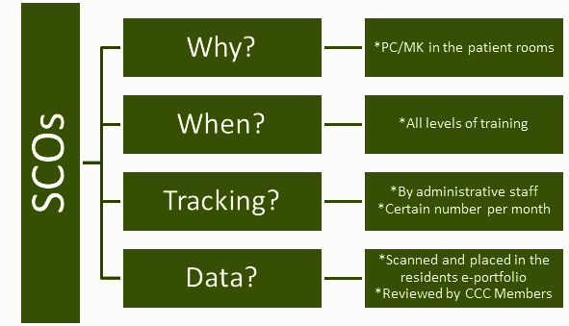
SCO (Structured Clinical Observation)
Presented by Partners in Medical Education, Inc. - 2015
23
Notes:
Partners in Medical Education, Inc.
23

Slide 24
Communication & Professionalism Skills
Why?
Evaluate OB/GYN resident’s communication/professionalism skills
Where?
In the patient room or at the bedside
Tracking?
Administrative staff; tracked on the program’s website
Other Uses:
SCC Program; Ortho Program
Presented by Partners in Medical Education, Inc. - 2015
24
Notes:
Partners in Medical Education, Inc.
24

Slide 25
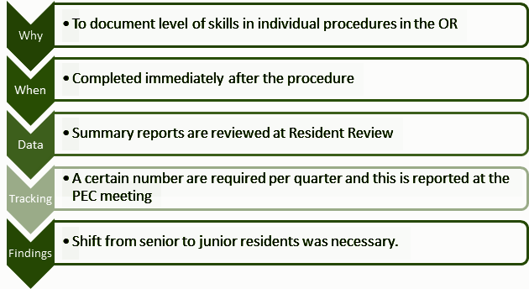
Surgical Observations
Presented by Partners in Medical Education, Inc. - 2015
25
Notes:
Partners in Medical Education, Inc.
25

Slide 26
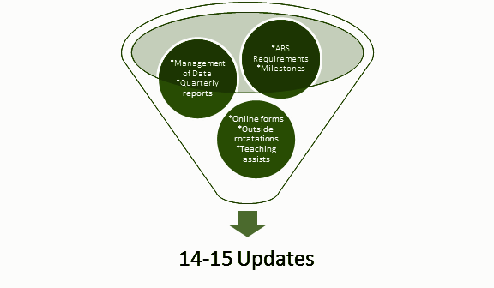
Presented by Partners in Medical Education, Inc. - 2015
26

Slide 27
Other Direct Observation Ideas
Internal Medicine--CEX/Mini CEX
Emergency Medicine--First specialty to see the need for immediate feedback so developed some of the first Direct Observation tools
Presented by Partners in Medical Education, Inc. - 2015
27
Notes:
Partners in Medical Education, Inc.
27

Slide 28
Brainstorming
Direct Observation Processes that could be tweaked
My “a-ha” thoughts
Presented by Partners in Medical Education, Inc. - 2015
28

Slide 29
Direct Observations & Milestones
Faculty Development
Time
Compliance
Use Data Effectively
Challenges
Presented by Partners in Medical Education, Inc. - 2015

Slide 30
Direct Observations & Milestones
How do we integrate direct observation data into milestones assessment?
Review at CCC Meeting
Align with milestone scale
Align with a specific milestone subcompetency
Incorporate evaluations into milestone scores in your residency management program
How will we
adapt our direct observations into our milestone assessment process...
Presented by Partners in Medical Education, Inc. - 2015
30
Notes:
Partners in Medical Education, Inc.
30

Slide 31
Clinical Competency Committee
Case Logs
Patient/Family Evaluations
Direct Observations:
Faculty Review
End-of-Rotation Evaluations
Competency Evaluations
Medical Team Evaluations
Resident Evaluations
Operative Evaluations
Communication/Professionalism
SCOs
Assessment of Milestones
Presented by Partners in Medical Education, Inc. - 2015
31

Slide 32
Challenges
Faculty development:
Faculty needs to understand form and process
Faculty needs to be encouraged to perform observations
Faculty needs to provide immediate feedback
How will we get buy-in from faculty….
Presented by Partners in Medical Education, Inc. - 2015
32
Notes:
Partners in Medical Education, Inc.
32

Slide 33
Challenges
Time:
Time spent in patient room, at the bedside or in the OR
Time for feedback immediately following observation
How will we find the time...
Presented by Partners in Medical Education, Inc. - 2015
33
Notes:
Partners in Medical Education, Inc.
33

Slide 34
Challenges
Compliance:
Frequent reminders
Easily accessible
Tracked
Rewarded
Who will track compliance?
How will they track compliance?
Presented by Partners in Medical Education, Inc. - 2015
34
Notes:
Partners in Medical Education, Inc.
34

Slide 35
Challenges
Use the Data Effectively:
Milestone Assessment
Feedback to residents/fellows (summary report) on a regular basis
How will we ensure that we use the data effectively in our program...
Presented by Partners in Medical Education, Inc. - 2015
35

Slide 36
Reviewing Key Questions
How
Who
will we incorporate this data into our milestone assessment process?
will we get buy-in from the faculty?
will we find the time?
will we track compliance?
will we use the data?
will track compliance?
Presented by Partners in Medical Education, Inc. - 2015
36

Slide 37
Questions
Presented by Partners in Medical Education, Inc. - 2015
37

Slide 38
Summary
What we covered today:
Understanding the importance of direct observation
Learned the use of direct observations in resident evaluation
Various templates of direct observations
Reviewed the challenges associated with direct observations
Presented by Partners in Medical Education, Inc. - 2015
38

Slide 39
Partners’ Online Education
Upcoming Live Webinars
Discussion of Generation Silent
to Generation Millennial
Tuesday, March 10, 2015
12:00pm – 1:30pm EST
Ask Partners – Spring Freebie
Thursday, March 19, 2015
12:00pm – 1:00pm EST
AOA: Program Readiness
Thursday, April 2, 2015
12:00pm – 1:30pm EST
CLER Pathways to Excellence –
Applied to Your Institution
Thursday, April 16, 2015
12:00pm – 1:30pm EST
Visit our website to see the rest of our Spring 2015 Schedule!
www.PartnersInMedEd.com
On-Demand Webinars
Self-Study Visits
Introduction to GME for
New Program Coordinators
Milestones & CCCs
GME Financing – The Basics
Single Accreditation System
The IOM Report
Institutional Requirements: What’s New?
Contact us today to learn
how our Educational Passports can save you time & money!
724-864-7320
Presented by Partners in Medical Education, Inc. - 2015
39

Slide 40
Partners in Medical Education, Inc. provides comprehensive consulting services to the GME community. For more information, contact us at:
724-864-7320
Info@PartnersInMedEd.com
www.PartnersInMedEd.com
Presented by Partners in Medical Education, Inc. - 2015
40

