Slide 1
Discussion of Generation Silent to Millennial Making or Breaking Relationships Between Faculty & Residents
PARTNERS IN MEDICAL EDUCATION, INC.
Presented by:
Diane Dean, RN-BC, LPC, CEG

Slide 2
Introducing Your Presenter…
Diane Dean, RN-BC, LPC, CEG
GME Consultant
Professional registered nurse, licensed professional counselor, & professionally-trained coach.
Speaks and writes on various conventional and non-conventional health topics.
Specialties include communication, energy management, confidence and emotional intelligence.
Guides and coordinated medical, nursing, and counseling student experiences throughout her career.

Slide 3
Goals & Objectives
Attendees will:
Recognize and articulate their own generational biases
Be able to name the four generations, their basic values and their motivators
Understand how generational communication differences may manifest in the workplace
Identify the tenets of effective communication, regardless of generation
Articulate communication strategies specific to each generation

Slide 4
What are the Generations?
GI Generation – Born before 1922
Silents/Traditionalists/Veterans – 1922-1945
Baby Boomers – 1946-1964
Generation X – 1965-1980
Generation Y – 1981-2000+
Generation Z – children/teens

Slide 5
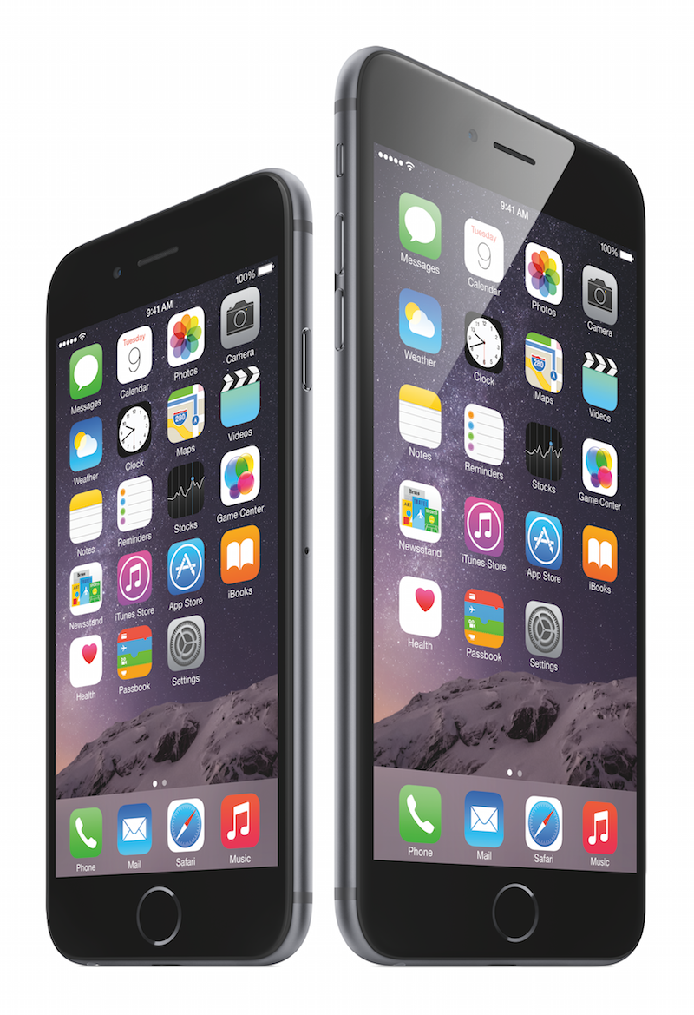
“Apple”

Slide 6
Egocentrism
“Each generation imagines itself to be more intelligent than the one that went before it, and wiser than the one that comes after it.”
George Orwell

Slide 7
What Have You Heard About _________?
Baby Boomers are stuck in their ways
Baby Boomers are just waiting to retire
Gen Xers are cynical and jaded
Gen Xers simply care only about money
Gen Yers are arrogant and impatient
Gen Yers are job hoppers
Millennials don’t know how to communicate
Traditionalists are “old school”
Baby Boomers work too hard
Notes:
Baby Boomers are often regarded as ‘stuck in their ways’ and because of their age, it is sometimes perceived that they are simply waiting for retirement.

Slide 8
Generational Issues in the Workplace
What do you see?

Slide 9
Generations and Emotional Intelligence

Slide 10
Traditionalists – 1925-1946 (ages 69-90)
believe in conformity, authority and rules
black/white & right/wrong
loyalty, discipline, logic, details
don’t like conflict
seek out technological advancements
hierarchical structure

Slide 11
Baby Boomers – 1946-1964 (ages 51-69)
strong, long work ethic
long term career / loyalty to their employer
enmeshed with work – self and work are fused
commitment to quality
find solutions
be in charge and respect authority

Slide 12
Gen X – 1965-1980 (age 35-50)
quality over quantity
very productive
multitask
balance work and life
free agents /marketable commodities
comfortable with authority
technically competent
value diversity
enjoy independence

Slide 13
Gen Y – 1981-1994 (ages 22-35)
work to effect change and making a difference
express themselves rather than defining themselves through work
multitasking all the time
actively involved
flexible/relaxed
teamwork
balanced work / life

Slide 14
Values - Traditionalist
Privacy: Don't expect them to share their inner thoughts.
Hard Work: They believe in paying their dues. Irritated with ‘wasted time.’ Career and self are enmeshed.
Trust: Keep their word.
Formality: A formal communication style is preferred, and formal dress and organizational structures.

Slide 15
Values - Traditionalist
Authority and institutional leadership: Traditionalists have a great deal of respect for authority.
Social Order: May be seen as biased, prejudiced, racist or sexist.
Things: This group loves their stuff and they won't get rid of it. “Pack rats” but remember the depression and going without.

Slide 16
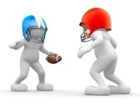
Values – Baby Boomers
Competition: Value peer competition and can be seen as egocentric.
Change: Thrive for possibilities and constant change.
Hard Work: Boomers started the "workaholic" trend. View it as necessary for moving to the next level of success.
Success: Climbing the ladder of success.
Body Language: “Show me” generation and body language is important.

Slide 17
Values – Baby Boomers
Teamwork: Eager to get rid of the command and control style
Anti Rules and Regulations: They don't appreciate rules for the sake of having rules and they will challenge the system.
Inclusion: This generation will accept people on an equal basis as long as they can perform.
Will Fight For A Cause

Slide 18
Values – Gen Xers
Entrepreneurial Spirit: Invest in their own development rather than in their organization's. Cautious about investing in relationships with employers, as they have been unreliable.
Loyalty: To an Xer, this may mean two-weeks notice.
Independence and Creativity: Prefer managing their own time and solving their own problems rather than having them managed by a supervisor.

Slide 19
Values – Gen Xers
Information: They love plenty of it.
Feedback: Needs continuous feedback and they use it to adapt to new situations.
Flexible.
Quality of Worklife: Focus on efficiency so that they have time for fun. Working hard so that they can have more time to balance work and life responsibilities.

Slide 20
Values – Gen Yers
Positive Reinforcement: Value positive reinforcement at accelerated rates compared to older generations.
Autonomy: Want more input into how they are learning and the independence to do it.
Positive Attitudes: Grew up during tranquil times - have a very optimistic outlook on life in general.

Slide 21
Values – Gen Yers
Diversity: Grew up with exposure to it in their community or through media.
Money: This group is used to making and spending money.
Technology: Technology is valued and is used as a tool for multi-tasking.

Slide 22
Motivators
Traditionalists – inherent satisfaction that the job was done well
Baby Boomers – $,title, recognition
Gen X – feedback is the best reward
Gen Y – meaningful work

Slide 23
Things to Consider
When They Grew Up
Values
Work Ethic
Communication Style
Leadership Style
Feedback and Rewards
Interactive Style
Family/Work Balance

Slide 24
Generations and Communication
Write
Talk
Email
Text
“express themselves”
“value teamwork”
“multi-task”
“comfortable with authority”
“technologically efficient”
“respect authority”
“strong/long work ethic”
“commitment to quality”

Slide 25
Debunking Generational Myths – Baby Boomers
“technologically illiterate” - 60% of Baby Boomers actively search for and consume social media content such as blogs, videos and forums.
47% of Boomers are active on social media
Boomers are more likely to communicate through social platforms for news, politics and shopping.
They are less likely to share personal information and photos.

Slide 26
Debunking Generational Myths – Gen X
“cynical and jaded” – they are realistic about the problems they face and they work hard to solve them.
“money hungry” – no fee-free education and many families were dual income and had to be in workforce

Slide 27
Debunking Generational Myths – Gen Y
“entitled” – Have good work-life balance. Not afraid to speak up for what they want and leave if they are not getting it.
“job hopper” - The Bureau of Labor Statistics found that the average preferred tenure for a Gen Y worker is 4.7 years. Current tenure rate sits at 1.5 years is due to their expectations not being met. Do not want to change jobs frequently, but will if they have to.
“high salary expectations” - tend to look for benefits such as mentoring, training, career progression and flexibility.

Slide 28
Tips for Communicating with Traditionalists
The "silent generation”: Don't expect members of this generation to share their thoughts immediately.
Keep their word. Focus on words rather than body language or inferences.
Face to face or written communication is preferred.
Don't waste their time.

Slide 29
Tips for Communicating with Traditionalists
Use testimonials and expert endorsements.
Do not rush or pressure them.
Offer them time with others.
Promote patriotism, teamwork and doing more with less.
Use the rules of conduct, respect for authority and a top-down chain of command approach.
Provide detailed directions on how to do something.

Slide 30
Tips for Communicating with Baby Boomers
Boomers are the "show me" generation; body language is important when communicating.
Speak in an open, direct style but avoid controlling language.
Answer questions thoroughly and expect to be pressed for the details.

Slide 31
Tips for Communicating with Baby Boomers
Provide knowledge. This group likes to understand the big picture.
Provide choices. This group likes to weigh their options.
Discuss technology. This group spends the most on technological products.
Talk about their well-being.
Speak less about the past and more about the future.
Consider communicating via social media. Baby boomers use Facebook, LinkedIn, have smartphones, and tablets. They rarely use these devices for texting.
Focus on their achievements and goals.

Slide 32
Tips for Communicating with Gen Xers
Use email as a primary communication tool.
Talk in short sentences to keep their attention.
Ask them for their feedback and provide them with regular feedback. Feedback and more feedback.
Share information regularly; keep them in the loop.
Use an informal communication style.

Slide 33
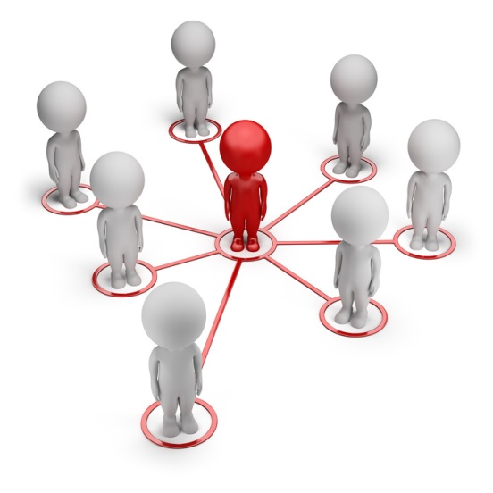
Tips for Communicating with Gen Xers
Promote quality.
Share images and graphics for credibility.
Involve their friends in the experience and decision making.
Let this group make their decision at their own pace. Don’t use hard selling techniques.
Deliver what you promise.
Ask or suggest vs. tell.
Approach from a global perspective.
Be direct.
Let them get to know you and trust you.
Provide options.

Slide 34
Tips for Communicating with Gen Yers
Use action words and challenge them.
Don’t talk down to them.
Seek their feedback and provide them with regular feedback.
Use humor and create a fun learning environment.
Encourage them to take risks and break the rules so that they can explore new ways of learning.

Slide 35
Tips for Communicating with Gen Yers
Consider using electronics: instant messaging, text and email, video conferencing, blogs, and social networks.
Find a way to get them involved and feeling valued.
Share how what you do will be an ethical solution to help their community.
Be transparent.
Invite groups of friends to get involved.
Offer valuable information that will help them solve their problems.

Slide 36
General Tips for Communicating Across Generations
Use multiple communication devices.
Individualize your approach.
Ask, don’t assume.
Be willing to teach. And to learn.
Understand their values and motivators.
Don’t take it personally.

Slide 37
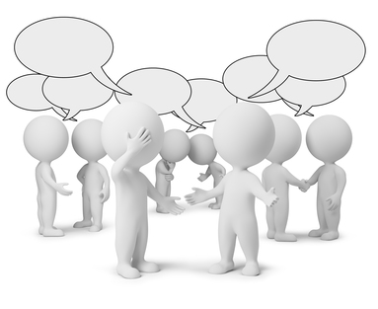
Why We Communicate
To meet an objective (objective effectiveness)
To maintain/improve a relationship (relationship effectiveness)
To maintain/improve self-respect (self-respect effectiveness)

Slide 38
Things That Get in the Way
Worry thoughts
Emotions
Lack of skill
Indecision
Environment

Slide 39
Universal Communication Strategies
“I statements”
Validation
Active Listening
Dialogue
“DEAR MAN”

Slide 40
Active Listening for…
Values
Strengths
Resources
Need for Referral
Patterns
Coachable?
What’s Missing?

Slide 41
Validation
Helping the other person feel understood
Find the golden nugget and agree with that
“It makes sense that you….”
“You feel ____________.”
“That really upset you.”

Slide 42
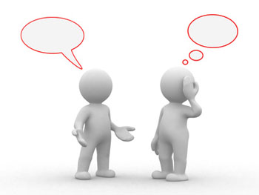
Monologue vs Dialogue

Slide 43
DEAR MAN
Describe – facts only
Express – emotions
Assert – needs, wants, appreciations
Reinforce – what’s in it for them?
(easy) Manner
Appear confident
Negotiate

Slide 44
Jennifer Deal
Her findings, based on seven years of research in which she surveyed more than 3,000 corporate leaders, are presented in her book, Retiring the Generation Gap: How Employees Young & Old Can Find Common Ground(Jossey-Bass).
“Our research shows that when you hold the stereotypes up to the light, they don’t cast much of a shadow,” says Deal. “Everyone wants to be able to trust their supervisors, no one really likes change, we all like feedback, and the number of hours you put in at work depends more on your level in the organization than on your age.”

Slide 45
Summary of Findings
All generations have similar values. For example, family tops the list for all of the generations. The most striking result of the research, Deal says, is how similar the generations are in the values that matter most.
Everyone wants respect. Everyone wants respect, but the generations don’t define it in the same way. In the study, older individuals talked about respect in terms of “giving my opinions the weight I believe they deserve,” while younger respondents characterized respect as “listen to me, pay attention to what I have to say.”
Leaders must be trustworthy. Different generations do not have notably different expectations of their leaders. Above all else, people of all generations want leaders they can trust.

Slide 46
Summary of Findings
Nobody likes change. The stereotype is that older people resist change while younger people embrace it. These assumptions don’t stand up under the research, which found that people from all generations are uncomfortable with change. Resistance to change has nothing to do with age; it has to do with how much you stand to gain or lose as a result of the change.
Loyalty depends on context. It is said that younger generations are not as loyal to their organizations as older workers. But the research shows, for example, that the amount of time a worker puts in each day has more to do with his or her level in the organization than with age. The higher the level, the more hours worked.
Everyone wants to learn. Learning and development were among the issues brought up most frequently by people of all generations. Everyone wants to learn and to ensure they have the training to do their job well.
Everyone likes feedback. According to the research, everyone wants to know how they are doing and to learn how they can do better.

Slide 47
Take Away
Don’t forget about our commonalities, while acknowledging our differences
Generational differences don’t necessarily trump our individual behavior styles, emotional intelligence, intelligence, etc.
Be sensitive to differences
Be interpersonally effective, regardless of generational differences

Slide 48
References
https://www.youtube.com/watch?v=Qb1n5aZHwks
http://www.amanet.org/training/articles/The-Myth-of-Generational-Differences-in-the-Workplace.aspx
http://carrerapartners.com.au/insights/31/
http://www.sciencedaily.com/releases/2014/07/140714100350.htm
http://www.sciencedaily.com/releases/2012/05/120529144342.htm
http://biz.colostate.edu/mti/tips/pages/InteractionAmongTheGenerations.aspx
http://xyzuniversity.com/2013/07/communication-across-generations-making-it-work/

Slide 49
References
http://www.charmmdfoundation.org/resource-library/effective-communication/checklist-communicating-different-generations
http://www.forbes.com/pictures/fgdi45eiihi/dont-take-it-personally-2/
http://www.un.org/staffdevelopment/pdf/Designing%20Recruitment,%20Selection%20&%20Talent%20Management%20Model%20tailored%20to%20meet%20UNJSPF%27s%20Business%20Development%20Needs.pdf
http://www.amanet.org/training/articles/Leading-the-Four-Generations-at-Work.aspx
http://www.dbtselfhelp.com/html/interpersonal_effectiveness1.html
https://www.youtube.com/watch?v=CKzwmdu05_s

Slide 50
Partners’ Online Education
Upcoming Live Webinars
Ask Partners – Spring Freebie
Thursday, March 19, 2015
12:00pm – 1:00pm EST
AOA: Program Readiness
Thursday, April 2, 2015
12:00pm – 1:30pm EST
CLER Pathways to Excellence –
Applied to Your Institution
Thursday, April 16, 2015
12:00pm – 1:30pm EST
ACGME Application
Development for Programs
Tuesday, May 19, 2015
12:00pm – 1:30pm EST
Visit our website to see the rest of our Spring 2015 Schedule!
www.PartnersInMedEd.com
On-Demand Webinars
Self-Study Visits
Introduction to GME for
New Program Coordinators
Milestones & CCCs
GME Financing – The Basics
Single Accreditation System
The IOM Report
Institutional Requirements: What’s New?
Contact us today to learn
how our Educational Passports can save you time & money!
724-864-7320
Presented by Partners in Medical Education, Inc. - 2015
50

Slide 51
Partners in Medical Education, Inc. provides comprehensive consulting services to the GME community. For more information, contact us at:
724-864-7320
Info@PartnersInMedEd.com
www.PartnersInMedEd.com
Presented By:
Diane Dean, RN-BC, LPC, CEG
Epiphany! Counseling & Wellness Center
724-387-1650

