Slide 1
Are You Ready? Strategies & Tools for Assessing Your Program’s ACGME Readiness
PARTNERS IN MEDICAL EDUCATION, INC.
Presented by:
Tori Hanlon, MS, CCMEP
April 2, 2015

Slide 2
Introducing Your Presenter…
Tori Hanlon, MS, CCMEP
Over 10 years of experience working in Medical Education
Director of Medical Education and Designated Institutional Official at AtlantiCare Regional Medical Center
Accountable for oversight of undergraduate medical education affiliations and continuing medical education in addition to GME.
Experience in GME at a large academic medical center as well as a community-based, single-sponsor institution

Slide 3
Objectives
To review the timeline for accreditation under the Single Accreditation System
To explain the ACGME accreditation process for Sponsoring Institutions and programs
To identify and understand components of the ACGME’s Next Accreditation System (NAS)
To outline new terms and concepts for programs currently accredited by the AOA

Slide 4
Who’s Here?
Director of Medical Education
Osteopathic Program Director
Hospital Executive (such as CEO)
OPTI Representative
Program Coordinator
Osteopathic Resident/Fellow
Other

Slide 5
What Are You Most Interested in Hearing About Today?
ACGME Accreditation Process for AOA-approved programs
Institutional Accreditation
Program Accreditation
Next Accreditation System (NAS)
Clinical Learning Environment Review (CLER)
Milestones

Slide 6
Implementation Timeline
Now
Sponsoring Institutions (SI) can begin to apply for ACGME institutional accreditation
Who is my SI?
Intent to Apply for Institutional Accreditation
Institutional Application

Slide 7
Implementation Timeline
July 1, 2015
Programs can begin to apply for ACGME program accreditation
SI already has ACGME institutional accreditation
SI received “pre-accreditation status”
June 30, 2020
All programs must achieve initial accreditation through ACGME. The AOA no longer accredits programs.

Slide 8
Accreditation Process
Pre-accreditation
Initial accreditation
Continued accreditation

Slide 9
Pre-accreditation
A SI or osteopathic program has initiated the process of becoming ACGME accredited while still under AOA approval.
Pre-accreditation
SI
Program
Intent to Apply for Institutional Accreditation
Institutional Application
Program Application

Slide 10
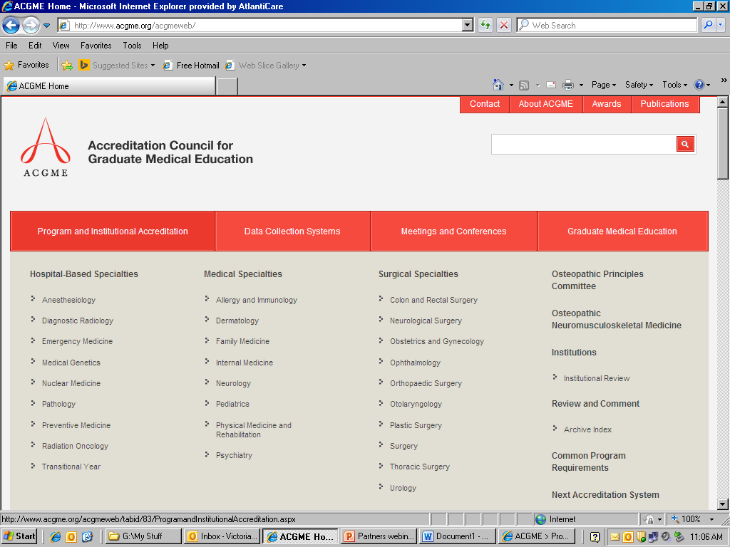

Slide 11
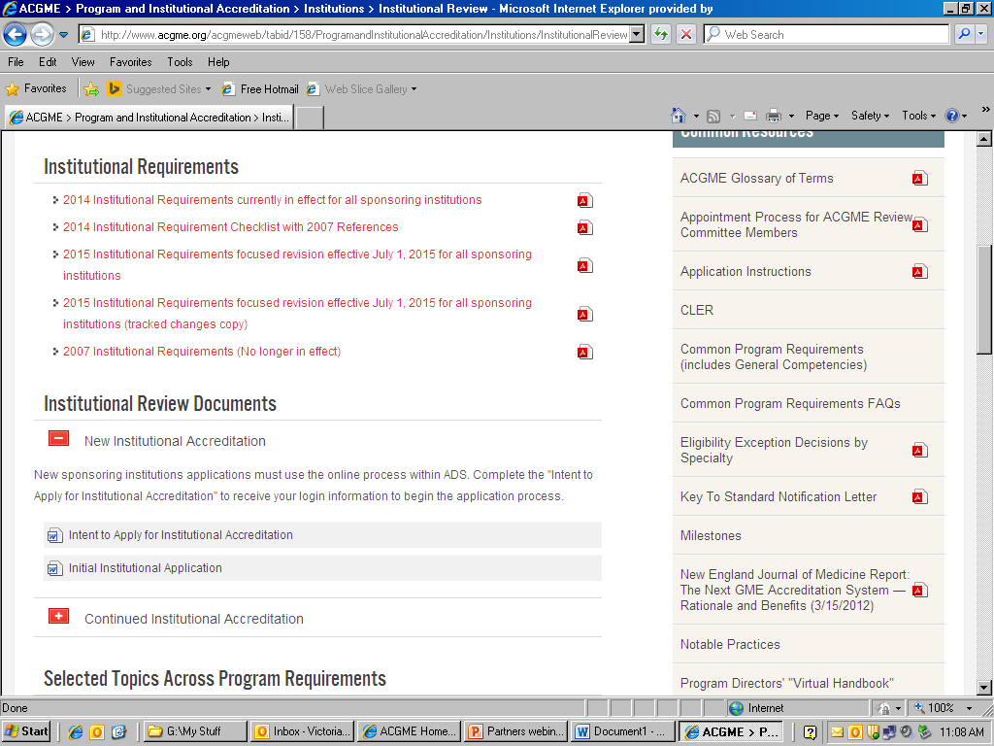

Slide 12
Pre-accreditation
ACGME reporting
ADS annual update
Case log reporting
Resident/faculty surveys
Milestones
Osteopathic recognition

Slide 13
Initial Accreditation
Pre-accreditation
Site visit
Initial accreditation

Slide 14
Initial Accreditation
Granted to programs with pre-accreditation status that have demonstrated to the ACGME Review Committee to be in substantial compliance with the applicable ACGME Program Requirements.
Site visit
Letter of Notification

Slide 15
“Substantial Compliance”
Core Requirement – Statements that define structure, resource, or process elements essential to every GME program.
EXAMPLE
II.A.4.j) The Program Director must implement policies and procedures consistent with the institutional and program requirements for resident duty hours and the working environment, including moonlighting

Slide 16
“Substantial Compliance”
Detail Requirement – Statements that describe a specific structure, resource, or process, for achieving compliance with a Core Requirement. Programs in substantial compliance with the Outcome Requirements may utilize alternative or innovative approaches to meet Core Requirements.
EXAMPLE
II.A.4.j).(3) adjust schedules as necessary to mitigate excessive service demands and/or fatigue

Slide 17
“Substantial Compliance”
Outcome Requirement – Statements that specify expected measurable or observable attributes of residents or fellows at key stages of their graduate medical education.
EXAMPLE
IV.A.5.d) Residents must demonstrate interpersonal and communication skills that result in the effective exchange of information and collaboration with patients, their families, and health professionals.

Slide 18
Question
What happens if my program is not granted initial accreditation following the site visit? | Programs will remain in pre-accreditation status. The program may reapply submitting an updated application addressing how the citations from the prior review are being corrected.

Slide 19
Continued Accreditation
Initial accreditation
Site visit
Continued accreditation

Slide 20
Continued Accreditation
Granted to SIs and programs with initial-accreditation status that have demonstrated to the ACGME Review Committee to be in substantial compliance with the ACGME Institutional Requirements and/or applicable Program Requirements.
2 years with Initial Accreditation status

Slide 21
Question
Does this accreditation process apply to both core and subspecialty programs? | Not necessarily. All core programs, but not all subspecialty programs, will require a site visit before initial accreditation can be granted. However, all programs will require a site visit before continued accreditation can be granted.

Slide 22
Core vs. Specialty Program
Core (specialty) – a structured educational experience in a field of medical practice following completion of medical school…
Subspecialty – a structured educational experience following completion of a prerequisite specialty program in GME…
Dependent subspecialty – A program that is required to function in conjunction with an accredited core program, usually reviewed conjointly with the core program… The continued accreditation of the subspecialty program is dependent on the core program maintaining its accreditation.

Slide 23
Question
Do dually-accredited programs need to do anything? | Dually-accredited programs will just need to ensure that their entire resident complement is approved by the ACGME. Therefore, programs may need to apply to the ACGME for an increase in resident complement which can be done electronically via the ACGME’s WebADS system.

Slide 24
Question
How fast can I expect an accreditation decision to be made at each of the 3 stages of accreditation? | Pre-accreditation is conferred immediately upon the ACGME’s receipt of the application. Site visits for initial accreditation are expected to be scheduled about 4-9 months after pre-accreditation status has been granted. A decision regarding initial accreditation status will be dependent upon when the review committee meets. Site visits for continued accreditation are expected about 2 years after initial accreditation status has been granted. A decision regarding continued accreditation status will be dependent upon when the review committee meets.

Slide 25
What about Osteopathic Principles?
Programs with Initial or Continued Accreditation are eligible
ACGME Osteopathic Principles Committee

Slide 26
Question
If my program obtains osteopathic recognition, does it apply to the entire program, or part of the program? | It is the program’s choice. Osteopathic recognition may be obtained for an entire training program or a subset of positions within a training program. A subset of training positions is known as a track. Programs that have an osteopathic-focused track must have a minimum of one resident per year in the track.

Slide 27
Next Accreditation System (NAS)
10-year self study & accreditation site visit
Full vs. focused site visit
Accreditation Data System (ADS)

Slide 28
Self-Study
Strengths
OFIs
Program aims
threats
Annual program evaluations (APE)
Resident/faculty surveys
Stakeholder input
Other relevant info

Slide 29
Site Visit
Full Site Visit | Focused Site Visit
Occurs every 10 years | Occurs on an as needed basis
Used to determine that the program is in compliance with the accreditation standards | Used when additional information is needed to investigate a potential problem, or to explore a complaint made against the program

Slide 30
Accreditation Data System (ADS)
Duty hours/learning environment
Major changes
Evaluation methods
Scholarly activity (residents + faculty)

Slide 31
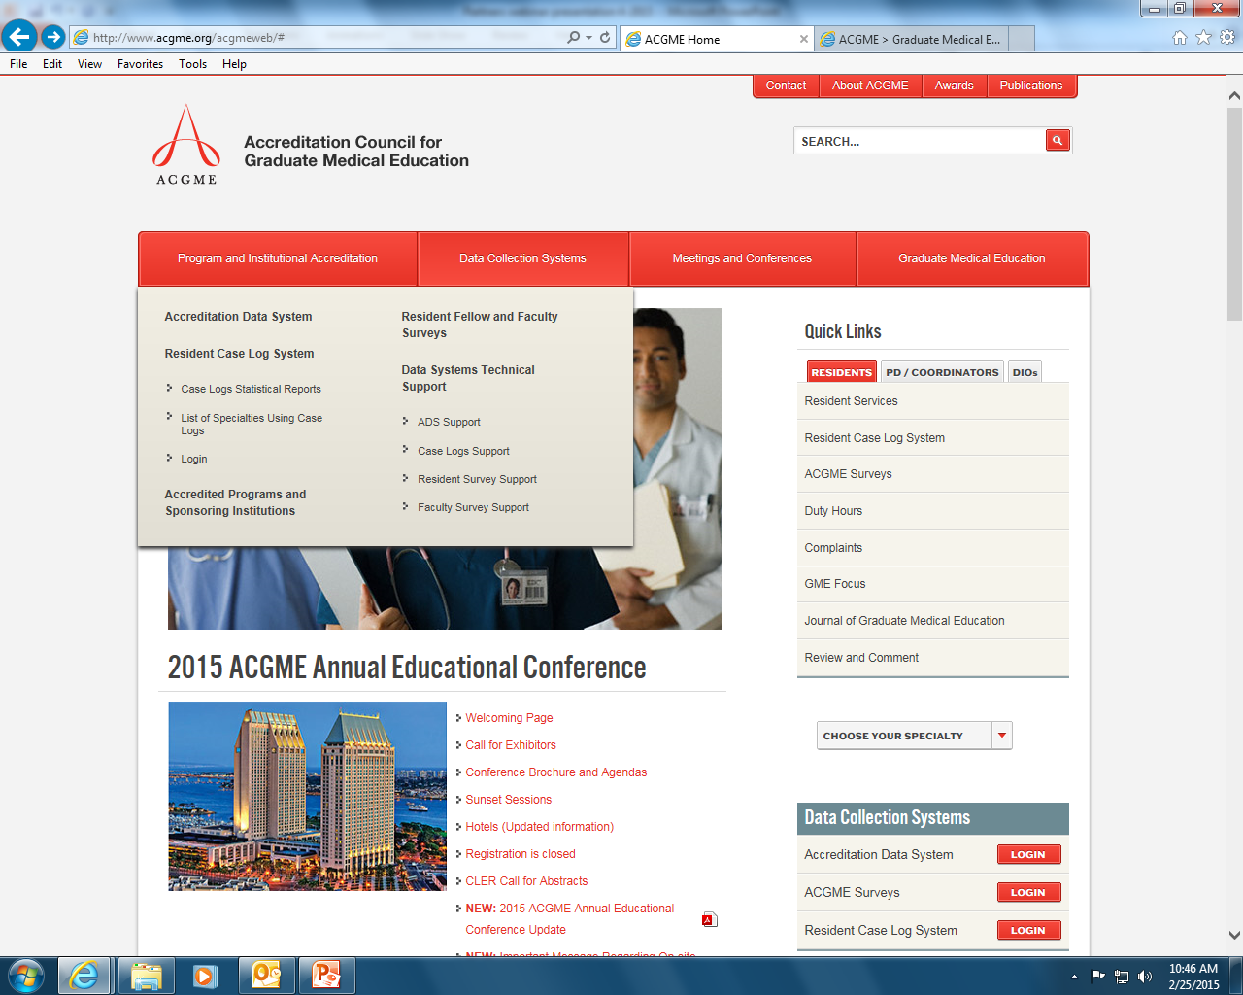
Accreditation Data System (ADS)

Slide 32
New Concepts
Institution
Annual Institutional Review (AIR)
Clinical Learning Environment Review (CLER)
Program
Clinical Competence Committee (CCC)
Program Evaluation Committee (PEC)
Annual Program Review (APE)
Milestones
General
Residency Review Committees (RRC)

Slide 33
Annual Institutional Review (AIR)
GMEC responsibility
Institutional performance indicators
Institutional self-study visit results
Resident/faculty survey results
Programs’ accreditation statutes

Slide 34
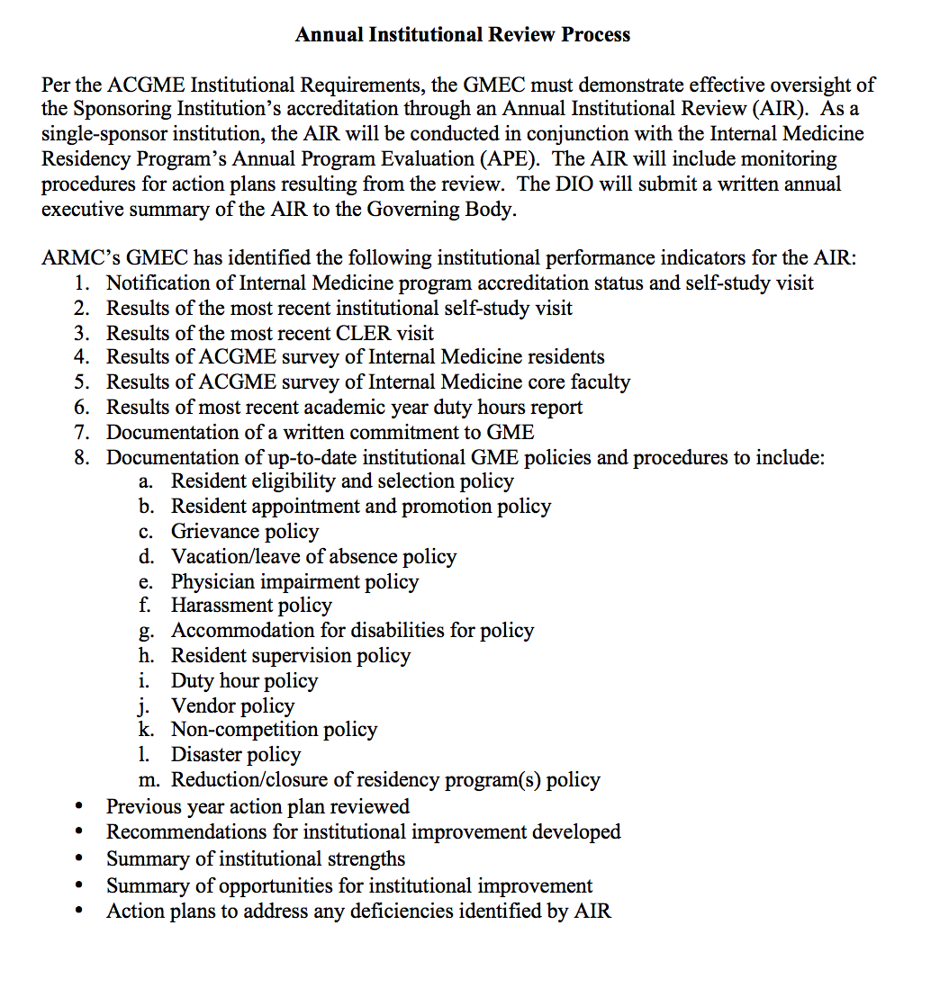

Slide 35
Annual Institutional Review
Monitoring procedures for action plans
Annual executive summary
Plan
Do
Check
Act

Slide 36
Clinical Learning Environment Review
Component of the Next Accreditation System (NAS)
Provide teaching hospitals with periodic feedback addressing six focus areas
Encourage clinical sites to improve engagement of residents in learning to provide safe, high quality patient care

Slide 37
CLER
Patient safety
Healthcare quality & disparities
Transitions of care
Supervision
Duty hours & fatigue management
Professionalism

Slide 38
CLER Site Visit
Short notice: 10-14 days
Group meetings
Senior leadership
Quality & patient safety leadership
Residents
Faculty
Program Directors
Walking rounds

Slide 39
CLER Site Visit: 5 key questions
Who and what form the infrastructure of a Sponsoring Institution’s clinical learning environment?
How integrated is the GME leadership and faculty within the SI’s current clinical learning environment infrastructure?
How engaged are the residents in using the SI’s current clinical learning environment infrastructure?
How does the SI determine the success of its efforts to integrate GME into the quality infrastructure?
What areas have the SI identified as opportunities for improvement?

Slide 40
Clinical Competence Committee (CCC)
Review resident evaluations semi-annually
Prepare and assure the reporting of Milestones evaluations of each resident semi-annually to ACGME
Advise the PD on resident progress including promotion, remediation and dismissal

Slide 41
Clinical Competence Committee
PD appoints CCC
Minimum of 3 program faculty
Eligible but not required
Faculty from other programs
Non-physician members of the healthcare team

Slide 42
Clinical Competence Committee
HR Rep
PD & APDs
CCC
Core Faculty

Slide 43
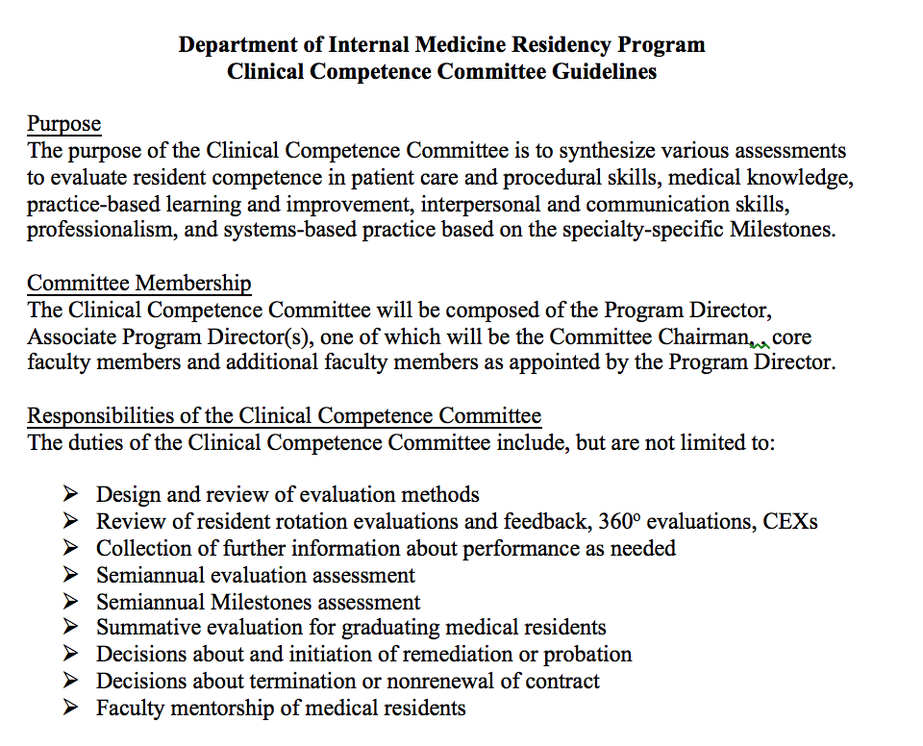

Slide 44
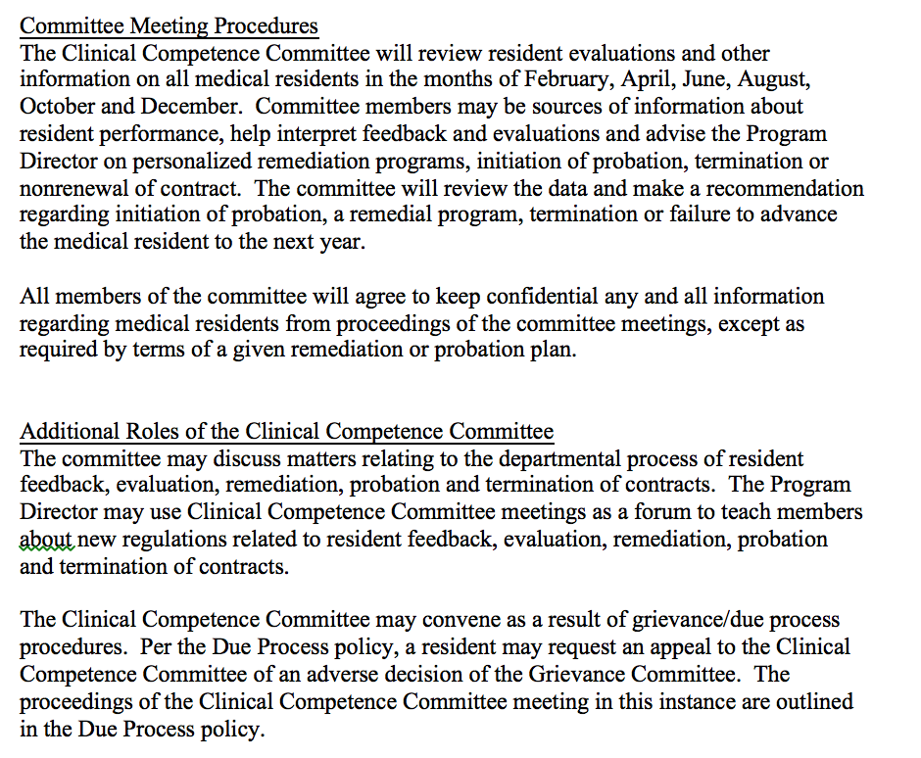

Slide 45
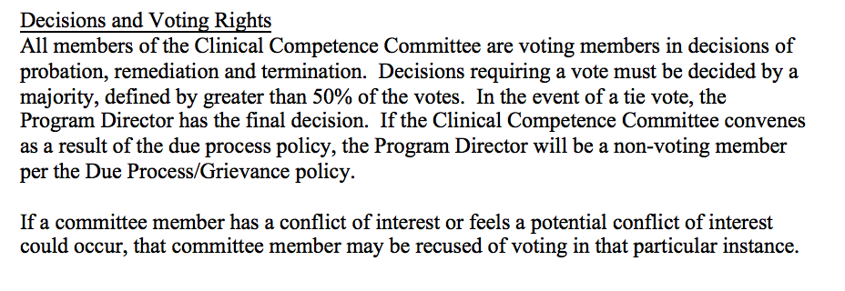

Slide 46
Program Evaluation Committee (PEC)
PD appoints PEC
Minimum of 2 program faculty and 1 resident

Slide 47
Program Evaluation Committee
Planning, developing, implementing and evaluating educational activities of program
Reviewing and making recommendations for revision of competency-based curriculum goals/objectives
Addressing areas of non-compliance with ACGME standards
Reviewing program annually using evaluations of faculty, residents, and others

Slide 48
Annual Program Evaluation (APE)
Formal, systematic evaluation of curriculum
Minimum annually
Written report

Slide 49
Annual Program Evaluation
Resident performance
Faculty development
Graduate performance
Program quality
Progress on previous year’s action plan

Slide 50
APE: Resident Performance
In-house exams
Scholarly activity
Resident involvement in QI
Resident involvement in committees

Slide 51
APE: Faculty Development
Evaluation of faculty development programs held
Suggested topics of interest
Needs assessment

Slide 52
APE: Graduate Performance
80% of residents completing training in last 3 years must have taken certifying exam
Must achieve a minimum 80% pass rate for first-time test takers in most recent 3-year period

Slide 53
APE: Program Quality
Resident/faculty program evaluation
Resident/faculty surveys

Slide 54
Annual Program Evaluation
PEC prepare a written report including action plan(s) for areas of improvement
Action plan reviewed and approved by faculty

Slide 55
Milestones
Competency-based developmental outcomes
Knowledge
Skills
Attitudes
Performance
Designed to help programs produce highly competent physicians

Slide 56
Milestones
Descriptive developmental framework for CCCs
Early identification of struggling residents
Increase transparency of resident performance expectations
Better feedback for professional development

Slide 57
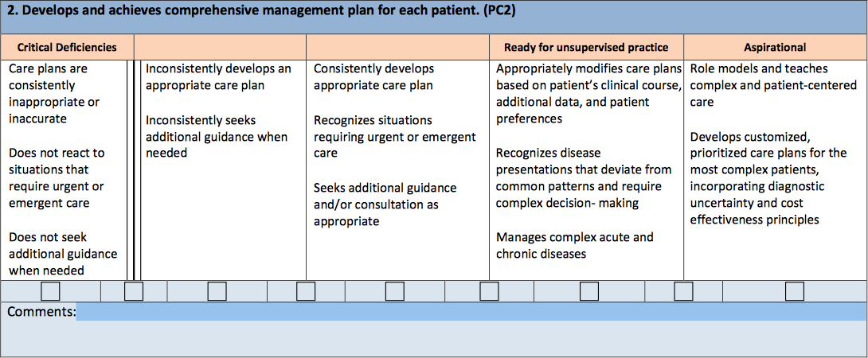
Milestones

Slide 58
Milestones
Reported to ACGME semi-annually
Incorporate into semi-annual resident reviews
SHARE with residents

Slide 59
Residency Review Committees (RRCs)
Specialty-specific committees comprised of physician volunteers and resident and public members
30 committees
27 specialty review
1 transitional year
1 institutional review
1 osteopathic principles

Slide 60
Residency Review Committees
Set accreditation standards
Peer evaluation of programs
Confer accreditation status

Slide 61
Question
What are the board certification requirements for Program Directors under the Single Accreditation System? | Program Directors must have current certification in the specialty by an ABMS specialty board, or specialty qualifications that are acceptable to the Review Committee. Programs that are AOA-approved as of July 1, 2015, and have matriculated residents/fellows as of July 1, 2015, are permitted to have co-Program Directors. One PD must be certified by an ABMS specialty board and the other PD must be certified by an AOA specialty board. EXCEPTION: IM and FM programs are permitted to have a PD who is certified by the applicable AOA specialty board.

Slide 62
Question
Will I be eligible for CMS reimbursement in any of the accreditation stages? | Programs with Initial Accreditation and Continued Accreditation are eligible for CMS reimbursement. Therefore, programs with pre-accreditation status will want to maintain their AOA accreditation until they receive Initial Accreditation in order to receive reimbursement from CMS.

Slide 63
Question
Will the match process be the same under the Single Accreditation System? | Programs will only be listed with the NRMP once they receive Initial Accreditation. Therefore, programs with pre-accreditation status that are approved by the AOA should have their applicants go through the NMS still.

Slide 64
Question
What impact does the Single Accreditation System have on my residents’ ability for fellowship programs? | In general, residents completing training after July 1, 2015 in a program with pre-accreditation status will be eligible for ACGME-accredited fellowships.

Slide 65
Resources
http://www.acgme.org/acgmeweb/tabid/445/GraduateMedicalEducation/SingleAccreditationSystemforAOA-ApprovedPrograms.aspx
http://www.osteopathic.org/inside-aoa/single-gme-accreditation-system/Pages/default.aspx

Slide 66
QUESTIONS?

Slide 67
Partners’ Online Education
Upcoming Live Webinars
CLER Pathways to Excellence –
Applied to Your Institution
Thursday, April 16, 2015
12:00pm – 1:30pm EST
ACGME Application
Development for Programs
Tuesday, May 19, 2015
12:00pm – 1:30pm EST
Making Physicians Better: Professionalism & It’s Role in Patient Care
Thursday, June 4, 2015
12:00pm – 1:30pm EST
Our Summer/Fall 2015 Education
Schedule – COMING SOON!
www.PartnersInMedEd.com
On-Demand Webinars
Self-Study Visits
Introduction to GME for
New Program Coordinators
Milestones & CCCs
GME Financing – The Basics
Single Accreditation System
The IOM Report
Institutional Requirements: What’s New?
Contact us today to learn
how our Educational Passports can save you time & money!
724-864-7320
Presented by Partners in Medical Education, Inc. - 2015
67

Slide 68
Partners in Medical Education, Inc. provides comprehensive consulting services to the GME community. For more information, contact us at:
724-864-7320
Info@PartnersInMedEd.com
www.PartnersInMedEd.com

