Slide 1
CLER PATHWAYS TO EXCELLENCE
Applied to YOUR Institution
Presented by:
Candace DeMaris, MAIS
Consultant
Partners in Medical Education, Inc.

Slide 2
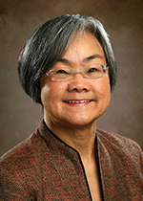
Introducing Your Presenter…
Candace DeMaris, MAIS
GME Consultant
25+ years experience throughout the spectrum of medical education: from undergraduate to GME, primary care to surgical specialties, in academic medical centers and community based-teaching hospitals.
Expertise in both institutional and program requirements and the area of GME finances – including maximizing CMS reimbursement, assessing the financial feasibility of starting new programs and demonstrating the value of established programs

Slide 3
Goals and Objectives
Review the basic tenants of CLER, including the 6 focus areas and “flow” of a CLER visit.
Provide updates for small and single sponsoring institutions and Cycle 2 for multi-program sponsors
Discuss the CLER Pathways to Excellence document
Identify actions that can be taken along the CLER pathways that will optimize the clinical learning environment at your institution.

Slide 4
“The underlying principle of the CLER is that safe health care settings are necessary to prepare residents to be safe health care practitioners.”
ACGME Manual of Policies & Procedures
effective July 1, 2013
“The Sponsoring Institution and its ACGME-accredited programs must only assign residents/fellows to learning and working environments that facilitate patient safety and health care quality.”
ACGME Institutional Requirements I.A.4
effective July 1, 2013

Slide 5
What We Know About CLER Visits
Approximately every 18-24 months
Scheduled on short notice, but no less than 10 days
2-6 surveyors
1-5 days on site

Slide 6
5 General Questions
Who/what form the institutional infrastructure designed to address the six focus areas?
How integrated is the GME leadership and faculty in institutional efforts across the six focus areas?
How integrated are the residents and fellows?
How does the sponsoring institution determine its success of its efforts to integrate residents into the six focus areas?
What are the areas the hospital has identified for improvement?

Slide 7
During the CLER Visit…
Interviews
Senior Leadership (Hospital C-Suite):
CEO required - no designees. Must attend opening and closing sessions.
CMO, CNO requested (designees allowed)
CQO – Two meetings
COO, CFO optional (at request of CEO)
Others, for example, the CMIO or Risk Management officer
GME Leadership
DIO required - no designees. Associate/Deputy DIO optional
GMEC Chair
Resident Member of GMEC
**UPDATE** 4 passes allowed - failure to schedule within the cycle will result in recommendation for administrative probation.
Notes:
Early findings: the DIO and CEO do communicate. Many CEOs attend GMEC meetings

Slide 8
During the CLER Visit…
Interviews – continued
Core Faculty
Broad range of core programs and larger fellowships
No program directors (separate meeting)
Program Directors
Majority of core programs and larger fellowships
Designees allowed
Resident/Fellow Group Meeting
Peer selected (PGY 2 & higher)
Broad range of core programs and larger fellowships
Significant portion of training at participating site

Slide 9
During the CLER Visit…
Use of audience response system
Walking tours and interviews with hospital staff and others
Unannounced
Resident escorts
After-hours visits
Frequent team “huddles”
Exit debriefing of strengths and opportunities for improvement
Notes:
Early finding - Nurses & leadership are engaged with GME community

Slide 10
After the CLER Visit
Written report to DIO in 3-4 weeks
DIO is invited to respond (optional)
CLER visit report to CLER Evaluation Committee
Final report from CLER Evaluation Committee is forwarded to the Sponsoring Institution
Aggregated, de-identified data shared publically to inform future accreditation policies, procedures and requirements

Slide 11
CLER for Multi-Program Institutions
SI with at least 1 participating site that has 3 or more core programs
Cycle 1 is nearing completion
Visited 298 institutions
Gathered 25,000 pieces of information from audience response system
CLER Evaluation Committee reviewing optional institutional responses
National data released Summer 2015

Slide 12
CLER for Multi-Program Institutions
Cycle 2 is underway!
Revisit Cycle 1 participating site
Sample visits to multiple participating sites
Protocol aligns with Pathways document
Overall flow is similar to Cycle 1
3 pilots March - May
New questions
Modified volunteer program
Sub-protocols for patients, governance, operating room in development
Testing of pathway feedback (request from CEO’s): Where are we along the CLER pathways?

Slide 13
CLER for Small and Single Program Institutions
(+/- 400 institutions)
2 or less core programs
Includes institutional sponsors of 3 or more programs but no one participating hospital has 3 core programs
Will include institutions that enter the single accreditation system as they receive institutional accreditation (programs with pre-accreditation status are not subject to CLER)
Protocols under development to adapt for a range of sizes and environments
Planned pilot testing in summer, full roll-out later in 2015

Slide 14
6 CLER Focus Areas

Slide 15
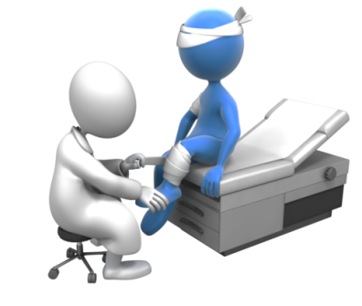
6 Focus Areas 1 - Patient Safety
Access to systems for reporting errors, adverse events, unsafe conditions, and near misses in a protected manner that is free from reprisal; and,
Opportunities to contribute to root cause analysis or other similar risk-reduction processes.
Think about:
What are the patient safety priorities of the hospital?
Is the reporting system difficult to use?
Is there feedback to the reporter of a event?
Is there teaching around near errors and near misses?
Are residents/fellows involved in RCA?
Do residents participate on inter-professional teams to promote patient safety?

Slide 16
Early Observations - Patient Safety
Most common education is during orientation
In general, residents experienced events but not reported through systems
In general, events were not tracked
Lack of prioritization of based on risk to patients
Notes:
Black hole effect – can’t fix if don’t now.

Slide 17
6 Focus Areas 2 – Health Care Quality
Access to data to improve systems of care, reduce health care disparities, and improve patient outcomes; and
Opportunities to participate in quality improvement initiatives
Think about:
How is the hospital assessed on clinical quality?
How do you know that the hospital is “successful” ?
Have you shared your quality strategic plan with the residents and faculty?
Are GME leaders, faculty, and residents integrated into the hospital’s quality improvement activities?
Are hospital leaders integrated into the residents’ quality improvement activities?
How do residents learn to identify opportunities for reducing health care disparities?
Do residents use data to improve systems of care?
Do residents receive data to show their own personal clinical effectiveness?
Is there an interdisciplinary team approach to QI?
Are residents involved in QI committee work?
Notes:
Disparities – Multicultural training goes beyond the use of translators

Slide 18
Early Observations - Healthcare Quality
Most residents believed they knew SI’s priorities in health care quality
Most common alignment around
Quality regulatory measures
Value-based purchasing
Majority of residents on QI project
Related to program or institutional requirement
Common role was as an implementer
Occasionally an agent of change that leads to sustainable improvement.
Notes:
(common role was as an implementer) - Resident QI involvement leads to substantial improvement

Slide 19
6 Focus Areas 3 - Transitions of Care
Facilitate professional development for core faculty members and residents/fellows regarding effective transitions of care; and,
Ensure that participating sites engage residents/fellows in standardized transitions of care consistent with the setting and type of patient care.
Think about:
Describe the a hand-off procedure.
How does the sponsoring institution facilitate professional development for residents and faculty about transitions of care?
How integrated is the EMR between inpatient and outpatient settings?
Are lab results and imaging studies readily available and current?

Slide 20
Early Observations – Transitions of Care
Lack of standardized, institutional approach
Really good handoffs when nursing is involved

Slide 21
6 Focus Areas 4 - Supervision
Supervision of residents/fellows consistent with institutional and program-specific policies; and
Mechanisms by which residents/fellows can report inadequate supervision in a protected manner that is free from reprisal.
Think about:
Does the sponsoring institution establish and monitor policies for effective supervision of residents 24/7?
Is there adequate supervision whenever residents on duty?
Do all residents have a protected mechanism to report inadequate supervision? Do they use it?
Have any patient safety concerns resulted from inadequate supervision?
How does hospital staff know which residents can perform what procedures with indirect supervision?
Are resident entries in the medical record reviewed and approved by faculty?

Slide 22
Early Observations - Supervision
Continue to see challenges in under and over supervision
Disconnect between residents and safety leaders perceptions
Majority of concerns related to nights and weekends

Slide 23
6 Focus Areas 5 - Duty Hours, Fatigue Management, and Fatigue Mitigation
resident/fellow duty hours consistent with the Common and specialty/subspecialty-specific Program Requirements across all programs,
systems of care and learning and working environments that facilitate fatigue management and mitigation for residents/fellows; and
an educational program for residents/fellows and core faculty members in fatigue management and mitigation.
Think about:
Is there institutional oversight and monitoring of duty hours across all programs? How?
Is there education for residents and faculty about fatigue?
How is duty hour compliance?
What services or facilities are available to residents who are too fatigued to return home safely? Do residents use it?
Do residents report hours at-home work on the EMR?

Slide 24
Early Observations – Fatigue Management
Generally never ask for exceptions
“Power through” the last 2 hours
Caffeine used the most to mitigate fatigue
No one using strategic naps
Alternative rides home were offered, but not used
Notes:
Power through the last 2 hours. Never ask for exceptions

Slide 25
6 Focus Areas 6 - Professionalism
residents’/fellows’ and core faculty members’ fulfillment of educational and professional responsibilities, including scholarly pursuits;
accurate completion of required documentation by residents/fellows; and, identification of resident/fellow mistreatment.
Think about:
Is the behavior of residents and faculty monitored?
Is there truthfulness in scholarly activities?
Is program and institutional data accurately reported to the ACGME?
Are duty hours reported accurately?
Is documentation of patient care honest?
Is there integrity during test-taking?
Have you witnessed, reported, or experienced mistreatment?

Slide 26
Early Observations - Professionalism
In general, residents do not compromise their professional integrity
C-Suite recalled a professionalism incident in GME
Recurring incidents of disruptive behavior reported on some individuals
Disrespectful behavior is not tolerated

Slide 27
CLER Pathways to Excellence

Slide 28
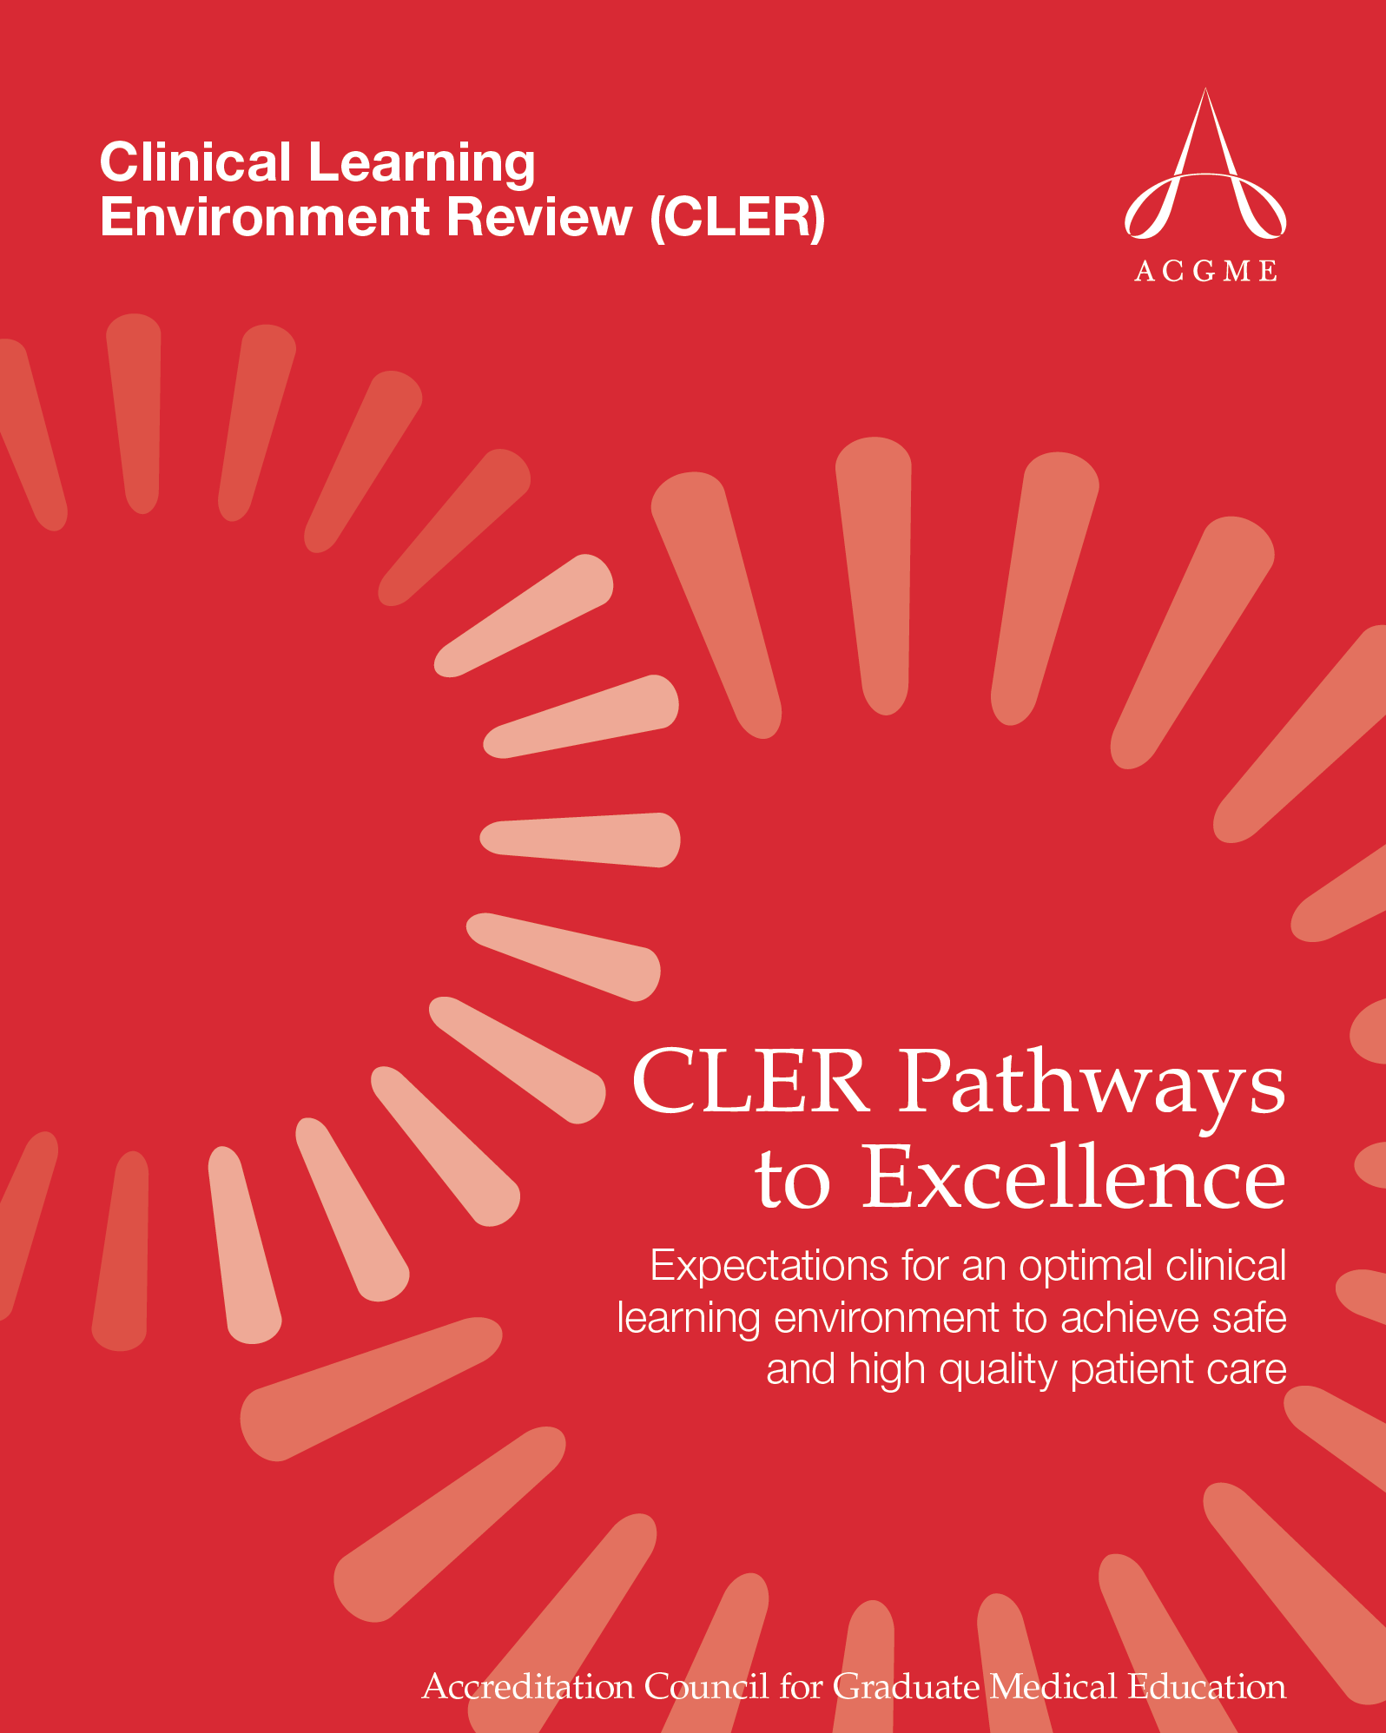
Notes:
CLER Evaluation Committee provides oversight and guidance on CLER program development
Experts in patient safety, health care quality, fatigue mitigation, hopsital administration, patient advocacy and GME

Slide 29
CLER Pathways to Excellence
Framework for evaluating the clinical learning environment
Tool for promoting discussions and actions that will optimize the clinical learning environment

Slide 30
CLER Pathways to Excellence
Based on…
Expert input from the CLER Evaluation Committee
Selected literature
Input from field staff from the first 100 CLER visits
Focus groups of DIOs and CMOs from teaching institutions
Common threads
Faculty modeling and mentorship
Interprofessional teams
Partnership between GME and executive leadership

Slide 31
CLER Pathways to Excellence
6 FOCUS AREAS
34 PATHWAYS believed to be essential to creating an optimal clinical learning environment
89 PROPERTIES that can be assessed from low to high along a continuum of resident and faculty engagement within the learning environment.

Slide 32
CLER Pathways to Excellence
Not all pathways are assessed on every CLER visit, but all items provide valuable guidance
Will evolve over time

Slide 33
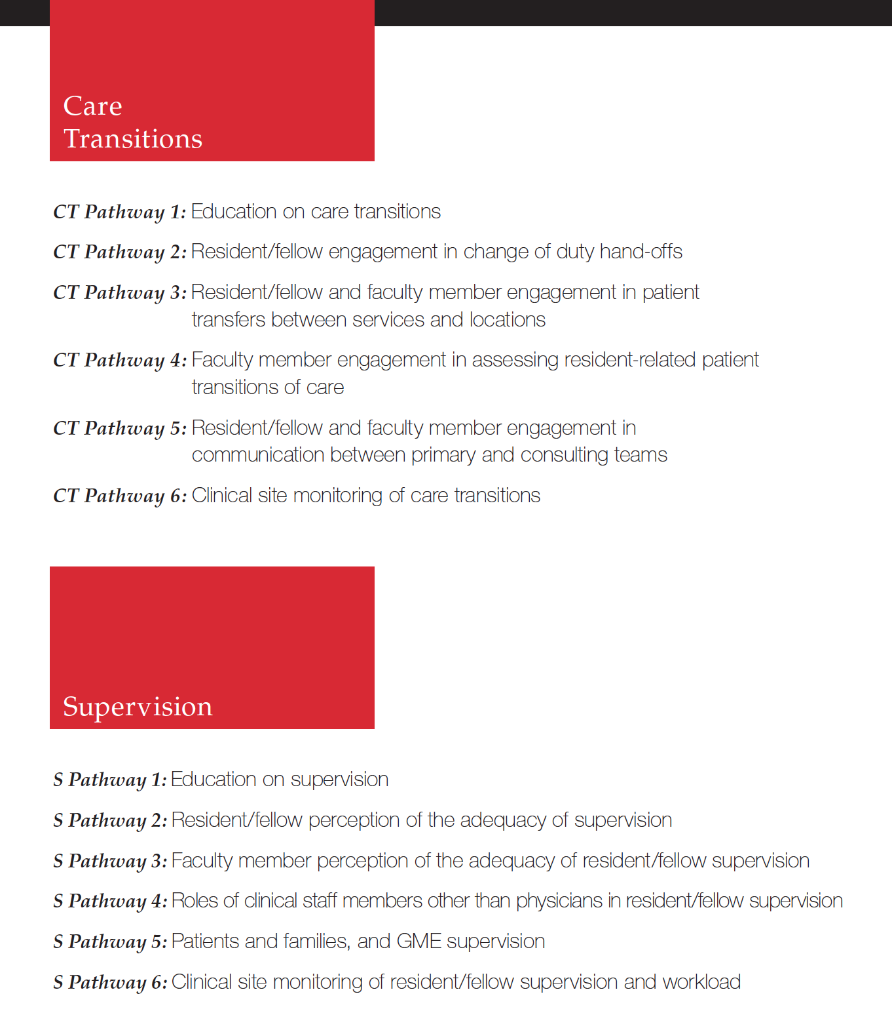

Slide 35
Applied toYOUR Institution

Slide 36
What can you do Now? “Optional” Documents
Organizational chart (showing the relationship of the sponsoring institution and the participating site)
Quality strategic plan
Policies
Duty Hours
Transitions in Care
Supervision
Annual report to the governing body
Have available…
Evidence of resident engagement in QI and PS
Other information related to the 6 focus areas and evidence of periodic reporting to the CEO

Slide 37
What can you do Now? Take an critical look…
Review the Pathways document and written report together.
Look for alignment
Beliefs and perceptions vs. fact
Organize a multi-disciplinary workgroup
Conduct your own interviews, walk-arounds, and observations
Inventory your own activities around the 6 focus areas and estimate your position along each of the pathways

Slide 38
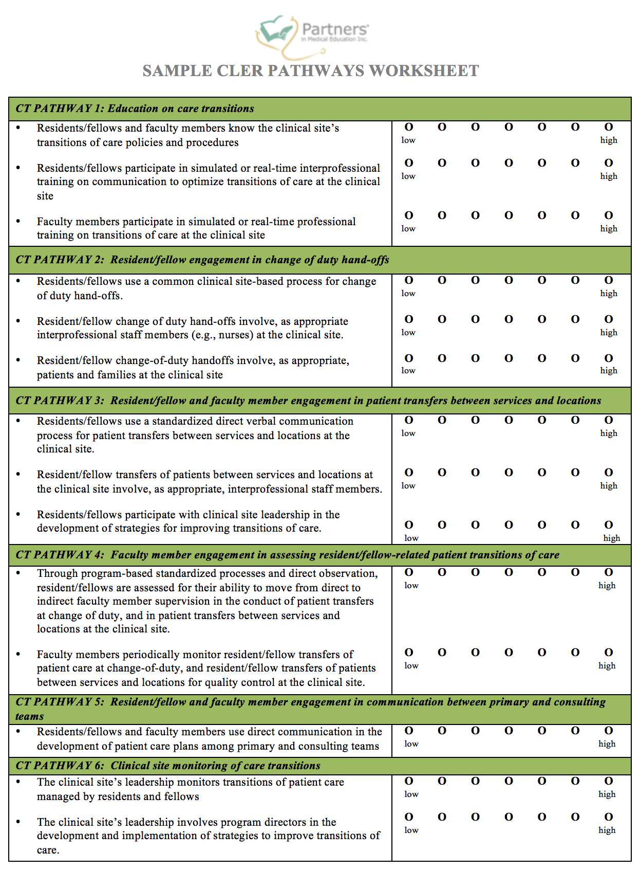
What can you do Now?

Slide 39
What can you do Now?
Develop a workplan, including measureable outcomes
Assign accountabilities
Share progress with your CEO

Slide 40
Why the C-Suite MUST Be Engaged in CLER Visits
A team of surveyors will be in-house for several days.
Surveyors will interview senior leadership.
The findings may impact your hospital operations.
After July 1, 2014, the findings related to your hospital could impact ACGME accreditation status of the sponsoring institution and its programs.

Slide 41
What can you do Now?

Slide 42
CLER is about opening conversations…
within GME
between GME and hospitals
between interested organizations: NCICLE (AAMC, ACCME, ACGME, AHA, AIAMC, AHME, IHI, LCME, and others)

Slide 43
Final Thoughts
Think continuous readiness.
CLER is a QI activity.
The ACGME does want to help your hospital improve – for the sake of the residents that train there.
“…safe health care settings are necessary to prepare residents to be safe health care practitioners.”

Slide 44
Partners’ Online Education
Upcoming Live Webinars
ACGME Application
Development for Programs
Tuesday, May 19, 2015
12:00pm – 1:30pm EST
Making Physicians Better: Professionalism
& It’s Role in Patient Care
Thursday, June 4, 2015
12:00pm – 1:30pm EST
Self-Study Visits
Tuesday, July 7, 2015
12:00pm – 1:30pm EST
Your CLER Report: From Paper to Practice
Thursday, July 23, 2015
12:00pm – 1:30pm EST
Our Summer/Fall 2015 Education
Schedule – COMING SOON!
www.PartnersInMedEd.com
On-Demand Webinars
Self-Study Visits
Introduction to GME for
New Program Coordinators
Milestones & CCCs
GME Financing – The Basics
Single Accreditation System
The IOM Report
Institutional Requirements: What’s New?
Contact us today to learn
how our Educational Passports can save you time & money!
724-864-7320
44

Slide 45
Partners in Medical Education, Inc. provides comprehensive consulting services to the GME community. For more information, contact us at:
724-864-7320
Info@PartnersinMedEd.com
www.PartnersInMedEd.com

