Slide 1
Making Physicians Better – Professionalism and its Role in Patient Care
Presented By:
Barry A. Doublestein, DSL
President – Leadership Solutions
Partners in Medical Education, Inc.

Slide 2
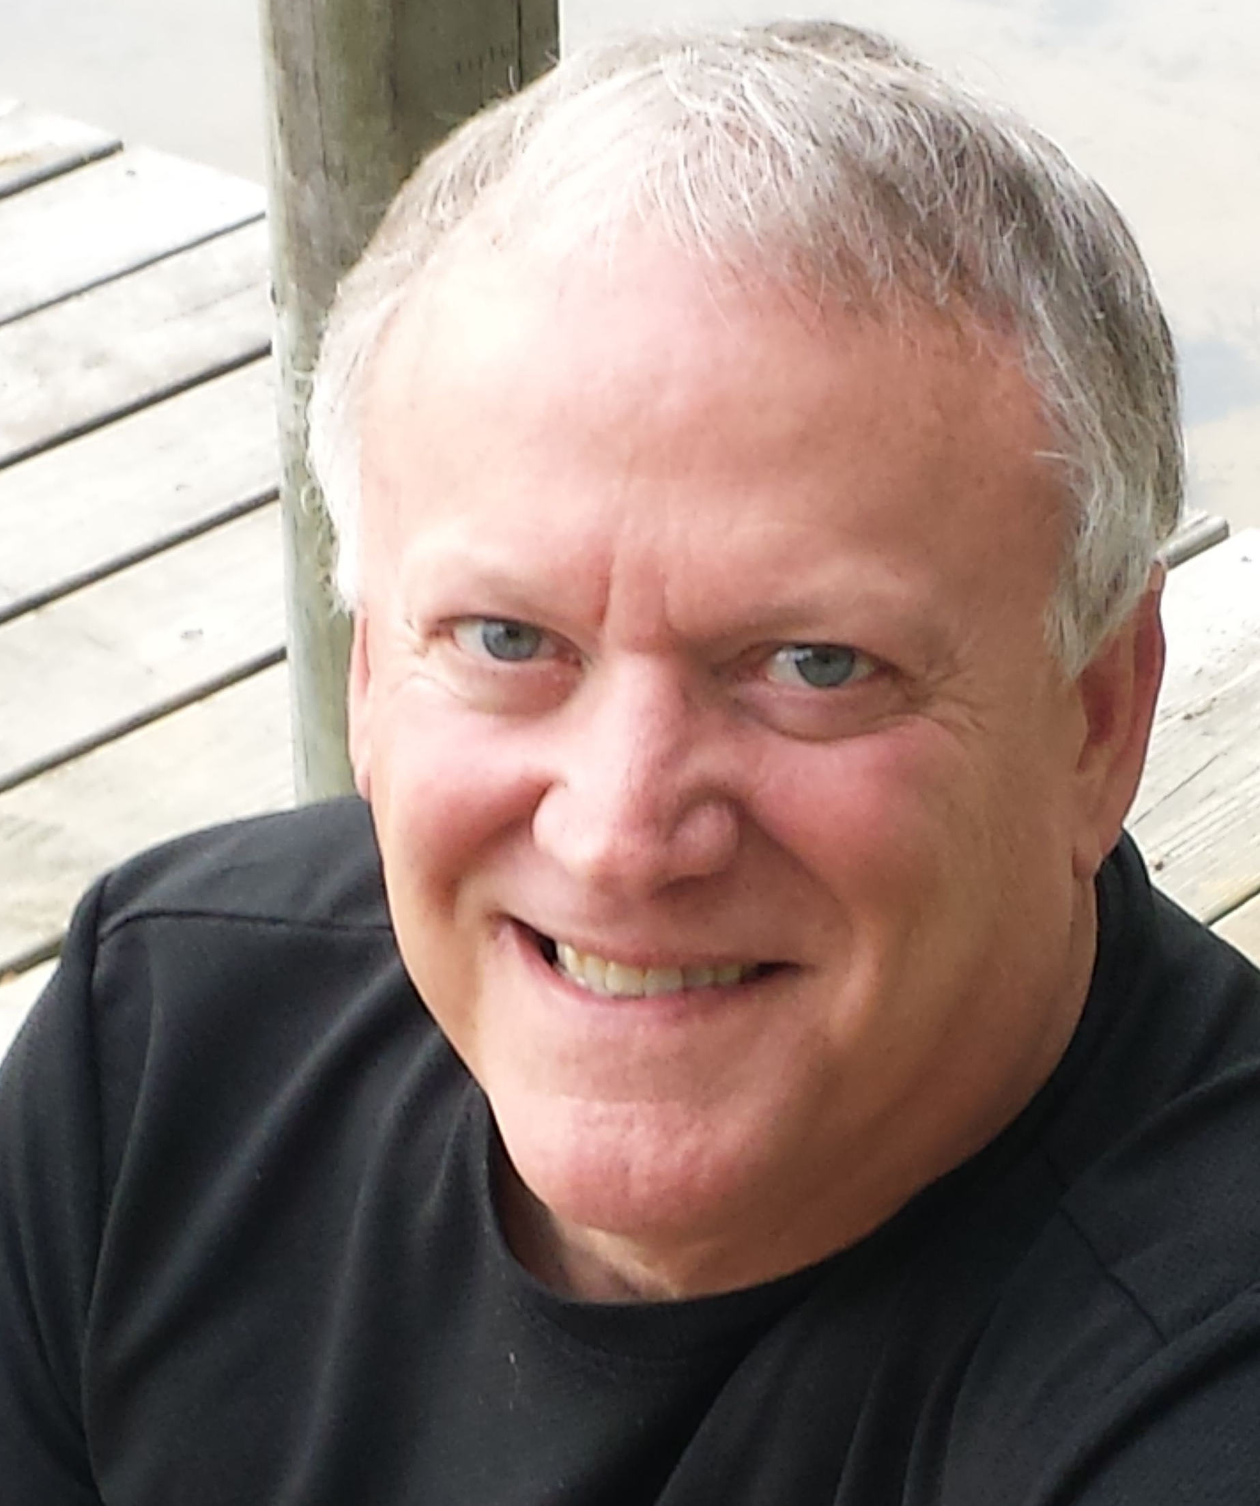
Your Presenter…..
Barry A. Doublestein, DSL
President of Leadership Solutions
President & COO of the Osteopathic Institute of the South since 1989
Passionate about physician-professionalism
Certified AOA Osteopathic Graduate Medical Education Consultant

Slide 3
How would you define professionalism in medicine?

Slide 4
Have you experienced a lapse of professionalism around you in the last 30 days?

Slide 5
What behaviors would you consider un-professional?

Slide 6
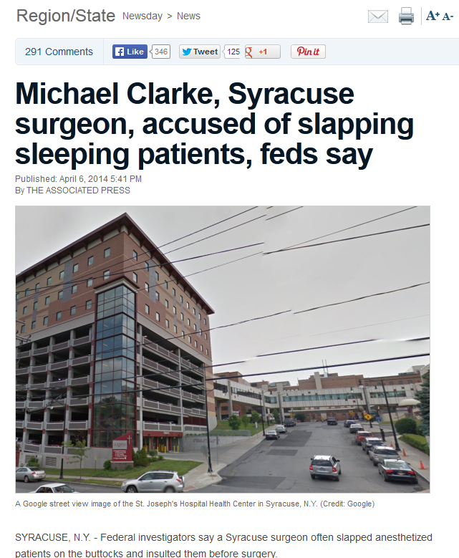

Slide 7
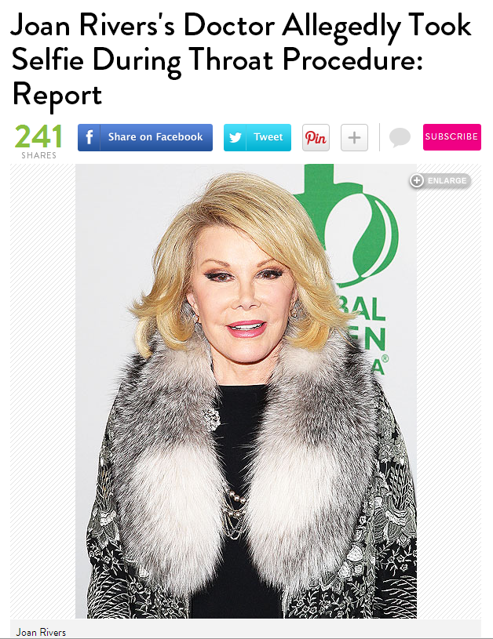
http://www.people.com/article/joan-rivers-doctor-allegations-yorkville-clinic. Retrieved: March 3, 2015

Slide 8
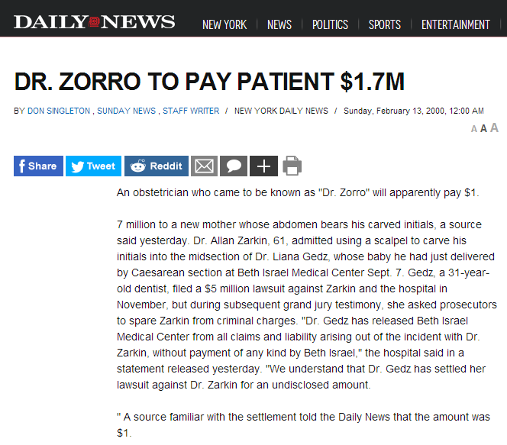

Slide 9
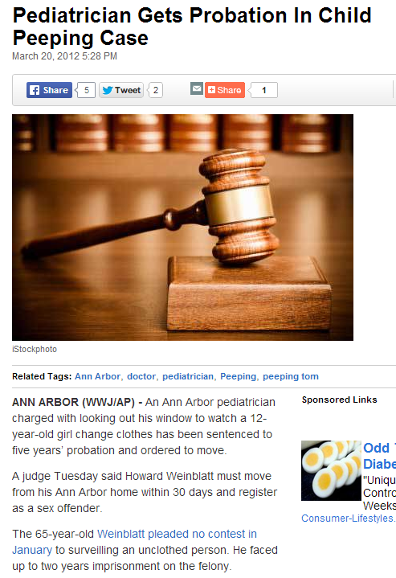
http://detroit.cbslocal.com/2012/03/20/pediatrician-gets-probation-in-child-peeping-case/. Retrieved: March 3, 2015

Slide 10
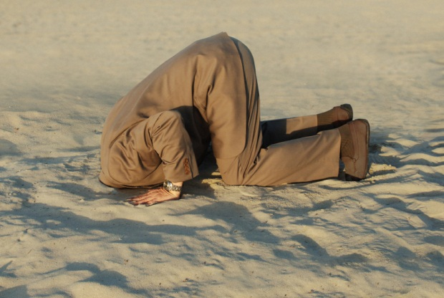
Would you consider these behaviors unprofessional?

Slide 11
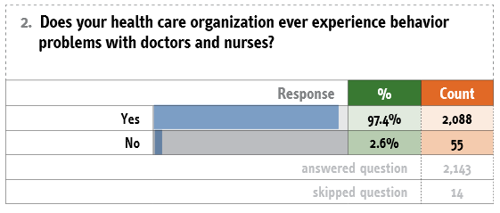
Johnson C. Bad Blood: Doctor-Nurse Behavior Problems Impact Patient Care. Physician Executive Journal. Nov.-Dec., 2009. https://www.ache.org/policy/doctornursebehavior.pdf. Retrieved: April 23, 2014.

Slide 12
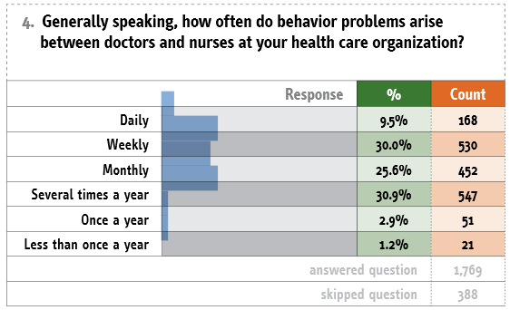
Johnson C. Bad Blood: Doctor-Nurse Behavior Problems Impact Patient Care. Physician Executive Journal. Nov.-Dec., 2009. https://www.ache.org/policy/doctornursebehavior.pdf. Retrieved: April 23, 2014.

Slide 13
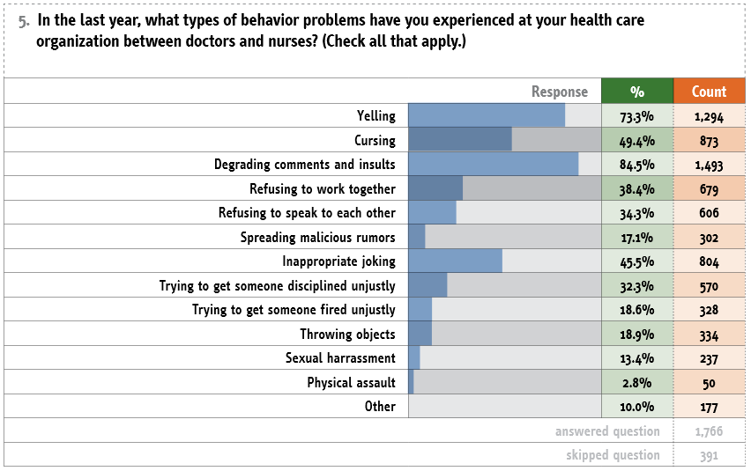
Johnson C. Bad Blood: Doctor-Nurse Behavior Problems Impact Patient Care. Physician Executive Journal. Nov.-Dec., 2009. https://www.ache.org/policy/doctornursebehavior.pdf. Retrieved: April 23, 2014.

Slide 14
“A substantial barrier to progress in patient safety is a dysfunctional culture rooted in widespread disrespect.”
Leape LL, Shore MF, Dienstag JL, Mayer RJ, Edgman-Levitan S, Meyer GS, Healy GB. A culture of respect, part 1: The nature and causes of disrespectful behavior by physicians. Academic Medicine. 2012 Jul;87(7):845-852.
Leape LL, Shore MF, Dienstag JL, Mayer RJ, Edgman-Levitan S, Meyer GS, Healy GB. A culture of respect, part 2: Creating a culture of respect. Academic Medicine. 2012 Jul;87(7):853-858.

Slide 15
“Disrespect is a threat to patient safety because it inhibits collegiality and co-operation essential to teamwork, cuts off communication, undermines morale, and inhibits compliance with and implementation of new practices.”
Leape LL, Shore MF, Dienstag JL, Mayer RJ, Edgman-Levitan S, Meyer GS, Healy GB. A culture of respect, part 1: The nature and causes of disrespectful behavior by physicians. Academic Medicine. 2012 Jul;87(7):845-852.
Leape LL, Shore MF, Dienstag JL, Mayer RJ, Edgman-Levitan S, Meyer GS, Healy GB. A culture of respect, part 2: Creating a culture of respect. Academic Medicine. 2012 Jul;87(7):853-858.

Slide 16
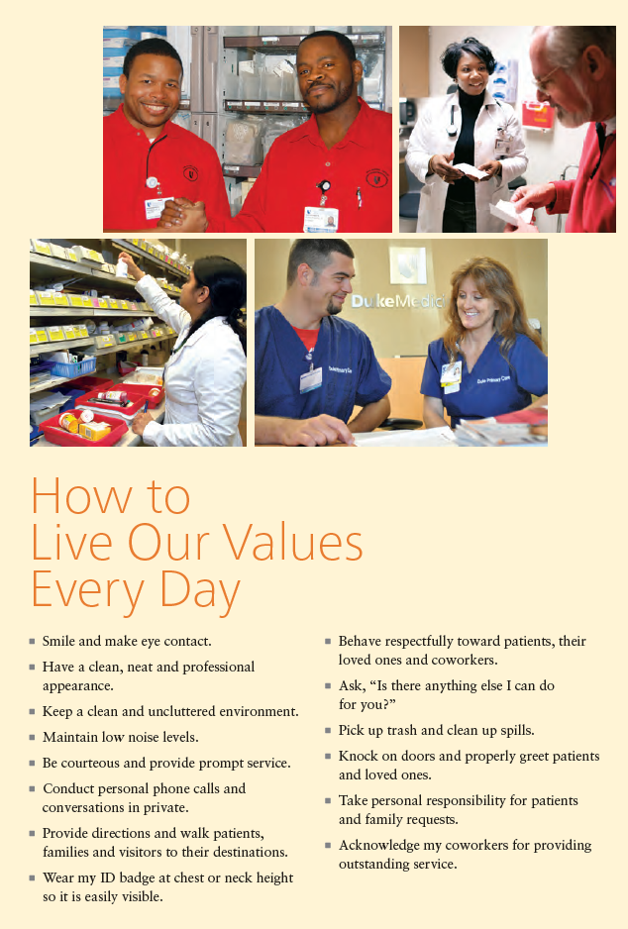

Slide 17
Are we left with…
’you know it when you see it?’

Slide 18
Is there a way to define it easily, discover its components, assess where one falls in the continuum, and devise a plan for improvement?

Slide 19
The key concept in getting us there is the term…

Slide 20
Agenda
Defining Professionalism
Demonstrate how improved professionalism by providers positively affects patient care
Provide you with a new model of professionalism
Stress the importance of culture and how it can be changed through leadership practice

Slide 21
Why Professionalism?

Slide 22
Medical Education Goals
Flexner -- 1910:
Standardization
Integration
Habits of inquiry and improvement
Professional formation
Flexner 2 -- 2010
Standardization and individualization
Integration
Habits of inquiry and improvement
Professional formation

Slide 23
Medical Education Goals
Professional formation:
Promote formal ethics instruction
Address the underlying messages expressed in the hidden curriculum
Offer feedback on assessment of professionalism
Promote positive role models
Create collaborative learning environments committed to excellence and continuous improvement

Slide 24
Institute of Medicine
Recommend the development of a federal GME policy committee to oversee GME funding and governance
IOM. (2014). Graduate Medical Education That Meets the Nation’s Health Needs. http://www.ncbi.nlm.nih.gov/books/NBK248022/. Retrieved: May 21, 2015

Slide 25
Huge Push to Focus on Professionalism in Medical Education
ACGME: New Accreditation System
Josiah Macy Foundation
Arthur Gold Foundation
Duke University Medical Center

Slide 26
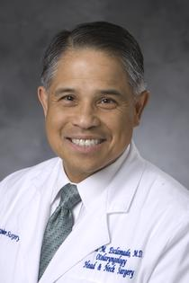
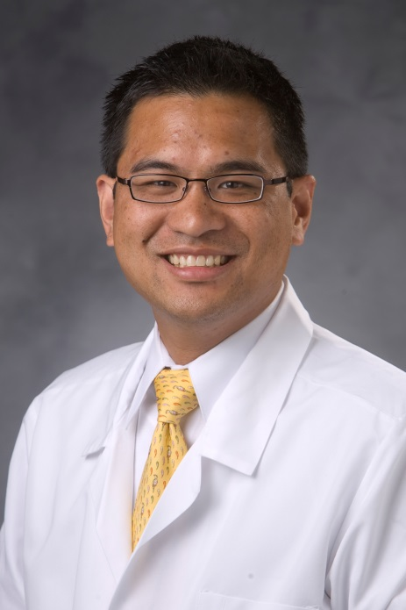
Focus on Professionalism at Duke University Medical Center
Duke Otolaryngology – Head & Neck Virtues:
Integrity
Initiative
Accountability
Self-discipline
Responsibility
Leadership Lived Out:
Professional Intervention
Raymond Esclamado, MD
Walter Lee, MD

Slide 27
Lessons Learned
Can produce positive change
Culture trumps global change
Better results moving to UME or sooner
Requires a commitment to excellence and self-betterment
Faculty/department chairs are not exempt from intervention

Slide 28
Lack of Professionalism in Medicine
Jeopardize Patient Care¹
Aimless Leadership – opening doors for others to lead¹
Limits Currency – lifelong learning which leads to mastery of communication, behavioral and attitudinal skills in patient care¹
Early lapses in professionalism in medical education correlates with lapses later in practice²
Loss of key virtues necessary in excellent patient care through improper or inadequate learning environments – those without professionalism focus
Loss of balance between ‘heart’ and ‘mind’ of medicine – humanism vs. cognitive intelligence focus³
Doukas, DJ, McCullough, LB, Wear, S., Lehmann, LS, Nixon, LL, Carrese, JA, Shapiro, JF, Green, MJ, Kirch, DG. The Challenge of Promoting Professionalism Through Medical Ethics and Humanities Education . Acad Med. 2013;80:892–898
Papadakis, M., Teherani, A., Banach, M., Knettler, T., Rattner, S., Stern, D., Veloski, J., Hodgson, C. (2005). Disciplinary Action by Medical Boards and Prior Behavior in Medical School. New England Journal of Medicine; 353:2673-2682.
Coulehan J. Viewpoint: Today’s professionalism: Engaging the mind but not the heart. Acad Med. 2013;88, No.11:1-6.

Slide 29
Model Built Upon Certain Premises
Every Physician is a leader: Self, Patient, Team, Organization/vocation
Emotional Intelligence, Cognitive Intelligence, and Leadership Intelligence can be modified or improved through direct intervention programs
One’s level of professionalism is not so much about a Quotient (number) but is more about balance between the three intelligences

Slide 30
Need for a Definition
Cannot offer feedback on assessment without a commonly-accepted definition of professionalism
Cannot assess something without a model

Slide 31
Defining Professionalism

Slide 32
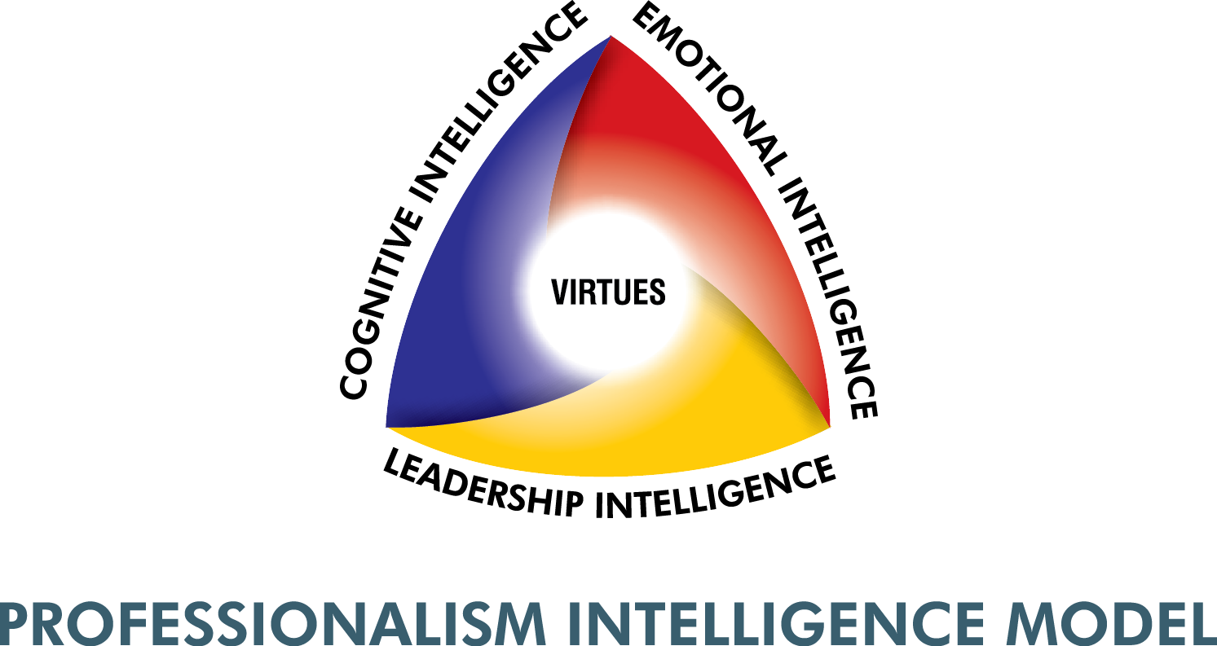
Defining Professionalism

Slide 33
Defining Professionalism
Behaviors are conditioned by one’s cognitive and emotional intelligences and guided by a certain set of virtues

Slide 34
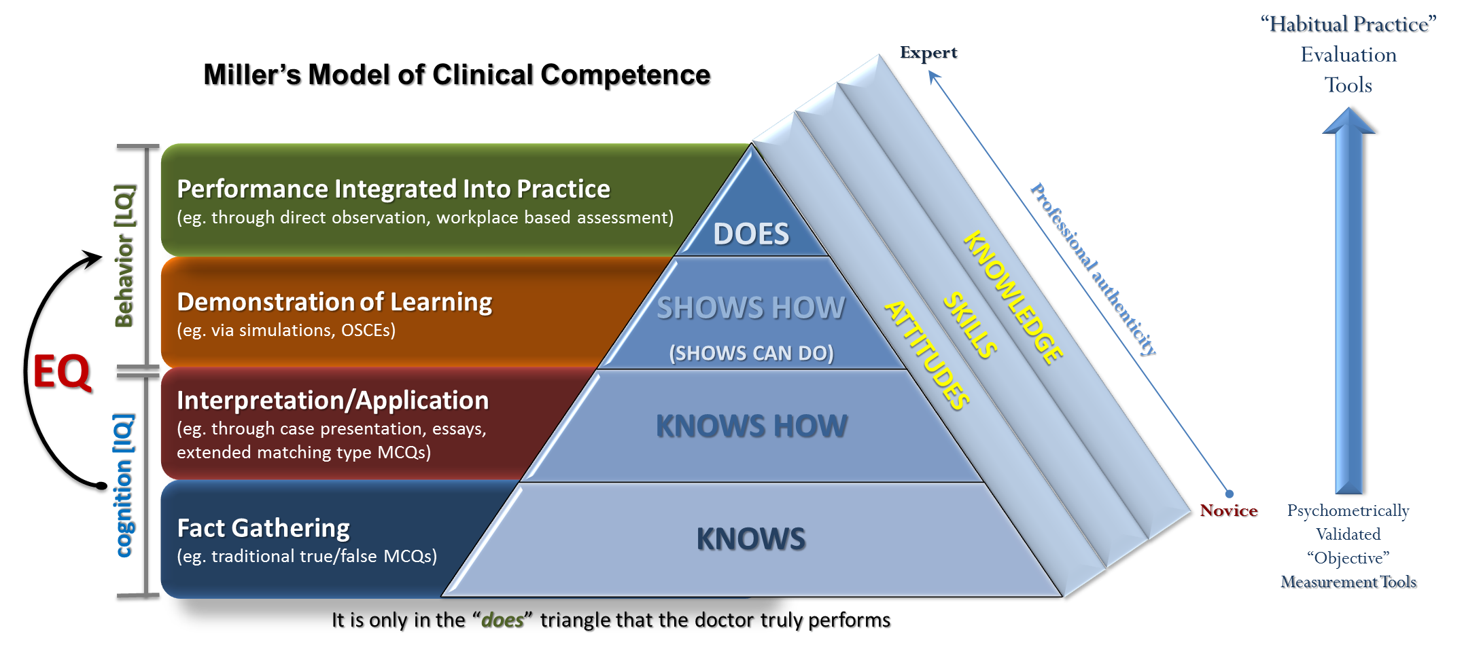
Defining Professionalism Miller’s Prism (Pyramid) of Clinical Competence
[LQ]
[CQ]

Slide 35
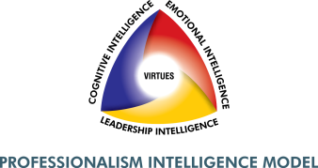
CQ Scales
Cognitive Intelligence
Focused-Thinking
Problem-Solving
Critical-Thinking
Decision-Making
Explanation
To what level can I block out distractions in order to think clearly?
To what level can I offer a logical and well-thought out explanation of my actions?
To what level am I able to break problems into elements and find a solution?
To what level can I make good decisions based upon known facts?
To what level can I make clear and reasoned judgments?

Slide 36
EQ Scales
Emotional Intelligence
Self-Awareness
Self-Regulation
Interpersonal Relationships
Empathy
Motivation
To what level do I understand my own self?
To what level do I regulate my emotions?
To what level am I motivated to do my job? Am I committed?
To what level do I interact with others?
How strong is my empathy for others and their plights?

Slide 37
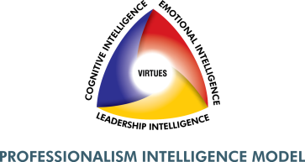
LQ Scales
Leadership Intelligence
Embodiment
Inspiration
Excellence
Empowerment
Recognition
To what level do I model behaviors expected of others?
To what level do I recognize others and their accomplishments?
To what level do I inspire others to be the best they can be?
To what level do I empower others to be and seek their best?
To what level am I committed to seeking excellence in all that I do?

Slide 38
What are barriers that stand in the way of true professionalism?

Slide 39
#1 - Culture

Slide 40
“A substantial barrier to progress in patient safety is a dysfunctional culture rooted in widespread disrespect.”
Leape LL, Shore MF, Dienstag JL, Mayer RJ, Edgman-Levitan S, Meyer GS, Healy GB. A culture of respect, part 1: The nature and causes of disrespectful behavior by physicians. Academic Medicine. 2012 Jul;87(7):845-852.
Leape LL, Shore MF, Dienstag JL, Mayer RJ, Edgman-Levitan S, Meyer GS, Healy GB. A culture of respect, part 2: Creating a culture of respect. Academic Medicine. 2012 Jul;87(7):853-858.

Slide 41
The leader sets the culture…
“When people feel safe, they trust.”
-Simon Sinek

Slide 42
#2 – Lack of
Interest in
Self-Betterment

Slide 43
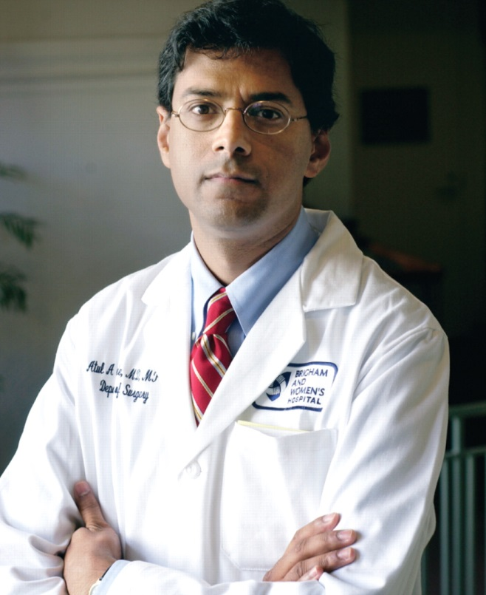

Slide 44
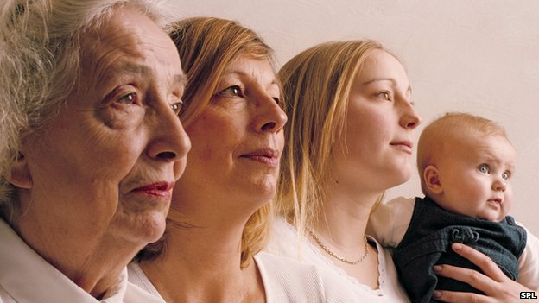
#3 – Generational
Expectations

Slide 46
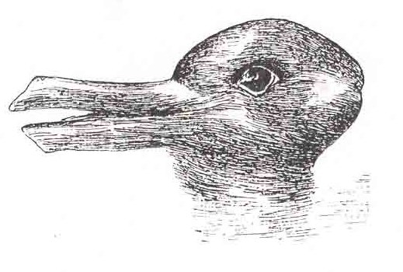
#4 – Hidden
Curriculum

Slide 47
Hidden Curriculum
More than transmission of knowledge and skills
Socialization process
Norms and values transmitted that undermines the formal message
Implicitly taught by example
It is a major problem
Mahood, SC. Medical Education: Beware the hidden curriculum. Canadian Family Physician. September, 2011 vol. 57 no. 9 983-985

Slide 48
Hidden Curriculum
Causes students to move from being opened-minded to closed-minded
Move from being intellectually curious to narrowly focused on facts
From empathy to emotional detachment
From idealism to cynicism
From civility and caring to arrogance and irritability
Mahood, SC. Medical Education: Beware the hidden curriculum. Canadian Family Physician. September, 2011 vol. 57 no. 9 983-985

Slide 49
Hidden Curriculum
Erodes ethics in medical students
62% of medical students had done unethical behaviors:
Pretending to examine patients, or making up vitals
Ignoring contamination
Obtaining informed consent without knowledge of the procedure
Withholding results from patients
Doing unnecessary procedures for experience
Feudtner C, Christakis DA, Christakis NA. Do clinical clerks suffer ethical erosion? Students’ perceptions of their ethical environment and personal development. Acad Med 1994;69(8):670-9.

Slide 50
#5 – Unclear Expectations

Slide 51
#6 – Lack of Consensus of Shared Virtues

Slide 52
Take Action

Slide 53
Action Steps
Recognize ways in which you can promote professionalism now (at home, work, play)
Elevate professionalism to one of the top five elements of your GME program
Consider developing an internal professionalism intervention program
Consider implementing a progressive professionalism evaluation protocol

Slide 54
Action Steps
Identify your shared organizational virtues
Do a cultural assessment
Chief Resident Leadership Training
Consider attending Leadership Solution’s Physician Leadership Academy
Take the PQ-i assessment tool - free

Slide 55
Questions?

Slide 56
Partners’ Online Education
Upcoming Live Webinars
Self-Study Visits
Tuesday, July 7, 2015
12:00pm – 1:30pm EST
Your CLER Report: From Paper to Practice
Thursday, July 23, 2015
12:00pm – 1:30pm EST
Annual Institutional Review
Thursday, August 20, 2015
12:00pm – 1:30pm EST
Milestones & CCCs
Thursday, September 10, 2015
12:00pm – 1:30pm EST
Our Summer/Fall 2015 Education
Schedule – AVAILABLE NOW!
www.PartnersInMedEd.com
On-Demand Webinars
Self-Study Visits
Introduction to GME for
New Program Coordinators
Milestones & CCCs
GME Financing – The Basics
Single Accreditation System
The IOM Report
Institutional Requirements: What’s New?
Contact us today to learn
how our Educational Passports can save you time & money!
724-864-7320

Slide 57
Partners in Medical Education, Inc. provides comprehensive consulting services to the GME community. For more information, contact us at:
724-864-7320
Info@PartnersinMedEd.com
www.PartnersInMedEd.com
Presented by:
Barry A. Doublestein, DSL, President
Leadership Solutions
5303 Holly Brooke Lane, Loganville, GA 30052
barry@leader-solutions.net | (678) 894-0051

