Slide 1
Self-Study Why? What? How? July 7, 2015
PARTNERS IN MEDICAL EDUCATION, INC.
Presented by:
Christine Redovan, MBA
GME Consultant
Notes:
Partners in Medical Education, Inc.
1

Slide 2
Goals & Objectives
Understand the rationale behind a self-study
Relate self-study to program improvement (APE)
Incorporate the ACGME 8 steps for self-study into the process
Utilize SWOT analysis for further understanding and identification of program strengths, weaknesses, opportunities and threats
Presented by Partners in Medical Education, Inc. - 2015
2
Notes:
2

Slide 3
Overview
No accreditation cycle lengths in NAS
Accreditation assigned each year after review of annual program update information
Focused or full site visits scheduled as needed
Every ten years programs and institutions perform a self-study
Every ten years ACGME performs full site visit of program
Presented by Partners in Medical Education, Inc. - 2015
3
Notes:
Partners in Medical Education, Inc.
3

Slide 4
Self-Study Site Visit Definition
“The 10 Year Self Study site visit is based on a comprehensive self-study, which includes a description of how the program or sponsoring institution creates an effective learning and working environment, and how this leads to desired educational outcomes, and an analysis of strengths, weaknesses, and plans for improvement.”
ACGME Policies and Procedure Manual, Section 17.30(a), February 7, 2015
Presented by Partners in Medical Education, Inc. - 2015
4
Notes:
Partners in Medical Education, Inc.
4

Slide 5
What is a self-study
It’s a process
Allows assessment of compliance with accreditation standards
Determines how you can change policies, procedures and practices
Can reinforce maintenance of existing practices that work
It’s a document
Provides evidence of assessment and improvement
Serves as a historical document
Meets current required accreditation standards

Slide 6
What is a self-study?
“The self-study is an objective, comprehensive evaluation of the residency or fellowship program, with the aim of improving it. Underlying the self-study is a longitudinal evaluation of the program and its learning environment, facilitated through sequential annual program evaluations that focus on the required components, with an emphasis on program strengths and “self-identified” areas for improvement (“self-identified” is used to distinguish this dimension of the self-study from areas for improvement the Review Committee identifies during accreditation reviews).”
http://www.acgme.org/acgmeweb/tabid/473/ProgramandInstitutionalAccreditation/Self-Study.aspx
Presented by Partners in Medical Education, Inc. - 2015
6
Notes:
Partners in Medical Education, Inc.
6

Slide 7
The Self-Study
As we know it today (July 2015):
Every 10 years
Approximately 12-18 month process (self-study to visit)
12 months to complete the self-study
Upload by end of the month it is due (see LON)
Short turnaround for self-study visit
Separate and distinct from 10 year accreditation visit (12-18 months after the self-study has been submitted)
Current pilot project with phase I NAS programs that were due for self-study this year to assess ACGME process and results

Slide 8
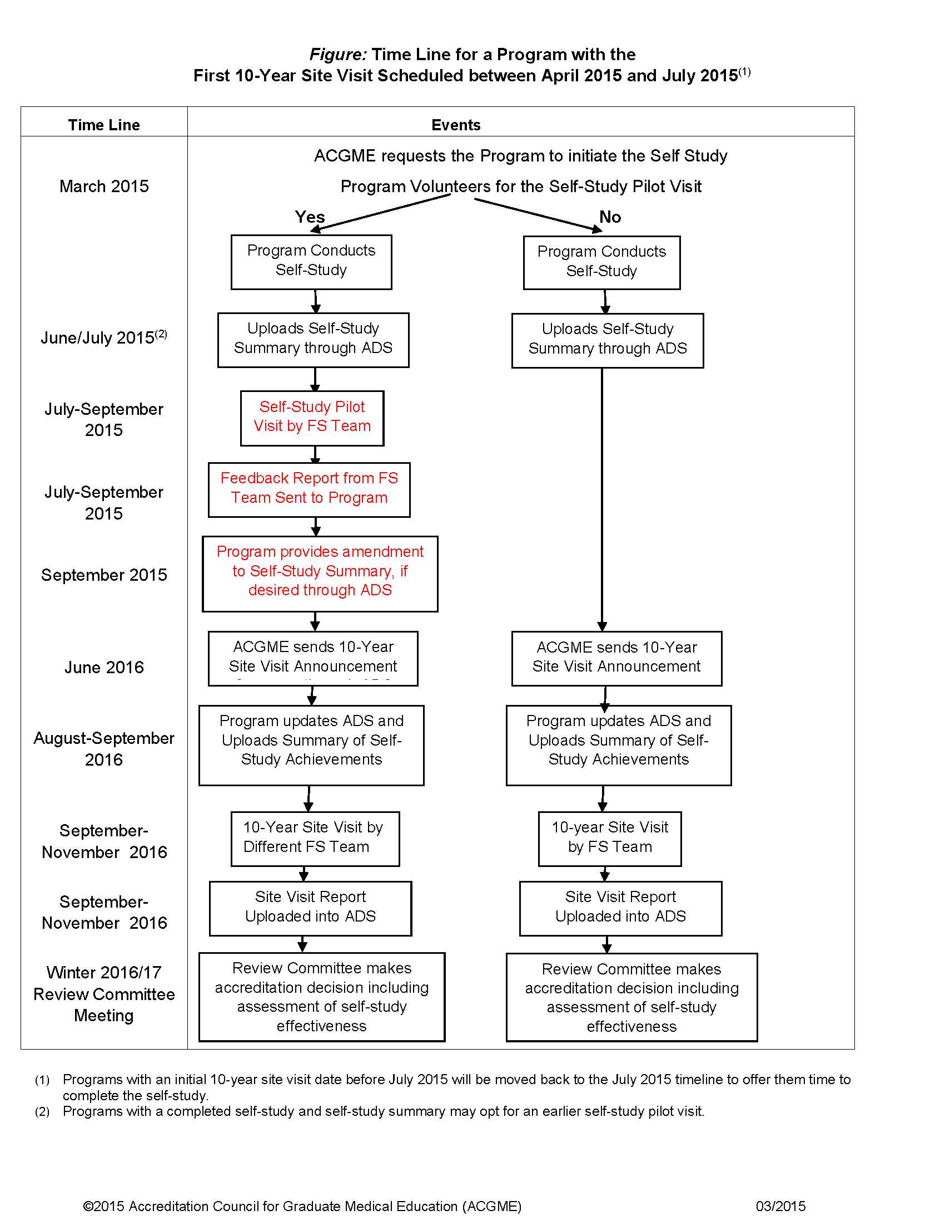

Slide 9
The Self-Study
Core and subspecialty programs reviewed together
Focus on improvement
Uses existing data already collected; identifies data that should be collected
Forces consideration of all resources available – internal and external
Evaluates strengths & weaknesses (areas for improvement) [which is not new to us]
Introduces new concepts of:
Program Aims
Opportunities and Threats

Slide 10
Self-Study Starts with APE
Performed by Program Evaluation Committee (PEC)
Required to document formal, systematic evaluation of the curriculum…
Must review
Resident performance, Faculty development
Graduate performance, Program quality
Results in written action plan AND at least one performance improvement initiative
Presented by Partners in Medical Education, Inc. - 2015
10
Notes:
Partners in Medical Education, Inc.
10

Slide 11
Data to Consider in APE
Summary information from previous APE’s
Citations, actions taken, results
“Areas of Improvement” noted by ACGME
Annual changes (rotations, didactics, sites)
Rotation schedule/block diagram
ADS data – Resident & Faculty qualifications, turnover, scholarly activity
Resident & faculty surveys (ACGME & internal)
Resident files (quality of documentation)
Curriculum; Procedure logs; Patient numbers
ACGME program and institutional standards
Presented by Partners in Medical Education, Inc. - 2015
11
Notes:
Partners in Medical Education, Inc.
11

Slide 12
Additional Data for APE
Program aims
SWOT analysis
Action plan results from previous APE & Self-study
Tracking all of this data is just as important as gathering the information
Do you know what you have?
Do you know what you don’t have?
Presented by Partners in Medical Education, Inc. - 2015
12
Notes:
Partners in Medical Education, Inc.
12

Slide 13
ACGME Expectations for Self-Study
8 Step Process
http://www.acgme.org/acgmeweb/tabid/473/ProgramandInstitutionalAccreditation/Self-Study.aspx
Presented by Partners in Medical Education, Inc. - 2015
13
Notes:
Partners in Medical Education, Inc.
13

Slide 14
Step 1
Assemble the self-study group
Membership
PEC, coordinator
Residents, chair, department leaders
CCC member
Others as appropriate
Presented by Partners in Medical Education, Inc. - 2015
14
Notes:
Partners in Medical Education, Inc.
14

Slide 15
Step 2
Engage in Discussion
Program Aims
Key expectations of the program
How you differentiate your program
Types of trainees recruited
Type of career trained for
Patient population
Changeable over time in response to factors
Presented by Partners in Medical Education, Inc. - 2015
15
Notes:
Partners in Medical Education, Inc.
15

Slide 16
Step 3
Examine Opportunities and Threats (and strengths and weaknesses)
Assess the programs environment
SWOT is helpful in brainstorming and examining each area
Presented by Partners in Medical Education, Inc. - 2015
16
Notes:
Partners in Medical Education, Inc.
16

Slide 17
SWOT Analysis
SWOT is a strategic planning tool
Helpful for taking advantage of your strengths and opportunities
Helpful for eliminating weaknesses and minimize threats
Will provide action items for the self-study improvement plan
Allows for brainstorming and identification of concerns without blame
Depends on being truthful and honest in your assessments

Slide 18
http://commons.wikimedia.org/wiki/File:SWOT_en.svg. Permission: Creative Commons Attribution-Share Alike 2.5 Generic

Slide 19
SWOT
Strengths are internal factors that are in your control.
At the core of your program
Something you, students or the hospital values
What do you do well?

Slide 20
SWOT
Weaknesses are internal factors that are in your control.
An existing, missing or potential element that is preventing you from reaching full program success
What systems do you need to change?
What knowledge or skills are you lacking?

Slide 21
SWOT
Opportunities are external factors that are not in your control.
Anything that you can use to give your program an advantage
Who could you collaborate with?

Slide 22
SWOT
Threats are external factors that are not in your control.
Anything that could erode a strength of your program or cause harm to your program
What will the impact of reduced GME funding have on your program?

Slide 23
Step 4
Aggregate and analyze data to generate a longitudinal assessment of the programs improvement
Use of APE to assess the program strengths and improvement opportunities
Pick key information
Use action plans to track and update progress
Surveys
Milestones
CLER results
Letters of Notification
Other information
Presented by Partners in Medical Education, Inc. - 2015
23
Notes:
Partners in Medical Education, Inc.
23

Slide 24
APE Sample Aggregate Template

Slide 25
Sample Action Plan

Slide 26
Step 5
Obtain stakeholder input
Meetings; Retreats
Surveys
Recent graduates
Faculty
Residents
Others essential to the program
Other specialties that interact with residents
Presented by Partners in Medical Education, Inc. - 2015
26
Notes:
Partners in Medical Education, Inc.
26

Slide 27
Step 6
Interpret the data and aggregate the self-study findings
Must Include:
Working set of program aims
List of key program strengths
Prioritize self-identified areas for improvement
Select a few for active follow-up
Define specific program improvements
Opportunities that may enhance the program and plans to take advantage of them
Threats and plans to mitigate their impact
Presented by Partners in Medical Education, Inc. - 2015
27
Notes:
Partners in Medical Education, Inc.
27

Slide 28
Step 7
Discuss findings with stakeholders
Share with faculty, residents, leaders
Validate the findings of your self-study
Revise aims based on feedback
Review list of priority improvements
Gain support and buy-in
Presented by Partners in Medical Education, Inc. - 2015
28
Notes:
Partners in Medical Education, Inc.
28

Slide 29
Step 8
Develop a succinct self-study document
Upload to ADS; Use template
Key Areas:
Program Description & Aims
Activities to advance the aims
Environmental Context
Opportunities & Threats
Annual Program Evaluation
Self-study Process
Optional – learnings during the self-study
Do NOT include areas for improvement!
Presented by Partners in Medical Education, Inc. - 2015
29
Notes:
Partners in Medical Education, Inc.
29

Slide 30
Self-Study Template

Slide 31
The Self-Study Improvements at the Accreditation Site Visit
Upload summary of improvements*
Approximately 1200 words
Only include information about those improvements that you achieved
*Template will be forthcoming

Slide 32
After the Self-Study Visit
The self-study visitor will provide verbal feedback.
Self-study visitors will be different field staff from the site visitor that conducts the accreditation visit.
A written report is provided to the program and the RC
For now, the report will NOT be used in making accreditation decisions
Eventually we expect to receive feedback from the RC’s how effective the self-study was and the programs ability to meet their aims and identified improvements

Slide 33
ACGME Pilot Program Three Evaluations*
1. Needs Evaluation
Program director information and learning needs
Review Committee and ACGME staff learning needs
Tools and resources to assist programs in conducting their self-study
* Philibert, I & Nasca, T. (2015). The program self-study and the 10-year site visit: Rationale for a new approach. The Journal of Graduate Medical Education (7)2, 310- 312. DOI: http://dx.doi.org/10.4300/JGME-07-02-52
.

Slide 34
ACGME Pilot Program Three Evaluations*
2. Process Evaluation
Self-study process (for best practices)
Self-study pilot visit (for best practices)
10-year site visit (for best practices)
Adequacy of the delay between self-study and 10-year site visit (process component)
* Philibert, I & Nasca, T. (2015). The program self-study and the 10-year site visit: Rationale for a new approach. The Journal of Graduate Medical Education (7)2, 310- 312. DOI: http://dx.doi.org/10.4300/JGME-07-02-52

Slide 35
ACGME Pilot Program Three Evaluations*
3. Outcomes Evaluation
Improvement in all programs
Improvement for programs with a self-study pilot visit versus those without the added visit
Adequacy of the delay between self-study and 10-year site visit (outcome component)
* Philibert, I & Nasca, T. (2015). The program self-study and the 10-year site visit: Rationale for a new approach. The Journal of Graduate Medical Education (7)2, 310- 312. DOI: http://dx.doi.org/10.4300/JGME-07-02-52

Slide 36
Part 2 – AIMS & SWOT
Develop a working set of program aims
Begin SWOT analysis
Data, discussion and prioritization of SWOT items
Presented by Partners in Medical Education, Inc. - 2015
36
Notes:
Partners in Medical Education, Inc.
36

Slide 37
Program Aims
Key expectations of the program…
How you differentiate your program…
Types of trainees recruited…
Type of career trained for…
Patient population…
Presented by Partners in Medical Education, Inc. - 2015
37
Notes:
Partners in Medical Education, Inc.
37

Slide 38
SWOT
Strengths are internal factors that are in your control.
What is the unique thing about your program?
What are the things that other people say you do well?
How long have you been in the business of education?
What makes you better than other programs for the education of residents?
What are the advantages you have over your competition?
What are your program competencies? What knowledge, skills and attitudes do you have that can help your program succeed?

Slide 39
SWOT
Weaknesses are internal factors that are in your control.
What areas do your competitors have an advantage on?
Are you lacking in knowledge or skills?
Do you have enough investment to continue the program?
Is your patient base too low? Are there procedures or diagnoses that residents do not obtain easily?
Are you reaching the program goals, aims & outcomes?
In what ways are you not efficient?
Where are you wasting resources?

Slide 40
SWOT
Opportunities are external factors that are not in your control.
What external changes will bring your opportunities?
What are the current ongoing trends? Positive or negative?
What are the social and economic conditions?
Is your reputation helping you to get finance easier?
What real opportunities are present today?
Is there anything that is going on around you that may be useful?
What are some best practices that you can incorporate?
What can you do today that is not being done?
Who can support you and how?

Slide 41
SWOT
Threats are external factors that are not in your control.
What are the negative aspects in the current market?
Are your key staff members and workers satisfied with their wages and other benefits?
Do you see them being poached by your rivals?
Do you see a change in resident recruitment?
Are any new government regulations going to affect you?
What are the chances of a natural disaster affecting your program?
Will political instability hurt you?
What might cause you problems in the future and how?
What is your competition doing that might cause difficulties for you?
Do your residents stay in the organization or do they work elsewhere?

Slide 42
In Summary….
Self-study is an important component of NAS and is a required activity
Based on recognizing program improvements that go above and beyond minimum standards
The process is dynamic and changeable
Worth doing even if your self-study is not due for a while
Do a SWOT; work on your program aims; obtain stakeholder input
Self-study is built off APE – APE process/report extremely important

Slide 43
Questions
Presented by Partners in Medical Education, Inc. - 2015
43

Slide 44
Partners’ Online Education
Upcoming Live Webinars
Your CLER Report: From Paper to Practice
Thursday, July 23, 2015
12:00pm – 1:30pm EST
Annual Institutional Review
Thursday, August 20, 2015
12:00pm – 1:30pm EST
Milestones & CCCs
Thursday, September 10, 2015
12:00pm – 1:30pm EST
Special Review Process
Thursday, September 24, 2015
12:00pm – 1:30pm EST
Our Summer/Fall 2015 Education
Schedule – AVAILABLE NOW!
www.PartnersInMedEd.com
On-Demand Webinars
Self-Study Visits
Introduction to GME for
New Program Coordinators
Milestones & CCCs
GME Financing – The Basics
Single Accreditation System
The IOM Report
Institutional Requirements: What’s New?
Contact us today to learn
how our Educational Passports can save you time & money!
724-864-7320
Presented by Partners in Medical Education, Inc. - 2015

Slide 45
Partners in Medical Education, Inc. provides comprehensive consulting services to the GME community. For more information, contact us at:
724-864-7320
Info@PartnersInMedEd.com
www.PartnersInMedEd.com
Presented by Partners in Medical Education, Inc. - 2015
45

