Slide 1
Annual Institutional Review (AIR)
PARTNERS IN MEDICAL EDUCATION, INC.
Presented by:
Lauren McGuire, MBA, C-TAGME

Slide 2
Introducing Your Presenter…
Lauren McGuire, MBA, C-TAGME
Administrative Director of Undergraduate and Graduate Medical Education
Hands-on experience obtaining and maintaining accreditation
In-depth understanding to complete and review Institutional/Program site visit documentation in addition to coordinating and preparing for site visits

Slide 3
Webinar Objectives
Define and understand the Annual Institutional Review (AIR)
Interpret the minimum requirements of an AIR to streamline your program and institutional reviews
Design the AIR to improve performance across your residency programs
Determine the role of the GMEC
Utilize data collected from the AIR to approach Special Reviews

Slide 4
Define and understand the Annual Institutional Review (AIR)

Slide 5
Annual Institutional Review (AIR)
Who
What
Where
When
Why
Graduate Medical Education Committee (GMEC) and Designated Institutional Official (DIO)
Demonstrate effective oversight of accreditation
Monitoring procedures for action plans resulting from the review
Submit an executive summary to the governing body
The Sponsoring Institution
Scheduled at a time that best works for each Sponsoring Institution
Results in a report that describes the quality improvement goals, the corrective actions, and the process for GMEC monitoring of outcomes

Slide 6
How does the AIR fit into the ACGME’s Next Accreditation System (NAS)?
CCC
PEC
APE
AIR
Special Reviews

Slide 7
AIR
APE
PEC Meeting
APE
PEC Meeting
APE
APE
APE
PEC Meeting
PEC Meeting
PEC Meeting
PEC Meeting
PEC Meeting
PEC Meeting
NAS at the Institutional Level
Special
Review
Special
Review

Slide 8
NAS at Program Level
Annual Program Evaluation (PR V.C.)
Resident performance
Faculty development
Graduate performance
Program quality
Documented improvement plan
Self-
Study
VISIT
Self-
Study
Ongoing Improvement
Yr 0
Yr 1
Yr 2
Yr 3
Yr 4
Yr 5
Yr 6
Yr 7
Yr 8
Yr 9
Yr 10
AE
AE
AE
AE
AE
AE
AE
AE
AE
AE
“The Program Evaluation Committee and the Annual Program Evaluation” PowerPoint
2013 Accreditation Council for Graduate Medical Education (ACGME)

Slide 9
NAS at Institutional Level
Self-
Study
VISIT
Self-
Study
Ongoing Improvement
Yr 0
Yr 1
Yr 2
Yr 3
Yr 4
Yr 5
Yr 6
Yr 7
Yr 8
Yr 9
Yr 10
AIR
AIR
AIR
AIR
AIR
AIR
AIR
AIR
AIR
AIR

Slide 10
Institutional Review Questionnaire
Attachment 6 (I.B.5.a-b)
A copy of the two most recent written executive summaries of the Annual Institutional Reviews as presented to the governing body.
Attachment 7 (I.B.6.a.1)
A copy of GMEC Special Review Protocol
Attachment 8 (I.B.6.a.2)
A copy of any Special Review reports that have been conducted by the GMEC in the past two years.

Slide 11
Your APEs Should Feed Your AIR
Apply a lean approach when collecting data
Start by an APE form
standardizing

Slide 12
Why Standardize?
Avoid Common Citations at Program Level
Institutional oversight
Develop a formal system to help programs improve

Slide 13
What Performance indicators must the AIR include?
results of the most recent institutional self-study visit
results of ACGME resident and faculty surveys
programs’ accreditation statuses and self-study visits
programs’ board pass rates
tracking of resident and faculty scholarly activity
documentation of sufficient Faculty development
a, b, and c
all of the above

Slide 14
Minimum AIR Performance Criteria
Results of the most recent institutional self-study visit
References the institutional 10 year-self study
Results of ACGME Faculty and Resident Surveys
Utilize the data from the ACGME surveys to identify areas for improvement
Programs’ accreditation statuses and self-study visits
Maintain oversight

Slide 15
What are considered good performance indicators?
Established targets
Measureable outcomes
Demonstrates program effectiveness
Inspires Action

Slide 16
Choosing SMART Indicators
Specific
Measurable
Attainable
Relevant
Timeframe

Slide 17
Applying SMART to Performance Indicators:
Indicator | Specific What is the purpose of the target area? | Measure Quantify how the indicator will be considered successful | Attainability Is this Indicator realistic? How is it achieved? | Relevance Will the results demonstrate the effectiveness of the program? | Timeframe When will the results be available?
Board Pass Rate
According to specialty requirements
(i.e. Internal Medicine 80%)
Pass Rate will indicate how well the program prepared graduate to meet national standards
Graduate Performance
National Standard
On a Yearly Basis

Slide 18
Applying SMART to Performance Indicators:
Indicator | Specific What is the purpose of the target area? | Measure Quantify how the indicator will be considered successful | Attainability Is this Indicator realistic? How is it achieved? | Relevance Will the results demonstrate the effectiveness of the program? | Timeframe When will the results be available?
Faculty Development
Institutional financial support ; CME required for other agencies/
programs
Demonstrate commitment and supportive environment for faculty development
Systematic approach to improving faculty skills
CME credits or hours attended
On a Yearly Basis

Slide 19
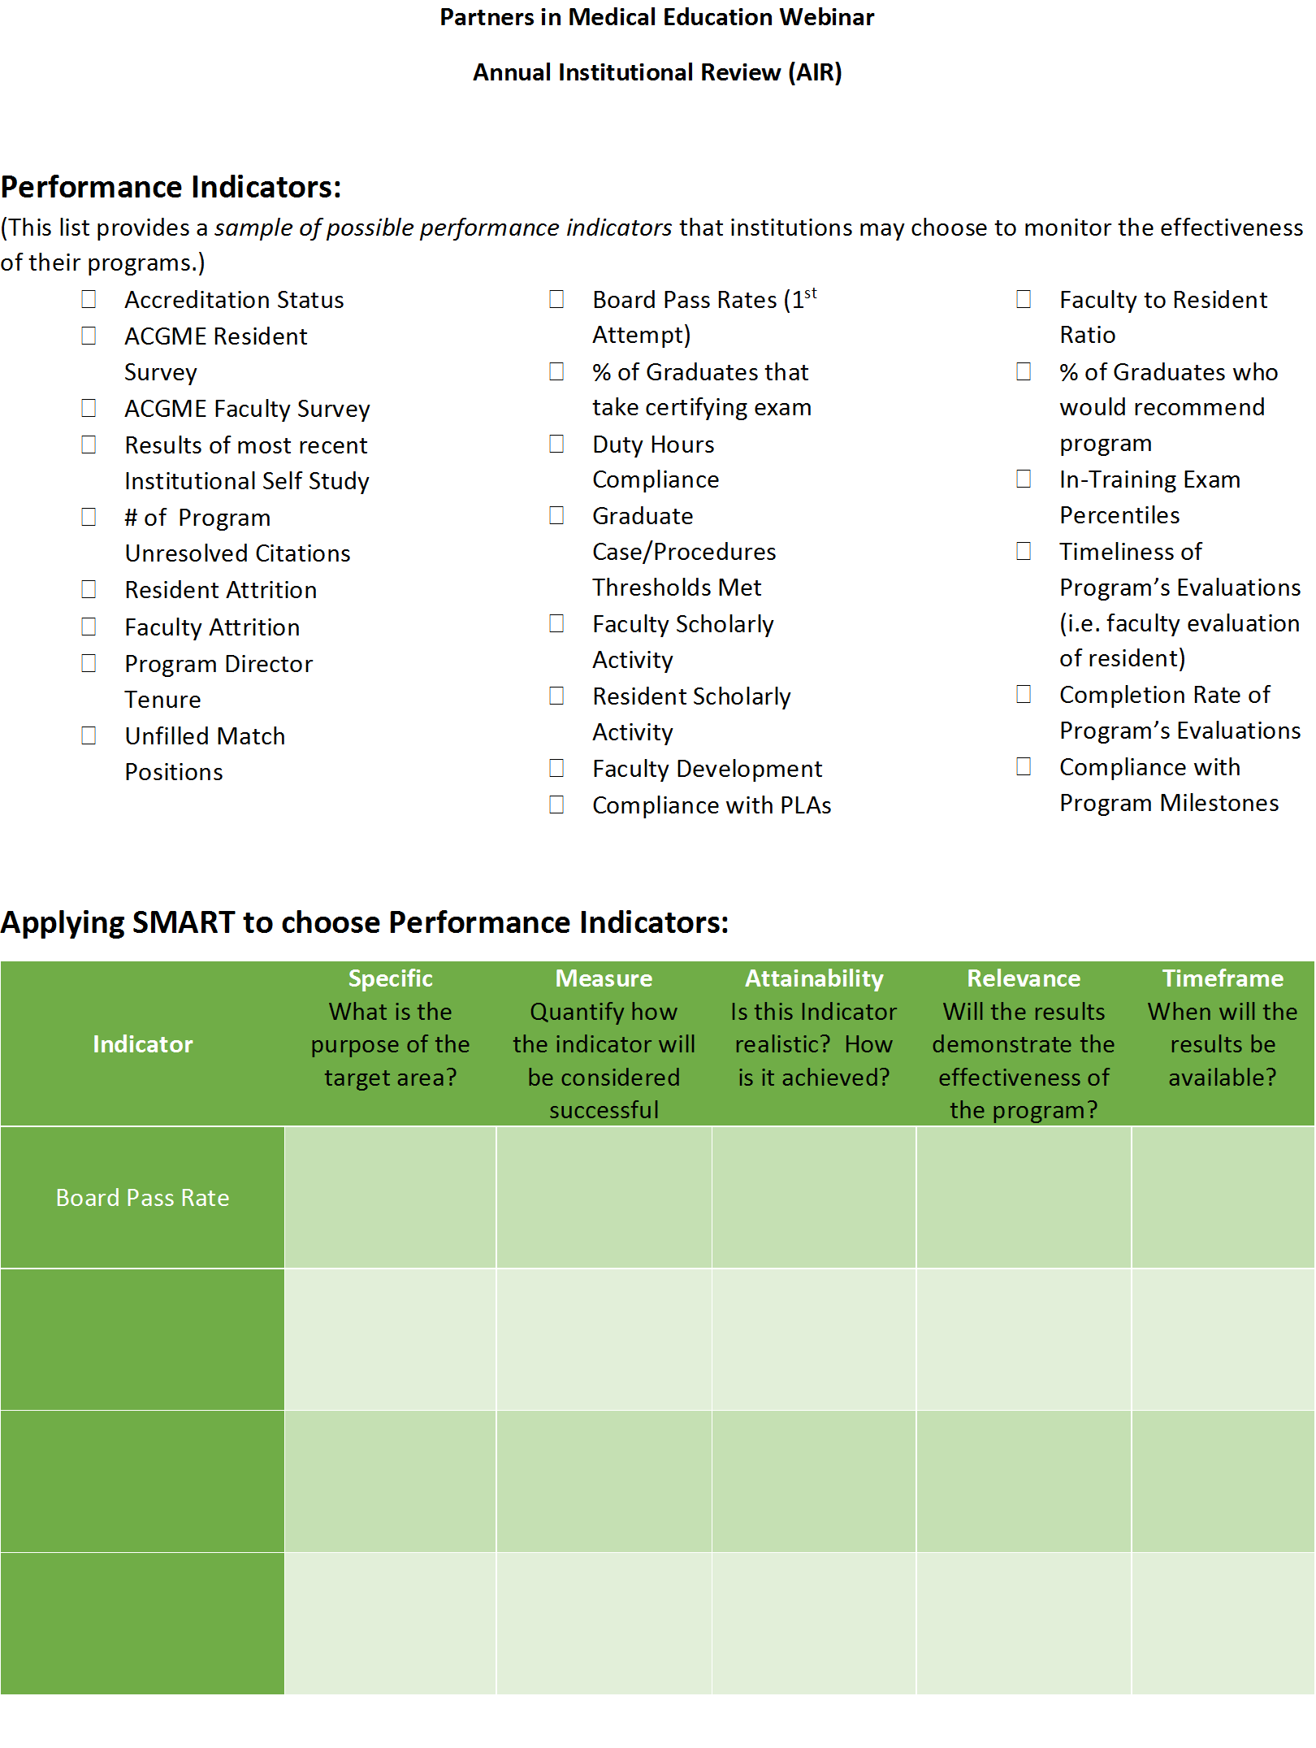
Performance Indicators Worksheet

Slide 20
GMEC Defined Criteria and Parameters
 | GREEN | YELLOW | RED
Accreditation Status | Continued | Warning | Probation
Citations | 100% Resolved | 1-3 Unresolved | >3 Unresolved
ACGME Resident Survey If Improving or Meets National Average → No Flag If Yellow and Red Values are found, only counts as one flag on institutional dashboard | Score of 4.5 or Higher | Score of 4.0 - 4.4 | Score lower than 4.0

Slide 21
Using the PDCA Cycle
Plan: align program activities with goals of institution
Do: collect and analyze data
Check/Study: Did the results match the goals? What changes should be made for next year?
Act: improvement?

Slide 22
Criteria and parameters do not have to be set it stone
Agree upon indicators in a working PowerPoint format during a GMEC

Slide 23
Example of PDCA Application
Resident Scholarly Activity (for Graduates) | 50-100% At least 1 point/Graduate over the length of the training program | 10-49% | <10% Less than 1 point/Graduate over the length of the training program
Research (PubMed ID), Posters (presented at national meetings), Abstracts, Textbook/Chapter, Participation in IRB Approved Research

Slide 24
Last Year’s Resident Scholarly Activity Criteria…
Plan
Program demonstration that scholarly activity is promoted
Institution expects each resident to be engaged in scholarly activity

Slide 25
Last Year’s Resident Scholarly Activity Criteria…
Resident Scholarly Activity | 50-100%
Research (PubMed ID), Posters (presented at national meetings), Abstracts, Textbook/Chapter, Participation in IRB Approved Research
Institution set parameters for resident scholarly activity
Program submitted data indicating what percentage of their residents had met criteria
Do

Slide 26
Last Year’s Resident Scholarly Activity Criteria…
Majority of scholarly activity was produced in the final years of training
Unrealistic to expect the residents in their first year of training would be producing research
Check/
Study

Slide 27
Last Year’s Resident Scholarly Activity Criteria…
Act
Revamp performance indicator to report scholarly activity of graduates.
Track scholarly activity over course of residency to demonstrate overall program promotion of scholarly activity.

Slide 28
PDCA Cycle Applied to Resident Scholarly Activity Indicator
Plan
Check/Study
Act
Program demonstration that scholarly activity is promoted
Institution expects each resident to be engaged in scholarly activity
Institution set criteria for resident scholarly activity
Program submitted data indicating % of residents who met criteria
Majority of scholarly activity was produced in the final years of training
Unrealistic to expect residents in first year of training to produce research
Revamp performance indicator to track scholarly activity over course of residency
Do
Resident Scholarly Activity (for Graduates) | At least 1 point/Graduate over the length of the training program | Less than 1 point/Graduate over the length of the training program
Research (PubMed ID), Posters (presented at national meetings), Abstracts, Textbook/Chapter, Participation in IRB Approved Research

Slide 29
Design an Institutional Dashboard
Provides a visual to identify trends
Track progress over years at institutional and program levels
Use color coding to indicate if goals are met
conditional formatting in excel spreadsheet
Develop data driven action plans (Special Reviews)
Demonstrates GMEC oversight

Slide 30
Sample Institutional Dashboard

Slide 31
Sample Institutional Dashboard Program Comparison by Academic Year

Slide 32
Templates are Essential
Avoid confusion between objective and the questions
Collect enough data but do not over-complicated
Standardize metrics for programs across institution

Slide 33
Using a Template to Analyze ACGME Surveys Across Programs

Slide 35
Grade Scale/ Conditional Formatting

Slide 37
An Example of When to Use Templates:
 | GREEN | YELLOW | RED
Faculty Scholarly Activity | Collective Program Total Average ≥2 points/Core Faculty | Collective Program Total 1-1.9 points/ Core Faculty | Collective Program Total < 1 point/Core Faculty
Core Faculty Participation in at least one: Research (PubMed ID), Posters (presented at national meetings), Abstracts, Grants, Textbook/Chapters, Peer Review Role

Slide 38
Metrics for Scholarly Activity for Core Faculty
Position | Fail |  |  |  |  |  |  | Pass |  |  |  |  | Commendation for Program
Faculty (FTE) | Average <2 points/Faculty Member |  |  |  |  |  |  | Average 2 pts/Faculty Member |  |  |  |  | Average ≥5 pts/Faculty Member
 | One point given for documented activity in each of the following activities over the length of the review cycle:
 | Grants
 | Publications
 | Selected chapters, text books
 | Presentation at local, regional or national meeting
 | Education related service on national committees
Faculty Scholarly Activity that Occurred During Academic Year 7/1/2014-6/30/2015
Definitions: | Pub Med Ids (assigned by PubMed) for articles published in the previous academic year. List up to 4. Pub Med ID (PMID) is an unique number assigned to each PubMed record. This is generally an 8 character numeric number. The PubMed Central reference number (PMCID) is different from the PubMed reference number (PMID). PubMed Central is an index of full-text papers, while PubMed is an index of abstracts. |  |  |  |  |  |  |  | Number of abstracts, posters, and presentations given at international, national, or regional meetings in the previous academic year | Number of other presentations given (grand rounds, invited professorships), materials developed (such as computer-based modules), or work presented in non-peer review publications in the previous academic year. Articles without PMIDs should be counted in this section. This will include publication which are peer reviewed but not recognized by the National Library of Medicine. | Number of chapters or textbooks published in the previous academic year | Number of grants for which faculty member had a leadership role (PI, Co-PI, or site director) in the previous academic year | Had an active leadership role (such as serving on committees or governing boards) in national medical organizations or served as reviewer or editorial board member for a peer-reviewed journal in the previous academic year |  | In the previous academic year, held responsibility for seminars, conference series, or course coordination (such as arrangement of presentations and speakers, organization of materials, assessment of participants' performance) for any didactic training within the sponsoring institution or program. This includes training modules for medical students, residents, fellows and other health professionals. This does not include single presentations such as individual lectures or conferences. | Total Scholarly Activity pts accrued per Faculty Member based on metrics
Core Faculty Member | PMID 1 |  | PMID 2 |  | PMID 3 |  | PMID 4 |  | Conference Presentations (#) | Other Presentations (#) | Chapters / Textbooks (#) | Grant Leadership (#) | Leadership or Peer-Review Role (Y/N) |  | Teaching Formal Courses (Y/N)

Slide 40
Another Example of a Template
 | GREEN | YELLOW | RED
Board Pass Rate Dependent on each Specialty's Requirements | Meets Requirements | Demonstrates Progress | Not Meeting Requirements

Slide 41
Family Medicine ABFM Board Scores
ACGME Board Pass Rate Requirement for Program Specialty:
At least 95 percent of a program's eligible graduates from the preceding five years must have taken the American Board of Family Medicine (ABFM) certifying examination for Family Medicine. At least 90 percent of a program's graduates from the preceding five years who take the ABFM cerifying examination for family medicine for the first time must pass.
Academic Year | # of Graduates | # Who Took Exam (First Time Takers) | % Pass Rate
2014-2015 | 8 | 8 | 100%
2013-2014 | 8 | 8 | 100%
2012-2013 | 8 | 8 | 100%
2011-2012 | 6 | 6 | 100%
2010-2011 | 9 | 9 | 100%
% of Graduates Who Took Exam in 5-Year Period: |  | 100.0%
Program 5-Year Average Pass Rate: |  | 100.0%

Slide 42
Special Review Requirements
The GMEC must demonstrate effective oversight of underperforming programs through a Special Review Process
Utilize data collected from the AIR to approach Special Reviews
The Special Review process must include a protocol

Slide 43
Special Review Protocol
Revamp your old Internal Review Protocol!
Establishes criteria for identifying underperforming programs
Determine who will serve on the special review committee(s)
Results in a report that describes the quality improvement goals, the corrective actions, and the process for GMEC monitoring of outcomes.
Use a template

Slide 44
Example of Types of Special Reviews
Full Special Review
There are ≥3 Red
Limited Special Review
There are ≥4 Yellow
Focused Special Review
There are any Combination of ≥4 Yellow and Red

Slide 46
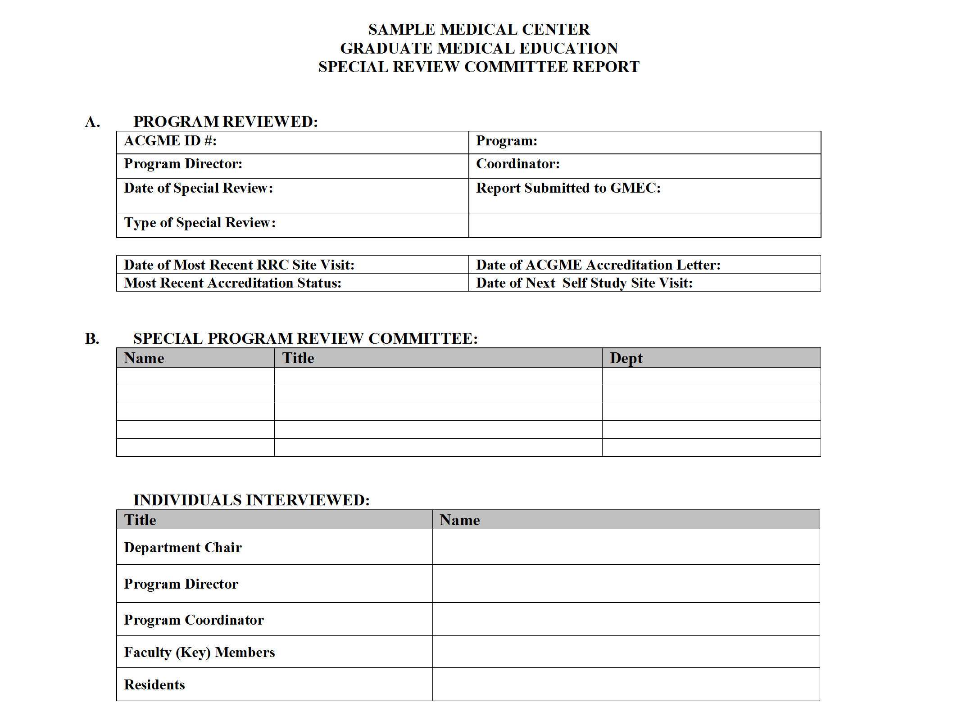
Special Review Report Template

Slide 47
The Role of the GMEC and the Special Review
Involve GMEC in action plan oversight
Provide Systematic Feedback
Identify Effective Programs → who is doing well
Help programs to continue to improve

Slide 48
AIR Report
Compile APE and AIR Data
Use graphs to provide visuals
GMEC must review and approve
Attach to Executive Summary

Slide 49
Executive Summary 101
DON’T
DO
Abstract, introduction, preface, highlights
≤ 4 pages
Use complicated GME terms
Do not bore with minutiae
Miniature version of AIR Report
2 pages
Be clear, concise and provide relevant information about GME
Grab the reader’s attention

Slide 50
AIR Executive Summary
Determined by the GMEC
GMEC activities that are most important to governing body
May include content such as:
demographic information regarding residency programs,
resident participation in patient safety and quality care initiatives
summaries of accreditation letters of notification
Clinical Learning Environment Review (CLER) reports (if received during the reporting period).

Slide 51
Apply the SWOT Analysis?

Slide 52
SWOT Analysis 101
PURPOSE
Recognize internal and external influences on GME
To provide precise information
Develop an action plan for dealing with weaknesses and threats
To minimize or eliminate threats

Slide 53
SWOT Analysis 101
DO
Start with the external threats and opportunities first
Be honest about what you don’t know
Identify how GME at your institution is unique
Identify your reference points
Include the organizational culture, structure, climate and leadership in your assessment
Identify how you can utilize resources and innovate

Slide 54
SWOT Analysis 101 Cont.
DON’T
Get caught up on your own strengths and weaknesses
Focus on just one issue

Slide 55
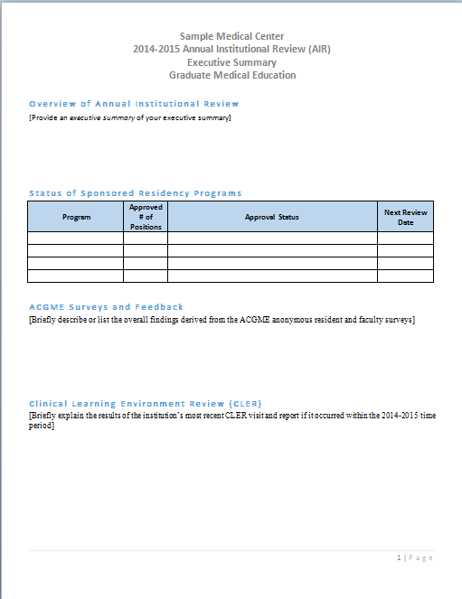
AIR Executive Summary
Template

Slide 56
AIR Executive Summary cont.

Slide 57
Where Do You Begin?

Slide 58
Back to the Requirements
I.B.5.The GMEC must demonstrate effective oversight of the Sponsoring Institution’s accreditation through an Annual Institutional Review (AIR).
The GMEC must identify institutional performance indicators for the AIR which include:
I.B.5.a).(1) results of the most recent institutional self-study visit;
I.B.5.a).(2)results of ACGME surveys of residents/fellows and core faculty members
I.B.5.a).(3)Notification of each of its ACGME accredited programs’ accreditation statuses and self-study visits.

Slide 59
Back to the Requirements Cont.
I.B.5.b) The AIR must include monitoring procedures for action plans resulting from the review.
I.B.5.c) The DIO must submit a written annual executive summary of the AIR to the Governing Body

Slide 60
Back to the Requirements Cont.
The GMEC must demonstrate effective oversight of underperforming Programs through a Special Review process
I.B.6.a) The Special Review process must include a protocol that:
I.B.6.a).(1) establishes criteria for identifying underperformance; and
I.B.6.a).(2) results in a report that describes the quality improvement goals, the corrective actions, and the process for GMEC monitoring of outcomes

Slide 61
Start with the minimum requirements: institutional & program self-studies, accreditation status, ACGME surveys
Identify additional performance indicators and set expectations/goals for the programs to achieve
Standardize the APE to include questions and templates that gather data for all of the performance indicators
Conduct Special Reviews as necessary
Identify underperforming programs that did not meet set expectations
Populate an institutional dashboard based on institutional and APE data
GMEC must monitor ongoing progress of special reviews
DIO submits an Executive Summary of the AIR to the governing body
Review what performance indicators were useful and revamp to improve next year’s results
61
Presented by Partners in Medical Education, Inc. - 2015

Slide 62
Words of Caution
Do not try to be over-achievers too soon
Special Reviews require a lot of time!
Meet the minimums
Follow-up!!!

Slide 63
Partners’ Online Education
Upcoming Live Webinars
Milestones & CCCs
Thursday, September 10, 2015
12:00pm – 1:30pm EST
Special Review Process
Thursday, September 24, 2015
12:00pm – 1:30pm EST
Keep Your Eyes on the Dashboard
Thursday, October 15, 2015
12:00pm – 1:30pm EST
Strategies for Resident Engagement
in Patient Safety & QI
Tuesday, October 27, 2015
12:00pm – 1:30pm EST
Our Summer/Fall 2015 Education
Schedule – AVAILABLE NOW!
www.PartnersInMedEd.com
On-Demand Webinars
Self-Study Visits
Introduction to GME for
New Program Coordinators
Milestones & CCCs
GME Financing – The Basics
Single Accreditation System
The IOM Report
Institutional Requirements: What’s New?
Contact us today to learn
how our Educational Passports can save you time & money!
724-864-7320

Slide 64
Partners in Medical Education, Inc. provides comprehensive consulting services to the GME community. For more information, contact us at:
724-864-7320
Info@PartnersinMedEd.com
www.PartnersInMedEd.com

