Slide 1
Getting the Most Out of Your Resident Interview
Tori Hanlon, MS, CHCP
Consultant, Partners in Medical Education

Slide 2
Introducing Your Presenter…
Tori Hanlon, MS, CHCP
GME Consultant
Over 11 years working in Medical Education
Bachelor’s in Health Services Administration
Master’s in Health Administration and Policy
Designated Institutional Official
Experienced in GME at a large academic medical center

Slide 3
Objectives & Goals
Evaluate interview strategies to identify applicants who are the best fit for your program
Identify best practices for conducting resident interviews
Explore ACGME Requirements and how they can assist programs in the interview process

Slide 4
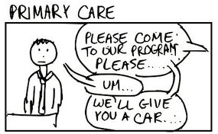
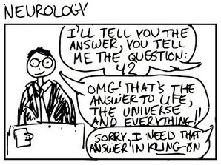
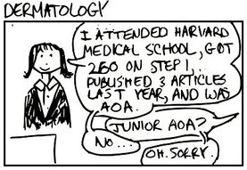
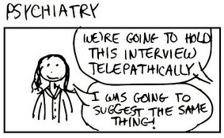

Slide 5
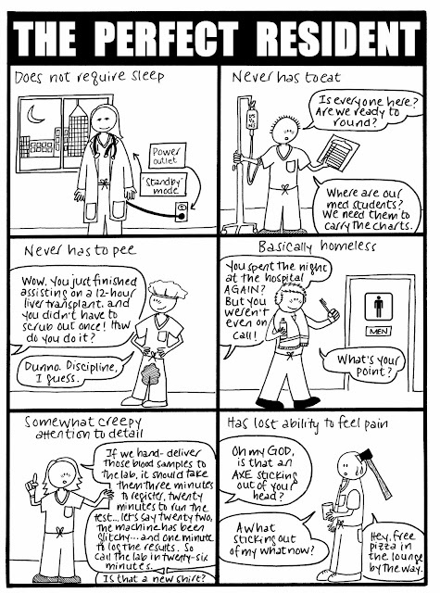

Slide 7
Best vs. Best Fit

Slide 8
What Does “Fit” Mean?
Person-organization fit
Compatibility between an applicant’s personality, attitudes, work and learning style/preferences, and goals AND the organization’s culture
Person-job fit
Compatibility between an applicant’s competencies, knowledge, skills, abilities, and other attributes AND the competencies and characteristics required to learn and perform the job successfully

Slide 9
Assessing Applicants
USMLE Scores, Grades, Deans Letter, LORs, personal statement, Interview
PC
Prof
ICS
PBL
SBP
MK

Slide 10
Self-Study
Use program aims to identify applicants who are the “right” fit for your program
How would you sell your program to someone?
What is special about your program?
What kind of residents are you training?
Where do your residents come from?
What skills/strengths do residents bring with them?
What are you training your residents to do when they graduate?
What kinds of jobs or future training do residents choose after graduation?
What patient population does your program serve?

Slide 11
EPAs
EPA 1: Gather a history & perform a physical exam
EPA 2: Prioritize a differential diagnosis following a clinical encounter
EPA 3: Recommend & interpret common diagnostic & screening tests
EPA 4: Enter & discuss orders & prescriptions
EPA 5: Document a clinical encounter in the patient record
EPA 6: Provide an oral presentation of a clinical encounter
EPA 7: Form clinical questions & retrieve evidence to advance patient care

Slide 12
EPAs
EPA 8: Give or receive a patient handover to transition care responsibility
EPA 9: Collaborate as a member of an interprofessional team
EPA 10: Recognize a patient requiring urgent or emergent care & initiate evaluation & management
EPA 11: Obtain informed consent for tests and/or procedures
EPA 12: Perform general procedures of a physician
EPA 13: Identify system failures & contribute to a culture of safety & improvement

Slide 13
Milestones
Use to guide and set expectations of incoming residents
Analyze Milestones data for interns
Focus on Milestones associated with non-cognitive competencies
Professionalism
Interpersonal & communication skills
Practice-based learning & improvement

Slide 14
CPRs
Patient safety
Quality improvement
Supervision & accountability
Professionalism
Well-being
Transitions in care

Slide 15
Interview Structure
Structured Interviews | Unstructured Interviews
Standardization (same questions, same opportunities) | Lack of standardization in questions and evaluation process
Improves reliability and validity | Greater susceptibility to bias
Resources needed for training interviewers | Little planning needed
May allow better assessment of competencies | May allow more positive applicant reactions when probing questions are asked

Slide 16
Interview Questions
Behavioral Questions | Situational Questions
Ask about past behaviors and experiences | Ask what one would do in hypothetical situation
Tend to better measure personality traits | Tend to better measure job knowledge (PC, MK)
Reliable and valid but may have slightly higher validity | Reliable and valid

Slide 17
Interview Questions
Behavioral Question | Situational Question
“Tell me about a time when you observed, or were a part of a patient safety event, or potential event. What was the event, what did you do, and what was the outcome?” | “While working on the floors, you suspect another resident may be too fatigued to work and care for patients. What would you do?”

Slide 18
Interview Questions
Questions should be job-related
Determine what traits/competencies to measure
Communicate resident selection criteria to interview committee
Avoid potentially discriminatory questions

Slide 19
Areas to Avoid in Interview
Race
Ethnicity
Marital status
Children
Religion
Disability
Age
National origin
RANK LIST

Slide 20
Other Considerations
Program website
Rank list
Structure of the interview day
Telephone/videoconferencing interviews

Slide 21
Questions?

Slide 22
References
Association of American Medical Colleges. (2016, September). Best Practices for Conducting Residency Program Interviews. Washington, DC: Author.
Association of American Medical Colleges. (2014,). Core Entrustable Professional Activities for Entering Residency. Washington, DC: Author.
Ayogu, N., Bortoletto, P. &Hariton, E. (2016). Residency Interviews in the 21st Century. Journal of Graduate Medical Education, 8(3), 322-324. https://doi.org/10.4300/JGME-D-15-00501.1
Brady, D.W., Davis, K.R., Hemphill, R.R. & Santen, S.A. (2010). Potentially Discriminatory Questions During Residency Interviews: Frequency and Effects on Residents’ Ranking of Programs in the National Resident Matching Program. Journal of Graduate Medical Education, 2(3), 336-340. https://doi.org/10.4300/JGME-D-10-00041.1
Burkhardt, J.C. (2015). What Can We Learn From Resident Selection Interviews? Journal of Graduate Medical Education, 7(4), 673-675. https://doi.org/10.4300/JGME-D-15-00403.1
Chiang, S., Houmard, B.S., Kim, S., Manyak, A., Oberoi, S. & Stephenson-Famy, A. (2015). Use of the Interview in Resident Candidate Selection: A Review of the Literature. Journal of Graduate Medical Education, 7(4), 539-548. https://doi.org/10.4300/JGME-D-14-00236.1
Cullen, M.J. & Marcus-Blank, B. (2015, February). Using Structured Interview Questions During the Residency Selection Process. PowerPoint presentation at the 2015 ACGME Annual Educational Conference, San Diego, CA.

Slide 23
Upcoming Live Webinars
APE for New Program & AOA Transitional Programs Tuesday, September 12, 2017
12:00pm – 1:00pm EST
The Millennial Learner Tuesday, September 26, 2017
12:00pm – 1:00pm EST Quality Improvement: Are You Meeting the New Requirements Tuesday, October 10, 2017
12:00pm – 1:00pm EST
2017 Common Program Requirements Update Thursday, October 19, 2017
12:00pm – 1:00pm EST
www.PartnersInMedEd.com
Partners® Snippets
On-Demand Webinars
Using #SocialMedia and Technology in #GME
Leading the Team: Project Management Basics
What do They Do Up There in the GME Office?
Breaking Bad News to Residents: A Five Stage Process for Giving Instructive Feedback AOA to ACGME – What are you Waiting For? GMEC & Program Oversight
Lean Six Sigma for GME Support Staff
Contact us today to learn
how our Educational Passports can save you time & money!
724-864-7320

Slide 24
Partners in Medical Education, Inc. provides comprehensive consulting services to the GME community.
Partners in Medical Education
724-864-7320 | info@PartnersInMedEd.com
Tori Hanlon, MS, CHCP
tori@partnersinmeded.com
www.PartnersInMedEd.com

