Slide 1
Annual Program Evaluations for New Programs and AOA Transition Programs
Heather Peters, M.Ed, Ph.D
GME Specialist

Slide 2
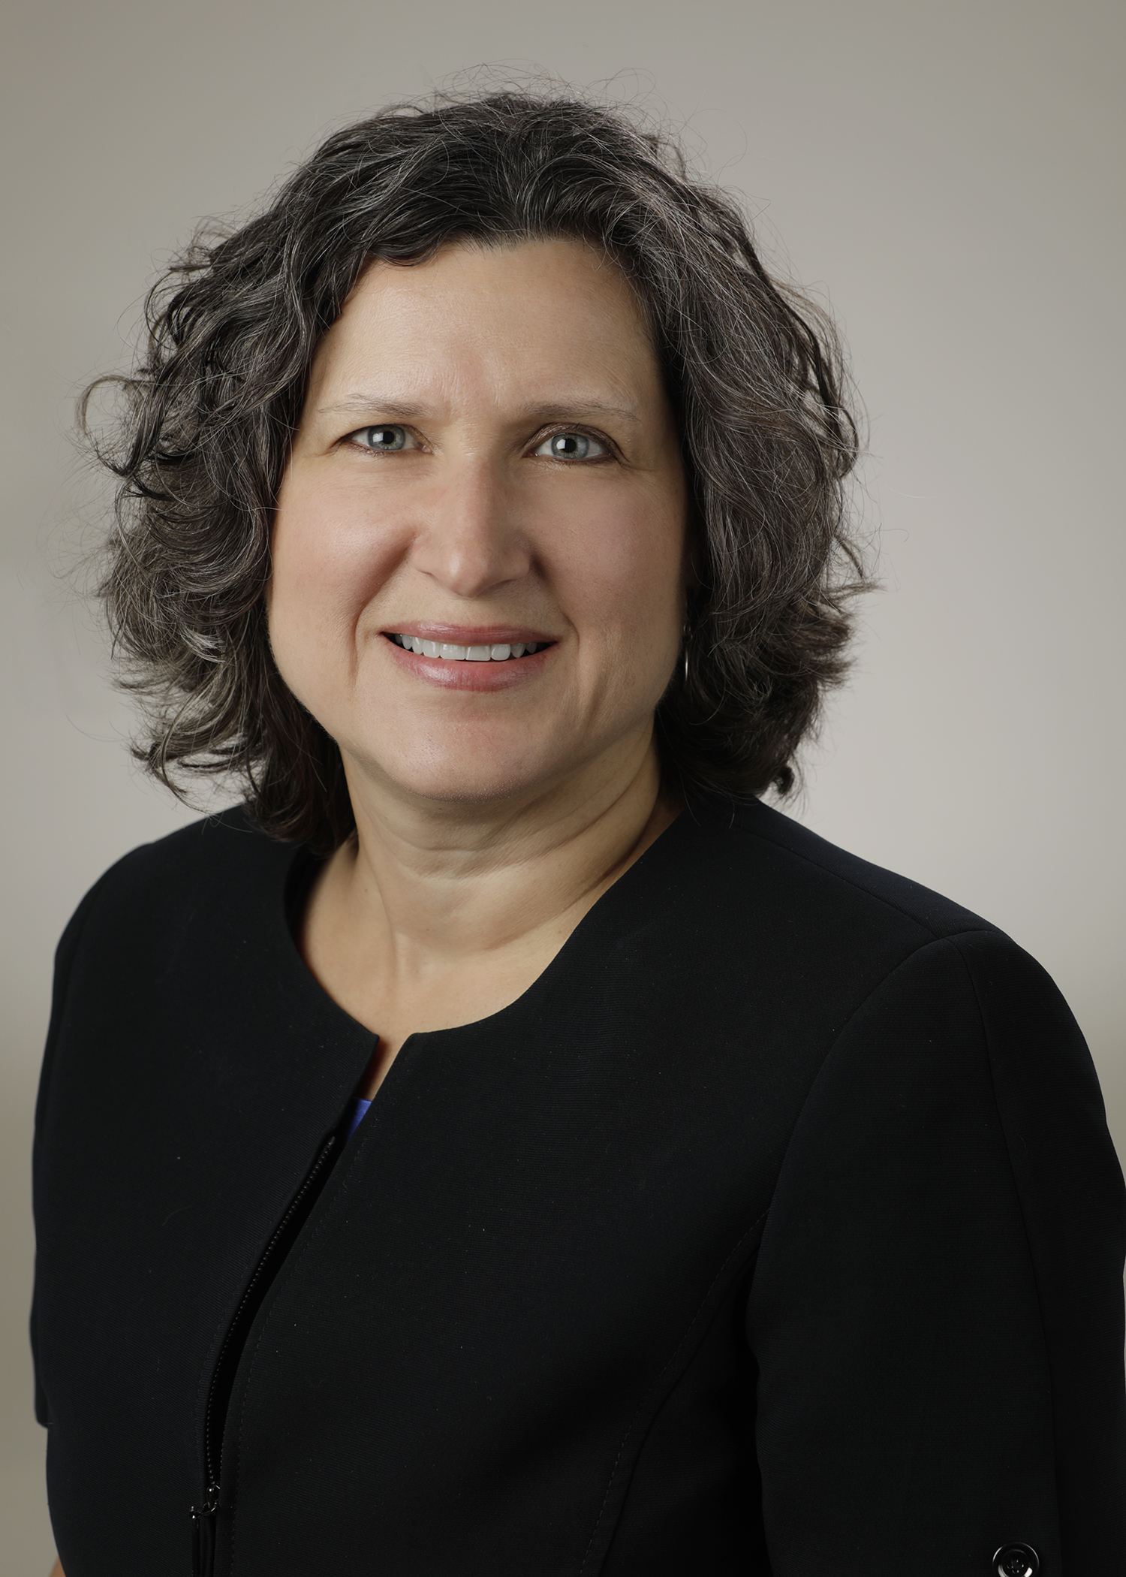
Introducing Your Presenter…
Heather Peters, M.Ed, Ph.D
GME Consultant
DIO & GME Specialist
Seasoned speaker at ACGME & sub-specialty national meetings
Institutional and Program accreditation experience
3 decades in education; Masters of Education in curriculum & evaluations, PhD concentration in secondary education & adult learning theories

Slide 3
Objectives & Goals
Discuss the elements and purpose of the Annual Program Evaluation (APE)
Identify challenges and best practices for the APE, including creating and monitoring action items
Provide a charter for the PEC (Program Evaluation Committee) that will provide direction for executing successful Annual Program Evaluation
Demonstrate how the APE provides information to the Annual Institutional review (AIR)
Notes:
Welcome to today’s webinar.
These are the objectives for today.
We will start off by laying a foundation for the Annual Program Evaluation process. If you are brand new to ACGME and trying to wrap your arms around the APE process, this webinar is definitely for you.
But beyond laying the foundational knowledge, we will also go into the challenges of the APE which means this webinar will also be beneficial to those who have been working on the APE for a couple of years now.
I often hear from people that the action items aspect of the APE is the part of the process that they find most challenging so will spend time looking at the element of the process in depth.
Then there is the driver of the APE, that being the PEC. That group is responsible for the APE and so some discussion of PEC best practices and a possible charter will follow.
Last of all we will do small dip into how the APE informs the AIR or Annual Institutional Review. We are not programs that operate with full autonomy as we are all under a sponsoring institution in the Next Accreditation System. And along with that we will touch very briefly on the Self Study process. By understanding where we want to be in 5 years, will help us develop a better process today.

Slide 4
The Basics of The APE
ACGME Requirements
Challenges to an effective APE
Best Practices for the APE
A potential 3 build-out plan
The purpose of internal surveys
Scheduling the APE
Tools to assist with the analysis phase of the APE
Notes:
So let’s start with the basics of the APE.
As with any ACGME concept, we base our APEs on the ACGME requirements themselves.
Then we will look at challenges and best practices.
I have provided a template for a 3-year build out for new programs and programs that are transitioning from AOA.
We will spend some time looking at the role of the internal survey for residents and faculty
Next is a some suggestions for scheduling the APE process, which has also been provided as a handout.
Lastly, in this section we will look at 2 tools that can be used during the analysis phase of the APE

Slide 5
ACGME Requirements
V.C. Program Evaluation and Improvement
The program must monitor and track each of the following areas:
resident performance;
faculty development;
graduate performance, including performance of program graduates on the certification examination;
program quality; and,
Residents and faculty must have the opportunity to evaluate the program confidentially and in writing at least annually, and
The program must use the results of residents’ and faculty members’ assessments of the program together with other program evaluation results to improve the program.
progress on the previous year’s action plan(s).
Notes:
So here are the requirements directly from the Common Program Requirements. All specialties follow these same requirements.

Slide 6
Challenges
Determining the data that is useful for your program
Providing enough time to gather data (particularly internal survey data)
Changing the format and items collected each year
Not following up on action items during the year
Notes:
So let’s start right off with the challenges that are common to the APE process.
So one of the first challenges that needs to be discussed is determining the data that is useful for your program. Data is the foundation for the annual program evaluation process. It’s all about data. If we rely too much on perception and don’t balance that with data, you can get off track very easily. Just as we use data to evaluate how the resident or fellow is performing, we will need data to see how the program is performing. For a list of possible data points, see the handout provided. We will look more at data points when we look at some APE templates and the AIR.
Another challenge is providing enough time to gather data (particularly internal survey data). Internal reviews are a required element of the APE process. The requirements state that residents/fellows and faculty have to provide written comments annually. One of the elements required of any new program application is a program evaluation so this is something that ACGME believes is very important. Creating internal surveys is a time-consuming project and the PEC should drive this activity.
Action items, which we will go into more detail in few slides, has to be followed up throughout the year by the PEC/faculty. If the action plans are only reviewed once a year at the time of the APE, it is difficult to determine if we have made enough progress to consider whether to consider the item resolved or if it needs to be carried over to the next year. I have provided a form that shows how you can track your action items during the year so that small increments can be noted.

Slide 7
Best Practices
Using the APE to highlight successes as well as determine program needs
Involving the entire program (residents, faculty, staff, other departments)
Creating a mission and key distinguishing AIM statements (we will discuss this more during the Self Study piece) to drive the data collection
Taking the long view to program improvement
Following up with the PEC throughout the academic year to ensure that progress is being made on action items
Notes:
Using the APE to highlight successes as well as determine program needs
If we only focus on the weaknesses and challenges during the APE process, this process will become something that everyone dreads. It’s important to celebrate successes during the APE.
Involving the entire program (residents, faculty, staff, other departments)
Use the APE to bring some unity to the entire program. When you have the APE meeting which should become an annual date on the program calendar where everyone is included. Use a didactics time and invite everyone. Any person who interfaces with the trainees. One of the surgery programs I was a faculty for used to have at least 60 people in attendance at the APE.
Creating a mission and key distinguishing AIM statement (we will discuss this more during the Self Study piece) to drive the data collection
Taking the long view to program improvement
If we take the long view to program improvement, we won’t get swayed by small setbacks that are bound to happen on an annual basis. Or get disenheartened by the murmurings of one resident or faculty members.
Following up with the PEC throughout the academic year to ensure that progress is being made on action items
We touched on this already, but it’s really important to follow up on the action items in the PEC meetings throughout the year. A good way to ensure you do this is use the action plans as the either the first item on the PEC agenda or the entire agenda for the PEC. Either way, it’s important to continually follow up on action plans during the year so that progress is documented.

Slide 8
3 Year Build Out Plan
Phase I
Essentials for aligning with the institutional AIR
Phase II
Mission Statement and SWOT
Phase III
Providing more data about each rotation; including internal surveys
Phase IV
Providing data that is specific to your specialty; starting to track data related to your AIMS
Notes:
Three year build-out plan
While its not a requirement, and you don’t have to follow this suggestion.
I have provided a set of handouts that details a three-year buildout of annual program evaluations.
It’s tempting to ask programs to dive in and meet every element of a program evaluation, but sometimes it works better to build up over time and feel successful as you master each step along the way. I would posit that the end goal is to embrace the annual program evaluation and not necessarily be able to do everything just perfectly from day one. I would particularly recommend this approach if you are an AOA transition program or if you are a brand new residency program.

Slide 9
Internal Surveys
Why do internal surveys?
What should comprise an internal survey?
How to trend internal survey data
Be careful who sees “raw comments”
Don’t get distracted by “one off” comments -- “lack of supervision (5)”
Beware of the “soapbox”
Notes:
Internal Surveys
Why do internal surveys?
One of the elements of the effective APE is the internal surveys. It is a requirement that residents and faculty provide written comments about the program. So this is the reason that we need to complete internal surveys.
What should comprise an internal survey?
There are certain elements that should be included in the survey. Those include didactics, participating site evaluation, issues from ACGME surveys
How to trend internal survey data
Be careful who sees “raw comments”: It is important to keep the information/comments on the surveys confidential. Since people can easily be identified by their raw comments, it is important to trend comments before any versions of an APE go out for public consumption. The number of people who see the raw comments should be limited to those in leadership. I once hahatd a program really create a huge issue by distributing their raw program evaluation, with all the original comments. It took years before the residents and the faculty were okay about putting comments on the APE evaluation after that.
Don’t get distracted by “one off” comments
Along with trending comments so that they aren’t identifiable is to only include comments that really do reflect a trend. It’s easy to get caught up in the “one off comments” of the grumbler in the group. But remember, one person does not reflect a trend. I often number the amount of times a particular subject is mentioned with a brief descriptor when I am trending comments. For the example I have provided, the idea of lack of supervision was discussed by 5 people. While they each said something different perhaps, the idea is that there is a lack of supervision that is being discussed by 5 people. Then in the analysis stage, you can go back and dig into when and why there is this perception of lack of supervision.
Beware of the “soapbox”
Some residents and faculty will use the annual program evaluation as an opportunity to ‘dump’ their frustrations and go on and on in their comments. Or they may call out a particular faculty member or a peer. These comments should not appear in the trended version of the program evaluation data. The leadership should follow up if there seems to be an issue that needs to be investigated.

Slide 10
Scheduling
APEs take several months to put together
Someone in your program has to be the “one in charge” (Program Director & Coordinator Team)
See sample timeline
Notes:
Scheduling the annual program evaluation
It takes months to put together an effective, data-driven program evaluation. I have provided the template of the timeline that I followed when I was managing five programs simultaneously.
If we look at the timeline, you can see that it takes about 5 months from the start of the process to when the annual program evaluation takes place. The most time-consuming aspect is the internal surveys.

Slide 11
Tools For The APE
Getting to the Root Cause:
The 5 Whys
The Fishbone Diagram (Ishikawa)

Slide 12
Activity 1: Practice with the 5 whys
Problem Statement:
1. Why
2. Why
3. Why
4. Why
5. Why

Slide 13
Practice With The “Fishbone diagram”
Sample Text
Sample
Text
Sample
Text
Another Sample Text
Another Sample Text
Another Sample Text
Another Sample Text
Another Sample Text
Sample
Text
Sample
Text

Slide 14
ACTION PLANS

Slide 15
Basics of Action Items
ACGME Requirements
Ensuring Robust Action Plans
Tool: Voice of the…
Best Practices

Slide 16
ACGME Requirements
V.C. Program Evaluation and Improvement
The PEC must prepare a written plan of action to document initiatives to improve performance in one or more of the areas listed in section V.C.2., as well as delineate how they will be measured and monitored.
The action plan should be reviewed and approved by the teaching faculty and documented in meeting minutes.

Slide 17
Ensuring Robust Action Plans
The categories of the APE should be reflected in the action plans
Resident performance (milestone data, rotation data, in-training examination data)
Graduate performance (board examination data, alumni surveys, placement of graduates)
Faculty development (faculty surveys, faculty development activities)
Program quality (ACGME surveys, internal surveys)
Do your actions plans include at least one from each category?

Slide 18
TOOL: Voice of the…
Trainee Comment (What are they saying?) | Gathering More Understanding (Why are they saying it?) | Trainee Needs (What do they want/need?)
The residents stated on the program evaluation survey that the supervision is only sufficient “sometimes” | A focus group was held to discuss why the residents stated that supervision was sufficient “sometimes.” Comments made during the focus groups include: Some faculty do not provide supervision and residents are often left on their own; this seems to be faculty that are also more disengaged in teaching overall Some rotations (PICU, NICU and wards) do not have consistent supervision Most of the core faculty provide more than adequate supervision | The residents need supervision that is consistent across rotations and faculty members, whether core or non-core. The supervision policy needs to be reinforced and faculty need to be accountable for patient safety reasons as well as resident well-being reasons.

Slide 19
Best Practices
Don’t choose too many – it’s better to make progress on few items, than accomplish nothing because you are going in too many directions
Measurements – it’s essential to think about how to measure success
PECs should review the action items throughout the year – use it as your agenda for PEC meetings

Slide 20
Annual Institutional Review

Slide 21
AIR (ANNUAL INSTITUTIONAL REVIEW)
List Accredited Programs | Trainees Filled/ Approved | Match Fill Rate 2016/17 AY | % filled | Status Effective Date | Site Visit Date | ACGME Accred Status | Decision(s): Program Commended/Areas for Improvement/ Concerning trends | Cert Exam Pass Rate (Board report) | # of Citations | ACGME Resident Survey | ACGME Faculty Survey | Duty Hour Comp: Total # Violations
Institution |  |  |  | 4/27/2016 | Not sched | CA | Commended; Citation: oversight of Residencies |  | 1
Int. Med. - Cat/Prelim | 80/92 | 97% | 100% | 1/15/2016 | Not sched | CA | Commended; Citation: concern for duty hr. compliance | 86% | 0 |  |  | 41
IM – Endocrinology | 2/3 | 100% | 67% | 7/1/2015 | Not sched | CA | -- | 100% | 0 |  |  | 0
IM – Gastroenterology | 6/6 | N/A | 100% | 7/1/2015 | Not sched | CA | -- | 86% | 0 |  |  | 0
IM – Nephrology | 4/4 | 0% | 100% | 7/1/2015 | Not sched | CA | -- | 86% | 0 |  |  | 0
OB/GYN | 17/17 | 80% | 100% | 2/19/2016 | Not sched | CAW | Citations: volume-Inadequate experience vh,lh,cystos; evaluation of residents; duty hours; Responsibility of PD | 61%/50% Written/oral | 7 |  |  | 2
Ophthalmology | 13/12 | 100% | 108% | 3/31/2016 | 2/22/2016 | CAW | Citation: Board scores; Concern for Clinical Experience | 35% | 1 |  |  | 0
Pediatrics | 29/30 | 100% | 97% | 1/28/2016 | 3/18/2015 | CA | Citation: Board pass rate 45.45%, | 45% | 1 |  |  | 13

Slide 22
PEC (Program Evaluation Committee)

Slide 23
Best Practices of PEC
ACGME Requirements
Purpose of PEC
Challenges
Best practice for the PEC

Slide 24
ACGME Requirements
V.C. Program Evaluation and Improvement
The Program Evaluation Committee:
The program director must appoint the Program Evaluation Committee (PEC)
must be composed of at least two program faculty members and should include at least one resident;
must have a written description of its responsibilities; and, should participate actively in:
planning, developing, implementing, and evaluating educational activities of the program;
reviewing and making recommendations for revision of competency-based curriculum goals and objectives;
addressing areas of non-compliance with ACGME standards; and,
reviewing the program annually using evaluations of faculty, residents, and others, as specified below.
V.C.3.b) There must be regular meetings during the academic year of the program leadership, including select core faculty members and residents, to review program outcomes and develop, review, and follow-through on program improvement plans. (Detail)

Slide 25
Purpose of PEC
Guide the APE
What is in the APE
When/how is it conducted
Reviews the data
Follows up on the action items
Keeps an eye on the curriculum (goals and objectives, comments from residents about rotations/services, procedural numbers obtained on the rotation)
A venue for implementing change

Slide 26
Challenges
Too much to do for one meeting a year
Can lose focus if not directed
Can become a “gripe session”
Does not represent the major services

Slide 27
Best Practices
Meet as many times a year as necessary to review the curriculum and rotations on a regular basis
Have a schedule for the reviews
Service chiefs or Rotation directors can attend the meeting that discusses their service/rotation
Create a template for reporting on rotations/services so that the data is collected and reviewed consistently
Use the action items as the agenda for the meeting or at least the first item on the agenda so that they are looked at frequently

Slide 28
Site Visit Documentation
Written description of Program Evaluation Committee (PEC):
membership,
evaluation and tracking protocols,
resident evaluations of rotations/assignments,
development of written Annual Program Evaluation (APE), and
action plans resulting from the APE

Slide 29
SELF STUDY

Slide 30
Purpose
The 10 year Self-Study visit is based on a comprehensive self-study, which includes a description of how the program or sponsoring institution creates an effective learning and working environment, and how this leds to desired educational outcomes, and an analysis of strengths, weaknesses, and plans for improvement. Rationale: A standards and citation-based approach offers limited benefits for the majority of programs on Continued Accreditation¹
¹Excerpted from: Byrne LM, Miller SM, Nasca TJ. Implementing the Next Accreditation System: Results of the 2014-2015 Annual Data Review. J Grad Med Educ. 2016 Feb;8(1):118-123

Slide 31
Elements of the self study: A 5 year “look back” and a 5 year “look forward” What will take this program to the next level?
Program Description
Succinct description of the program
Program AIMS
Goals of the program
What does the program strive to “produce”
Activities in furtherance of the AIMs
Listing of actions or projects aligned with AIMs
An environmental assessment
SWOT
Notes:
When we ask this question of what will take this program to the next level we are actually asking several questions:
What does the next level look like
How do we get there? And when do we expect to get there?
What help, resources, etc. are needed?
The self-study is a catalyst for change
The focus is on the long-term and on sustainability
If you have been in GME for any amount of time, you are aware, that as hard as it to get a program up and running and fully accredited, it’s even more of a daunting task to keep that program running in a upward trajectory.

Slide 32
Approximate Timeline for Self Study/10 Year Site Visit
 | J | F | M | A | M | J | J | A | S | O | N | D | J | F | M | A | M | J | J | A | S | O | N | D
Ph.1
Ph.2
Ph.3
Phase 1: Self Study Process
Phase 2: Preparation for 10 Year Site Visit
Phase 3: 10 Year Full Accreditation Visit

Slide 33
Write down your “aha” thoughts

Slide 35
Upcoming Live Webinars
The Millennial Learner Tuesday, September 26, 2017
12:00pm – 1:00pm EST Quality Improvement: Are You Meeting the New Requirements Tuesday, October 10, 2017
12:00pm – 1:00pm EST
2017 Common Program Requirements Update Thursday, October 19, 2017
12:00pm – 1:00pm EST Bullying in the Workplace Thursday, November 2, 2017
12:00pm – 1:00pm EST
www.PartnersInMedEd.com
Partners® Snippets
On-Demand Webinars
Using #SocialMedia and Technology in #GME
Leading the Team: Project Management Basics
What do They Do Up There in the GME Office?
Breaking Bad News to Residents: A Five Stage Process for Giving Instructive Feedback AOA to ACGME – What are you Waiting For? GMEC & Program Oversight
Lean Six Sigma for GME Support Staff Initial & Pre-Accreditation: Annual Date Updates
Contact us today to learn
how our Educational Passports can save you time & money!
724-864-7320

Slide 36
Partners in Medical Education, Inc. provides comprehensive consulting services to the GME community.
Partners in Medical Education
724-864-7320 | info@PartnersInMedEd.com
Heather Peters, M.Ed, Ph.D
heather@partnersinmeded.com
www.PartnersInMedEd.com

