Slide 1
Bullying in the Workplace
Presented by: Christine Redovan, MBA
GME Consultant

Slide 2
Introducing Your Presenter…
Christine Redovan, MBA
GME Consultant
Seasoned Director of Medical Education and GME Operations
Accreditation and Management success for both ACGME & AOA Programs
ACGME-I Accreditation Expert
Successful Continued Accreditation & New Start-Up Implementation
Focused on continual readiness and offering timely and useful GME resources
17 years GME experience

Slide 3
Goals and Objectives
Recognize bullying behaviors in the workplace
Apply strategies to address bullying in the workplace
Learn how to prevent bullying in the workplace

Slide 4
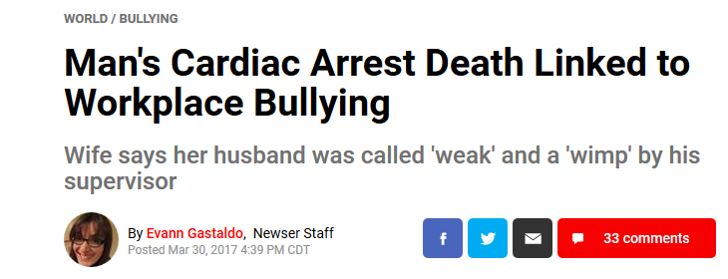
Think about it…

Slide 5
Why Do We Care?
19% of Americans are bullied
19% witness bullying
61% are aware of abuse conduct in the work place
Namie, G. (2017). 2017 workplace bullying institute: US work place bullying survey. Retrieved from http://www.workplacebullying.org/

Slide 6
Why Do We Care?
60.3 million Americans are affected by bullying
Namie, G. (2017). 2017 workplace bullying institute: US work place bullying survey. Retrieved from http://www.workplacebullying.org/

Slide 7
What is Bullying?
No one agreed upon definition.
Repeated mistreatment of an employee by one or more employees; abusive conduct that is: threatening, humiliating, or intimidating, work sabotage, or verbal abuse.
Namie, G. (2017). 2017 workplace bullying institute: US work place bullying survey. Retrieved from http://www.workplacebullying.org/

Slide 8
What is Bullying?
Creates a psychological power imbalance
Causes harm – such as stress, fear, anxiety and sleeplessness
Typically repetitive – occurring at least once a week for a minimum of six months
Wilkie, D. (2016, June 30). Tried-and-true ways to deal with a workplace bully: Real stories from companies around the nation [Blog post]. Retrieved https://www.shrm.org

Slide 9
Harassment vs. Bullying
Harassment
Bullying
Treated poorly because of a protected characteristic or activity
Illegal
Treated poorly not because of a protected characteristic or activity
Not illegal
Robertson, B. (2016, February 29). What is the difference between harassment, discrimination, & bullying in California employment law? [Blog post] Retrieved from https://brobertsonlaw.com/difference-harassment-discrimination-california/
Notes:
f people are bullied because of their race, religion, gender, sex, sexual orientation, perceived sexual orientation, disability, perceived disability, nationality, or a whole host of other reasons, then that behavior is against the law because it is harassment, and the targets of that behavior have legal recourse.

Slide 10
Harassment vs. Bullying
Jane is harassed by John if he calls her a derogatory name because she is a woman.
Jane is bullied by John if he makes fun of her because she is a Cleveland Brown’s fan.
Robertson, B. (2016, February 29). What is the difference between harassment, discrimination, & bullying in California employment law? [Blog post] Retrieved from https://brobertsonlaw.com/difference-harassment-discrimination-california/

Slide 11
Profile of a Bully
70% Male
30% Female
65% Female targets
67% Female targets
35% Male targets
33% Male targets
Namie, G. (2017). 2017 workplace bullying institute: US work place bullying survey. Retrieved from http://www.workplacebullying.org/

Slide 12
Bullying in Medicine
Worldwide problem
Affects targets physically and emotionally
Affects the organization
Not just physicians….nurses, students, residents, ancillary support, administrative support
Widely ignored as part of the medical “culture”
Literature searches indicate bullying is prevalent, on-going and some refer to bullying as an epidemic

Slide 13
Medical Students
Medical student mistreatment first documented, in 1990, by Dr. Silver.
46.4% of medical students reported they were abused at some point during their training.
AAMC graduate questionnaire, in 2013, documented 41.2%.
Little change and continues today. Does bullying play a part in physician suicide?
Silver, H.K. (1990). Medical student abuse: Incidence, severity, and significance. JAMA 26:263(4), 527-532.
Association of American Medical Colleges. (2013). Medical school graduation questionnaire: All schools summary report 2013. Available at www.aamc.org

Slide 14
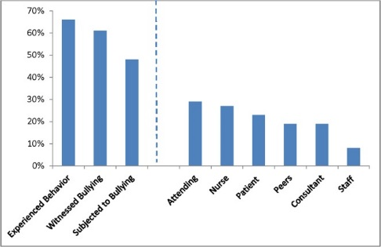
National Resident Survey
Percentage of participants who experienced bullying behaviors, witnessed bullying of colleagues, or were subjected to bullying themselves, and the source of that bullying
66% of respondents experienced bullying behavior
Chadaga AR, Villines D, Krikorian A. (2016). Bullying in the American graduate medical education system: A
national cross-sectional survey. PLoS ONE11(3),1-14. doi: 10.1371/journal.pone.0150246
Notes:
“Experienced behavior” was defined as a participant indicating they had experienced one or more of the specific bullying behaviors while “witnessed” and “subjected” were individual questions in the survey.

Slide 15
Residents (Surgery)
Schlitzkus, L.L., Vogt, K.N., Sullivan, M.E., Schenarts, K.D. (2014). Workplace bullying of general surgery residents by nurses. Journal of Surgical Education 71(6), 149-151 doi: 10.116/j.surg.2014.08.003

Slide 16
ACGME
Institutional and program requirements
2011, 2015, 2017
Questions on resident surveys
Fear of retaliation
What does your survey reveal?
CLER
Focus on learning environment
Physician well-being
Elevated awareness and importance

Slide 17
Recognizing Bullying
Falsely accusing someone of error they did not make
Hostile staring (non-verbal intimidation)
Unjustly discounting thoughts/feelings/comments in front of others
Giving the silent treatment
Making up rules
Constant and harsh criticism
Isolating a co-worker; gang-up on a co-worker
Yelling/screaming, creating a scene to humiliate another

Slide 18
Effects of Bullying
On Individual
On Institution
High blood pressure
Heart palpitations
Anxiety
Sleep difficulty
Concentration difficulty
Depression
Increased turnover
Lower productivity
Increased absenteeism
Decreased morale
Increased risk of legal action
Reputation
Recruitment

Slide 19
Effects of Bullying
On Patient Safety
Disrupts teamwork and communication
Leads to errors
Leads to adverse events
Loss of concentration
Loss of information during transition of care
Schlitzkus, L.L., Vogt, K.N., Sullivan, M.E., Schenarts, K.D. (2014). Workplace bullying of general surgery residents by nurses. Journal of Surgical Education 71(6), 149-151 doi: 10.116/j.surg.2014.08.003

Slide 20
Addressing Bullying
Report; Make needs known
Address issue directly
Maintain documentation
Seek assistance
Employee responsibility
Employer responsibility

Slide 21
Preventing Bullying
Workplace policies
Workplace culture
Build employee relationships
Training and development
Foster environments that will not tolerate bullying

Slide 22
Final Thoughts…
Be cognizant of the “bad day”
Be mindful of joking around…stop before it goes too far
Use your GME Office, PD/DIO and HR department for support and questions
Listen to your residents – the ACGME surveys are a great start
Educate, educate, educate
Culture change starts with you!

Slide 23
Questions

Slide 24
Upcoming Live Webinars
Meet the Experts – Fall Freebie Tuesday, November 14, 2017
12:00pm – 1:00pm EST Self Study – Have You Analyzed Your Data Yet? Thursday, December 7, 2017
12:00pm – 1:00pm EST
Creating a Robust Resident Evaluation System Tuesday, December 12, 2017
12:00pm – 1:00pm EST
www.PartnersInMedEd.com
Partners® Snippets
On-Demand Webinars
What do They Do Up There in the GME Office?
Breaking Bad News to Residents: A Five Stage Process for Giving Instructive Feedback AOA to ACGME – What are you Waiting For? GMEC & Program Oversight
Lean Six Sigma for GME Support Staff Initial & Pre-Accreditation: Annual Date Updates Can I Do That? Becoming an Integral Member of the GME Education Team
Getting the Most Out of Your Resident Interview
Contact us today to learn
how our Educational Passports can save you time & money!
724-864-7320

Slide 25
Partners in Medical Education, Inc. provides comprehensive consulting services to the GME community.
Partners in Medical Education
724-864-7320 | info@PartnersInMedEd.com
Christine Redovan, MBA GME Consultant
Christine@PartnersInMedEd.com
www.PartnersInMedEd.com

