Slide 1
”Meet The Experts” Fall Freebie
Heather Peters, M.Ed, Ph.D Christine Redovan, MBA Tori Hanlon, MS, CHCP
Pam Royston, PhD

Slide 2
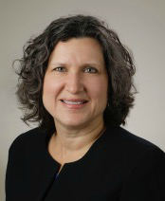
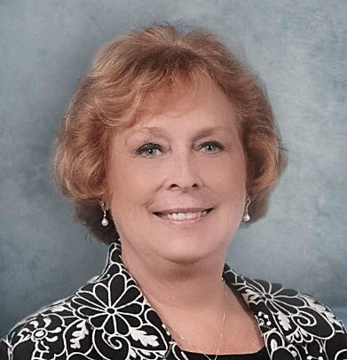
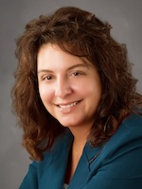
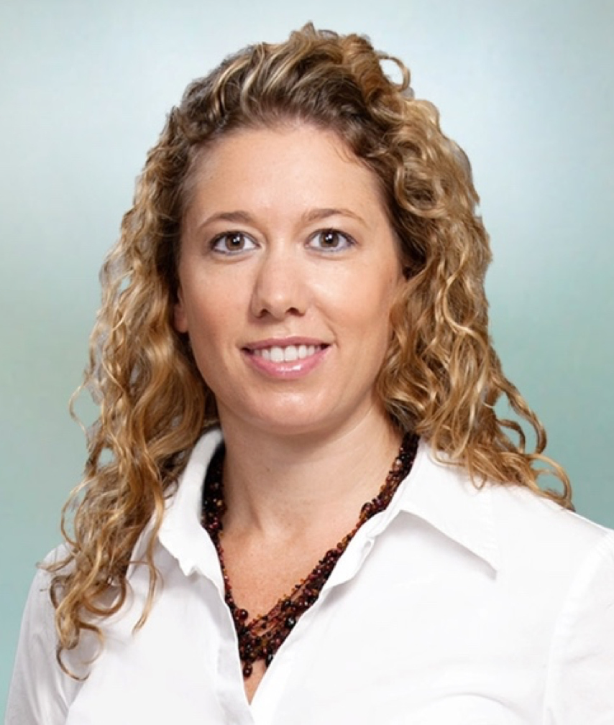
Partners Consulting Team
Heather Peters, M.Ed, Ph.D
GME Consultant
Pamela Royston, Ph.D
GME Consultant
Christine Redovan, MBA
GME Consultant
Tori Hanlon, MS, CHCP GME Consultant
GME Director & DIO
Seasoned speaker at ACGME & sub-specialty national meetings
Institutional and Program accreditation experience
3 decades in education; Masters of Education in curriculum & evaluations, PhD concentration in secondary education & adult learning theories
GME Director & DIO
(GME) program analysis and strategic planning
GME Agreements and Contracts
Certified MBTI Consultant
New residency program development – pre-startup through implementation
GME policy development and integration with HR policy
15+ years GME Operations, Accreditation and Management success
Focused on continual readiness and offering timely and useful GME resources
Over 13 years working in Medical Education
Bachelor’s in Health Services Administration
Master’s in Health Administration and Policy
Designated Institutional Official
Experienced in GME at a large academic medical center

Slide 3
NEW Well-Being Requirements 2017 Common Program Requirements: Section VI Update
Heather Peters, M.Ed, Ph.D
DIO & GME Specialist

Slide 4
Objectives and Goals
Discuss the new well-being requirements in the common program requirements and the proposed changes to the institutional requirements
Provide tools for assessing current well-being structures and planning for expansion at both the sponsoring institution and program level

Slide 5
Philosophy Background & Intent
Italicized Language: Describes the underlying philosophy of the requirements within the section and it not citable
Background and Intent: Provides additional guidance on how to implement the requirements in a manner consistent with the intent

Slide 6
Well-Being “ Physicians need to be trained in a way that considers their well-being over the course of a lifelong career.” ACGME Symposium on Physician Well-Being, 2015
Goals:
Understanding the problem across the continuum
Advising the ACGME Board on how it can be an effective agent of transformational change
Beginning a national dialogue that leads to change in the culture of the clinical learning environment
Beginning ongoing collaborations with other organizations to better the well-being of health care professionals

Slide 7
Well-Being
Residents and faculty members at increased risk for burnout and depression
Psychosocial, emotional, and physical well-being are critical in the development of the competent, caring and resilient physician
Culture of respect and accountability for physician well-being is crucial to physicians’ ability to deliver the safest, best possible care to patients

Slide 8
Well-Being: Program and Sponsoring Institution Responsibilities
Efforts to enhance the meaning that each resident finds in the experience of being a physician, including protecting time with patients, minimizing non-physician obligations, providing administrative support, promoting progressive autonomy and flexibility, and enhancing professional relationships; ^{(Core)} (VI.C.1.a)
Attention to scheduling, work intensity, and work compression that impacts well-being ^{(Core)} (VI.C.1.b)
Evaluating workplace safety data and addressing the safety of residents and faculty members ^{(Core)} (VI.C.1.c)
Policies and program that encourage optimal resident and faculty member well-being ^{(Core)} (VI.C.1.d)

Slide 9
Well-Being: Program and Sponsoring Institution Responsibilities
Residents must be given the opportunity to attend medical, mental health, and dental care appointments, including those scheduled during their work hours ^{(Core)} (VI.C.1.d.(1))
Attention to resident and faculty member burnout, depression, and substance abuse. The program, in partnership with its Sponsoring Institution, must educate faculty members and residents in identification of the symptoms of burnout, depression, and substance abuse, including means to assist those who experience these conditions. Residents and faculty members must also be educated to recognize those symptoms in themselves and how to seek appropriate care ^{(Core)} (VI.C.1.e)

Slide 10
Well-Being: Program and Sponsoring Institution Responsibilities
The program, in partnership with the SI, must encourage residents and faculty members to alert the program director or other designated personnel or programs when they are concerned that another resident, fellow, or faculty member may be displaying signs of burnout, depression, substance abuse, suicidal ideation, or potential violence ^{(Core)} (VI.C.1.e).(1))
Provide access to appropriate tools for self-screening ^{(Core)} (VI.C.1.e).(2))
Provide access to confidential, affordable mental health assessment, counseling, and treatment, including access to urgent and emergent care 24 hours a day, seven days a week ^{(Core)} (VI.C.1.e).(3))

Slide 11
Well-Being: Program and Sponsoring Institution Responsibilities
There are circumstances in which residents may be unable to attend work, including but not limited to fatigue, illness, and family emergencies. Each program must have policies and procedures in place that ensure coverage of patient care in the event that a resident may be unable to perform their patient care responsibilities. These policies must be implemented without fear of negative consequences for the resident who is unable to provide the clinical work. ^{(Core)} (VI.C.2)

Slide 12
Planning Documents for Inventorying and Development of Your Institutional/Program Resources for Well-being
Inventory of Elements of Sponsoring Institution (Handout)
Inventory of Elements of Program (Handout)

Slide 13
Well-Being Resources http://www.acgme.org/What-We-Do/Initiatives/Physician-Well-Being/Education
American Association of Colleges of Osteopathic Medicine (AACOM) “Mental Health Awareness in Osteopathic Medical Education”
Association of American Medical Colleges (AAMC) “Well-being in Academic Medicine”
American Foundation for Suicide Prevention (AFSP) “Physician and Medical Student Depression and Suicide Prevention”
American Hospital Association (AHA) “The Impact of Emotional Intelligence and Resiliency on Health Care Performance” “Forum Focus – Recognizing and Addressing Physician Stress and Burnout to Improve Satisfaction and Patient Care”
Alliance of Independent Academic Medical Centers (AIAMC) “2017 Annual Meeting focusing on resiliency and well-being”
American Medical Association (AMA) “Physician Health” “5 things institutions can do to prevent resident burnout” Articles on physician wellness in AMA Wire “Steps Forward” CME modules “Physician wellness: preventing resident and fellow burnout” “Preventing physician burnout” “Improving physician resiliency”
American Osteopathic Association (AOA) “Watch: Medical students discuss mental illness”
National Collegiate Athletic Association (NCAA) “Mental Health”

Slide 14
Demystifying the “M” in SMART goals
Christine Redovan, MBA
GME Consultant

Slide 15
Goals and Objectives
Use SMART technique to capture APE, AIR and Self-Study goals
Understand measurement in setting goals

Slide 16
Action Plans Are Everywhere!
PEC develops as part of the APE process
GMEC develops as part of the AIR process
GMEC develops as part of CLER process (optional)
Programs use previous action plans to feed self-study process
Programs develop as part of self-study process
We all use whenever we have an improvement to make - work and personal

Slide 17
SMART Outline
Specific. Know what and how.
Measurable. Precise way to record.
Attainable. Visualize the path.
Realistic. Visualize the results.
Timely. Timeline to accomplish.

Slide 18
Measurable
Most important consideration
Identifies how you will record success
How much? How many?
How will I know the goal is accomplished?
What is the metric – numerical or descriptive?
Review 8 rotation goals and objectives
Match in the top 20% of rank list
Implement 4+1 scheduling system by Oct. 1.

Slide 19
Measurable
Not Measurable
Measureable
Write a cookbook
Improve resident survey
Give residents more elective time
Provide better care to patients
Write a cookbook of 100, 5 ingredient or less, Italian recipes
Improve % compliance in supervision by 20% over the next year
Provide residents with four weeks additional elective time during training
Improve patient satisfaction survey score to 90% next year

Slide 20
Examples
Specific | Measurable | Attainable | Realistic | Timely
Lose 5 pounds by January 1, 2018 | -5 pounds as measured by scale -able to fit into new dress w/out Spanx | -cut down on sugar -take stairs instead of elevator -park far away from entrances | -two months is doable -minimal changes required -not a lot of time is invested | Completed by New Years Eve
Provide 70% of residents with practice data | -review resident received at time of semi-annual evaluation -2017 rate was 50% | -make part of monthly residency meeting -have QI person present | National compliance rate is 70%. | Completed in time for the 2018 ACGME survey

Slide 21
Examples
Specific | Measurable | Attainable | Realistic | Timely
100% of residents will be credentialed in central lines by the end of PGY 1 | -Report of credentialed residents at the end of June -3 observed central lines by Dec. -6 observed by May | -video training -two sim lab sessions 1st quarter -use of checklists for faculty -documented observations in RMS | -all faculty are credentialed and can supervise -required for promotion to PGY 2 | End of academic year

Slide 22
SMART Success
Make goals that are meaningful and valuable to you and your program. Ask why it is valuable.
Put goals in writing. State them positively.
Make them visible.
Break out the steps you will take for each goal.
Review often.
Stick with it!

Slide 23
Preparing in the “Off-Season”
Tori Hanlon, MS, CHCP
GME Consultant

Slide 24
Goals and Objectives
To provide programs with guidance on what they can do to better prepare for positive annual accreditations decisions, as well as avoid unexpected site visits.

Slide 25
Continuous Improvement
Programs
Must evolve
and engage in
a cycle of
Continuous Improvement

Slide 26
Where To Start?
APE
ACGME Resident/Faculty Surveys

Slide 27
ADS Annual Update
Documentation in major changes section
Major changes!
Summary of most recent APE action plans
How the program is addressing the ACGME Resident/Faculty Survey results
How the program is addressing any other areas that the ACGME may identify as issues or problem areas
Scholarly activity
Duty hours

Slide 28
SV Document Check List
PLAs
Overall Program G&O
Rotation G&O

Slide 29
Policies
Patient Safety, QI
Supervision, Accountability
Professionalism
Well-Being
Fatigue Mitigation
Transitions of Care
Clinical Experience & Education (formerly duty hours)

Slide 30
Professional Boundaries in GME
Pam Royston, PhD
GME Consultant
DIO/DME Henry Ford Allegiance Health

Slide 31
Learning Objectives
Describe situations placing you at risk stepping over professional boundaries
Recall definition of agent for the organization
Employ phrases to draw professional boundaries

Slide 32
Are you over the boundary?
Indicators may include:
spending more time with this resident than others
having very personal conversations with the resident
receiving calls or texts at home from the resident
developing strong feelings for the resident, “I really like him/her”
doing things for the resident you are not doing for other residents

Slide 33
Balancing Act
Over-involvement – GME staff are too friendly and personally involved
Detachment – resident/fellow feels as if no one cares

Slide 34
Risky Situations
Resident complaints of unfairness, intimidation, or harassment
Faculty
Program Director
Other residents
Resident personal conversations
Leading to impairment
Drinking
Drugs

Slide 35
Your Role in Organization
Agent of the organization
respondeat superior (rehs-pond-dee-at superior) n. Latin for "let the master answer," a key doctrine in the law of agency, which provides that a principal (employer) is responsible for the actions of his/her/its agent (employee) in the "course of employment."
Duties of Agents
Performance
Notification
Loyalty

Slide 36
Agent - Duty of Notification
You may be required by your employer to:
Report hostile or abusive conduct
You may be required by State Licensing or other regulatory bodies to report

Slide 37
Establish Boundaries
Are you venting?
Ask what they can do to improve the situation
Constant complaining creates a downward spiral for you and the resident
Redirect
– you’ve talked about this before and you didn’t change your actions (behaviors)
I am unable to listen to stories about your parting
I will keep your confidence to the extent I am able to do so.

Slide 38
Helpful Phrases
I would like to, but I’m unable to ….
I appreciate you asking me, but I’m unable to ….
I’m going to say no for now and I will let you know if something changes
No, I can’t do that but here is what I can do…..
You’ve mentioned that before have you talked to the Chief Resident, the Program Director……
I’m sorry to interrupt you but I have to a deadline on this project

Slide 39
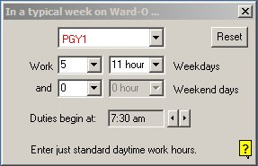
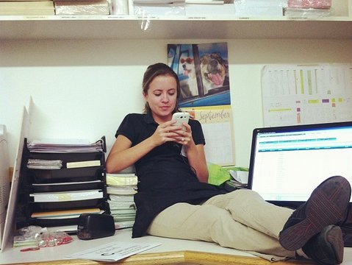
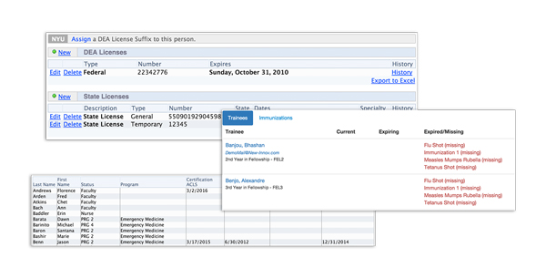
Find the Balance
ZONE OF HELPFULNESS
UNDER-INVOLVED
OVER-INVOLVED
Thank you!

Slide 40
Upcoming Live Webinars
Self Study – Have You Analyzed Your Data Yet? Thursday, December 7, 2017
12:00pm – 1:00pm EST
Creating a Robust Resident Evaluation System Tuesday, December 12, 2017
12:00pm – 1:00pm EST
www.PartnersInMedEd.com
Partners® Snippets
On-Demand Webinars
What do They Do Up There in the GME Office?
Breaking Bad News to Residents: A Five Stage Process for Giving Instructive Feedback AOA to ACGME – What are you Waiting For? GMEC & Program Oversight
Lean Six Sigma for GME Support Staff Initial & Pre-Accreditation: Annual Date Updates Can I Do That? Becoming an Integral Member of the GME Education Team
Getting the Most Out of Your Resident Interview
Contact us today to learn
how our Educational Passports can save you time & money!
724-864-7320

Slide 41
Partners in Medical Education, Inc. provides comprehensive consulting services to the GME community.
Partners in Medical Education
724-864-7320 | info@PartnersInMedEd.com
Heather Peters, M.Ed, Ph.D heather@PartnersInMedEd.com
Christine Redovan MBA christine@PartnersInMedEd.com
Tori Hanlon, MS, CHCP tori@PartnersInMedEd.com
Pamela Royston, Ph.D pam@PartnersInMedEd.com
www.PartnersInMedEd.com

