Slide 1
Transitioning from Residency to Practice
Trish Gallagher, CPMSM, CPCS

Slide 2
Introducing Your Presenter…
Trish Gallagher, CPMSM, CPCS
Director of Professional Affairs at MetroHealth Medical Center in Cleveland, Ohio
Accreditation and Management success for both Joint Commission and NCQA
Credentialing and Privileging Expert
ACCME Expert for Continuing Medical Education
Focused on Peer Review and Professional behavior, bylaws and medical staff organizations
Over 25 years experience in Credentialing and Privileging

Slide 3
Learning Objectives & Goals
Describe a successful credentialing and privileging process
Determining the options of practice, Private Practice vs Hospital Employed Physician
Discover resources and best practices for credentialing and privileging
Discovering a lifetime of growth in all medical practices

Slide 4
Moving from one Umbrella to the next!
ACGME
GME Office
Private Practice
Hospital

Slide 5
Transitioning into a Credentialing and Privileging World!
Employed Staff with a Hospital vs member of a Private Practice
Managed Care Organizations-Establishing patient panel
Accrediting institutions-Who is responsible?
Legal Malpractice Responsibilities
Privileging
Professional Conduct
Licensing
Sanctions/Actions-National Practitioner Data Bank
Board Certification
Bylaws
Private Practice Policies
Proctoring and Competency
Peer Review

Slide 6
What is the definition of Credentialing?
Provider Credentialing is the recognition of professional and technical competence. This process includes the gathering of detailed information on providers of care and the selection of providers for participation based upon compliance with pre-defined standards. This information includes performance as a resident or fellow and your competency of certain procedures.
With the advent of Centers for Medicaid and Medicare (CMS) Standards for hospitals, private practices and managed care, credentialing standards over the years has been intensified.
Joint Commission (TJC) and National Committee for Quality Assurance (NCQA) have monitored these standards for hospitals and managed care organizations.

Slide 7
Current Dimensions of Credentialing and Performance are based on the ACGME Core competencies.
1. Patient care
2. Medical/clinical
Knowledge
3. Interpersonal and Communication
4. Professionalism
5. Systems-based practice
6. Practice-based learning and improvement

Slide 8
Peer Review for Hospitals and Insurance Companies are based on these…..
Performance Improvement
Regulatory
Cultural

Slide 9
Employed by a Hospital
Employed by a Hospital
Employed by a Hospital
Professional Affairs Office serves as the Human Resources
Appointments and Reappointments managed through Medical Staff Office
Graduate, undergraduate and resident and fellow programs managed by GME
Professional Billing managed by Provider Relations Office
Compliance with Medicaid/Medicare CMS Conditions of
Participation (COP)
Legal and Compliance Office
Credentials and Peer Review monitors quality, competency
& performance
Medical Executive Committee serves as authority
Bylaws the book of Rules

Slide 10
New Model for Hospitals
GME Office under the Professional Affairs Office
Advantages Include
Monitoring of procedures
Joint Commission Tracer requirements
Shared resources
Combined recruitment efforts, keeping your talent!
Centralized databases for reporting or verifying
Communication between Attending's and Residents….They should know what Attending's know!

Slide 11
Private Practice
Responsible for policies compliant with State Laws and contracted
managed care organizations.
Admitting privileges with a health system contracted by MCOs.
Professional Billing managed by own billing office or company
Compliance with Medicaid/Medicare CMS, (COPs) Conditions of Participation
Outside legal representatives
Malpractice Insurance Coverage
Monitor own procedures, quality, competency
Salary higher but more out of pocket costs

Slide 12
Now you’re a billing doctor!
Now you’re a billing doctor!
Now you’re a billing doctor!
Hospital | Private Practice
Provider Relations | Staff
Delegated Contracts | Single Credentialing
Coders; EMR; Group billing | Coders; EMR; Self Management
Negotiated Contracts | Self Negotiations
Group Acceptance | Targeted Specialties
CMS helps regulate reimbursement, residents move from census CMS
Payment to pay for performance.

Slide 13
Accreditation Standards for Hospitals.
Medicaid/Medicare CMS
The Joint Commission-Vendor of CMS
National Committee for Quality Assurance
Utilization Review Accreditation Commission
Health on the Net Foundation
Accreditation Commission for Health Care

Slide 14
Accreditation Standards for Private Practice
Medicaid/Medicare CMS - Reimbursement
National Committee for Quality Assurance
Utilization Review Accreditation Commission

Slide 15
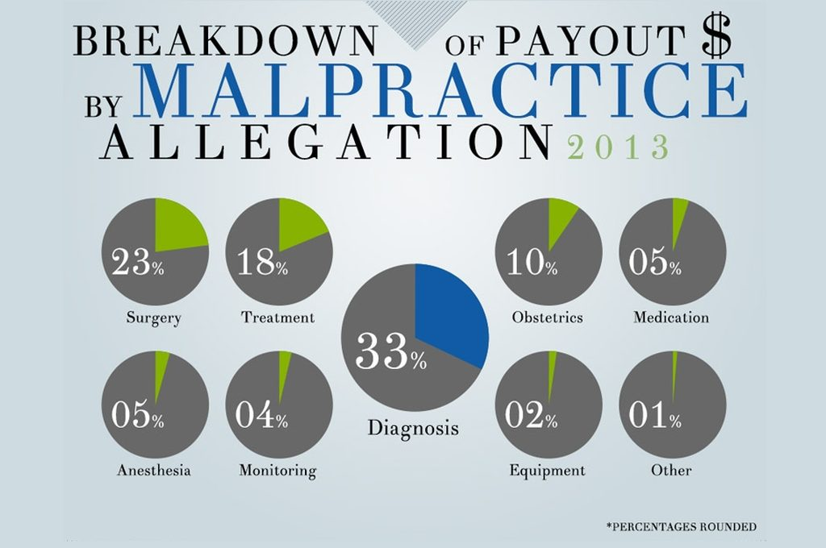
Legal Responsibilities
Hospital | Private Practice
Self Insurance | High Premiums
Group Settlements | Provider Settlements
Tort Controlled (state) | Tort Controlled (state)
Low cost for provider | High cost for practice
National Practitioner Data Bank | National Practitioner Data Bank

Slide 16
What is the National Practitioner Data Bank….
The NPDB is an information clearinghouse created by Congress with the primary goals of improving health care quality, protecting the public, and reducing health care fraud and abuse in the United States. The NPDB collects information on medical malpractice payments and certain adverse actions and discloses that information to eligible entities to facilitate comprehensive reviews of the credentials of health care practitioners, entities, providers, and suppliers. These payments and actions are required to be reported to the NPDB under Title IV of Public Law 99- 660, the Health Care Quality Improvement Act of 1986 (Title IV); Section 1921 of the Social Security Act (Section 1921); Section 1128E of the Social Security Act (Section 1128E); and their implementing regulations found at 45 CFR Part 60.

Slide 17
Do you report Residents?
Entities are required to report malpractice cases that have direct payment on behalf of the resident or fellow or if there is a criminal judgement made against the resident or fellow.
Reports must be submitted to the NPDB when medical malpractice payments are made for the benefit of licensed residents or interns, including those insured by their employers.
If a supervisory practitioner is named in a lawsuit based on the actions of a subordinate practitioner (e.g., a licensed resident or intern), separate reports must be submitted for each practitioner. The report on the supervisory practitioner should be submitted using the same malpractice claim description code used in the subordinate practitioner's payment report. The reporting entity should use the narrative description to explain that the supervisory practitioner was named based on the subordinate practitioner's services.

Slide 18
NPDB Continued
You do not have to report if a resident or fellow is not renewed or if they leave a program.
Residents who moonlight under the policies of the medical staff bylaws are required to be reported to NPDB in the event of an adverse action.
Residents should be aware of the NPDB rules in training. Once they graduate they are required to be reported if adverse actions occur.
Link to NPDB: https://www.npdb.hrsa.gov/

Slide 19
What is the definition of Privileging?
A process that usually occurs in a hospital based practice. Committee of peers (Credentials Committee) will review your competency and training and approve a set of procedures defined by your specialty. (Delineation of Privileges)
Competency is based on accredited residency and fellowships
Board Certification through the American Board of Medical Specialties or American Osteopathic Board
Proctoring procedures

Slide 20
Privileging It’s all about the Skill!
Hospitals require privileges to admit and perform procedures.
Regardless of Private Practice or employed Hospital Physician, you will be required to stay competent.
Electronic Medical Records, Logs, Peer Review, metrics
Doctors must maintain their Competency! No more Lifetime Pass!

Slide 21
Professional Conduct!
Hospitals monitor behavior! Disruptive Physicians Policies; Human Resources Policies, legal policies
This should be a familiar Competency!
Private practices not monitored or controlled!

Slide 22
Licensing
All states require providers to be licensed in their working state and states they participate in tele-health
License sanctions and restrictions are monitored
All providers regardless of state are monitored and reported to the National Practitioner Data Bank
Medicare/Medicaid sanctions can prohibit conditions of employment and patient care
Federation of State Medical Board and Federation Credentialing Verification Services
https://www.fsmb.org/fcvs/

Slide 23
Bylaws, Policies, and Procedures
All medical staff members of a hospital are governed by a set of Medical Staff Bylaws
Private practices typically follow policies that are mandated by accrediting bodies
CMS regulates the Rules and Regulations of the Medical Staff

Slide 24
Proctoring and Competency and Peer Review
Full privileges typically come after one year of practice in a hospital
Focused Provider Performance Evaluation mandated by Joint Commission for all privileged providers
Continuing Medical Education and Board Certification typically were all that was needed to prove competency. Ongoing Provider Performance Evaluation (OPPE) is designed to monitor continuously
Harder to demonstrate and monitor private practice providers causing obstacles with reappointment of privileges
Privileges are continuously a product of a peer review investigation.

Slide 25
Preparing Residents and Fellows
Preparation for the next steps as residents is crucial
Working with Professional Affairs office to combine efforts for training and recruitment
Shadowing experiences and/or moonlighting
Teaching the importance of following the established ACGME Core Competencies
Teaching them regulatory requirements

Slide 26
26

Slide 27
Upcoming Live Webinars Ask Partners – Spring Freebie Tuesday, March 20, 2018 12:00pm – 1:00pm EST Building a Scholarly Infrastructure at a Community Based Institution Thursday, March 29, 2018 12:00pm – 1:00pm EST
ACGME Check–Up for Programs and Institution Tuesday, April 10, 2018 12:00pm – 1:00pm EST
www.PartnersInMedEd.com
On-Demand Webinars The Millennial Learner
Quality Improvement: Are You Meeting the New Requirements 2017 Common Program Requirements Update Bullying in the Workplace
Meet the Experts - Fall Freebie
Self-Study…Have You Analyzed Your Data Yet? Creating a Robust Resident Evaluation System
Institutional Site Visit Prep Process
From APE to Self-Study… and Everything in Between
Contact us today to learn
how our Educational Passports can save you time & money!
724-864-7320

Slide 28
Partners in Medical Education, Inc. provides comprehensive consulting services to the GME community.
Partners in Medical Education
724-864-7320 | info@PartnersInMedEd.com
www.PartnersInMedEd.com

