Slide 1
Demystifying Resident and Faculty ACGME Survey
Heather Peters, M.Ed., Ph.D
GME Consultant
Partners in Medical Education

Slide 2
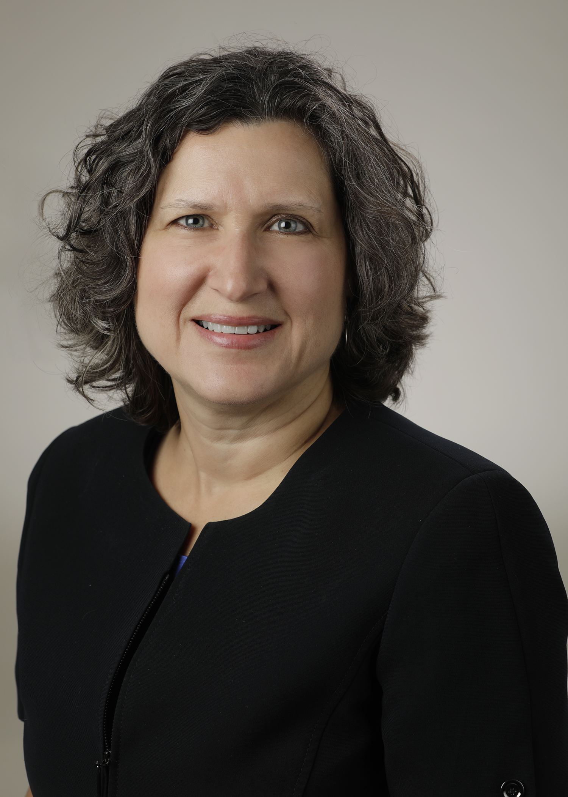
Introducing Your Presenter…
Heather Peters, M.Ed, Ph.D
GME Consultant
DIO & GME Specialist
Seasoned speaker at ACGME & sub-specialty national meetings
Areas of Expertise: Institutional and Program accreditation experience; Strategic planning; Annual Program Evaluation processes; Evaluation processes; and more
3 decades in education; Masters of Education in curriculum & evaluations, PhD concentration in secondary education & adult learning theories

Slide 3
Learning Objectives
Develop an understanding of ACGME Survey construction & purpose
Determine best practices for ACGME Surveys
Review Resident, Faculty and Well-Being items
Analyze ACGME Survey results
Develop trending and tracking strategies for ACGME Survey results
Discuss why and how to disseminate ACGME Survey results to key stakeholders
Notes:
Objectives for the webinar.

Slide 4
Understanding ACGME Survey Construction

Slide 5
Purpose
Purpose: “an additional method used to monitor graduate medical clinical education and provide EARLY WARNING of potential non-compliance with ACGME accreditation standards”
.
References:
http://www.acgme.org/Data-Collection-Systems/Resident-Fellow-and-Faculty-Surveys
Holt K, Miller RS. The ACGME resident survey aggregate reports: an analysis and assessment of overall program compliance. Journal of Graduate Medical Education. December 2009

Slide 6
Accreditation System
Continuous observations (Collect data)
Identify opportunities for improvement (Find problems)
Program makes improvements (Solutions)
Assess program improvement (Program evaluations)
KEY POINT: Current accreditation system promotes INNOVATION

Slide 7
Program Data Points
Annual Data Updates (WebADS)
Scholarly activity*
Citation responses*
Major changes*
Clinical Competency Committee
Milestones
ACGME Surveys
Annual Program Evaluation
Program Evaluation Committee
Resident/Fellow*
Faculty*
Potential
Program Data
Points
*Data Points used for Accreditation

Slide 8
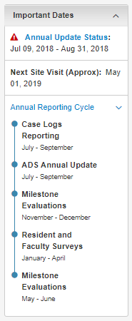
Annual Data Review
Data is reviewed annually include¹
information about the program’s characteristics,
the clinical learning environment,
program and institutional leadership,
the opinions of faculty and residents through ACGME survey,
resident clinical experience data, and
first-time pass rate data provided to the ACGM by the ABMS
¹Bryne L, Miller R, Nasca T. Implementing the Next Accreditation System: Results of the 2014-2015 Annual Date Review. JGME. February 2016.

Slide 9
Rationale for Surveys
When programs meet the required compliance rates for each survey, reports are provided that aggregate their survey data to provide an
anonymous
comparative look at how the program compares against
national,
institutional, and
specialty averages
Source: http://www.acgme.org/Data-Collection-Systems/Resident-Fellow-and-Faculty-Surveys

Slide 10
Content of Surveys
Resident Focus areas:
Faculty Focus areas:
Clinical Experience and Education (formerly Duty Hours)
Faculty
Evaluation
Education Content
Resources
Patient Safety
Teamwork
Supervision and Teaching
Educational Content
Resources
Patient Safety
LINKS: http://www.acgme.org/Portals/0/ResidentSurvey_ContentAreas.pdf
http://www.acgme.org/Portals/0/ACGME%20FacultySurvey%20QuestionContentAreas.pdf

Slide 11
Resident/Fellow Surveys
Important Information:
Scheduled from January-April
Need 70% compliance to see results
Off-cycle residents
Specialty-specific questions
Handout: FAQs – Resident Survey

Slide 12
Faculty Surveys
Similar information to resident/fellow
Level of involvement in program
60% compliance
Handout: FAQs – Faculty Survey

Slide 13
Wellness Surveys
New questions – residents & faculty
2017 – based on CPR, Section VI: Wellness
Aggregate reports will be provided to program and sponsoring institution
Not provided to Review Committee

Slide 14
ACGME Surveys “Best Practices”

Slide 15
Before the Survey
Review
Educate
Discuss
KEY POINT: Chief Residents or Senior Residents should lead these activities

Slide 16
Activating the Survey
Access the survey activation screen either just prior to or while the residents/fellows are gathered so that if there are any issues with the emails (incorrect emails), it will be discovered
You are allowed to send reminder emails once a day
KEY POINT: The email for the survey has to be activated by the program

Slide 17
During the Survey
Residents/Fellows
Schedule time for all to complete survey simultaneously
Use didactics time if you can get laptops
Schedule time in computer lab
Schedule soon after Review-Educate-Discuss session
Faculty
New faculty should be guided through process

Slide 18
After the Survey
Thank residents & faculty for providing their feedback
Remind residents & faculty…
Surveys happen every spring
It is better to bring issues into the open prior to the survey
KEY POINT: Don’t ask the residents how they responded

Slide 19
Tracking/Trending ACGME Survey Results

Slide 20
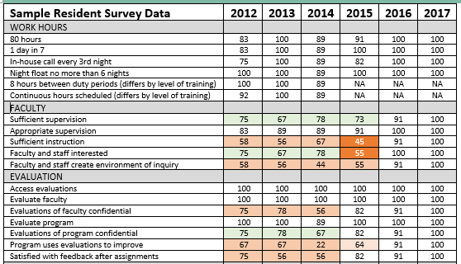
Sample Trended Survey Data

Slide 21
Disseminating Results

Slide 22
Survey results should be shared with…
Program
GMEC
C-Suite
Governing Board

Slide 23
Program (trainees, faculty, staff)
APE (Annual Program Evaluation)
“Prioritize the actions needed to rectify issues found on the ACGME resident and program faculty surveys”¹
¹Simpson D, Lypson M. The year is over, not what? The annual program evaluation. Journal of Graduate Medical Education. September 2011.

Slide 24
GMEC
AIR (Annual Institutional Review)
Trends/issues identified
Resource needs identified by surveys
Next steps…
KEY POINT: ACGME Surveys MUST be reviewed and discussed by the GMEC. This is a Sponsoring Institution requirement.
Citation Alert: Sponsoring Institutions often receive citations for not reviewing the actual ACGME survey reports at the GMEC meetings. It’s not enough to talk about them in the aggregate.

Slide 25
C-Suite
Trends in the resident/faculty surveys – particularly downward trends
Key
KEY POINT: “Quality Indicators”, such as those found on the ACGME surveys will pique their interest and may assist in getting necessary resources if you provide the data in the right way

Slide 26
Governing Board
Summary Information
How does this survey support the data regarding number of retained graduates?
Does the current data bode for more or less graduate retention in the future?

Slide 27
Others?
Potential faculty and program directors
Specific stakeholders depending on your institution
Academic Medical Centers
Community-Based Institutions

Slide 28
Be careful when sharing with…
Resident/fellow recruits
Patients

Slide 29
Take Home Points
The ACGME Survey is a data point that is closely followed by the Review Committees
Preparation of residents/fellows and faculty is prudent
Tracking, trending & distributing data helps anticipate possible citations in the future

Slide 30
Upcoming Live Webinars
Oversight of the Clinical Learning and Working Environment Tuesday, August 28, 2018 12:00pm – 1:00pm EST
Policies, PLA’s and Policing Thursday, September 13, 2018 12:00pm – 1:00pm EST
Making “Cents” Out of GME Financing Tuesday, September 25, 2018 12:00pm – 1:00pm EST
”Invisible” Faculty Development: Maximizing Your Reach Thursday, October 18, 2018 12:00pm – 1:00pm EST
www.PartnersInMedEd.com
On-Demand Webinars
Journey from Initial Accreditation to Continued Accreditation
Resident Remediation
DIO Competencies
How to Prepare for Your 10 Year Site Visit
Coordinator Development - How to Build a Team
Responsiveness to Diverse Patient Populations
Contact us today to learn
how our Educational Passports can save you time & money!
724-864-7320

Slide 31
Partners in Medical Education, Inc. provides comprehensive consulting services to the GME community.
Partners in Medical Education
724-864-7320 | info@PartnersInMedEd.com
Heather Peters, M.Ed, Ph.D heather@PartnersInMedEd.com
www.PartnersInMedEd.com

