Slide 1

Making Cents of GME Financing
Pam Royston, PhD, Consultant

Slide 2
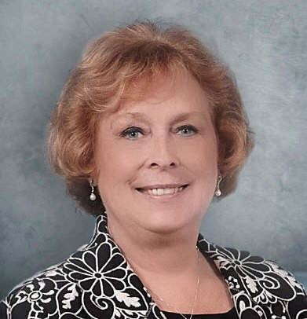
Introducing Your Presenter…
Pamela Royston, Ph.D
DIO, GME & Finance Expert
Over 25 years experience in medical education, both undergraduate and graduate
Institutional, Program, FQHC start-up and maintenance
National Speaker GME Accreditation and Financing
Ph.D - A.T. Still University

Slide 3
Learning Objectives
1. Describe the costs of your training program.
2. Develop an expense budget.
3. Describe indirect and direct GME Medicare funding.
4. Identify where to find GME revenue on the Cost Report.
5. Estimate contribution margin of your training program.
6. Calculate the opportunity costs with program elimination.
Revenue
Variable Costs
Contribution Margin

Slide 4

Understanding the “C” Suite
Primary focus – IMPROVE BUSINESS RESULTS
Increasing sales (revenue)
Increasing market share
Improving customer loyalty
Reducing costs
Reducing errors
Customer service
Employee turnover
Employee engagement

Slide 5
Basic Terminology
Assets – some of value – can be converted to cash
Balance Sheet – Snapshot in time of financial position
CONTRIBUTION MARGIN – The sales price less variable costs which contributes to bottom line
Expenses – use up assets (fixed, variable or accrued)
Net Income – bottom line which is either a profit or loss for a certain time period
Overhead – indirect expenses that are not directly attributable to a product or service. These are real expenses!

Slide 6

How Much Does Your Program Cost
Budget – projected cost and first place to start
  Program Director and faculty compensation (know ACGME requirements)
  Salaries and fringe benefits
    Residents
    Program coordinator
  Associated resident costs
    Lab coats, pagers, licenses,
    in-training exams, PDA
  Travel – required conferences
  Recruitment
  Fees (ACGME, AOA)
  Recruitment
IMPORTANT – Know Your Per Resident Expense

Slide 7

GME Revenue – AKA Medicare Reimbursement
COMPLEX!!!
Two parts to Medicare reimbursement
DGME – Direct Graduate Medical Education
IME – Indirect Medical Education

Slide 8
Direct (DME) and Indirect (IME) Funds
Pays Medicare's share of residency education cost
Based on each hospital's 1984 cost estimate
Reported on annual "hospital cost report“
Indirect Medical Education (IME) Payments
  Partially pays for higher patient care costs due to presence of residents and "inefficiencies“
  Paid through a higher inpatient DRG rate

Slide 9
DGME
Easy way to think of this:
DGME Formula
Price x Quantity x Share
Price = Per Resident Amount (PRA)
Quantity = Number of residents
Share = portion of hospital costs attributable to Medicare

Slide 10
DGME Reimbursement Example
Assume share of inpatient days = 40%
20 residents (10 residents and 10 fellows)
CAP is 21
1984 Per resident amount = $60,000
(this is an example!)
Assume CPI since 1984 = 30%
10 residents * $60,000 * 130% * 40 % = $312,000
10 fellows * $60,000* 130% * 40% * 50% = $156,000
Total Payment $468,000
Fellows – exceed IRP

Slide 11
What are DGME payments intended to cover?
For costs directly related to educating residents:
Residents' stipends/fringe benefits
Faculty Salaries/fringe benefits
Other direct costs
Allocated overhead costs
Residents must be in ACGME or AOA approved program or pre-requisite year required for ABMS certification

Slide 12
IME
IME -designed to pay for the “additional” costs associated with residency training
Difference in formula is based on the Intern and Resident Bed Ratio
The constant is the “IME multiplier” which is defined in law and currently 1.35.
IRB Ratio = number of residents and interns divided by the number of hospital beds

Slide 13
IME Formula
DO NOT PANIC – You will never have to do this!
# Residents
1.35*( ( ( 1 + ——————) ^{0.405} )- 1)
# of Beds

Slide 14
IME Reimbursement Example
20 residents (10 residents and 10 fellows)
CAP is 21
150 Available beds
(same as prior year)
Assume
DRG Payment
$7,169.26
Add on payment calculation:
20 Residents
1.35*( ( ( 1 + ——————) ^{0.405} )- 1) = .0701
150 Beds
Payment for this care (Medicare patient) would be:
$7,169.26 * 1.0701 = $7,671.83

Slide 15
IME Reimbursement Practical Way
None of us will calculate IME on each payment.
Calculation is based on the percentage of Medicare in-patient net revenue.
Example: Total net revenue is $84,375,000. Medicare share is 40% (Medicare in-patient days). Medicare net revenue is $84,375,000 x 40% = $33,750,000.
$33,750,000 x .0701 = $2,365,875
Multiplier from previous slide

Slide 16

Other Revenue Available
Medicaid – limited to a few states
Blue Cross Blue Shield
Military – TriCare
Veterans Hospital/Clinic rotations

Slide 17
What is the resident Cap?
The number of FTE allopathic and osteopathic residents that a hospital may count for DME and IME payments is limited to hospital 1996 Medicare cost report count
  1997 Balanced Budget Act
    (P.L. 105-33 Sections 4621 and 4623)
Limits may be different for DME and IME

Slide 18
Are you over Cap?
Limits may be different for DME and IME and resident slots
  Shrink and eliminate programs
  Not paying program director or faculty costs
CFO’s want residents to maximize resident FTE’s
  Residents need to spend time in hospital
  Well documented FTE counts
  Programs the maximize clinical revenue

Slide 19
Resident Counts
Resident FTE count at each site is a major factor in determining IME and DGME payments
Hospitals have to prove to CMS (Medicare) auditors FTE counts – schedules, logs, evaluations
Time to remove from FTE counts
  Out rotations to another hospital provider
  Research
  Didactics – full day outside of hospital
The better you track rotations will result in higher FTE counts

Slide 20
Resident Count DGME and IME Payments
DGME
IME
Hospital | Non-Hospital | Hospital | Non-Hospital
Patient Care | Patient Care | Patient Care | Patient Care
Vacation/Sick | Vacation/Sick | Vacation/Sick | Vacation/Sick
Didactic | Didactic (Since 2009+) | Didactic (since 1983+) | NOT Didactic
Research | NOT Research | NOT Research | NOT Research
ACA: Affordable Care Act
Note: Text in Italics indicates language in the ACA

Slide 21
Making the Most of FTE’s
Documentation of residents is crucial
Move research “projects” into the hospital
Quality Improvement projects count!
Move didactics into the hospital
Increase number of residents over cap
  Make business argument
    More patients
    Faculty retention
    High value service

Slide 22
The Indirect Value of GME
Difficult to quantify.
Financial pressures of organizations will require GME to add value
NEED TO REMEMBER – Contribution Margin
What are some of indirect values provided by GME?

Slide 23
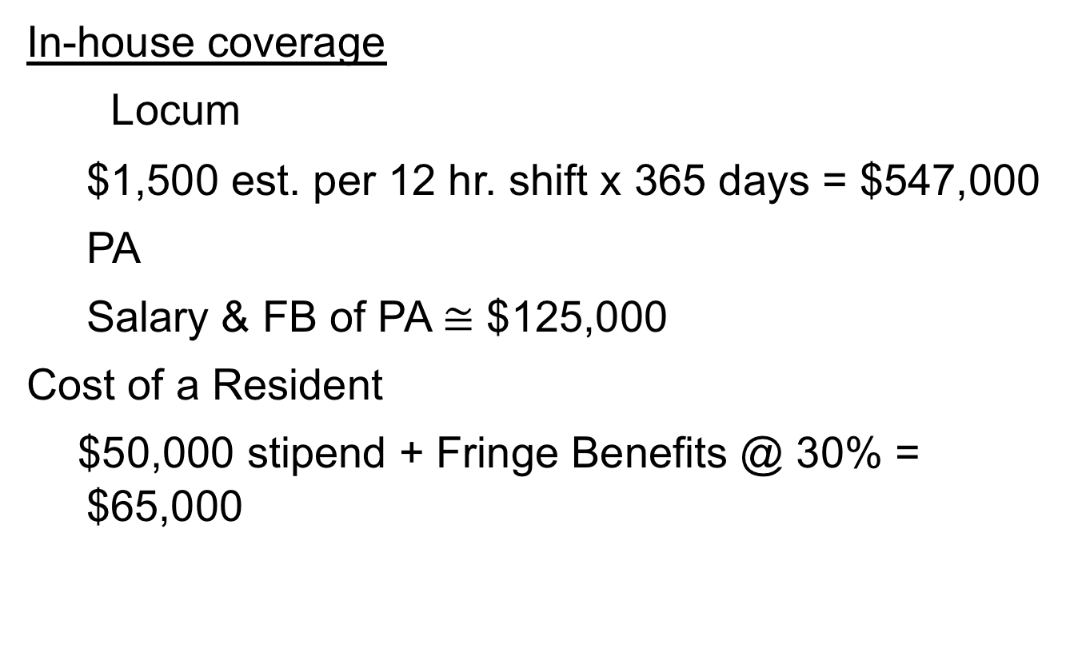
Estimating the Indirect Value of GME
In-house coverage
Locum
  $1,500 est. per 12 hr. shift x 365 days = $547,000
  PA
  Salary & FB of PA $≅$ $125,000
  Cost of a Resident
  $50,000 stipend + Fringe Benefits @ 30% = $65,000

Slide 24

Intangible Benefits of GME
Resident Clinics
Access to care
Leverage
Length of Stay
Patient Satisfaction
Readmissions (Value Based Purchasing)
Research / Scholarly Activity
Assist with implementation new technology

Slide 25
Future of GME Funding
Many bills introduced into Congress
Clear trend is:
  Less money to GME, less per resident
  More accountability
  Redistribution for geography, primary care
  Cap on GME slots
More reliance on hospital clinical dollars

Slide 26






Upcoming Live Webinars
”Invisible” Faculty Development: Maximizing Your Reach
Thursday, October 18, 2018
12:00pm – 1:00pm EST
ACGME Section 6 and Wellness Update
Tuesday, October 30, 2018
12:00pm – 1:00pm EST
New Institution – The value of Graduate Medical Education
Thursday, November 8, 2018
12:00pm – 1:00pm EST
Meet the Experts – Fall Freebie
Tuesday, 27, 2018
12:00pm – 1:00pm EST
www.PartnersInMedEd.com
On-Demand Webinars
Journey from Initial Accreditation to Continued Accreditation
Resident Remediation
DIO Competencies
How to Prepare for Your 10 Year Site Visit
Coordinator Development - How to Build a Team
Responsiveness to Diverse Patient Populations
Contact us today to learn
how our Educational Passports can save you time & money!
724-864-7320
26

Slide 27

Partners in Medical Education, Inc. provides comprehensive consulting services to the GME community.
Partners in Medical Education
724-864-7320 | info@PartnersInMedEd.com
Pam Royston, PhD, Consultant
Pam@PartnersInMedEd.com
www.PartnersInMedEd.com

