Slide 1
Please Note…
Please make sure your Start Video is OFF when logging into the WebEx platform.
Here is what it should look like
ALSO
It is NORMAL to not hear any sound until the webinar starts at 12:00 noon EST.
Your phone line is muted, but you can always chat to the host, BJ Schwartz, if you have any questions or concerns during this time.

Slide 2
Coaching in GME
Heather Peters, M.Ed, Ph.D
Christine Redovan, MBA, MLIS
Carmela Meyer, Ed.D

Slide 3
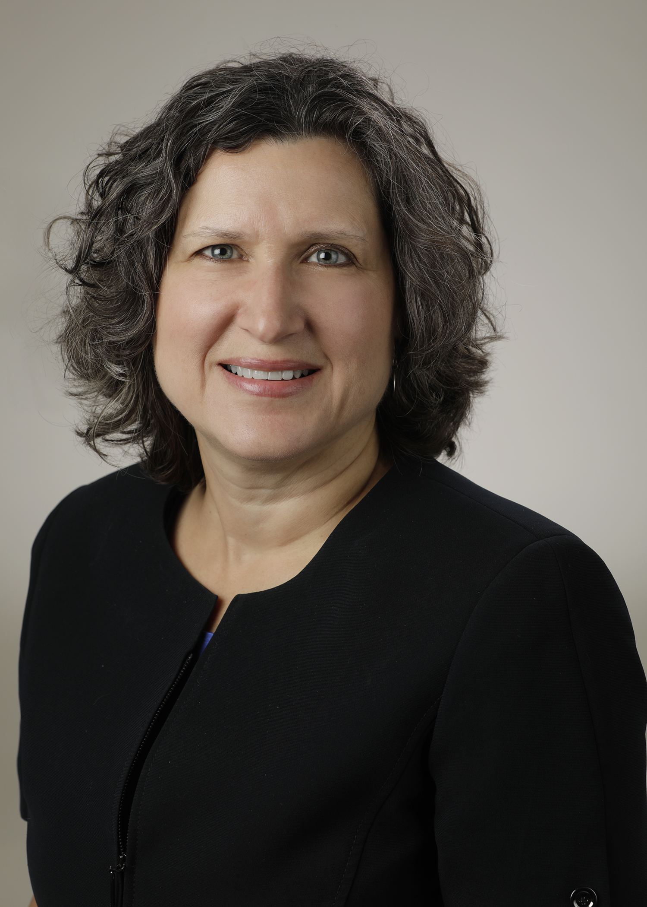
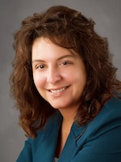
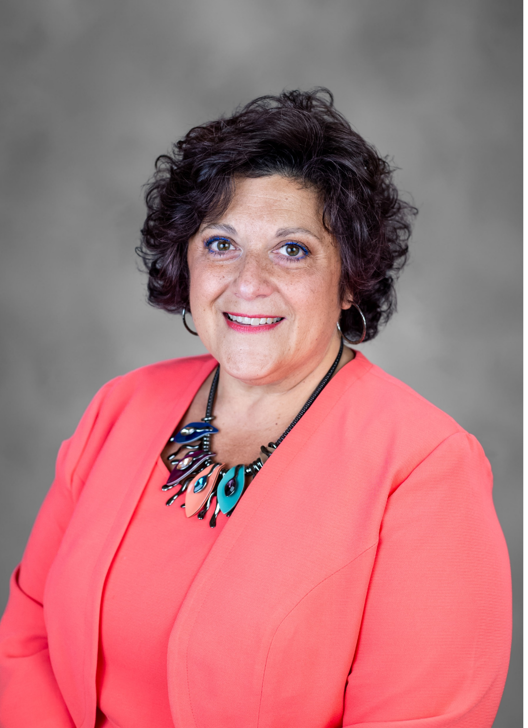
Introducing Your Presenters…
Heather Peters, M.Ed, Ph.D
GME Consultant
Christine Redovan, MBA, MLIS
GME Consultant
Carmela Meyer, EdD
GME Consultant
Heather has developed a coaching program at Valley Children’s Hospital, developed GME curriculum for several specialties, provided workshops at ACGME and other national GME events on curriculum building.
Chris has developed coordinator and GMEC coaching curricula for multiple programs focusing on ACGME requirements, processes and tackling the yearly GME cycle.
Carmela has worked with faculty to build coaching curricula for academic settings and community-based hospitals.

Slide 4
LEARNING OBJECTIVES
REFINE understanding of the ways that programs can individualize the curriculum for each trainee
REVIEW faculty development concepts related to building a coaching program
DISCUSS the implementation of a coaching program with the use of the current semi-annual form
Table comparing resident support methods
Adapted Semi-Annual Form for Coaching

Slide 5
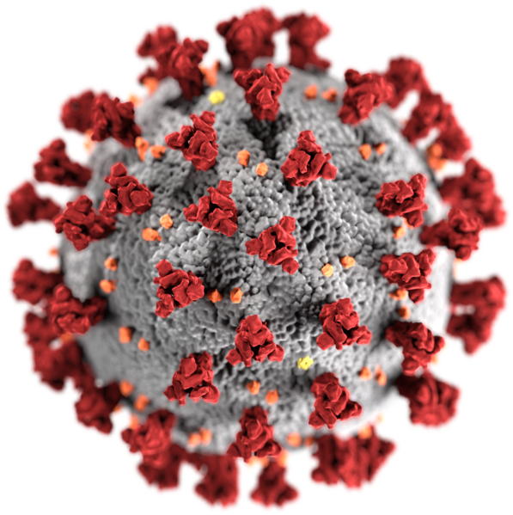
Dr. Yang – PGY-1
Part I: COVID-19: Coaching in GME Becomes a Necessity
Dr. Yang is an OBGYN PGY-1 in 2021. She had a disrupted MS3 and MS4 experience due to COVID-19 adjustments at the hospitals where her classmates would normally have done their core clerkships. She has been given positive feedback in her early rotations, but her belief in her ability is leading to being quiet in didactic discussions and on rounds. She has come to you as she is worried about her medical knowledge. She is unsure how to compensate for the gaps in her knowledge due to the disrupted medical student experiences.
How can you, as Dr. Yang’s coach, help her prioritize what to prioritize?
How can you help her develop lifelong learning skills?
How can you help her stay motivated to keep learning in a busy and stressful work environment?
This Photo by Unknown Author is licensed under CC BY-SA-NC

Slide 6
Advising
Part II: Understanding the Differences in Resident Support Models
Very familiar....
One-time interaction
Seeking answer(s)
Targeted topic
This Photo by Unknown author is licensed under CC BY.

Slide 7
Advising Examples
Financial advisors – provide specific answers to a question
What are my best options for low-risk investment?
Academic advisors – recommend specific classes/careers.
I want to be a musician. What math classes are good for me?
I want to work with dogs. What careers are available?
Academic GME advisors – recommend specific electives.
I want to be a cardiologist. What electives should I take that will be helpful?
I'm going into rural practice. What electives should I take that will be beneficial to my future practice?

Slide 8
Mentoring & Coaching
Both....
Support a person's development
Occur over a series of meetings over time
Rely on good rapport between parties
Based on a 1-1 relationship
This Photo by Unknown author is licensed under CC BY-NC-ND.

Slide 9
What is the difference?
Mentoring
Coaching
Career - Share knowledge, expertise, skills
Knowledge of subject is important
Communication skills are important
Skill – teach the coachee to learn; maximize own performance.
Knowledge of subject not important.
Coaching skills are important.
This Photo by Unknown author is licensed under CC BY-ND.

Slide 10
Mentoring
Develop a relationship that focuses on achieving specific goals
Benefits both mentor and mentee
Useful when increasing access to programs (think underrepresented in medicine individuals)
Useful for increasing access to clinical specialty (think women in orthopedics)
Important in professional and personal development
This Photo by Unknown author is licensed under CC BY.

Slide 11
When to use mentoring
Understanding organization or industry, future opportunities, building netwoks
Preparation for future roles, retention and integration
Capable but lacks experience, able to accelerate development
Senior staff willing to give back to organization

Slide 12
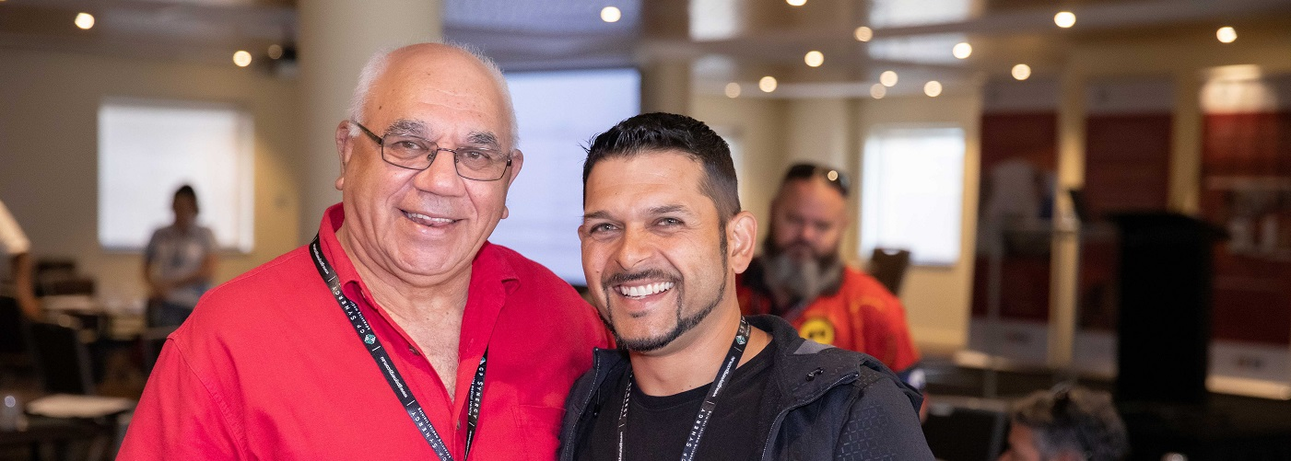
Mentoring Examples
This Photo by Unknown author is licensed under CC BY-NC-ND.

Slide 13
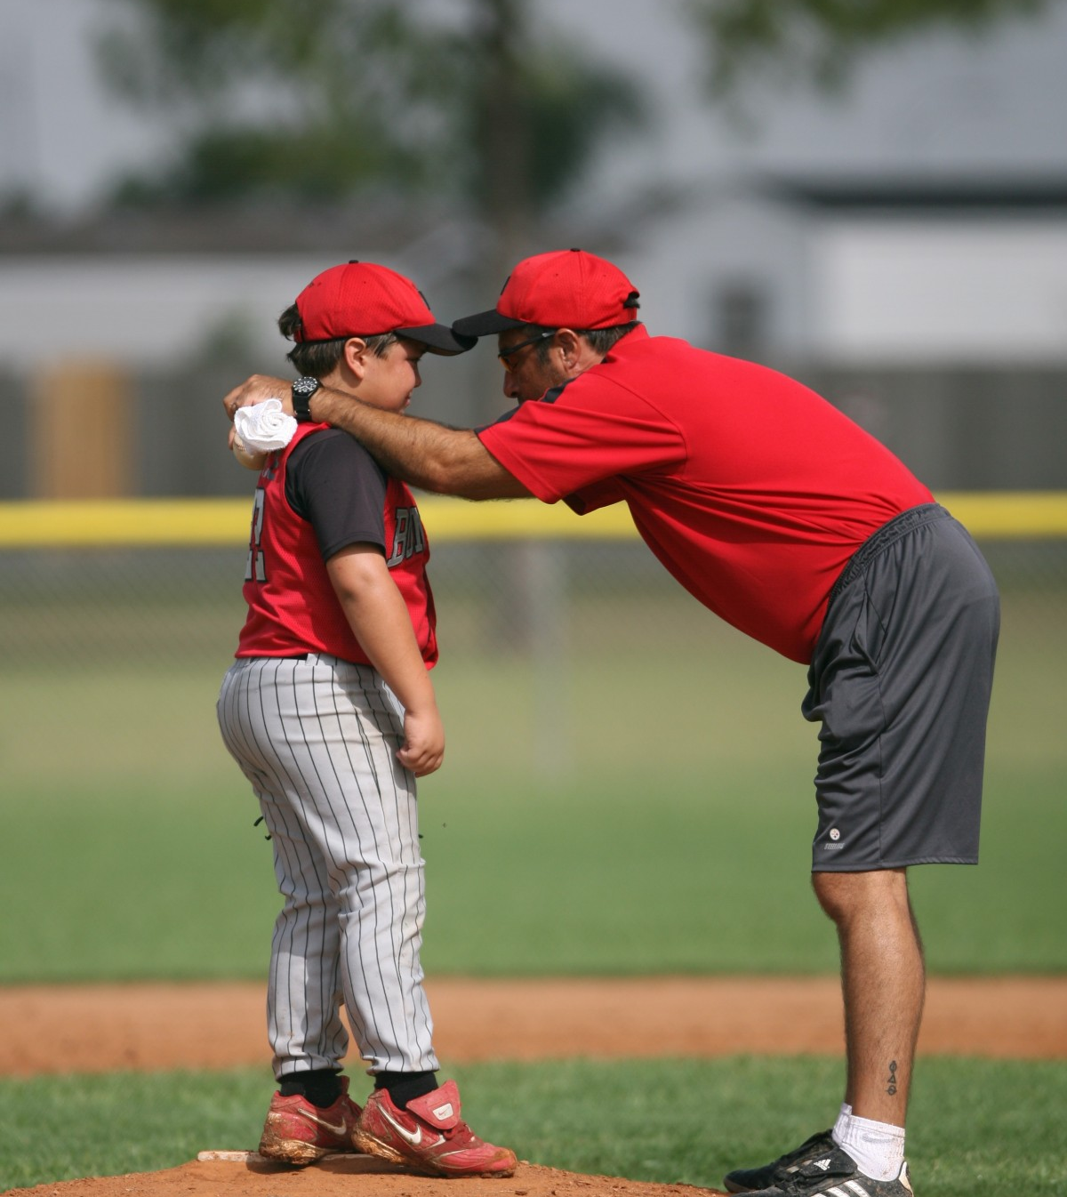
Coaching
Unlocks potential of coachee
Benefits the coachee
Useful when coachee can direct
Useful for finding strategies
Important in building relationships and improving coachee outcomes

Slide 14
When to use coaching
If facing a specific challenge
Preparation for immediate skills in current role
Capable but needs support to reflect and learn to improve current role
Coaching capability in organization or budget to source external partner

Slide 15
Coaching Examples
This Photo by Unknown author is licensed under CC BY.
This Photo by Unknown author is licensed under CC BY-SA.
This Photo by Unknown author is licensed under CC BY-SA.
This Photo by Unknown author is licensed under CC BY-SA-NC.
* https://www.ted.com/talks/atul_gawande_want_to_get_great_at_something_get_a_coach?utm_campaign=tedspread&utm_medium=referral&utm_source=tedcomshare

Slide 16
Dr. Porter – Program Director
Dr. Porter, a seasoned program director, has come to you because he is frustrated by the new class of PGY-1s. Due to COVID-19 disruptions in medical student education, he is overwhelmed by the needs of the PGY-1s. He feels that these new learners need so much guidance. He has heard of the concept of “coaching,” but needs to understand how this differs from advising and mentoring.
What is the best way to explain the differences between the three concepts?
How do you decide which is the best option for Dr. Yang?
This Photo by Unknown Author is licensed under CC BY-ND

Slide 17
Coaching Cycle
Part III: Nuts and Bolts of Coaching
Assess
Adjust
Staying Motivated
Prioritization
Sample
Text
Plan
Solicit Feedback
Self-Assessment
Fausone, M., Raja, N., & Wolff, M. (2019). Chapter 6: How can my coach help me develop as a master adaptive learner? AAMC Accelerating Change in Medical Education Coachee Handbook.

Slide 18
Learning Strategies
Underlining
Highlighting
Re-reading
INEFFECTIVE
Recall
Spaced Repetition
Concept Interleaving
Concept Mapping
EFFECTIVE
Rohrer, D. Pashler, H. (2010). Recent Research on Human Learning Challenges Conventional Instructional Strategies. Educ Res. 39(5):406-412.
Rohrer, D. (2012) Interleaving Helps Students Distinguish among Similar Concepts. Educ Psychol Rev. 24(3):355-367.

Slide 19
Intrinsic Motivators
Relatedness
Sharing results of work with other helps the learner stay motivated
Competence
03
When a learner feels a goal is obtainable, the learner is more likely to stay motivated
Autonomy
02
Feeling in control of decisions helps learners be more motivated, curious and interested in challenge
01
Schwartz, D.L., Tsang, J.M., & Blair, K.P. (2016). R is for reward: Motivating behavior. In The ABCs of how we learn: 26 scientifically proven approaches, how they work, and when to use them (pp. 220-233). New York, NY: W.W. Norton & Company.

Slide 20
Director Medical Education
Part IV: Program Assessment
The Director of Medical Education at St. Stephen’s Community-Based Institution is very interested in analyzing this coaching program. She wants to know if this is something that should be replicated across the other training programs.
What should the DME do to assess the quality of the coaching program?
How can the DME provide the program director and the coaches support in the 2nd year of the coaching program?

Slide 21
Program Assessment Model
Who? What? When? Where? How?
Analysis
A
Evaluate
E
D
Design
What’s working? What isn’t?
Future Stages
Methodology Format
Monitoring
ADDIE
Implementation
I
D
Development
Put the program in place (Coaches, Coachees)
Goals & Objectives
https://www.talentlms.com/blog/addie-training-model-definition-stages/

Slide 22
Develop a Train the Trainers
Faculty Development
Brainstorm about how to implement across programs
Goal-setting
SUPPORT – Year 2
Provide time to present
Highlight in AIR
Observe
Mentor

Slide 23
Dr. Vincenzo – Potential Coach
Part V: Faculty Development
Dr. Vincenzo is interested in coaching Dr. Yang. She is a junior faculty member (less than 3 years experience) and she has come to you to learn about coaching. She understands the difference between Mentoring, Coaching, and Advising, but she would like to have an Individual Learning Plan for her development as a coach.
What are some key concepts that Dr. Vincenzo should keep in mind?
What achievable goals should she set for herself?

Slide 24
Key Coach Concepts
Dr. Yang, our PGY-1, needs the following from her coach:
Multiple sources of information to direct the learning (self-reflection, feedback from colleagues, peer-exemplars)
Guidance triaging what issues are the highest priority and most relevant
Model how to set achievable goals
Assess ways that Dr. Yang likes to learn

Slide 25
Mentoring to Coaching
Johnson, E. a. (2021, March). Mentoring vs Coaching: The Key Differences and Benefits. Retrieved from PUSHfar: https://www.pushfar.com/article/mentoring-vs-coaching-the-key-differences-and-benefits/

Slide 26
Coach2Coach Model
Orr and Sonnadara conducted a literature review encompassing 21 studies on coaching efficacy for medical learners, found positive outcomes in areas of well-being and resilience, decision-making, teamwork, reflective practice and technical skill acquisition.
Deliberate practice will improve skill acquisition and is one aspect missing from currently available faculty development tools in coaching via online webinars.
Collaborative relationship that supports the growth of both faculty members
Orr, C. J. (2019). Coaching by design: exploring a new approach to faculty development in a competency-based medical education curriculum. Advances in Medical Education and Practice, 10 229–244.

Slide 27
References
Curtrer, W.B., Miller, B., Pusic, M. et al. (2017). Fostering the development of Master Adaptive Learners: A Conceptual Model to Guide Skill Acquisition in Medical Education. Acad Med. 92(1):70-75.
Fausone, M., Raja, N., & Wolff, M. (2019). Chapter 6: How can my coach help me develop as a master adaptive learner? AAMC Accelerating Change in Medical Education Coachee Handbook.
Johnson, E. A. (2021, March). Mentoring vs Coaching: The Key Differences and Benefits. Retrieved from PUSHfar: https://www.pushfar.com/article/mentoring-vs-coaching-the-key-differences-and-benefits/
Marcante, K. & Simpson, D. (2018). Choosing when to advise, coach or mentor. J Grad Med Educ, 10(2), 227-228, doi: 10.4300/JGME-D-18-00111.1
Orr, C. J. ( 2019). Coaching by design: exploring a new approach to faculty development in a competency-based medical education curriculum. Advances in Medical Education and Practice, 10 229–244.
Palamara, K., Kauffman, C., Stone, V.E., Bazari, H. & Donelan, K. (2015). Promoting success: A professional development coaching program for interns in medicine. J Grad Med Educ. 7(4), 630–637 doi: 10.4300/JGME-D-14-00791.1
Rohrer, D. Pashler, H. (2010). Recent Research on Human Learning Challenges Conventional Instructional Strategies. Educ Res. 39(5):406-412.
Rohrer, D. (2012) Interleaving Helps Students Distinguish among Similar Concepts. Educ Psychol Rev. 24(3):355-367.
Schwartz, D.L., Tsang, J.M., & Blair, K.P. (2016). R is for reward: Motivating behavior. In The ABCs of how we learn: 26 scientifically proven approaches, how they work, and when to use them (pp. 220-233). New York, NY: W.W. Norton & Company.
https://www.talentlms.com/blog/addie-training-model-definition-stages

Slide 28
Upcoming Live Webinar
GME Financing: The Basics, the Strategies, and the Upcoming Changes Thursday, October 7, 2021 12:00pm – 1:00pm EST
Planning and Tracking Scholarly Activity
Thursday, October 21, 2021
12:00pm – 1:00pm EST
A Successful Coordinator? You Must Be C-C-Crazy!
Tuesday, November 2, 2021
Meet The Experts Fall Freebie
Thursday, November 18, 2021
12:00pm – 1:00pm EST
Latest On-Demand Webinars
A Day in the Life of A DIO
Site Visits – What to Expect in 2021
ADS Update 2021
GME Grants and Funding Sources
Survey Research
Impactful AIR & APE – Bridging Data & Action
GMEC Checkups – QIPS Edition
ACGME Surveys – What Now?
Other Approaches to CCC & Evaluation
Lessons Learned from the Pandemic: Planning for the Next Disaster
Ask Partners – Spring Freebie
Digging for Data Part 3
How to Maximize Virtual Learning Part 2
Faculty Development Series
15 Minutes to Effective Feedback
Toolbox for Teaching Millennials
Taking Supervision to the Next Level
Contact us today to learn how our Educational
Passports can save you time & money!
724-864-7320
www.PartnersInMedEd.com
Presented by Partners in Medical Education, Inc. 2021
28

Slide 29
Partners in Medical Education, Inc. provides comprehensive consulting services
to the GME community.
Partners in Medical Education
724-864-7320 | info@PartnersInMedEd.com
Heather Peters, M.Ed, Ph.D
Heather@PartnersInMedEd.com
Christine Redovan, MBA, MLIS
Christine@PartnersInMedEd.com
Carmela Meyer, EdD
Carmela@PartnersInMedEd.com
www.PartnersInMedEd.com

