Slide 1
Please Note…
Please make sure your Start Video is OFF when logging into the WebEx platform.
Here is what it should look like
ALSO
It is NORMAL to not hear any sound until the webinar starts at 12:00 noon EST.
Your phone line is muted, but you can always chat to the host, BJ Schwartz, if you have any questions or concerns during this time.

Slide 2
Meet the Experts
Heather Peters, M.Ed, Ph.D Carmela Meyer, MBA, Ed.D
Tori Hanlon, MS, CHCP Cheryl Haynes, BA, C-TAGME
Christine Redovan, MBA, MLIS

Slide 3
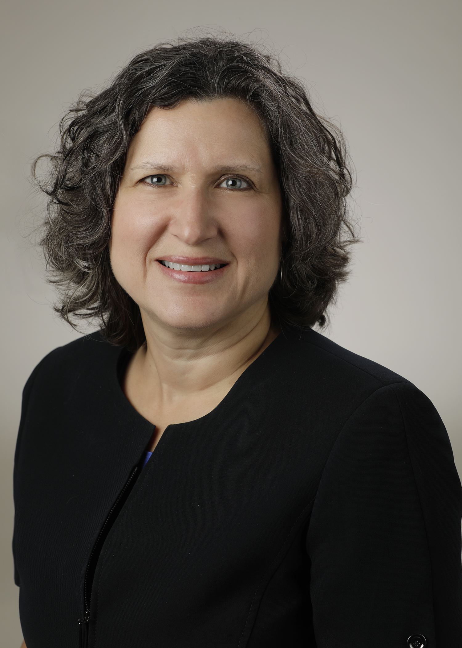
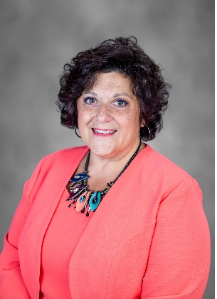
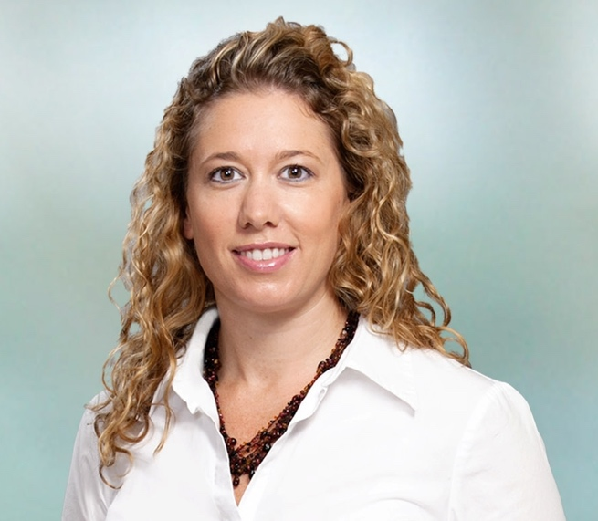
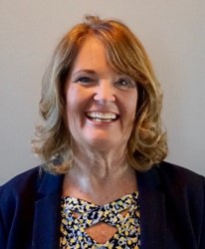
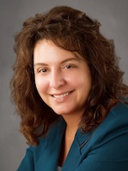
Introducing Your Presenters…
Heather Peters, M.Ed., PhD
GME Consultant
Carmela Meyer, Ed.D
GME Consultant
Tori Hanlon, MS, CHCP
GME Consultant
Cheryl Haynes, BA
GME Consultant
Christine Redovan, MBA, MLIS
GME Consultant
Expertise in project management and tracking outcomes across the GME environment
Heather will focus on how to trend comments in survey reports/aggregated evaluations.
Over 25 years of medial education experience with a business/accounting background
Carmela will focus on GME finance.
Current DIO with experience providing solutions to programs and institutions with long standing GMEC experience
Tori will review and highlight the latest on program aims.
22 years in GME with experience in program administration in both academic and community-based programs
Cheryl will focus on key NRMP & ERAS rules to assure a compliant interview season.
Seasoned consultant; accreditation readiness proponent
Chris will review and highlight the latest ACGME updates.

Slide 4
Learning Objectives
Ascertain the impact of residency activities on CMS reimbursement and cap-building
Discuss the rationale and provide methods for trending resident comments to protect confidentiality
Develop meaningful program aims and understand their importance
Understand key NRMP & ERAS rules to assure a compliant interview season
Investigate the latest ACGME resources for program advancement and improvement

Slide 5
Trending Trainee Comments Heather Peters, PhD

Slide 6
Trending Trainee Comments
Why?
ACGME SURVEY ISSUE
When?
Evaluations
Conversation
Surveys

Slide 7
HOW?
Best Practice:
Process:
Read the comments on the survey or evaluation
Transfer them to another document (excel, word)
Create a trended report using numerical representation
Export the document to Excel
Save two versions
Tip:
One that is labeled "with comments" so you never email the wrong version
Sample Trended Report:
Busy clinic is difficult (5)​
Wards often goes over the work hour rules (4)

Slide 8
Closing Comments
Never include “one-off comments”
Never include verbatim comments – too easy to determine who said it
Never include comments about a specific situation
Keep in Mind:
The size of your program.
If smaller, than you may start trending at 2.
If larger, you will want to wait till 4 or higher.
ACGME survey is set at 15% or higher

Slide 9
GME Financing Carmela Meyer, EdD

Slide 10
Cap
Total Resident FTE that CMS will reimburse.
Each hospital has 5 years to build their cap.
Additional slots can be added but not funded.*
Cap does not relate to number of residents approved for accreditation.
* Recently options have been allowed that would allow for increases in cap.

Slide 11
Here comes a curve ball
If a visiting resident rotates from an institution whose cap is already built – (resident is already counted in a cap).
The resident will not count toward your cap and because of how it is calculated may subtract from your cap.
Will not be reimbursed during your cap building phase.
Visiting residents can start your cap even if you do not submit a cost report.

Slide 12
Outside rotations
Resident rotations outside of your institution are not counted toward your cap. It does not matter if you pay their salary.
Resident rotations outside of your institution are not included on the Medicare Cost Report for reimbursement unless...
You have a signed Affiliation Agreement with the institution that states
You will pay the salary/benefits
You will claim the resident time on the CMS cost report

Slide 13
Tips for a PD
Limit outside rotations to essential experience that cannot be garnered at your institution.
Thread research activity throughout rotation not a month-long rotation.
Conduct didactics in the hospital – otherwise they are not reimbursed.
Be diligent recruiting residents that have completed time in another residency.

Slide 14
Tips for Coordinators
Ensure schedules are entered into your LMS accurately – changes updated.
Enter resident vacation time and didactics.
Create Affiliation Agreements for every outside location and include language regarding time included on your cost report.
Affiliation Agreements should be included in the Cost Report documentation.
Enter documents required by CMS into the LMS system (diploma, BLS, contract, resume, ECFMG)

Slide 15
Program Aims
Tori Hanlon, MS, CHCP

Slide 16
Objective
To understand what makes a meaningful program aim and why they are important

Slide 17
What is a Program Aim?
Program and institutional leaders' views of key expectations for the program, as well as how the program differentiates itself from other programs in the same specialty
Program aims should be aligned with the SI/department's mission, needs of community, and desired distinctive capabilities of its graduates (C.P.R. IV.A.1)

Slide 18
Aim Attributes
Longer-term, broad goal
Dynamic, not static
Current and relevant
Measurable

Slide 19
Why are Aims Important?
Provide strategic direction for the program
Commitment to the overall mission of the organization
Engagement of organizational leaders in GME
Help to shape program identity and curriculum
Aid in recruitment process

Slide 20
EXAMPLES
Focus | Sample Aim | Measurement
Types of trainees recruited by program | Recruit research-oriented applicants to support the department’s research-based mission | Percentage of applicants to program each year with clinical research experience
Preparing graduates for particular careers | Graduate residents who become community-based internists | Annually track # of graduates who become community-based internists
Other objectives (care for underserved patients, health policy/advocacy/population health, etc.) | Train individuals for expertise in population health and care of the medically underserved | Percentage of residents completing a population health project by the end of the training program

Slide 21
Program Aim Checklist
Engagement of stakeholders in developing or refining program aims, including PEC
Review of program aims as part of APE
Measurement of program's progress in meeting aims
Identify activities that advance and further aims
Aims displayed on program website
Aims communicated to program applicants, residents, and faculty

Slide 22
A Compliant Interview Season
Cheryl Haynes, BA, C-TAGME
This Photo by Unknown Author is licensed under CC BY-NC

Slide 23
Objective
to understand key NRMP & ERAS rules to assure a compliant interview season.

Slide 24
NRMP Code of Conduct for Programs
•Program Director responsibility
•Applies to all members of the recruitment team
•Communication with applicants
"atmosphere that is safe, respectful and free of harmful bias”,
compliant with institutional, state and federal employment laws and guidelines.

Slide 25
Do’s and Don’ts
Do focus communication on applicant’s interests relative to your program’s mission, aims and eligibility
Don’t ask questions related to
Race
National Origin
Sexual Orientation
Disability
Marital Status, family or pregnancy
Religion

Slide 26
Do’s and Don’ts
Do freely express your interest in an applicant.
“We’d love to have you in our program.”
“I think you would be a good fit for our program.”
Don’t ask applicants about their ranking intentions
“Are you going to rank us? How High?”
“Are you applying to other specialties?”
“Are you applying to Program X?”

Slide 27
Post-interview Communication
Do limit contact
Do communicate to clarify information
Don’t require follow up communication
Don’t require “second look’s”
Remember – AAMC policy prevents use of applicant data obtained from ERAS to contact applicants for the purpose of surveying or research prior to the Match.

Slide 28
Required Disclosures
•Eligibility for appointment
•Onboarding procedures
Drug screening
Background checks
Vaccine requirements
•Criteria for vetting applications
•Written verification
Remember – ACGME Institutional requirement to
provide applicants a copy of your contract.

Slide 29
NRMP Must's
Interaction environment is "safe, respectful and free of harmful bias".
If recording interview:
Applicant must be informed before invitation is issued
Applicant must have the option to out of recording
Applicant must provide written consent prior to the interview

Slide 30
Recording Interviews
•Cannot require
•If recording, must
inform applicants of intent before inviting
allow applicant to opt out of recording
have prior written permission from applicant

Slide 31
References
•NRMP Match Code of Conduct for Programs
•AAMC Policies Regarding Use of Application Data

Slide 32
Keeping Up With the ACGME
Christine Redovan, MBA, MLIS
This Photo by Unknown Author is licensed under CC BY-SA

Slide 33
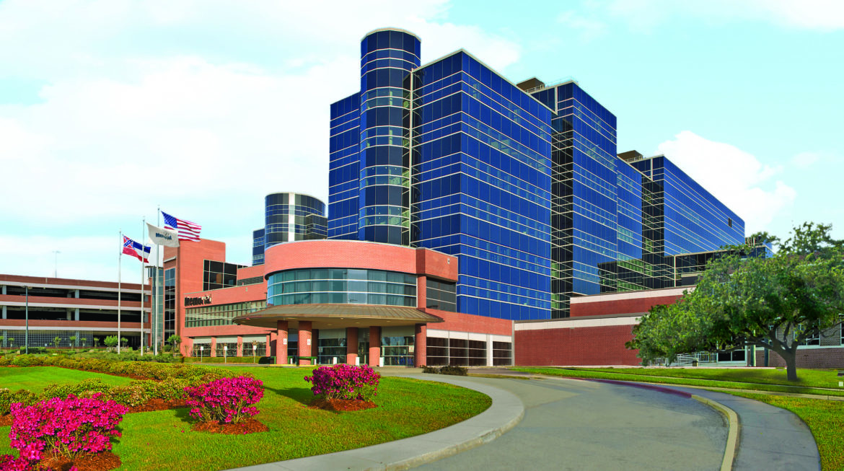
Institutional Requirements
Effective July 1, 2021
DIO approve Annual ADS updates
Requires GME mission statement
Requires SI self-study
Tweaked GMEC responsibilities
Effective July 1, 2022
Provide 100% of pay for six weeks, at least once, at any time, for approved medical, parental or caregiver leave from day one of residency
Develop a process for submitting and approving
Updated DIO Reference Sheets
This Photo by Unknown Author is licensed under CC BY-ND
For further details visit acgme.org

Slide 34
Common Program Requirements
Effective July 1, 2022
Changed “support” for core faculty to “dedicated time”
Clarified importance of coordinator time
Note: refers to specialty for specifics
FAQ’s updated July 2021. (Four pages of PLA info!)
Telecommunication supervision guidelines – table of all specialties
This Photo by Unknown Author is licensed under CC BY-SA-NC
For further details visit acgme.org

Slide 35
New Specialties
Healthcare Administration, Leadership, and Management
Recognition for Sponsoring Institutions with Non-Standard Training Programs for J-1 Visa Sponsorship
Pediatric Cardiac Anesthesiology
Neurocritical Care
Proposed name change: Neuroendovascular Intervention (current Endovascular Surgical Neuroradiology)
This Photo by Unknown Author is licensed under CC BY-SA
For further details visit acgme.org

Slide 36
All Specialties
Most have updated/specified PD protected time
Minor wording changes to align with CPR
Always check for latest application for new or two-year site visit
Check FAQ’s; may have been updated
Check Documents and Resource page; may have been updated
This Photo by Unknown Author is licensed under CC BY-SA
For further details visit acgme.org

Slide 37
New ACGME Resources
Pain Management Curriculum with specialty specific recommendations
Medically Underserved Areas and Populations
Rural Training Track page
Compilation of federal references related to rural track designation
Specific block diagrams and procedures for programs seeking rural track designation
This Photo by Unknown Author is licensed under CC BY-SA
For further details visit acgme.org

Slide 38
Updated ACGME Resources
APE template (7/2021)
Data Book 2020-2021
ACGME policies and procedures (11/1/2021)
Lots of information related to accreditation decisions, data used, outcomes
Milestone national data report (2021)
The only thing constant in GME is change
For further details visit acgme.org
This Photo by Unknown Author is licensed under CC BY-SA

Slide 39
Upcoming Live Webinar
Moral Injury in Healthcare
Thursday, December 9, 2021
Streamlining Your Special Review
Thursday, December 16, 2021
Getting to the Next Stage – Program Improvement I
Thursday, January 6, 2022
Digging for Data IV
Tuesday, January 18, 2022
Back to Basics – GME for New Coordinators
Tuesday, February 8, 2022
Leveraging RMS Technology for the Medicare Cost Report
Thursday, February 17, 2022
Latest On-Demand Webinars
Planning and Tracking Scholarly Activity
GME Financing: The Basics, the Strategies, and the Upcoming Changes
The Role of Coaching
Resident Wellness in the Virtual World
A Day in the Life of A DIO
Site Visits – What to Expect in 2021
ADS Update 2021
GME Grants and Funding Sources
Survey Research
Impactful AIR & APE – Bridging Data & Action
GMEC Checkups – QIPS Edition
ACGME Surveys – What Now?
Other Approaches to CCC & Evaluation
Faculty Development Series
15 Minutes to Effective Feedback
Toolbox for Teaching Millennials
Taking Supervision to the Next Level
Contact us today to learn how our Educational
Passports can save you time & money!
724-864-7320
www.PartnersInMedEd.com
Presented by Partners in Medical Education, Inc. 2021
39

Slide 40
Partners in Medical Education, Inc. provides comprehensive consulting services to the GME community.
Partners in Medical Education
724-864-7320 | info@PartnersInMedEd.com
Heather Peters, M.Ed., PhD
Heather@partnersinmeded.com
Carmela Meyer, EdD
Carmela@partnersinmeded.com
Tori Hanlon, MS, CHCP
Tori@partnersinmeded.com
Cheryl Haynes
cheryl@partnersinmeded.com
Christine Redovan, MBA, MLIS
Christine@partnersinmeded.com
www.PartnersInMedEd.com

