Slide 1
Please Note…
Please make sure your Start Video is OFF when logging into the WebEx platform.
Here is what it should look like
ALSO
It is NORMAL to not hear any sound until the webinar starts at 12:00 noon EST.
Your phone line is muted, but you can always chat to the host, BJ Schwartz, if you have any questions or concerns during this time.

Slide 2
GME Program Design Part II
Heather Peters, M.Ed, Ph.D
Carmela Meyer, MBA, Ed.D

Slide 3
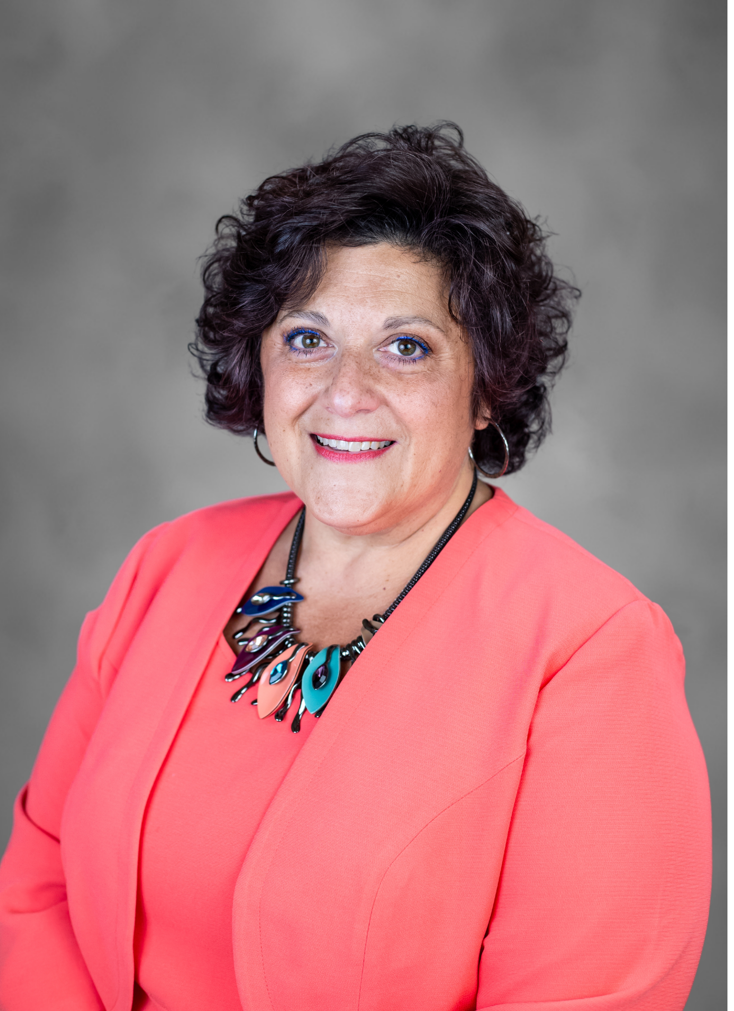
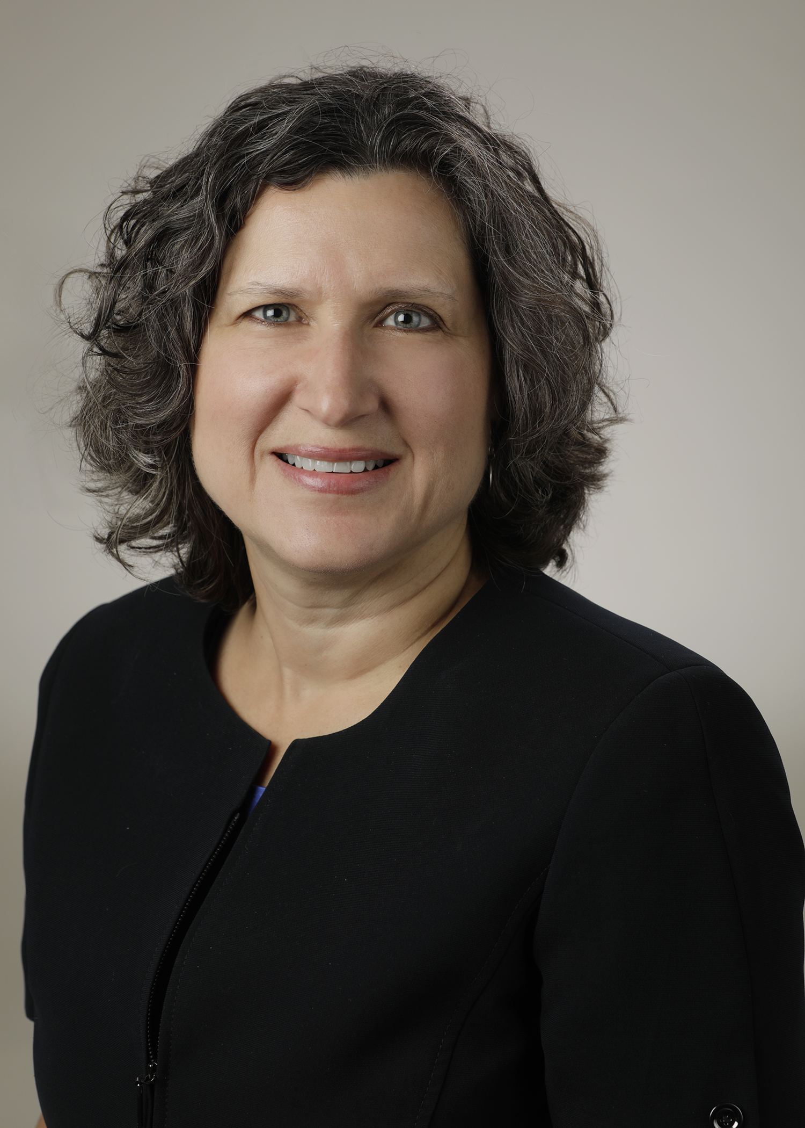
Introducing Your Presenters…
Carmela Meyer, MBA, Ed.D
GME Consultant
Heather Peters, M.Ed., Ph.D.
GME Consultant
Developed curriculum in multiple specialties
Taught “Curriculum Mapping” courses (webinar/in-person)
Experienced in holistic approach to curriculum and assessment
Master’s degree in curriculum and assessment
Developed multiple educational materials on CCC’s and PEC’s for Partners® and sponsoring institutions
Designed evaluation systems for multiple programs and institutions

Slide 4
Learning Objectives
After the webinar, the participants will be able to:
Articulate the “how” behind the curriculum structure that was discussed in Program Design I
Elaborate on the process for evaluating/designing the system that monitors all the curriculum elements – the evaluation process
Explore best practices for
1) faculty evaluation of trainees;
2) using evaluations to inform the CCC and program/faculty improvement, and
3) driving program improvement with trainee and faculty feedback
Hand-outs:
Graphic: Robust Evaluation System Components
Infographic: Principles of Formative Feedback for GME Faculty

Slide 5
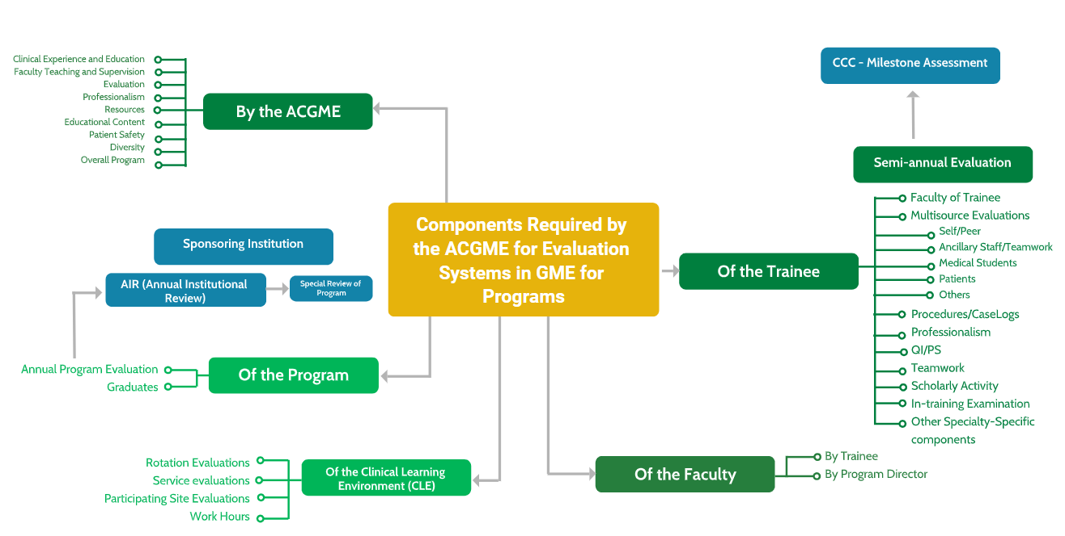
Evaluation Map for GME
Evaluation Systems…
Must be Efficient
Must be Organized
Must focus on Compliance

Slide 6
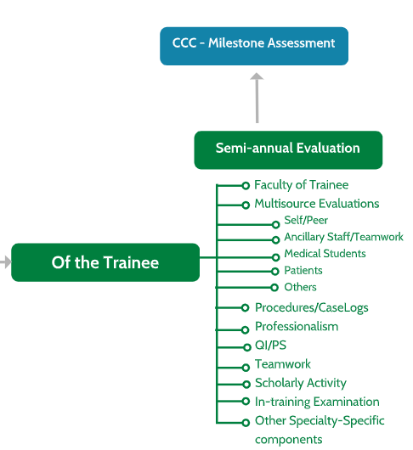
Trainee Evaluations

Slide 7
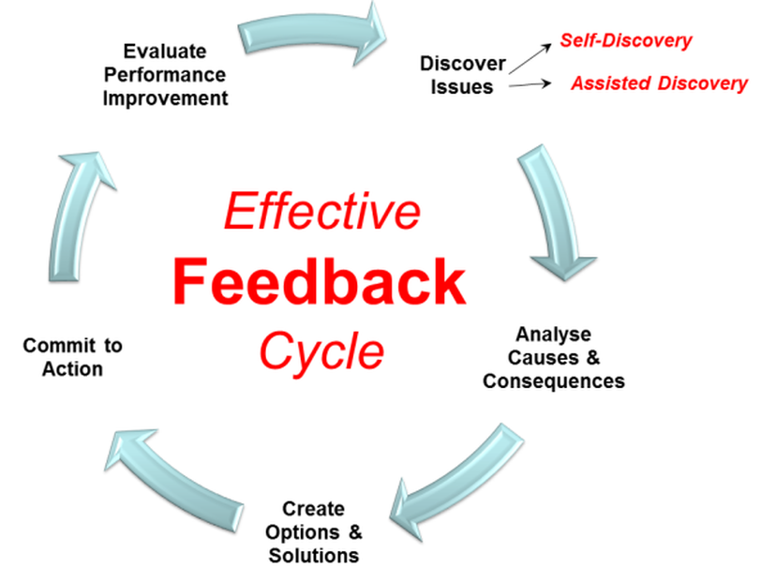
Feedback Cycle
Set CLEAR Expectations

Slide 8
Feedback sample
Expectation: I expect residents to arrive at 7:45 am for the morning clinic ready to see patients.
I noticed you arrived at 8:10am this morning, do you remember setting the expectation to arrive at 7:45am. This has happened twice this week.
What do you think is the reason for consistent tardiness? (traffic)
Since traffic is an issue at that hour what about leaving home 30 earlier? (Get a commitment)
Next day be sure to comment on timely arrival.
After several days of timely arrival; I’m so glad we were able to find a solution that works to get you here on time.

Slide 9
Formative Feedback vs Summative Evaluation
Formative Feedback
Summative Evaluation
Purpose - Improvement
Point of care/Daily/Weekly
Frequent
Documentation: usually verbal/informal
Purpose – Comparison to a Standard
At the end of an experience/ rotation
Documented in evaluation
Written and official

Slide 10
Feedback
Consider using the same techniques as caring for patients
Make your patient (learner) comfortable – build trust
Listen: what is the patient (learner) saying vs body language, tone, eye contact
Triage the issues – Prioritize the concerns – you don’t have to teach everything in a single encounter
Make a diagnosis – where is the decision-making need adjusting, what is missing from medical knowledge
Communicate the diagnosis – Be clear, specific, and HONEST
Develop a treatment plan – Let’s think about how I can help you be more efficient in taking a history

Slide 11
Recommended Feedback Techniques
Feedback is MOST Effective when it is…
Feedback is LEAST Effective when it is…
General
Negative
Impossible to change
Too much/too little
Given in front of others
Hearsay and speculative
Based on one incident
A personality attack
Specific
Positive
Useful
Right amount
Given privately
Based on first-hand observation
Fair
Timely
Focus on behavior
Actionable
Everyone needs time to process feedback…Everyone processes feedback differently
Presented by Partners in Medical Education, Inc. 2022

Slide 12
5 Reasons Well-Written Faculty Comments are Better than Milestone Scores
Actionable
Show commitment to the resident’s growth
They provide a picture to the CCC
More individualized than scores
More memorable

Slide 13
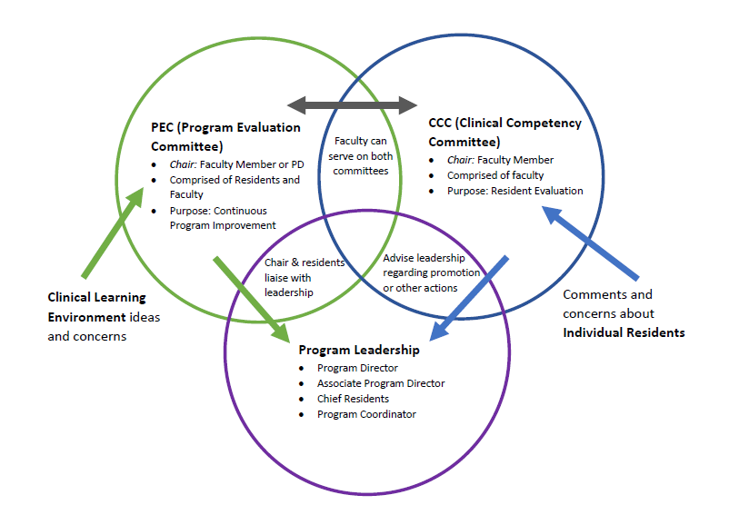
Clinical Learning Environment Evaluations

Slide 14
PROGRAM STRUCTURE

Slide 15
Rotation/Service Presentations at PEC
COLLECT DATA
PEC PRESENTATION BY ROTATION DIRECTOR
ACT
COLLECT DATA
PEC PRESENTATION BY ROTATION DIRECTOR
ACT
Collecting Data:
End of rotation evaluations

Slide 16
Rotation/Service Presentations at PEC
COLLECT DATA
PEC PRESENTATION BY ROTATION DIRECTOR
ACT
COLLECT DATA
PEC PRESENTATION BY ROTATION DIRECTOR
ACT
Provide data to Rotation Director
Provide slide templates to Rotation Director
Invite residents who recently completed the rotation
Rotation Director should provide improvement items

Slide 17
Rotation/Service Presentations at PEC
COLLECT DATA
PEC PRESENTATION BY ROTATION DIRECTOR
ACT
COLLECT DATA
PEC PRESENTATION BY ROTATION DIRECTOR
ACT
Give time to implement improvement plans
Include the improvement items in follow-up reports
Possibly add the items to the end of rotation evaluations

Slide 18
SAMPLE SERVICE PRESNTATION: Pediatric Hematology/Oncology Rotation Review

Slide 19
Feedback from Residents June – December 2021
Positives:
Good teaching.
Enthusiastic attendings.
Procedures.
Concerns:
Lack of independence in outpatient.
Desire more inpatient experience
Complaints re: call schedule.
Expectations can be improved.
SAMPLE SERVICE PRESNTATION: Pediatric Hematology/Oncology Rotation Review

Slide 20
Review of Curriculum
The goals and objectives need updating - updated version provided to the PEC for approval
Some of the procedures listed are no longer used so they have been deleted
SAMPLE SERVICE PRESNTATION: Pediatric Hematology/Oncology Rotation Review

Slide 21
Action Plans
Intern year, all residents rotate outpatient only
Second- and third-year residents - inpatient only
If goal is Hem/Onc team, then would need seniors and interns rotating inpatient only for 1 month
Outpatient as elective rotations
No inpatient team. Residents rotate outpatient only.
SAMPLE SERVICE PRESNTATION: Pediatric Hematology/Oncology Rotation Review

Slide 22
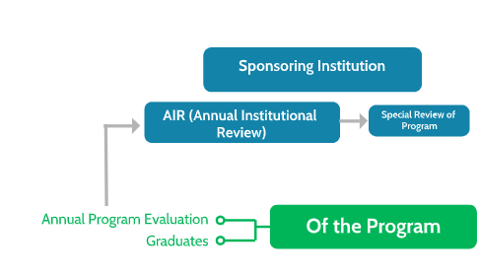
Program Evaluations

Slide 23
Faculty Evaluations
Recommended Scale:
1 = Hardly ever demonstrates this trait
2 = Demonstrates this trait occasionally
3 = Demonstrates this trait frequently
4 = Demonstrates this trait a great deal of the time
NA

Slide 24
Sample Faculty Evaluation
Sets clear expectations at the beginning of rotation
Teaches effectively on the wards and on rounds
Teaches effectively during didactic lectures
Probes residents with questions to improve critical thinking skills
Provides frequent (daily) actionable feedback to residents about their performance
Maintains good rapport with residents
Readily available for discussion of patient management

Slide 25
Sample Faculty Evaluation
Role Models professional interactions with patients*
Effectively uses literature to support views on patient management*
Attends and contributes to teaching conferences/didactics*
Incorporates cost-awareness during patient management discussions*
Incorporates discussion of healthcare disparities during patient management discussions*
Models interprofessional teamwork (teamwork with other members of the health care team)*
Provides appropriate supervision (responds to requests for guidance, is the communicator between resident team and other attendings)
*Aligns with a specific question on the ACGME survey

Slide 26
Feedback Cycle
Set CLEAR Expectations

Slide 27
Take Home Points
Compliance is key to an Evaluation System
Evaluation systems take time to develop
Evaluation systems will need to be revised every couple of years

Slide 28
Upcoming Live Webinar
Lights, Camera…Zoom!
Thursday, November 17, 2022
Meet the Experts – Fall Freebie
Tuesday, November 29, 2022
Motivating Faculty to Mentor & Do Research
Thursday, December 8, 2022
Sponsoring Institution Self-Study 101
Thursday, December 15, 2022
Look for our 2023 Jan – June Webinar Education Schedule
To be released on Monday, November 14, 2022
Latest On-Demand Webinars
GME Educational Program Design I
Wellness is a Team Sport
Looking Behind the Curtain at CMS Reporting
ADS 2022: Part II
Scholarly Activity – Starting the Year Off Right
JEDI Warriors in GME: Guardians of Justice, Equity, Diversity, and Inclusion
ACGME Complaint Letter: Now What?
Here We Grow Again – And With Our Community
The ABCs of GMEC: Part II
ADS 2022: Part I
Ask Partners – Spring Freebie
Faculty Development Series
15 Minutes to Effective Feedback
Toolbox for Teaching Millennials
Taking Supervision to the Next Level
Contact us today to learn how our Educational
Passports can save you time & money!
724-864-7320
www.PartnersInMedEd.com
Presented by Partners in Medical Education, Inc. 2022
28

Slide 29
Partners in Medical Education, Inc. provides comprehensive
consulting services to the GME community.
Partners in Medical Education
724-864-7320 | info@PartnersInMedEd.com
Carmela Meyer, MBA, Ed.D
Carmela@partnersinmeded.com
Heather Peters, M.Ed., Ph.D
Heather@partnersinmeded.com
www.PartnersInMedEd.com

