Slide 1
Please Note…
Please make sure your Start Video is OFF when logging into the WebEx platform.
Here is what it should look like
ALSO
It is NORMAL to not hear any sound until the webinar starts at 12:00 noon EST.
Your phone line is muted, but you can always chat to the host, BJ Schwartz, if you have any questions or concerns during this time.

Slide 2
A Day in the Life of a DIO…..
Anne Sullivan, MD, FAAFP, CPE anne.sullivan@bmg.md
Chief Academic Officer, DIO
Baptist Memorial Medical Education

Slide 3
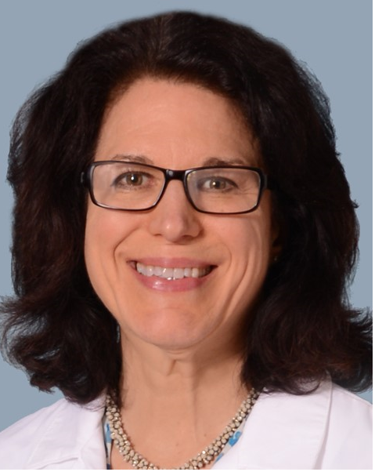
Introducing Your Presenter…
Anne Sullivan, MD, FAAFP, CPE
Family Medicine Physician 20+ years GME Experience including Program Director at 2 different programs
DIO since 2013; has led the growth of single sponsor institution to a SI with 10 accredited programs (2 more pending) across 3 states at 7 hospitals
Focused on Initial and Continuing Accreditation, building system infrastructure for GME and ensuring financial sustainability, and promoting physician and staff leadership development

Slide 4
LEARNING OBJECTIVES
Discuss the Tripartite role of the DIO:
Review how DIO Oversees Compliance for both ACGME and CMS
Discuss how DIO is responsible for Resource Procurement and Financial Sustainability
Discuss how DIO is GME Advocate and works for Talent Development

Slide 5
What is a DIO?
Italian word for God….
Designated Institutional Official (per ACGME)
The person who, within the world of Graduate Medical Education, is responsible for:
Compliance for both the ACGME and CMS
Resource Procurement and Financial Sustainability
GME advocate and Talent Development

Slide 6
COMPLIANCE: ACGME
ACGME Mission The mission of the ACGME is to improve health care and population health by assessing and enhancing the quality of resident and fellow physicians' education through advancements in accreditation and education.

Slide 7
ACGME VISION
We envision a health care system in which the Quadruple Aim* has been realized. We aspire to advance a transformed system of graduate medical education with global reach that is:
Competency-based with customized professional development and identity formation for all physicians;
Led by inspirational faculty role models overseeing supervised, humanistic, clinical educational experiences;
Immersed in evidence-based, data-driven, clinical learning and care environments defined by excellence in clinical care, safety, cost-effectiveness, professionalism, and diversity, equity, and inclusion;
Located in health care delivery systems equitably meeting local and regional community needs; and,
Graduating residents and fellows who strive for continuous mastery and altruistic professionalism throughout their careers, placing the needs of patients and their communities first.
_______________________ *The Quadruple Aim simultaneously improves patient experience of care, population health, and health care provider work life, while lowering per capita cost.

Slide 8
ACGME Values
Honesty and Integrity
Accountability and Transparency
Equity and Fairness
Diversity and Inclusion
Excellence and Innovation
Stewardship and Service
Leadership and Collaboration
Engagement of Stakeholders

Slide 9
ACGME— Goal to guarantee the best care of our population served both now and into the future, by ensuring excellent Clinical Learning Environment through adherence to, and optimization of ACGME accreditation regulations and inspirations….

Slide 10
Compliance-ACGME
IRC-System infrastructure
Program, Faculty and Resident surveys
Annual updates—new DIO approval for submission in 2021
Accreditation visits—New program applications and 2 year follow up; existing programs self-study
Assist in Prep and review before submission
Consider “outside eyes”—consultant?
Where are programs with their preparation for Self-Study…

Slide 11
Compliance: ACGME
GMEC oversite:
Policies, Policies, Policies
Special Reviews
Approval of new applications/ changes in complement
Approval of new/ deleted sites; PD changes
Review of Program Duty Hours

Slide 12
Compliance: CMS
Documentation, Documentation, Documentation
Accredited , allowed programs (ACGME only for Medical Education)
Allowed FTE’s—resident assignments impact reimbursement
IRIS to Cost Report—what goes in determines what comes out…
How familiar is your cost report team with GME?
Possibly need consultant/ discuss with MAC?
(MAC= Medicare Administrative Contractor)

Slide 13
Resource Procurement and Sustainability
Expenses vs. CMS and other revenues
Do you know your “Cap”, PRA, weighted FTE’s?
Compare per resident program costs to FTE reimbursement on Cost Report
Novel GME Hospitals (virgin) building “Cap”
Rural vs Urban 5-year rule
Grants?
Federal, state, system opportunities?
Foundation/ Charitable organization
Think about what you can set up to feed the future?

Slide 14
Talent Development
CLE—how to grow your residents?
Great seeds + fertile soil = better crop:
Assist in recruitment process—how the programs are recruiting the best “fit”
Behavior/ Reflective Questions?
Oversight of Well-Being initiatives
Oversight of implementing CLER best practices to train: “residents and fellows who strive for continuous mastery and altruistic professionalism throughout their careers, placing the needs of patients and their communities first.”

Slide 15
Talent Development
Faculty Growth—leverage your PD’s—future transition/succession planning
The role of the “senior” APD
From clinicians develop teachers, administrative leaders?
PD development:
Is this a terminal position or stepping stone?
Are they just doing time (they drew the short straw) and have other priorities…
Becoming Administrative Physician Leaders?

Slide 16
Questions?
Thank You!
anne.sullivan@bmg.md

Slide 17
Upcoming Live Webinar
Resident Wellness in the Virtual World
Tuesday, September 21, 2021
The Role of Coaching
Thursday, September 30, 2021
12:00pm – 1:00pm EST
GME Financing: The Basics, The Strategies, and the Upcoming Changes
Thursday, October 7, 2021
12:00pm – 1:00pm EST
Planning and Tracking Scholarly Activity
Thursday, October 21, 2021
12:00pm – 1:00pm EST
Latest On-Demand Webinars
Site Visits – What to Expect in 2021
ADS Update 2021
GME Grants and Funding Sources
Survey Research
Impactful AIR & APE – Bridging Data & Action
GMEC Checkups – QIPS Edition
ACGME Surveys – What Now?
Other Approaches to CCC & Evaluation
Lessons Learned from the Pandemic: Planning for the Next Disaster
Ask Partners – Spring Freebie
Digging for Data Part 3
How to Maximize Virtual Learning Part 2
Scholarly Work in Pandemic Times
Faculty Development Series
15 Minutes to Effective Feedback
Toolbox for Teaching Millennials
Taking Supervision to the Next Level
Contact us today to learn how our Educational
Passports can save you time & money!
724-864-7320
www.PartnersInMedEd.com
Presented by Partners in Medical Education, Inc. 2021
17

Slide 18
Partners in Medical Education, Inc. provides comprehensive consulting services to the GME community.
Partners in Medical Education
724-864-7320 | info@PartnersInMedEd.com
Anne Sullivan, MD, FAAFP, CPE
Guest Speaker
ann.Sullivan@bmg.md
www.PartnersInMedEd.com

