Slide 1
Please Note…
Please make sure your Start Video is OFF when logging into the WebEx platform.
Here is what it should look like
ALSO
It is NORMAL to not hear any sound until the webinar starts at 12:00 noon EST.
Your phone line is muted, but you can always chat to the host, BJ Schwartz, if you have any questions or concerns during this time.

Slide 2
A Successful Coordinator? You Must be C-C-CRAZY!!
Cheryl Haynes, C-TAGME

Slide 3
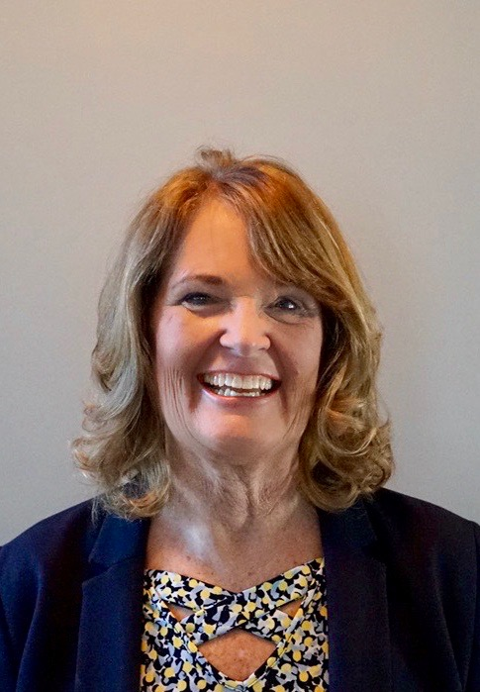
Introducing Your Presenter…
Cheryl Haynes, C-TAGME
GME Consultant
22 years in Graduate Medical Education
Seasoned speaker for ACGME, AAFP, ACOFP, as well as Partners in Medical Education
Experienced in program administration in both academic and community-based programs
Passionate about the well-being of everyone in GME.

Slide 4
Objectives
At the conclusion of today’s webinar, participants should
be able to:
recognize the attributes and abilities necessary to
successfully navigate our positions
accept that the one constant in graduate medical
education is change, and be able to adapt;
craft a personal and professional development plan to
assure growth and enhance well-being.

Slide 5
C-C-CRAZY!
Cheerful
Resilient
Achiever
Zealous
Creative
Curious
Yoga

Slide 6
CHEERFUL
Smile
HAPPINESS
Find joy in your work
Gretchen Rubin “The Happiness Project”
“The only way to be truly satisfied is to do what you believe is great work. And the only way to do great work is to love what you do.” Steve Jobs

Slide 7
CURIOUS “He who has a ’why’ can conquer any ‘how’.” Frederich Nietzche, German philosopher
Read and bookmark:
ACGME Institutional, Common Program and Specialty Program Requirements
FAQ’s
Tracked Changes copy
Always pay close attention to Background & Intent
Specialty Board certification requirements
What does it take for a resident in your specialty to
become board certified?
Institutional & Program Policies
Policies may determine the “how”

Slide 8
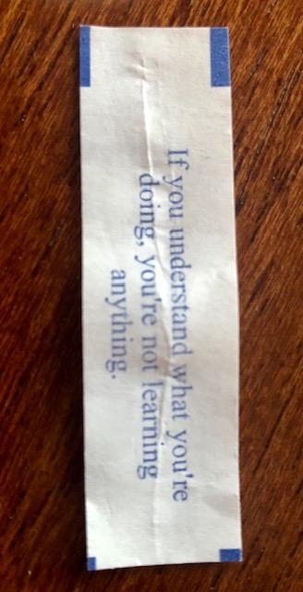
“If you understand what you’re doing, you’re not learning anything.”
Fortune Cookie Wisdom

Slide 9
CREATIVE
Activities for Residents, Team and Yourself
Meeting ACGME requirements -
“That’s the way we’ve always done it.”
But does it work for you?
Adapting to change
Change is purposeful.
The ACGME doesn’t give you the “how”.

Slide 10
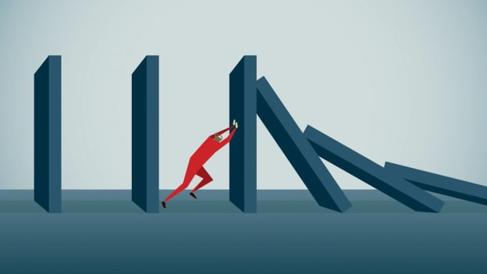
RESILIENCE
Change is constant
Mistakes are made
Adaptable
The ability to struggle well
Support system

Slide 11
ACHIEVER
Get things done!
Cross tasks off your list.
Establish your processes, do things the way that they work for you!
Find fulfillment

Slide 12
ZEALOUS
Cheerleader for your residents and your program
Recruitment
Be zealous about yourself - not just in your professional development, but in your personal development as well!

Slide 13
YOGA
Be physically active
Exercise
Calming/Centering activities
Relieve tension/stress
Take breaks

Slide 14
Be C-C-CRAZY…
Cheerful
Resilient
Achiever
Zealous
Creative
Curious
Yoga
…be successful.

Slide 15
What is Success?
Values
Strengths & Weaknesses
Goals & Objectives
Per Wikipedia, it is a concept, “the state or condition of meeting a defined range of expectations”.
Professional
Personal

Slide 16
What is your “defined range of expectations”?
Goals
Values
Strengths
Weaknesses

Slide 18
Lessons Learned
Just when you think you have it all figured out, it will change.
Who you are, the life experiences you have had or will have and the roles that you play dictate your definition of “professional development.”
Your path of development should be based on what matters to you.
Professional development is entirely personal.

Slide 19
Why do we need Professional Development?
“Well crafted and delivered continuing professional development is important because it delivers benefits to the individual, their profession and the public. CPD ensures your capabilities keep pace with the current standards of others in the same field...
CPD helps you to stay interested and interesting.”¹

Slide 20
What keeps us Interested?
Challenge of the work itself
Residents/People we work with
Being happy
Compensation
"Happiness comes from more than just money. It comes from relationships, job satisfaction, and enjoying your life." —Aimee Daramus, PsyD²
Feeling valued – don’t underestimate the little things

Slide 21
What makes us Interesting?
Commitment to our jobs
Commitment to our stakeholders (residents, faculty, etc)
Education – conferences, certifications
Being CCCRAZY
Personal Development

Slide 22
What will keep you…
Interested?
Interesting?
HAPPY?

Slide 24
Personal Development Plan
Goals: _____________________________ Values: ________________________________
_____________________________ ________________________________
Strengths: __________________________ Weaknesses: _________________________________
_____________________________ _________________________________
Where/in what do you envision yourself working in five years? ___________________________________________________________________________________
___________________________________________________________________________________
What skills do you need to develop to be able to achieve your vision?
___________________________________________________________________________________
___________________________________________________________________________________
What barriers do you think might deter achievement?
__________________________________________________________________________________
__________________________________________________________________________________

Slide 25
Objectives What do I want to be able to do or do better? What will keep me interested and interesting? | Success Criteria How will I review and measure improvement? How will I recognize success? | Actions What methods will I use to achieve my objectives or overcome perceived barriers? | Implementation How will I apply what I learn?

Slide 26
Personal Development Plan
Sign it
Date it
Get a co-signer
If related to your current position, use your PD, DIO or Supervisor
Mentor
Partner

Slide 27
Be CCCRAZY about yourself!
Know your strengths
Define a personal vision
Follow your Personal Development Plan

Slide 28
Recommendation
Gretchen Rubin’s Happiness Project
25+ minutes on Happiness
https://www.youtube.com/watch?v=BzuawrFE1xM

Slide 29
References
http://blog.mindgenius.com/2012/12/why-is-continuing-professional.html
https://www.wellandgood.com/how-much-money-to-be-happy/
Clip art obtained from Bing Image Search

Slide 30
Upcoming Live Webinar
Meet the Experts – Fall Freebie
Thursday, November 18, 2021
Moral Injury in Healthcare
Thursday, December 9, 2021
Streamlining Your Special Review
Thursday, December 16, 2021
Look for our new 2022 Spring Education Schedule
Jan – June
To Be Released
This Week
Latest On-Demand Webinars
GME Financing: The Basics, the Strategies, and the Upcoming Changes
The Role of Coaching
Resident Wellness in the Virtual World
A Day in the Life of A DIO
Site Visits – What to Expect in 2021
ADS Update 2021
GME Grants and Funding Sources
Survey Research
Impactful AIR & APE – Bridging Data & Action
GMEC Checkups – QIPS Edition
ACGME Surveys – What Now?
Other Approaches to CCC & Evaluation
Lessons Learned from the Pandemic: Planning for the Next Disaster
Faculty Development Series
15 Minutes to Effective Feedback
Toolbox for Teaching Millennials
Taking Supervision to the Next Level
Contact us today to learn how our Educational
Passports can save you time & money!
724-864-7320
www.PartnersInMedEd.com
Presented by Partners in Medical Education, Inc. 2021
30

Slide 31
Partners in Medical Education, Inc. provides comprehensive consulting services to the GME community.
Partners in Medical Education
724-864-7320 | info@PartnersInMedEd.com
Cheryl Haynes
cheryl@partnersinmeded.com
www.PartnersInMedEd.com

