Slide 1
Remediation of Struggling Learners
Using the Core Competencies
PARTNERS IN MEDICAL EDUCATION, INC.
Heather Peters, M.Ed., Ph.D.

Slide 2

Webinar Goals
Review foundational knowledge about remediation in training programs
Discuss medical knowledge deficits and remediation strategies for those deficits
Discuss interpersonal and communication skills and strategies to remediate difficulties in this competency
Discuss clinical reasoning and remediation strategies
Provide guidance to the Sponsoring Institution regarding meeting the needs of the programs for remediation

Slide 3
Some statistics…
Of the
50%
50%
7-15%
needing Intervention
will seek help
will NOT seek help
1/3
60%
OF PROGRAM DIRECTORS
STRUGGLE
OF GENERAL SURGERY
RESIDENTS NEED
INTERVENTION
WITH REMEDIATION DUE TO INADEQUATE DOCUMENATION
>
>
>
>
References:
ABIM estimates & General Surgery estimates reported in
Guerrasio J. Remediating the Struggling Medical Learner, AHME Publication, 2013.
Remediation in Medical Education: A mid-course correction, Kalet & Chou Ed, 2014

Slide 4
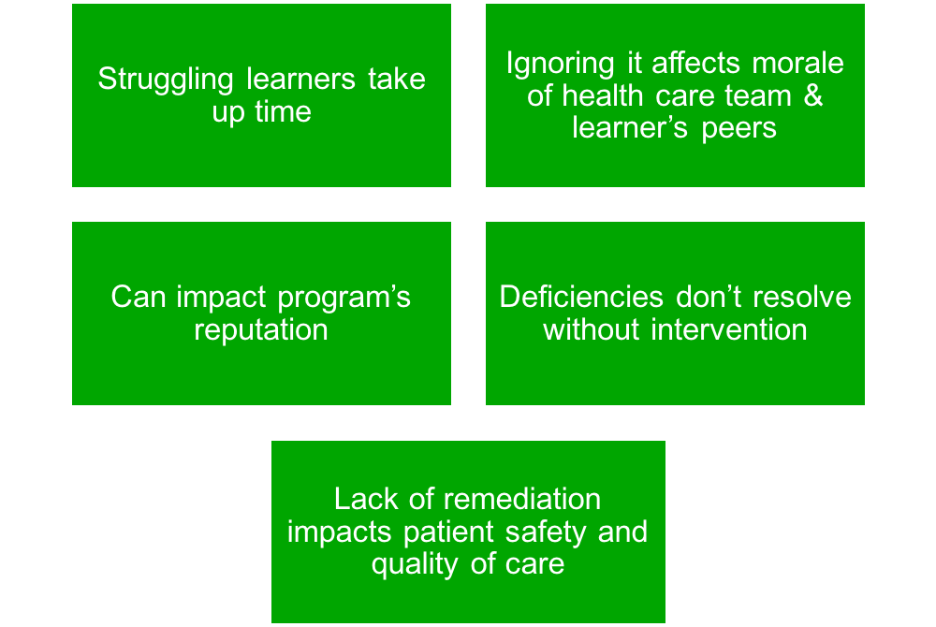
Importance of Learner Assistance
“Our obligation is to educate ALL learners”
J. Guerrasio

Slide 5
Early Identification to Provide Intervention, the Step BEFORE Remediation
Guidelines for initial identification phase
  Inform your new learners that you want to know what is going on with them when it is happening
  Meet with new learners one-on-one
  Hold faculty review meetings at the beginning of the academic year for new learners & transfers
Establishing early and late identifiers
  Early identifiers (comments, emails, PSAs, observation)
  Late identifiers (in-house medical knowledge exams, peer/multisource assessments, end of rotation evaluation, comments during a faculty review meeting, or unsatisfactory in-training exam performance)

Slide 6
Early Identification to Provide Intervention, the Step BEFORE Remediation
Faculty development principles
  PROVIDE every learner with FREQUENT FEEDBACK and establish authentic learner dialogue to uncover academic and behavioral issues early
  REVIEW expectations for educational experience with learners to allow them to see where they might be deviating from the norm
  NOTIFY appropriate persons when an issue is detected to obtain guidance
  DOCUMENT with examples whenever possible to guide the intervention process
Barriers
  Inadequate documentation
  No established procedures
  Mental health issues
    Psychosocial stressors, psychiatric diagnoses, substance abuse and
    Learning disabilities

Slide 7

Working with Learners with Medical Knowledge Deficits

Slide 8
Medical Knowledge
Goals:
  Differentiate between medical knowledge deficit and other deficits
  Provide some possible remediation strategies based on the type of medical knowledge deficit
  Recommendations for preventing and addressing medical knowledge deficits at the individual level, program level, and suggest faculty development objectives

Slide 9
It is a medical knowledge or some other deficit?
Comments such as “needs to read more” from faculty may point to a medical knowledge deficit, but never assume…
Investigate by interviewing the struggling learner

Slide 10

Key questions for Interview
How did you score on your USMLE step 1 and 2?
How did you score on other standardized tests, such as the SAT, MCAT, GRE compared with your peers
Was your performance consistent across all areas of the exam, or did you score low in one area and high in others?
Was your performance on exams throughout medical school consistent?
Can you identify a time when your performance significantly worsened? If so what was happening in your life at that time, and did your study habits change?
Is your knowledge gap global or related to a specific topic or set of topics?
What approaches have you been using to study? Can you describe your study habits in details?
Do you have a previously diagnosed disability?

Slide 11
It’s probably not a foundational MK deficit if…
The learner passed USMLE Step 1 on the first attempt and scored 200 or better
Instead investigate:
Clinical reasoning and related heuristic biases,
Communication skills
Mental health issues, such as anxiety

Slide 12

Maybe it’s a neuropsychiatric issue…
If the learner reports that they have always been a a “bad test taker” or had an injury or illness that resulted in a change in performance

Slide 13
If the knowledge deficit is limited to one or two topics…
Remediation will most likely be successful
Take a deep dive into their study skills…
Possible study skill problems:
Learner is putting in sufficient time, but study strategies are inefficient (reading the same textbook over many times rather than summarizing into briefer study tools—mind mapping, note cards)

Slide 14
Way better than “pump and dump” is
Spacing study of a particular content over long periods of time
Studying strategies which include frequent testing of recall using short answer-type questions, rather than multiple choice questions which test recognition rather than recall
Interleaving the studying of a variety of topics rather than blocking study tie by spending large amounts on a single topic and then moving onto the next topic
WARNING: Learners will feel these are less efficient because they produce long-term impact on learning, and they may be looking for a “quick fix”

Slide 15
Bloom’s Taxonomy of Educational Goals
Able to create, construct or formulate a new or unique point of view
Create
Evaluate
Analyze
Remember
Apply
Understand
Able to evaluate, defend, or judge a decision
Able to compare and contrast in order to differentiate between similar concepts
Able to demonstrate or illustrate a concept
Able to describe, explain and translate concepts
Able to define, recall, or memorize information

Slide 16

Remediation Plan A: Distracted Student with Chronic Low-Test Scores
Study skills coaching
Time management
Training for test taking
Self-regulation

Slide 17
Remediation Plan B: Lack of Committed Study Time
Explicit guidance toward high-yield material and the appropriate depth of learning
  Specific reading assignments with source and page numbers
Strict timelines
Frequent and regular meetings with a supervisor
Develop a study schedule with the learner
Model effective ways to blend background and just-in-time reading with experiential learning
Discuss the importance of learning material in depth to facilitate long-term retention and clinical application as opposed to “cramming”

Slide 18
Remediation Plan C: Anxiety, Confidence, and Chronic
Low-Test Scores
Keep in mind:
Chronic anxiety has been consistently associated with poor performance on cognitive assessments
Performance on academic subjects and achievement exam performance are negatively correlated with being black or Hispanic, lower socioeconomics status and parental education level, crowdedness of the home, and renting rather than owning a home.

Slide 19
Remediation Plan C: Anxiety, Confidence, and Chronic Low-Test Scores
Strategies:
Taking advantage or aural and visual learning
  Record summaries and listen to them over and over
  Create pictures with summaries (mind-mapping, pictorial representations of concepts)
Counteracting slow reading rate (English as a second language learners; Native English speakers who are slower processors
  Completing large volumes of practice test questions under timed conditions
  Work with a mentor who had similar struggles
  Needs a mentor’s support to establish boundaries with others or give up other non-academic tasks and responsibilities to preserve the necessary amount of protected study time

Slide 20
Remediation Plan C: Anxiety, Confidence, and Chronic
Low-Test Scores
A good use of medical educator’s time
  Ask learner to rephrase the question to demonstrate understanding of the concept being assessed
  Explain why the given answer is correct and the incorrect answers are wrong to ensure faulty knowledge is not learned
  Identify keywords to help him or her develop the ability to distinguish salient information from distracting facts
  Encourage learner to write their own multiple choice questions on a challenging topic actively engages the student in encoding, retrieving, and applying information to authentic scenarios

Slide 21
Remediation Plan C: Anxiety, Confidence, and Chronic Low-Test Scores
Determining when medical or neuropsychological testing is indicated
  Signs of an underlying learning disability include
    Prior difficulties in school
    Uneven strengths such as scoring high on physical science and biological science but low on verbal reasoning
    Difficulty understanding and following instructions
    Trouble remembering what someone just told him or her
    Difficulty distinguishing right from left
    Difficult identifying words or tendency to reverse letters, words, or numbers
    Lack of physical coordination
    Frequent loss or misplacement of items
    Difficulty understanding the concept of time

Slide 22

Who came to mind?
Take a moment during this cognitive break and jot down who came to mind while we were talking about medical knowledge deficits.
Now put down whether you think it is due to
  Distracted Student with Chronic Low-Test Scores
  Lack of Committed Study Time
  Anxiety, Confidence, and Chronic Low-Test Scores
Strategies to employ

Slide 23
Working with Learners that Possess Interpersonal and Communication Skills Challenges

Slide 24
Interpersonal and Communication Skills
Not as straight-forward as the medical knowledge deficit
Where this might identified:
  Clinical skills examinations
  Observation of the trainee in everyday clinical situations
Possible obstacles to successful communication:
  Knowledge deficit
  Attitude deficit
  Skills deficit
  Psychological and Psychiatric factors
  Interaction style
  Diversity

Slide 25
Remediator’s Process
Step 1: Establish a supportive learning environment
Step 2: Demonstrate your expertise on the topic and process of communication skills by modeling those techniques with the learner
Step 3: Listen to and acknowledge the learner’s emotions and understand his/her perspective
Step 4: Encourage reflection on strengths
Step 5: Share one or more objective observations of learner performance and encourage self-reflection
Step 6: Emphasize that is important for the learner to initiate the development of his/her own learning plan that is based on both self-reflection and feedback
Step 7: Determine a period of time for implementation followed by checking in on progress, revisiting learning plans, and modifying learning goals for continuous improvement

Slide 26
Who came to mind?
Take a moment and put down anyone who came to mind while we were talking about challenges with interpersonal and communication skills.
Start to identify which factors might be contributing this to this issue:
  Knowledge deficit
  Attitude deficit
  Skills deficit
  Psychological and Psychiatric factors
  Interaction style
  Diversity
Who could be a coach for this learner?

Slide 27
Working with Learners with Clinical Reasoning Issues

Slide 28
Clinical Reasoning
Four types of knowledge organization in physicians and trainees
Reduced
Dispersed
Elaborated
Compiled

Slide 29

Metacognition and Cognitive Biases
Premature closure
Anchoring
Confirmation bias
Availability
Diagnosis momentum

Slide 30
How to assess clinical reasoning skills
“Think aloud”
  Direct observations
  One minute preceptor
  Small group presentations
  Reading and giving feedback on patient notes in the setting of clinical care

Slide 31
Is it…
Difficulty with Problem Representation
OR
Problem with “Illness Scripts”

Slide 32
Difficulty with problem representation
Major symptoms:
  Limit or completely eliminate their assessment from a case presentation
  A separate set of diagnoses for related symptoms
  Poorly prioritized differential diagnosis
Remediation and Practice strategies:
Reverse presentations
Practicing using the use of semantic qualifiers
Analyzing learners’ presentations using the SNAPPS or the IDEA precepting models

Slide 33
Problem with “Illness Scripts”
Major symptoms:
  Miss relevant data on the history or examination
  “unfiltered data dump”
  Challenges creating differential diagnoses
    Frozen differential diagnosis
    Zebra differential diagnosis
Remediation and Practice strategies:
Asynchronous strategies
Synchronous/just in time strategies

Slide 34
Who came to mind?
Last time…write down who came to mind while we were on the topic of clinical reasoning.
Try to identify the issues:
  Difficulty with Problem Representation
  Problem with “Illness Scripts”
Strategies to employ

Slide 35
Addressing Remediation Issues at the Sponsoring Institution level?

Slide 36
Sponsoring Institution Considerations about Remediation
7-15% of medical trainees will experience difficulty during residency due to learning/behavior issues
While it’s ideal to have faculty who are well-versed in remediation strategies, that is the exception
  Large SIs should consider having someone who specializes in remediation at the institutional level
  Smaller SIs might create a collaboration with other smaller SIs to share an educator with these skills

Slide 37






Upcoming Live Webinars
The Stress Free Recipe:
Dealing with Burnout
Tuesday, February 7, 2017
12:00pm – 1:00pm EST
The Forgotten SI:
Single Sponsor Institutions
Tuesday, February 21, 2017
12:00pm – 1:00pm EST
Medical Knowledge ✔ Patient Care ✔ Now What?
Thursday, March 2, 2017
12:00pm – 1:00pm EST
Ask Partners – Spring Freebie
Thursday, March 23, 2017
12:00pm – 1:00pm EST
www.PartnersInMedEd.com
Partners® Snippets
On-Demand Webinars
Documentation and Coding to Teaching Physicians
Keeping up with Institutional NAS Requirements
New Program Accreditation.
Let’s get Started
GME Finance – The Basics
(2016 Update)
Maximizing Resident Forums
What Every Coordinator Needs to Know about NAS
CLER
Contact us today to learn
how our Educational Passports can save you time & money!
724-864-7320

Slide 38

Partners in Medical Education, Inc. provides comprehensive consulting services to the GME community.
Heather Peters, M.Ed., Ph.D.
724-864-7320 | Heather@PartnersInMedEd.com
www.PartnersInMedEd.com

