Slide 1
Please Note…
Please make sure your Start Video is OFF when logging into the WebEx platform.
Here is what it should look like
ALSO
It is NORMAL to not hear any sound until the webinar starts at 12:00 noon EST.
Your phone line is muted, but you can always chat to the host, BJ Schwartz, if you have any questions or concerns during this time.

Slide 2
ACGME Letter of Complaint: Now What?
Heather Peters, M.Ed, Ph.D
Carmela Meyer, MBA, Ed.D

Slide 3
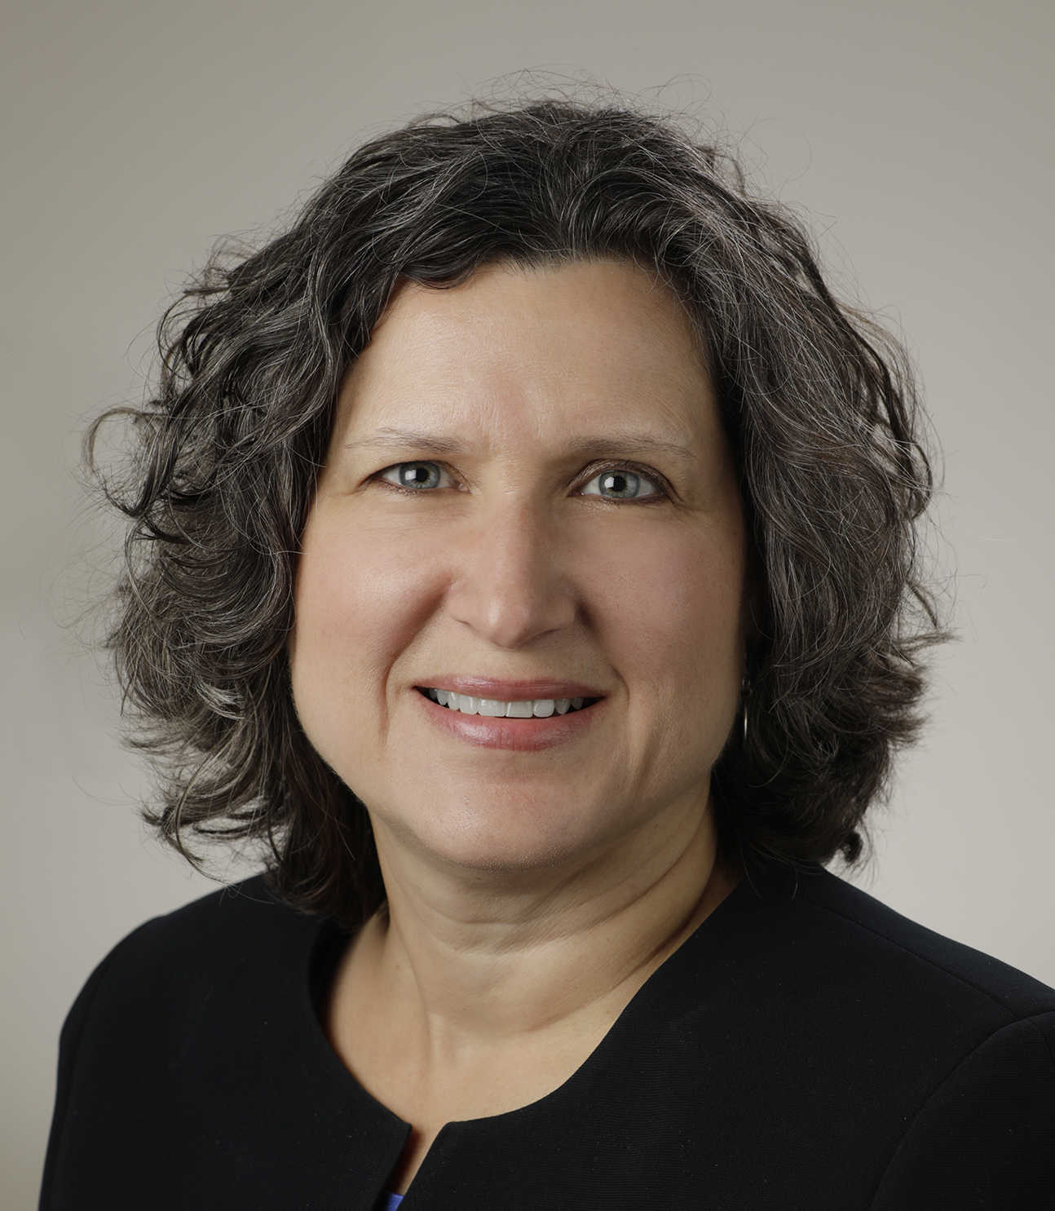
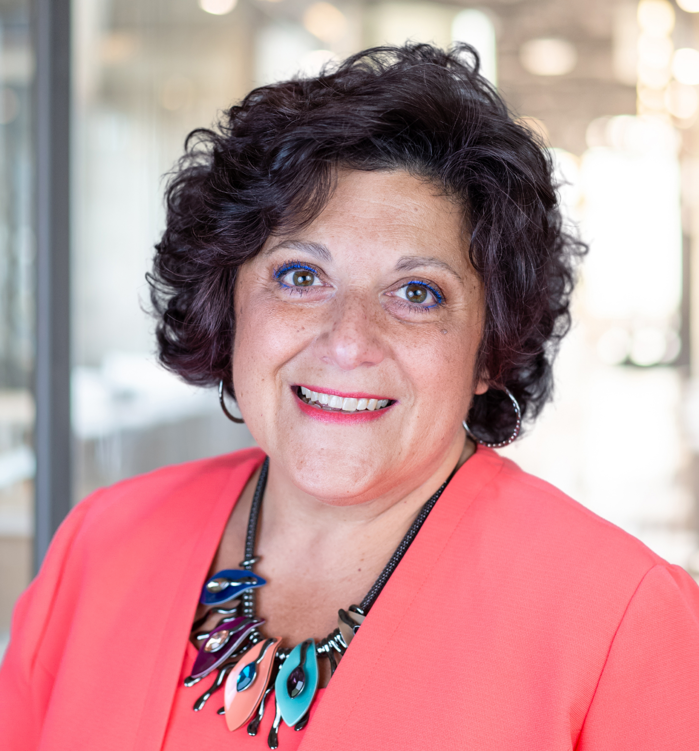
Introducing Your Presenters…
Heather Peters, MEd, PhD
Carmela Meyer, MBA, EdD
Guided two sponsoring institutions on probation after a “Site Visit for Cause” in their successful return to the continued accreditation
Assisted multiple programs and sponsoring institutions with preparing responses to ACGME Letters of Complaint
Expertise in program evaluation and promoting continuous program improvement
Guided a sponsoring institution on probation after a “Site Visit for Cause” in their successful return to the continued accreditation
Guided programs and sponsoring institutions during preparation for Site Visits for Cause resulting form Letters of Complaint
Expertise in building effective clinical learning environments

Slide 4
LEARNING OBJECTIVES
OUTLINE a framework for responding to ACGME Letter of Complaints at the program and the sponsoring institution level
ARTICULATE the oversight responsibilities of the sponsoring institution when a program receives an ACGME Letter of Complaint
REVIEW possible outcomes of an ACGME Letter of Complaint
DISCUSS how to prepare for a site visit if that is the outcome of the response to the ACGME Letter of Complaint
DESCRIBE how the sponsoring institution can prevent future ACGME Letters of Complaint
Tools:
Framework for Responding to an ACGME Letter of Complaint
Article: Twelve tips for giving effective Feedback in the clinical learning environment

Slide 5
One Day an Email Arrives…
A complaint has been filed…
This Photo by Unknown Author is licensed under CC BY-SA

Slide 6
Step One: Don’t Panic
Take a deep breath…
Realize that Letters of Complaint are more common these days
No data available from ACGME
The ACGME understands that "no program is perfect"​​
What kind of Letter of Complaint did you receive?

Slide 7
Understand the process Two Kinds of “Letters of Complaint”

Slide 8
Types of Complaints
Informal
Formal

Slide 9
What happens next?
Letter will discuss the issues and ask for an internal investigation with a follow-up report.
Letter of Complaint detailing allegations that MUST be responded to within four weeks.

Slide 10
Step Two: Read the Letter of Complaint Carefully
Take notes on the specific items detailed in the letter
Won’t name the person(s) who initiated the complaint
Trainee
Faculty
Outsider
Main Content
Requirements (specialty or common program requirements)
Allegations
Due date for Response

Slide 11
Sample Letter
The Accreditation Council for Graduate Medical Education (ACGME) has received a complaint alleging that ABC Residency Program (“the program”) is in violation of ACGME Requirements.
It is important for the ACGME to know the perspective of the program and Sponsoring Institution relating to the complaint allegations. Accordingly, please respond to the allegations set forth below and include any documentation that would demonstrate compliance with the requirements.

Slide 12
Sample Allegation
The following Requirements are alleged to have been violated:
(Program Requirement) VI.A.2.b).(1) The program must demonstrate that the appropriate level of supervision in place for all residents is based on each resident’s level of training and ability, as well as patient complexity and acuity. Supervision may be exercised through a variety of methods, as appropriate to the situation. (Core)
(Program Requirement) VI.A.2.d) The privilege of progressive authority and responsibility, conditional independence, and a supervisory role in patient care delegated to each resident must be assigned by the program director and faculty members. (Core)
(Program Requirement) VI.A.2.d).(1) The program director must evaluate each resident’s abilities based on specific criteria, guided by the Milestones. (Core)
(Program Requirement) VI.A.2.d).(2) Faculty members functioning as supervising physicians must delegate portions of care to residents based on the needs of the patient and the skills of each resident. (Core)
(Program Requirement) VI.A.2.e) Programs must set guidelines for circumstances and events in which residents must communicate with the supervising faculty member(s). (Core)
(Program Requirement) VI.A.2.e).(1) Each resident must know the limits of their scope of authority, and the circumstances under which the resident is permitted to act with conditional independence. (Outcome)
It is alleged that the program director is not providing levels of supervision in accordance with the above requirements. It is alleged that there is rarely direct or indirect supervision of consults and post-operative care. Allegedly, the program director does not see consults on a regular basis and he merely co-signs residents’ notes. It is further alleged that these concerns about supervision have been brought to the attention of the DIO, but they have not been addressed.

Slide 13
Important Information
Please provide a response to the above allegations by October 12, 2020. Please send only one electronic copy of the response to the email address below. (A paper copy is acceptable, but one electronic copy is encouraged).
The response must be reviewed and signed by the Program Director and the Designated Institutional Official.

Slide 14
Step Three: Calendar the Dates from Letter of Complaint
Example: For a response due October 12 – letter was dated September 10
If you need to reach out for help on response, do this soon
Call ACGME for guidance

Slide 15
Step Four: The Response
Build a response based on the facts using the framework
Be objective
If you make any new plans – put them in action
Plan for multiple reviews by reviewers who can be objective
Timelines are appropriate for some types of allegations, but not all

Slide 16
Framework
Most Common:
Supervision
Lack of teaching by faculty
DIO
Approval
Type of
Complaint
Next meeting/via email depending on timeline for response
Closed Meetings
Separate Faculty & Trainees
Inform GMEC
Inform Trainees
& Faculty
Draft Response
Determine
Timeline
Plan for several drafts
and reviews
Map Out
Response
Develop key points
List documents to attach to response

Slide 17
Oversight by the Sponsoring Institution
Schedule within a week of receiving the letter
Separate the faculty and trainees
Number the copies of the letter and collect after the meeting
Inform Trainees and Faculty
Best person to conduct the meetings with the trainees and faculty (best practice, not requirement)
Must sign the response letter (requirement)
DIO Oversight
Must be made aware of Letter of Complaint (must be in the minutes)
Must decide if a special review is required
GMEC Oversight
Recommendation:
Not this: “Letter of Complaint”
Better: “Letters of Complaint that do not get resolved by response”
Help the program with documentation/editing the response
Provide objectivity during a stressful event for the program
Monitor the well-being of the program director, APD, and the program coordinator
GME Oversight

Slide 18
Possible Outcomes of Response to the Letter of Complaint
Concern Resolved
Will receive letter that states “complaint has been resolved and there will be no more action”
Possible Outcomes
Site Visit Requested
Full - Everything in your specialty and common program requirements will be reviewed
Focused - The interviews will be focused on the allegations

Slide 19
Preparing for the Site Visit
Partners® Webinars:
“Virtual Site Visits” – January 2021 (On-Demand)
“Site Visits are Coming” – October 2022 (Live)
Some things that are overlooked during preparation for a “site visit for cause”:
Current citation responses for the program AND the sponsoring institution
ACGME Survey results for program AND the sponsoring institution

Slide 20
Prevention is the Best Strategy
This Photo by Unknown Author is licensed under CC BY-SA

Slide 21
Article: Twelve Tips for Giving Feedback in the Clinical Learning Environment
Communicate goals and objectives for feedback
Base feedback on direct observation
Begin the session with the learner’s self-assessment
Reinforce and correct observed behaviors
Use specific, neutral language to focus on performance
Confirm the learner’s understanding and facilitate acceptance
Conclude with an action plan
Create staff-development opportunities
Establish a respectful learning environment
Two-way feedback
Reinforce “learning” not “perfection” or “status quo”
Focus on continuous program improvement (PEC should drive this)
Make feedback part of institutional culture
For learners
For teaching faculty
For rotations
For didactics
For programs
For program leadership

Slide 22
Prevention is the Best Strategy
This Photo by Unknown Author is licensed under CC BY-SA
Open communication​ & transparency
Feedback must
go both ways
be encouraged
Pathways/venues for feedback must be prioritized
PEC
GMEC
Resident Forum
Listen without being defensive​
Oh, by the way, did we mention documentation!​

Slide 23
DO
I’ve got a complainer, now what?
Follow your procedures and policies
Document issues
Keep the whole program in mind, not just the individuals
This is a “call for help”

Slide 24
DON’T
I’ve got a complainer, now what?
Don’t allow the complainer(s) to drive the program
Don’t treat the complainer(s) differently

Slide 25
This Photo by Unknown Author is licensed under CC BY-NC-ND
Don’t panic! Prepare!
Follow the directions on the letter
Conduct a special review if the complaint warrants it
Keep the GMEC informed
Document everything!
This Photo by Unknown Author is licensed under CC BY-SA

Slide 26
Upcoming Live Webinar
JEDI Warriors in GME: Guardians of Justice, Equity, Diversity, and Inclusion
Thursday, June 23, 2022
Scholarly Activity – Starting the Year of Right
Tuesday, July 12, 2022
ADS 2022: Part II
Thursday, July 21, 2022
Looking Behind the Curtain at CMS Reporting
Thursday, August 4, 2022
Wellness is a Team Sport
Tuesday, August 16, 2022
Latest On-Demand Webinars
Here We Grow Again – And With Our Community
The ABCs of GMEC: Part II
ADS 2022: Part I
Ask Partners – Spring Freebie
Getting to the Next Stage – Program Improvement II
The ABCs of GMEC: Part I
Leveraging RMS Technology for the Medicare Cost Report
Back to Basics – GME for New Coordinators
Digging for Data IV
Getting to the Next Stage - Program Improvement I
Faculty Development Series
15 Minutes to Effective Feedback
Toolbox for Teaching Millennials
Taking Supervision to the Next Level
Contact us today to learn how our Educational
Passports can save you time & money!
724-864-7320
www.PartnersInMedEd.com
Presented by Partners in Medical Education, Inc. 2022
26

Slide 27
Partners in Medical Education, Inc. provides comprehensive consulting services to
the GME community.
Partners in Medical Education
724-864-7320 | info@PartnersInMedEd.com
Heather Peters, M.Ed., Ph.D
Heather@partnersinmeded.com
Carmela Meyer, Ed.D
Carmela@partnersinmeded.com
www.PartnersInMedEd.com

