Slide 1
ACGME Section 6 and Wellness Update

Slide 2
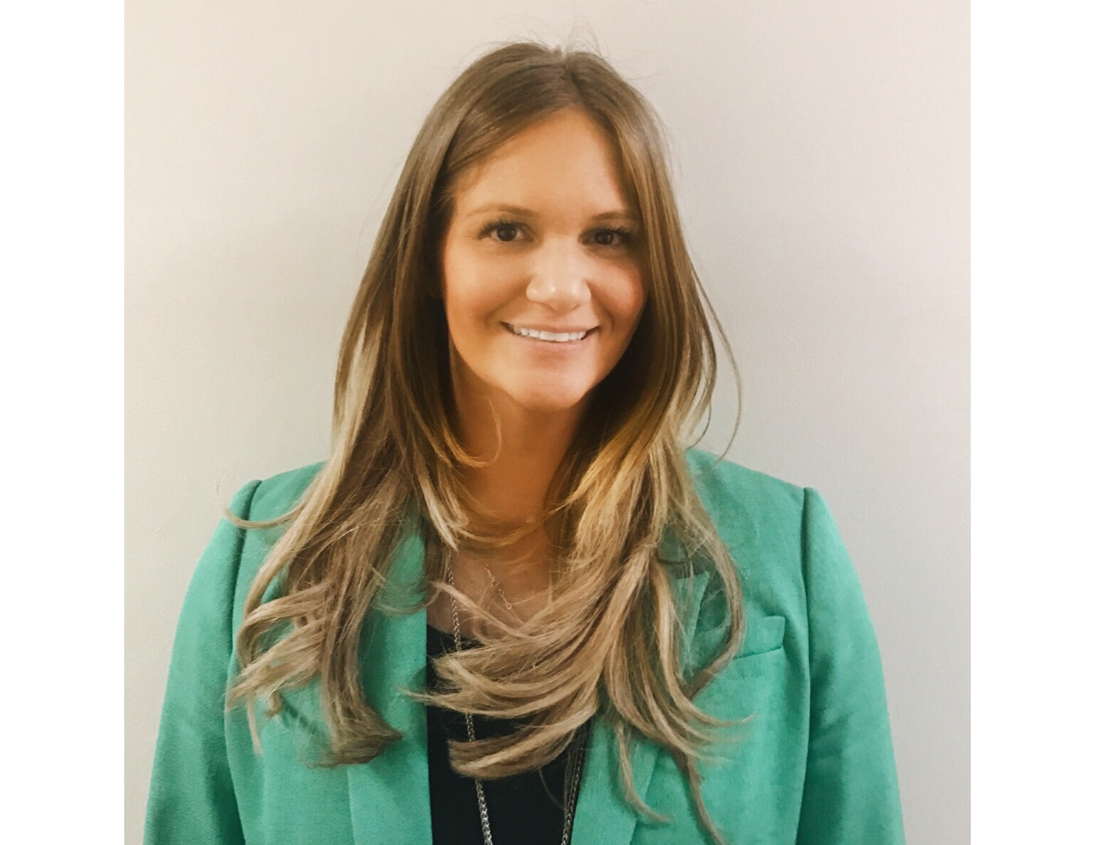
Introducing Your Presenter
Amy Lefkovic, MHA
Received her Bachelors Degree in Health Information Management from Kean University
Began her career in Graduate Medical Education (GME) at Hospital for Special Surgery as the Radiology Fellowship Program Coordinator
Received her Masters degree in Healthcare Administration from Seton Hall University
Continued her career in GME at Lutheran Medical Center as the OB/GYN Residency Coordinator
Is currently the Manager of GME and Academic Affairs at Staten Island University Hospital

Slide 3
Goals and Objectives
To review section 6 of the ACGME Common Program Requirements.
To review what has been accomplished since the requirements were revised.
To explore ways in which to enhance the compliance to these requirements.

Slide 4
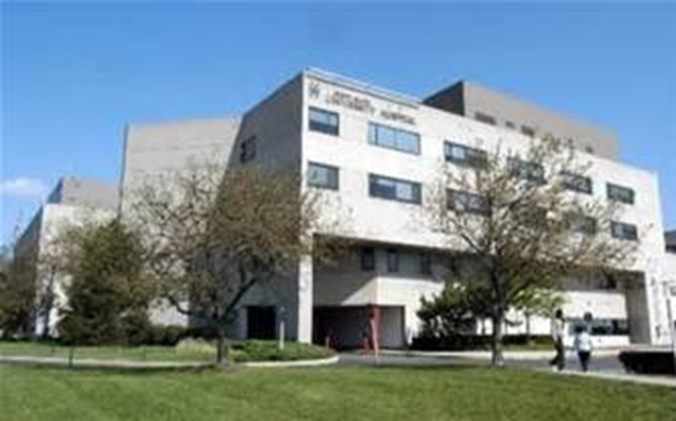
Staten Island University Hospital Northwell Health
Northwell Health
305 residents and fellows
16 programs

Slide 6
Section 6 Overview
Patient Safety
Quality Improvement
Supervision
Professionalism
Well-being

Slide 7
Section 6 Overview
Fatigue Mitigation
Teamwork
Transitions in care
Clinical experience and education
Clinical work hours
Moonlighting

Slide 8
Section 6
Something old
Something new
We love to borrow
Are you blue?

Slide 9
Patient Safety
Formal education
Reporting
Adverse actions
Near misses

Slide 10
Patient Safety
Investigating
Follow-up
Improvement

Slide 12
Patient Safety
WHO?
Who should they report these near misses?
WHAT?
What should they be reporting?
WHERE
Where should they report these near misses?

Slide 13
Patient Safety
WHEN?
When should they report them?
WHY?
Why should they report them?

Slide 14
Patient Safety
Culture change
Tattle tail
Repercussions
Learning experience for all

Slide 15
Update
Go beyond didactics
Work with patient safety officer
Review/new mechanism for reporting
Could not distinguish who was reporting

Slide 16
Quality Improvement
Access to data
Receive data quality metrics and benchmarks
Participate in interprofessional quality improvement activities

Slide 17
Quality Improvement
Who knows quality goals?
Eye opener for Department of Quality Improvement and Risk Management
GMEC poll
Educate…who??
Not enough just to educate and do case reports

Slide 18
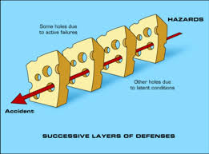
Update
Resident Quality Care Collaborative Council
3 years – FINALLY getting somewhere
Start each meeting with a quality tip or method
Determine project? – pebble in your shoe
Get stuck on not moving mountains
Quality Improvement toolkit
PDCA
Swiss Cheese Affect

Slide 19
Supervision
Safe and effective care to patients
Resident development
Knowledge
Skills
Attitude
Direct – Indirect - Oversight

Slide 20
Supervision
Always knew but brought things to light
Logging procedures correctly
Define how nursing staff can view privileges
Doctor badges
Encourage an environment of inquiry
You are in?...so am I!!

Slide 21
Update
One step further….tell them!
More of an education for faculty than residents
Feedback workshop

Slide 22
Professionalism
VI.B.3. The program director, in partnership with the Sponsoring Institution, must provide a culture of professionalism that supports patient safety and personal responsibility.

Slide 23
Professionalism
Non-physician obligations
Safety and wellness of patients entrusted in their care
Management of time before, during and after clinical assignments
Recognition of impairment
Wellness

Slide 24
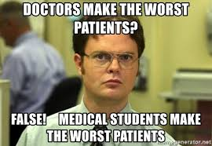

Slide 25
A different type of professionalism
Millennial entitlement
First job

Slide 26
Update
Remediation, probation, termination
Strict plan with articles and presentations
Ask them what professionalism is

Slide 27
Teamwork
Maximize communication
Work as members of an interprofessional team
PROFESSIONALISM

Slide 28
Transitions of Care
Maximize communication
Monitor effective, structured hand-over processes
Communicate schedules of attendings

Slide 29
Initial and Update
New policy to include form
Submitted to the Department of Academic Affairs
Supervise the same as procedures
Turn into a Quality Improvement project
Patient transfer note

Slide 30
Clinical and Educational Work Hours
VI.F.2.b) Residents should have 8 hours off between scheduled clinical work and education periods.
VI.F.3.a).Clinical and educational work periods for residents must not exceed 24 hours of continuous scheduled clinical assignments

Slide 31
Clinical and Educational Work Hours
VI.F.3.a).(1) Up to 4 hours additional time may be used for activities related to patient safety, such as providing effective transitions of care, and/or resident education.
Please don’t make this a scheduled thing!!!

Slide 32
Fatigue Mitigation
VI.D.1.a) Educate all faculty members and residents to recognize the signs of fatigue and sleep deprivation.
Should come after clinical work hours
Actually enforce it!

Slide 34
Well-Being
Self care is a learned skill
Attention to scheduling
Work intensity
Safety of residents and faculty members

Slide 35
Well-Being
Burnout
Depression
Substance abuse
Alert others

Slide 36
Well-Being
Opportunity to attend medical, mental health and dental care appointments
Confidential affordable mental health assessment
Policies and procedures in the event that a resident may be unable to perform their patient care responsibilities

Slide 38
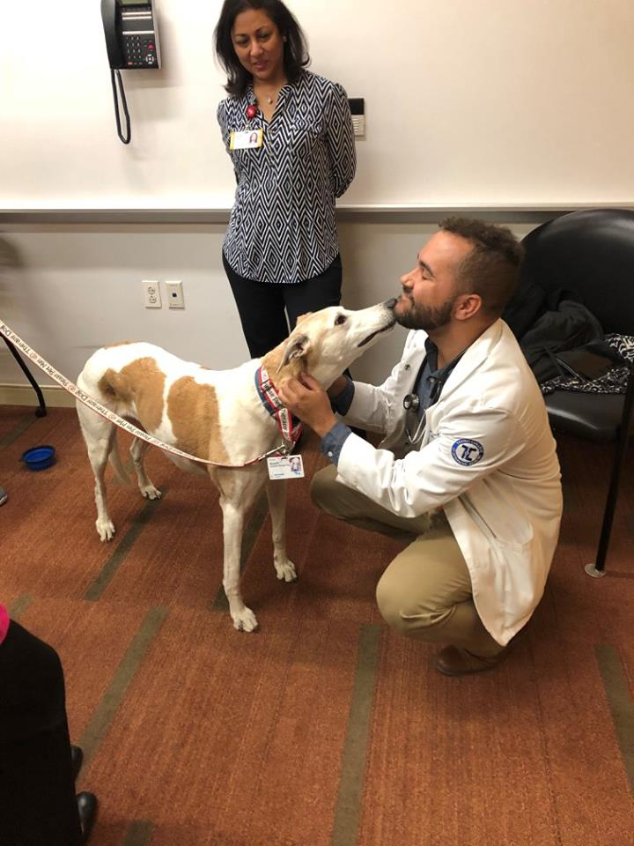
What we did
Talent search
Facebook page
Monthly activity calendar
Pet therapy (they do love it)

Slide 39
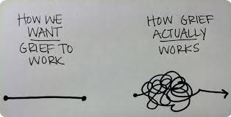
News Flash

Slide 40
A Little Better
Monthly subcommittee
Balint groups
Who can they call?
Mental health protocol with confidentiality and EMAIL ADDRESS!

Slide 41
Update
Difference between activities and well-being
Grief counseling
Schedule!!!!
Wellness rounds
Ask them to help fix it

Slide 42
Summary
All changes brought to light
Initial action was to educate
Residents
Faculty
Didactics are always good but how can you move to the next phase?
Go the extra mile

Slide 43
Upcoming Live Webinars
New Institution – The value of Graduate Medical Education Thursday, November 8, 2018 12:00pm – 1:00pm EST
Meet the Experts – Fall Freebie Tuesday, November 27, 2018 12:00pm – 1:00pm EST
Milestones – Beyond the CCC Tuesday, December 4, 2018 12:00pm – 1:00pm EST
Mentoring the GME Coordinator: The First 3 Years Thursday, December 13, 2018 12:00pm – 1:00pm EST
On-Demand Webinars
Coordinator Development – How to Build a Team Responsiveness to Diverse Patient Populations
Demystifying the Resident and
Faculty ACGME Survey
Oversight of the Clinical Learning and Working Environment
Policies, PLA’s and Policing
Making “Cents” Out of GME Financing
NEW Faculty Development Series
Contact us today to learn
how our Educational
Passports can save you
time & money!
724-864-7320
www.PartnersInMedEd.com
15 Minutes to Effective Feedback
43

Slide 44
Partners in Medical Education, Inc. provides comprehensive consulting services to the GME community.
Partners in Medical Education
724-864-7320 | info@PartnersInMedEd.com
Amy Lefkovic, MHA GME Consultant
Amy@PartnersInMedEd.com
www.PartnersInMedEd.com
Presented by Partners in Medical Education, Inc. 2018

