Slide 1
ACGME Survey Results Have Arrived Now What?
Heather Peters, M.Ed., Ph.D
GME Consultant
Partners in Medical Education

Slide 2
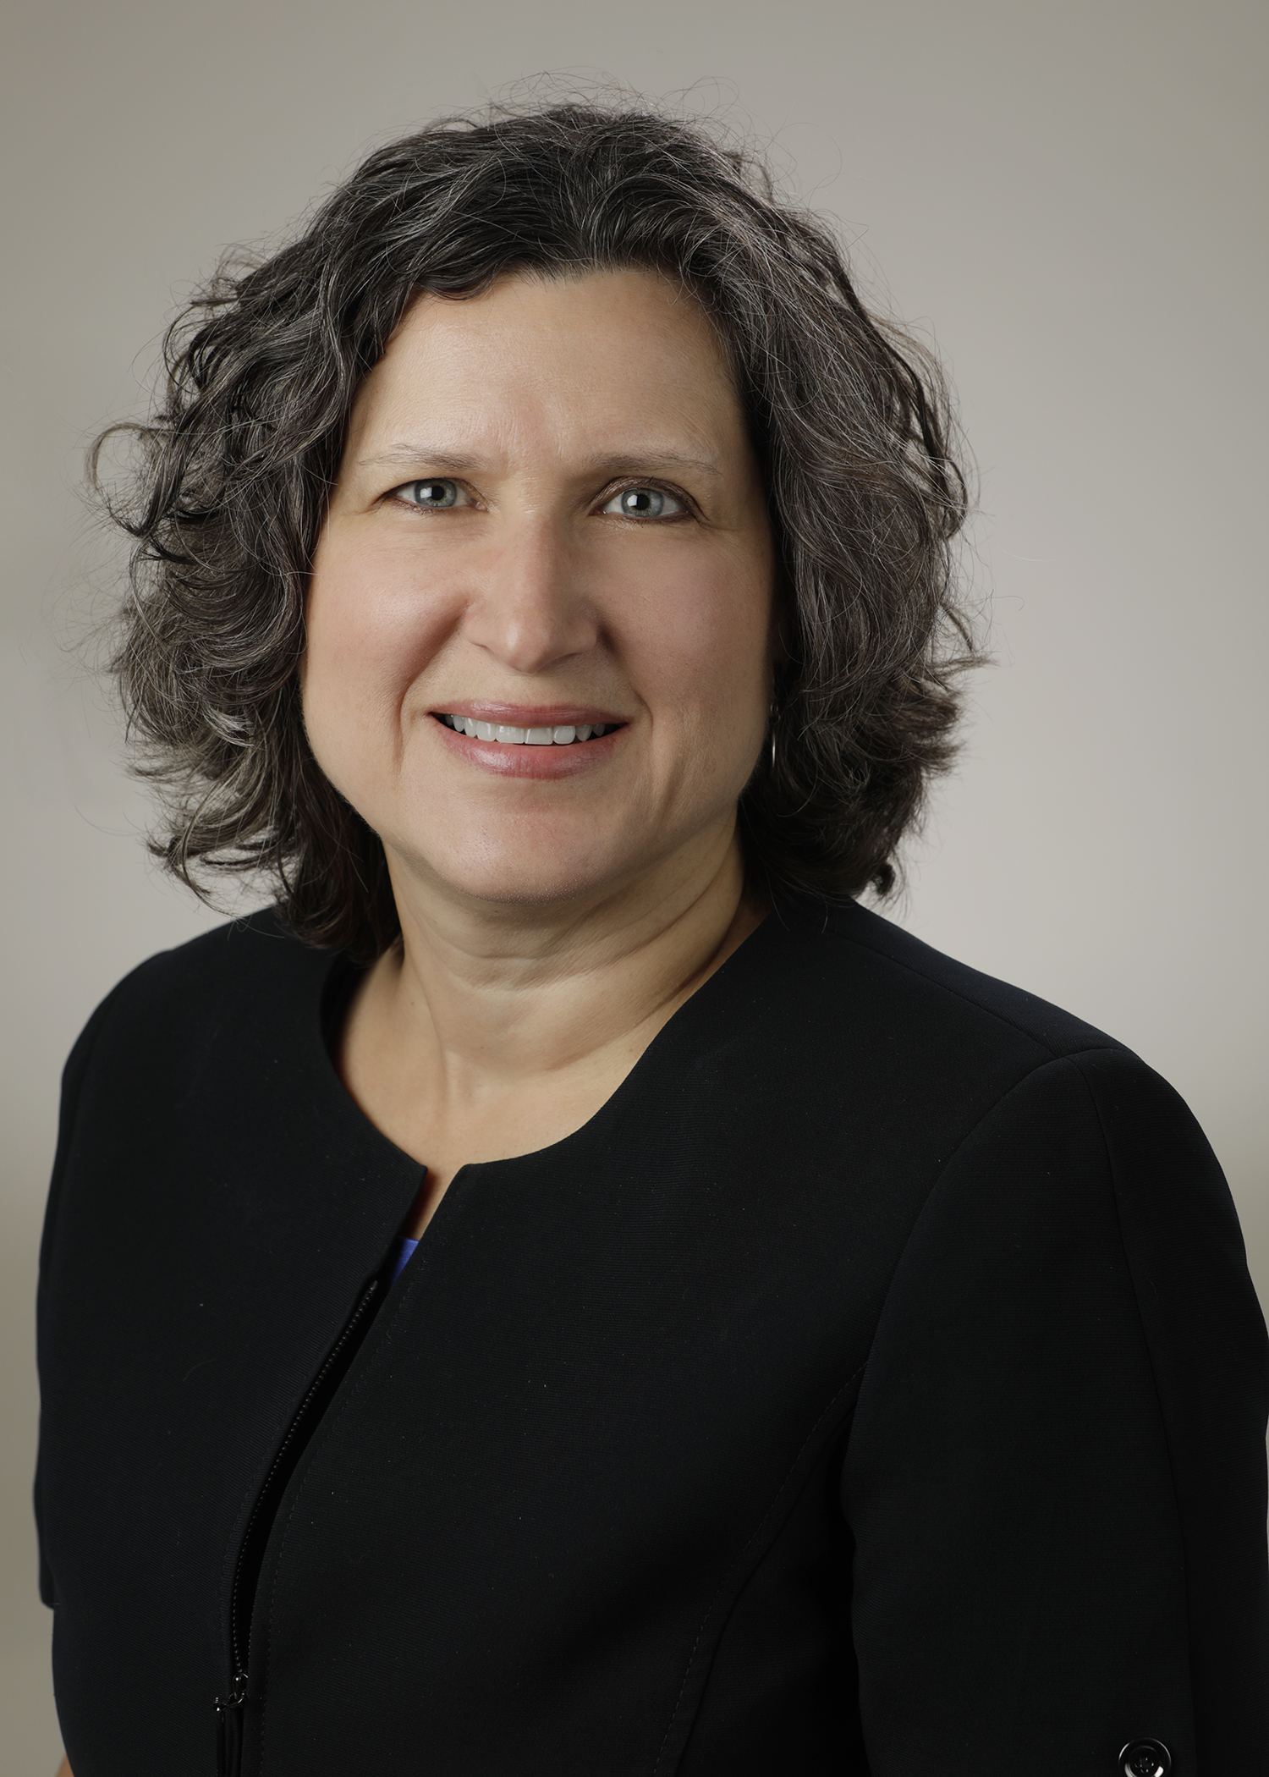
Introducing Your Presenter…
Heather Peters, M.Ed, PhD
GME Consultant
Former GME Director & DIO
Seasoned speaker at ACGME & subspecialty national meetings
Areas of Expertise: GME Strategic Planning; Program Evaluation; and Faculty Development
3 decades in education; Masters of Education in curriculum & evaluations, PhD concentration in secondary education & adult learning theories

Slide 3
Learning Objectives
Review basics and recent changes to the ACGME survey
Discuss how to leverage results with the GME organization and the governing board
Illustrate how to use results to develop action plans for improvement
Hand-out:
ACGME Survey Talking Points – Residents – Customizable

Slide 4
Understanding ACGME Surveys

Slide 5
Purpose
Purpose: “an additional method used to monitor graduate medical clinical education and provide EARLY WARNING of potential non-compliance with ACGME accreditation standards”
.
References:
http://www.acgme.org/Data-Collection-Systems/Resident-Fellow-and-Faculty-Surveys
Holt K, Miller RS. The ACGME resident survey aggregate reports: an analysis and assessment of overall program compliance. Journal of Graduate Medical Education. December 2009

Slide 6
Program Data Points
Annual Data Updates (WebADS)
Scholarly activity*
Citation responses*
Major changes*
Clinical Competency Committee
Milestones
ACGME Surveys
Annual Program Evaluation
Program Evaluation Committee
Resident/Fellow*
Faculty*
Potential
Program Data
Points
*Data Points used for Accreditation

Slide 7
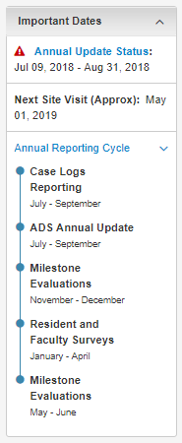
Annual Data Review
Data is reviewed annually include¹
information about the program’s characteristics,
the clinical learning environment,
program and institutional leadership,
the opinions of faculty and residents through ACGME survey,
resident clinical experience data, and
first-time pass rate data provided to the ACGM by the ABMS
¹Bryne L, Miller R, Nasca T. Implementing the Next Accreditation System: Results of the 2014-2015 Annual Date Review. JGME. February 2016.

Slide 8
Rationale for Surveys
When programs meet the required compliance rates for each survey, reports are provided that aggregate their survey data to provide an
anonymous
comparative look at how the program compares against
national,
institutional, and
specialty averages
Source: http://www.acgme.org/Data-Collection-Systems/Resident-Fellow-and-Faculty-Surveys

Slide 9
Content of Surveys Changed in 2020
Resident Focus areas:
Faculty Focus areas:
Resources
Professionalism
Patient Safety and Teamwork
Faculty Teaching and Supervision
Evaluation
Educational Content
Diversity and Inclusion
Clinical Experience and Education
Resources
Professionalism
Patient Safety and Teamwork
Faculty Teaching and Supervision
Educational Content
Diversity and Inclusion
LINKS: http://www.acgme.org/Portals/0/ResidentSurvey_ContentAreas.pdf
http://www.acgme.org/Portals/0/ACGME%20FacultySurvey%20QuestionContentAreas.pdf

Slide 10
Resident/Fellow Surveys
Important Information:
Scheduled from January-April
Need 70% compliance to see results
Off-cycle residents
Specialty-specific questions
Handout: FAQs – Resident Survey

Slide 11
Faculty Surveys
Similar information to resident/fellow
Level of involvement in program
60% compliance
Handout: FAQs – Faculty Survey

Slide 12
Wellness Surveys
New questions – residents & faculty
2017 – based on CPR, Section VI: Wellness
Aggregate reports will be provided to program and sponsoring institution
Not provided to Review Committee

Slide 13
Before the Survey
Review
Educate
Discuss
KEY POINT: Chief Residents or Senior Residents should lead these activities

Slide 14
Activating the Survey
Access the survey activation screen either just prior to or while the residents/fellows are gathered so that if there are any issues with the emails (incorrect emails), it will be discovered
You are allowed to send reminder emails every 2 hours
KEY POINT: The email for the survey has to be activated by the program

Slide 15
During the Survey
Residents/Fellows
Schedule time for all to complete survey simultaneously
Use didactics time to convey that this is important
Don’t ask them to do this “between patients” which is when they will do it if you do not schedule a specific time
Faculty
New faculty should be guided through process

Slide 16
After the Survey
Thank residents & faculty for providing their feedback
Remind residents & faculty…
Surveys happen every spring
It is better to bring issues into the open prior to the survey
KEY POINT: Don’t ask the residents how they responded

Slide 17
Disseminating Results

Slide 18
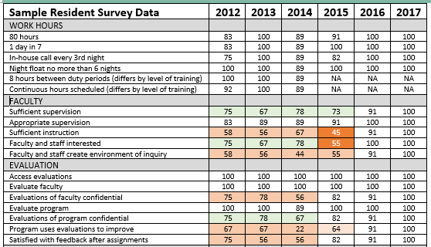
Sample Trended Survey Data

Slide 19
Survey results should be shared with…
Program
GMEC
C-Suite
Governing Board

Slide 20
Program (trainees, faculty, staff)
APE (Annual Program Evaluation)
“Prioritize the actions needed to rectify issues found on the ACGME resident and program faculty surveys”¹
¹Simpson D, Lypson M. The year is over, not what? The annual program evaluation. Journal of Graduate Medical Education. September 2011.

Slide 21
GMEC
AIR (Annual Institutional Review)
Trends/issues identified
Resource needs identified by surveys
Next steps…
KEY POINT: ACGME Surveys MUST be reviewed and discussed by the GMEC. This is a Sponsoring Institution requirement.
Citation Alert: Sponsoring Institutions often receive citations for not reviewing the actual ACGME survey reports at the GMEC meetings. It’s not enough to talk about them in the aggregate.

Slide 22
C-Suite
Trends in the resident/faculty surveys – particularly downward trends
Key
KEY POINT: “Quality Indicators”, such as those found on the ACGME surveys will pique their interest and may assist in getting necessary resources if you provide the data in the right way

Slide 23
Governing Board
Summary Information
How does this survey support the data regarding number of retained graduates?
Does the current data bode for more or less graduate retention in the future?

Slide 24
Others?
Potential faculty and program directors
Specific stakeholders depending on your institution
Academic Medical Centers
Community-Based Institutions

Slide 25
Why does the Survey Matter?
Resident Surveys are the number one reason for data-prompted site visits!
84% of RC’s listed Resident Survey as the trigger
51% was sole reason
Caniano, D, Martinez, S, & Nace, C. (2021). Reasons for data-prompted site visits: Field staff findings and review committee decisions. [Oral presentation]. ACGME Annual Educational Conference. [Virtual Experience.]

Slide 26
Most Frequent Areas of Survey
Duty hours
Faculty supervision
Feedback after assignments
Opportunities for scholarly activity
Raising concerns without fear
How many of your surveys show non-compliance or declining compliance in these areas?

Slide 27
Improvement Plans
Oversight
PEC
GMEC
Investigate current situation:
Focus groups: trainees, faculty, leadership
Confidential Surveys
Detail how you plan to get there by next survey
Goals go nowhere without plans
Determine goal: % increase
“20% increase at the time of the next survey”

Slide 28
Take Home Points
The ACGME Survey is a data point that is closely followed by the Review Committees
Preparation of residents/fellows and faculty is prudent
Tracking, trending & distributing data helps anticipate possible citations in the future
Creating improvement plans for areas needing improvement are necessary

Slide 29
Upcoming Live Webinar
GMEC Checkups – QIPS Edition Thursday, May 25, 2021 12:00pm – 1:00pm EST
Impactful AIR & APE – Bridging Data & Action Thursday, June 3, 2021 12:00pm – 1:00pm EST
Survey Research Tuesday, June 22, 2021 12:00pm – 1:00pm EST
GME Grants and Funding Sources
Tuesday, July 13, 2021
12:00pm – 1:00pm EST
Latest On-Demand Webinars
Lessons Learned from the Pandemic: Planning for the Next Disaster
Ask Partners – Spring Freebie
Digging for Data Part 3
How to Maximize Virtual Learning Part 2
Scholarly Work in Pandemic Times
How to Maximize Virtual Learning Par 1
Quality Improvement in GME: 5 years later
How to Manage A Virtual Site Visit
DIO Role & Responsibilities: Keys to Success
Working with Struggling Learners
Meet the Experts – Fall Freebie
NEW Faculty Development Series
15 Minutes to Effective Feedback
Toolbox for Teaching Millennials
Taking Supervision to the Next Level
Contact us today to learn how our Educational
Passports can save you time & money!
724-864-7320
www.PartnersInMedEd.com
29

Slide 30
Partners in Medical Education, Inc. provides comprehensive consulting services to the GME community.
www.PartnersInMedEd.com
Heather Peters, M.Ed, PhD
Heather@PartnersInMedEd.com
Partners in Medical Education
724-864-7320 | info@PartnersInMedEd.com

