Slide 1
Please Note…
Please make sure your Start Video is OFF when logging into the WebEx platform.
Here is what it should look like
ALSO
It is NORMAL to not hear any sound until the webinar starts at 12:00 noon EST.
Your phone line is muted, but you can always chat to the host, BJ Schwartz, if you have any questions or concerns during this time.

Slide 2
ADS Updates 2022
Heather Peters, M. Ed, Ph.D, GME Consultant
Carmela Meyer, MBA, Ed.D, GME Consultant

Slide 3
Learning Objectives
Learning Objectives:
REVIEW the 2022 ADS update
DISCUSS requirements for scholarly activity tracking, block diagrams, citation responses, and major changes
PROVIDE overview of ACGME resources & Partners’ resources
TOOLS
Strategies for ADS Updates Through the Year
Template for Major Changes Section
Email template for collecting Scholarly Activity of Faculty and Trainees

Slide 4
DIO Approval
DIO required to sign off on update
Program Director to DIO
DIO then either approves or sends back to the program for revisions

Slide 5
FTE for Program Leadership
What percent FTE salary support for APD
What percent FTE salary for coordinator
Check your program requirements for any specifics related to APD and subspecialty FTE

Slide 6
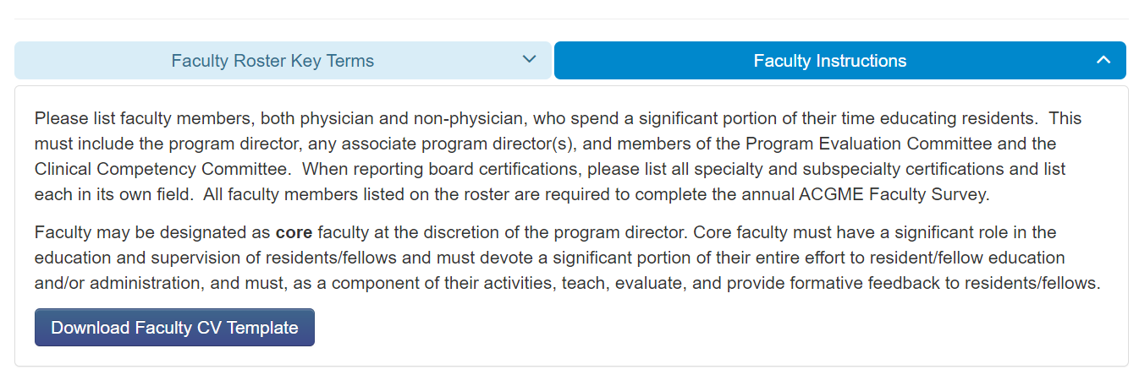
Faculty Roster
All RC's updated instructions that will be the default display. Pathology example:

Slide 7
Faculty Roster
Read FAQ's!
Board certification information
ABMS/AOBMS information pulled into ADS
Not automatic – use a double check. Is what you are entering matching the board data?
License information
Most state medical board sites have expiration data
Links to the scholarly activity table
Hours: Review your requirements for hours
Do not count patient care as GME hours

Slide 8
Tracking Scholarly Activity
This Photo by Unknown Author is licensed under CC BY-NC-ND
Quarterly updates from programs
Sending out email to all with more specific questions annually
Education during faculty meetings (importance of scholarly activity)
ADS – most frequent citation after work hours
Reputation of program/institution
Measure of educational quality

Slide 9
Block Diagram 101
Specialty Requirements
Review your specialty requirements – many revisions are in place as of July 2022!
Templates/Instructions
ACGME provides instructions for Block Diagrams (link on sites page)
RC's starting to incorporate required templates
Orthopedic Surgery, OBGYN, and TY
Block Diagram = Design of the Program
Do not include vacation as a block
Include notes for further clarification
Vacation
Longitudinal Experiences

Slide 10
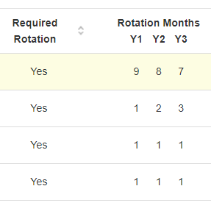
Participating Sites
To-Do List
Check sites table
Site Director Name
Miles/minutes
60 miles/60 minutes = remote site
EM – 30 miles/30 minutes
Rationales
PLA date

Slide 11
We interrupt this program for PSA about “Letters of Notification”
Only for those programs that are in “continued accreditation”
Pay attention to the areas for improvement or concerning trends – address these in the Major Changes section
This Photo by Unknown author is licensed under CC BY-SA-NC.

Slide 12
Citation Response in Four Easy Steps!
Faculty Scholarly Activity
IV.D.2.a) Among their scholarly activity, programs must demonstrate accomplishments in at least three of the following domains: (Core)
Research in basic science, education, translational science, patient care, or population health
Peer-reviewed grants
Quality improvement and/or patient safety initiatives
Systematic reviews, meta-analyses, review articles, chapters in medical textbooks, or case reports
Creation of curricula, evaluation tools, didactic educational activities, or electronic educational materials
Contribution to professional committees, educational organizations, or editorial boards
Innovations in education

Slide 13
Scholarship Citation Example
The information provided to the Review Committee, and verified at the time of the site visit, did not demonstrate substantial compliance with the requirement. Specifically, there was a dearth of scholarship among the program. The program will need to provide documented evidence of scholarly output across the program, before the citation is removed.

Slide 14
Step 1
Acknowledge the citation in a neutral way
The program realizes that scholarship was not as robust as required and has implemented several plans to improve scholarly activity and dissemination.

Slide 15
Step 2
Summarize the steps taken to address the citation.
These plans included:
Providing clear expectations for faculty participation in scholarly activity through improved job descriptions, regular meetings and two hours of protected time each month for scholarly activities.
Hiring of a PhD researcher to provide education, opportunities, and support for scholarly activities.
Developing benchmarks for scholarship production and dissemination

Slide 16
Step 3
Provide documented data to support your efforts
Over the past academic year:
All faculty have given a Grand Round (name, date, topic and where given)
Half of our faculty presented a QI poster, with a resident, at the hospital research day (name, date, topic and where given)
Two faculty presented at the national society meeting (name, date, topic and where given)
Our resident survey showed improvement from 25% compliance (2020) to 65% compliance (2021) for the opportunities to participate in scholarly activities question.

Slide 17
Step 4
Provide status today
We have updated our faculty scholary activity table to reflect the improved numbers of activities. Currently, all faculty have projects that are on-going or in development. One faculty has submitted a paper for publication. We continue to work on improving and supporting scholarship for our faculty, and our residents.
Uploading Documentation for Citation Responses: Each program has an “uploads’ tab

Slide 18
We interrupt this program for PSA about “Peer selection of Trainees”
Peer Selection Processes:
Each academic year (July)
GMEC
Two per program
GMEC Subcommittees
at least one per committee – can be based on interest (i.e., selection among those interested, not all residents)
PECs
Two per training year to maximize resident voice
Site Visit
All residents should be an option
Only ones that can be removed from selection process are those on vacation the date of the site visit

Slide 19
Major Changes
It is critical to use this section wisely
Leadership Changes
program director, APD
Faculty Changes
losses & additions
Curriculum Changes
Significant changes to educational program
consider informing the RC – some require it, but all appreciate the heads up
Major impact events (i.e., a merger)
Addressing ACGME Survey Issues
Sections below 4.0 or items below 85% (check with your GME department for your sponsoring institution specifics)
AFIs – Review Committees want to see AFI addressed in Major Changes (per ACGME 2021 ADS presentation)
“This is the only opportunity to discuss issues with the Review Committee”

Slide 20
ACGME Resources
Program Directors Guide
Contains examples and further clarification.
Residency and Fellowship editions
Avoiding Common Errors in the ADS Annual Update
Block schedule
Responding to citations
Entering scholarly activity
(available at www.acgme.org)

Slide 21
Partners Resources
Major Changes Template
Strategies for ADS Updates Through the Year
Sample Email for Collecting Scholarly Activity

Slide 22
Data Checklist for Programs
Trainee/Faculty Scholarly Activity Reports
ITE Training Results
Board Examination Pass Rate
Placement Data, Diversity Data, QI/PS Data
Faculty Development Activities
Action Plans for Previous APE/Current APE
Letters of Notification from ACGME
ACGME Surveys
PEC minutes
Other reports – ADS reports!
when doing your annual update, start working on your APE

Slide 23
Keys to Success
Make part of your on-going PEC agenda
It is your ONLY chance to provide the review committee information about your program
Use the annual update to get ahead of potential issues…address BEFORE the ACGME does
ADS updates should be in the back of your mind all year long
Annual Update data may trigger a site visit*
Upload supporting documentation, if pertinent
All parts of the update are important
This Photo by Unknown author is licensed under CC BY-NC.

Slide 24
Upcoming Live Webinar
Looking Behind the Curtain at CMS Reporting
Thursday, August 4, 2022
Wellness is a Team Sport
Tuesday, August 16, 2022
GME Educational Program Design I
Thursday, September 15, 2022
Back to Basics: Intermediate Topics for New Coordinators
Thursday, September 29, 2022
Sponsoring Institution 2025: 2022 Check-up
Thursday, October 6, 2022
Site Visit Are Coming!
Thursday, October 20, 2022
Latest On-Demand Webinars
ACGME Complaint Letter: Now What?
Here We Grow Again – And With Our Community
The ABCs of GMEC: Part II
ADS 2022: Part I
Ask Partners – Spring Freebie
Getting to the Next Stage – Program Improvement II
The ABCs of GMEC: Part I
Leveraging RMS Technology for the Medicare Cost Report
Back to Basics – GME for New Coordinators
Digging for Data IV
Getting to the Next Stage - Program Improvement I
Faculty Development Series
15 Minutes to Effective Feedback
Toolbox for Teaching Millennials
Taking Supervision to the Next Level
Contact us today to learn how our Educational
Passports can save you time & money!
724-864-7320
www.PartnersInMedEd.com
Presented by Partners in Medical Education, Inc. 2022
24

Slide 25
Partners in Medical Education, Inc. provides comprehensive consulting services to the GME community.
Partners in Medical Education
724-864-7320 | info@PartnersInMedEd.com
Heather Peters, M.Ed., Ph.D
Heather@PartnersInMedEd.com
Carmela Meyer, Ed.D
Carmela@PartnersInMedEd.com
www.PartnersInMedEd.com

