Slide 1
Partners Webinar Alert
Reminder…Because of the amount of individual logins for this webinar. Please DO NOT Unmute your Microphone after you enter this webinar.

Slide 2
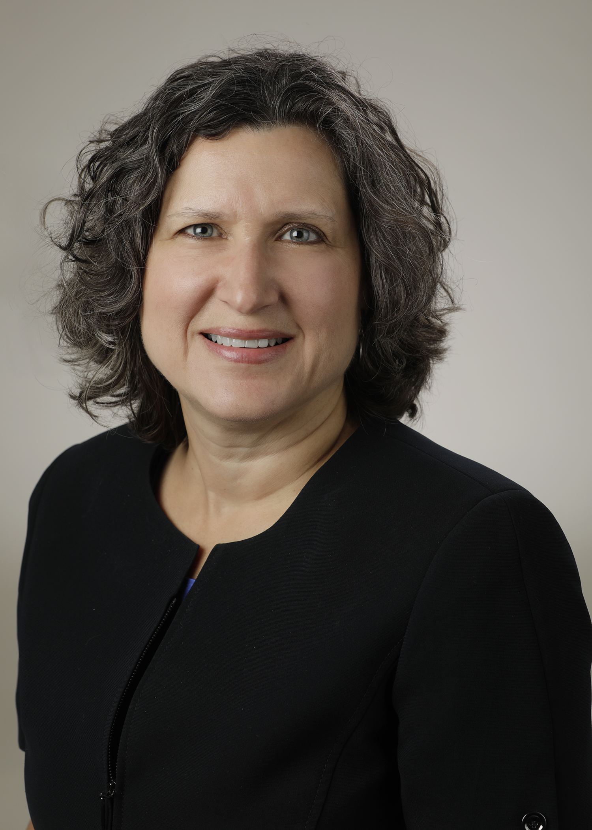
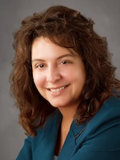
Introducing Your Presenter…
Heather Peters, M.Ed, Ph.D
GME Consultant
Christine Redovan, MBA, MLIS
GME Consultant
Former GME Director & DIO
Seasoned speaker at ACGME & subspecialty national meetings
Areas of Expertise: GME Strategic Planning; Program Evaluation; and Faculty Development
3 decades in education; Masters of Education in curriculum & evaluations, PhD concentration in secondary education & adult learning theories
Seasoned Director of Medical Education and GME Operations
Accreditation and Management Expert For New and Established Institutions and Programs
ACGME-I Accreditation Expert
Successful GME Start-Up Implementation
Focused on Continuous Accreditation Readiness. Data Mining, and Useful GME Resources
20+ years GME experience

Slide 3
ADS Updates 2020
Heather Peters, M. Ed, Ph.D, GME Consultant
Chris Redovan, MBA, MLIS, GME Consultant

Slide 4
Learning Objectives
Learning Objectives:
DISCUSS the 2020 ADS update – what has stayed the same, what has changed
EXPLAIN how to address the COVID-19 section
OUTLINE strategies for the annual update of ADS
Hand-outs:
Worksheet for ADS updates
Strategies for ADS Updates Through the Year
COVID-19 Tracking Document for Curriculum Adjustments
APE Template from Partners – COVID-19 Version
Email template for scholarly activity tracking

Slide 5
ADS 2020

Slide 6
Usual Questions
Any free-text will be preserved so you can see what you said last year
Important to read what you wrote and update!
The RC will read and take into consideration what you have written
Since ACGME survey data may be skewed this year, it will be imperative to provide clear, concise information related to your program.

Slide 7
Usual Questions
Mission and Aims*
Diversity
Citations*
Major changes*
Participating sites
PD CV
Faculty roster
Resident roster
Scholarly activity
Faculty development
Education & experience
Program resources
Evaluation
CLE, patient safety

Slide 8
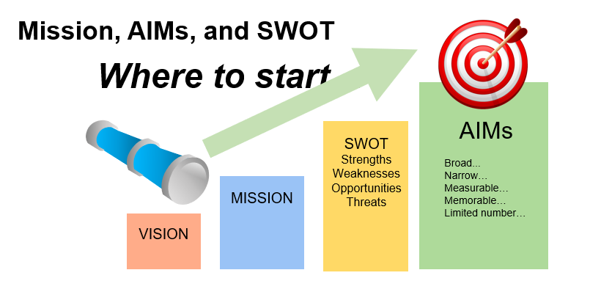
Mission & Aims
Mission statements do not need to change each year
The aims should be focused on action items that can be measured:
NOTE: Webinar at Partners-on-Demand for developing Vision, Mission and Aims

Slide 9
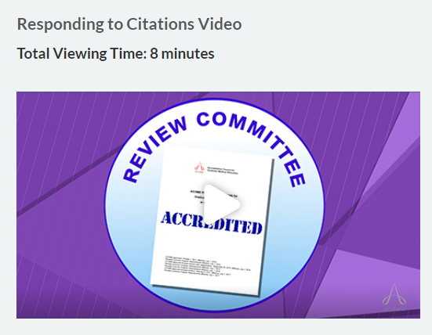
Citations
How to respond to citations from ACGME
https://www.acgme.org/Program-Directors-and-Coordinators/Welcome/Avoiding-Common-Errors-in-the-ADS-Annual-Update
False Positive Citations: Sometimes the program may receive a citation for a requirement that the program has actually met, but with the information available it was unclear to the committee that this was the case.
Even though it may be natural to be frustrated or angry after receiving a citation, the best response is to improve the communication to make it crystal clear to the committee how that particular program requirement was met. If you know how the miscommunication occurred, you may explain it.

Slide 10
Work Hour Citations
While the most common citation for programs and sponsoring institutions – ACGME is still very intent on Improvement
Documentation Expected
GME Level – independent verification
It is not apparent that the Sponsoring Institution provides oversight of work hours that is independent of programs’ processes
GMEC documentation:
Review of work hour reports
Discussions about trends and issues with work hours

Slide 11
Work Hour Citations
Program Level
Action Plan table demonstrating continual monitoring of the work hours
Tracking and trending of violations
Ensuring that residents are logging work hours (work hour compliance)
Attestations by residents and faculty – Best Practice

Slide 12
Major Changes
It is critical to use this section wisely
Leadership Changes
program director, APD
Faculty Changes
losses & additions
Curriculum Changes
Significant changes to educational program
consider informing the RC – some require it, but all appreciate the heads up
Major impact events (i.e., a merger)
Addressing ACGME Survey Issues
focus on 2019, if you do not have 2020; or on your own internal survey results

Slide 13
General Changes
Due to the feedback received after the 2019 ADS update:
Less narrative
Narrative responses carry over so you can see how you responded last year
More radio buttons
Fewer questions overall
Still no way for DIO to sign-off on program updates
[See proposed IR…oversight of ADS]

Slide 14
ADS Changes
How are residents/fellows informed of assignments, duties of each rotation and goals and objectives of each assignment?
What other learners will be sharing educational or clinical experiences with residents/fellows?
(How this enriches resident experience remains free text)
What are residents/fellows taught about pain management, including recognition of signs of addiction?

Slide 15
ADS Changes
From # hours to % FTE time
What percent of FTE salary support is allocated to the program director for non-clinical time devoted to the administration of this program?
What percent of FTE salary support is allocated to the program coordinator for time devoted to the administration of this program?

Slide 16
ACGME Resources
Program Directors Guide
Contains examples and further clarification.
Residency and Fellowship editions
Avoiding Common Errors in the ADS Annual Update
Block schedule
Responding to citations
Entering scholarly activity
(available at www.acgme.org)

Slide 17
Partners Resources
ADS Annual Update Worksheet

Slide 18
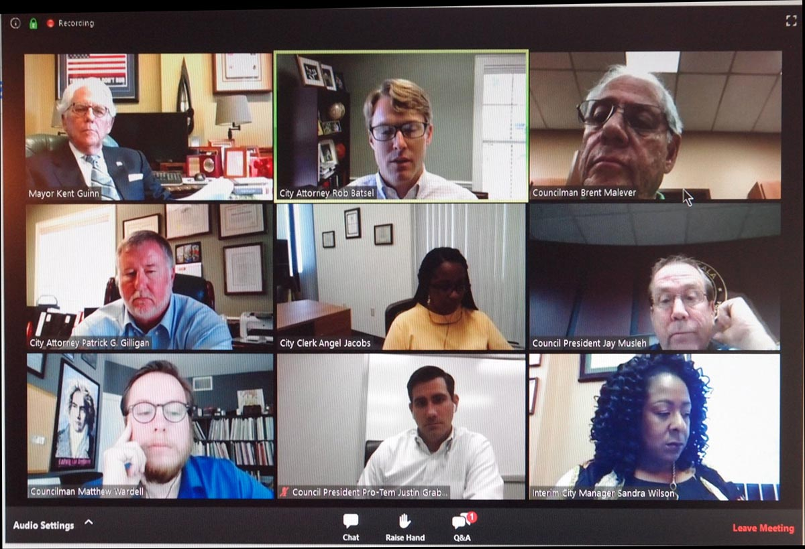
PSA: Site Visit Updates
July-August: Piloting virtual (remote) visits with Zoom
September-November: New program applications
Late 2020-Early 2021:
Initial Accreditation Programs
10-year/self-study site visits

Slide 19
PSA: Site Visit Updates: CLER
CLER Program is actively developing a specially-designed CLER site visit to understand the impact of COVID-19 on the clinical learning environment.
Visits will be piloted later in 2020 and fully implemented in 2021.
These visits—to be conducted via teleconferences and surveys—will be designed to inform the
executive leadership
GME leaders of clinical sites
GME community at large
as they examine and adapt their systems to optimize learning and patient care in both the near- and long-term in response to the COVID-19 pandemic

Slide 20
COVID-19 ADS Questions

Slide 21
COVID-19 Questions
Two sections
Part 1 - Used for accreditation review
Part 2 - Used for information/research only
IMPORTANT: The time frame for COVID-19 questions is:
March 1, 2020 – June 30, 2020

Slide 22
COVID-19 Questions
How long was your program significantly affected?
Less than 30 days
30-60 days
51-90 days
More than 90 days

Slide 23
COVID-19 Questions
During maximum effect of pandemic, increase or decrease of experiences in:
Ambulatory clinic visits
In-patient volumes
Elective operations and/or procedures
In-patient consultations
Out-patient consultations

Slide 24
COVID-19 Questions
During the pandemic, how many of your residents were deployed to a clinical area different from their originally scheduled rotation?
Emergency Department
Ambulatory visits in own specialty
Telemedicine visits in own specialty
Ambulatory visits in other specialty
Telemedicine visits in other specialty
In-patient units for other specialties
ICU
Different assignments within own specialty
Other

Slide 25
Platooning
During the pandemic, did you use a platooning system in your program?
“Platooning” is a two-team system that helps residents/fellows provide clinical care while ensuring the maintenance of a healthy workforce. Residents/fellows are divided into two groups: “active duty” and “working remotely”. Active duty residents/fellows participate in all clinical care activities. Residents/fellows designated as working remotely participate in educational activities such as didactics, online modules, study, scholarly activities, and quality improvement projects. (acgme.org)

Slide 26
COVID-19 Questions
UPCOMING WEBINAR (August 27)
Artificial Intelligence in Medicine: Its Impact on GME
Did you use telemedicine:
Before the pandemic?
During the pandemic?
Plan to increase moving forward?
What % of planned didactics:
Were cancelled?
Conducted remotely?
Replaced?

Slide 27
COVID-19 Questions
Be prepared to provide information related to procedures/logs for those specialties that use them.
DOCUMENTATION IS THE KEY
Were all elective operations/procedures cancelled at some point during the pandemic?
Provide dates this happened, when resumed (if it did) or when anticipated to resume.

Slide 28
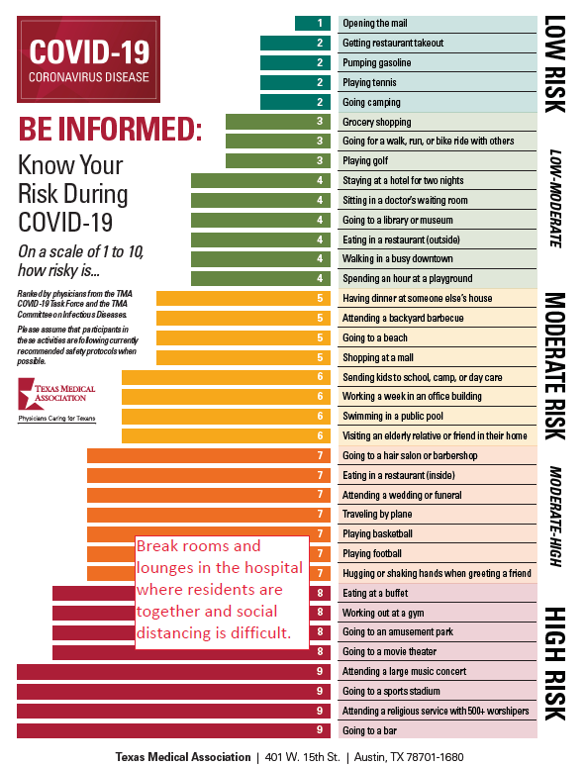
PSA: Resident Work Rooms/Break Rooms are High Risk for COVID-19
Research is showing that breakrooms are responsible for outbreaks in hospitals (Tenant)

Slide 29
COVID-19 Research Questions
Beginning March 1:
How many residents/fellows/faculty were quarantined* due to COVID-19 related illness?
How many residents/fellows/faculty were hospitalized due to COVID-19 related illness?
How many residents/fellows/faculty died due to COVID-19 related illness?
*quarantine is defined as required time away from work due to COVID-19 exposure or illness.

Slide 30
Strategies for Tracking Data for ADS

Slide 31
Strategies for Tracking Data for ADS
Faculty scholarly activity tips
Action items from APE
Work hour violations
Major Changes
Leadership Changes
Faculty Changes
Curriculum Changes
Significant changes to educational program (consider informing the RC)
Major impact (merger)
Action plans related to ACGME Survey results

Slide 32
Tracking Scholarly Activity
Quarterly updates from programs
Sending out email to all with more specific questions annually
Education during faculty meetings (importance of scholarly activity)
ADS – most frequent citation after work hours
Reputation of program/institution
Measure of educational quality

Slide 33
Checklist for Sponsoring Institutions
Trainee/Faculty Scholarly Activity Reports
ITE Training Results
Board Examination Pass Rate
Placement Data, Diversity Data, QI/PS Data
Faculty Development Activities
Action Plans for Previous APE/Current APE
Letters of Notification from ACGME
ACGME Surveys
Other Reports?

Slide 34
Wrapping Up!

Slide 35
Take Home Points
Make part of your PEC agenda
It is your ONLY chance to provide the review committee information about your program
Use the annual update to get ahead of potential issues…address BEFORE the ACGME does
All parts of the update are important
ADS updates need to be in the back of your mind all year long

Slide 36
Questions??

Slide 37
Upcoming Live Webinar
Graduate Medical Education Financing
Tuesday, August 11, 2020 12:00pm – 1:00pm EST
Artificial Intelligence in Medicine: Its Impact on GME
Thursday, August 27, 2020 12:00pm – 1:00pm EST
Faculty Development – A More Specific Approach
Thursday, September 3, 2020 12:00pm – 1:00pm EST
GME Workforce Planning
Thursday, September 24, 2020 12:00pm – 1:00pm EST
Latest On-Demand Webinars
Research and Scholarly Process in a Nutshell: Getting Started
Ask Partners – Spring Freebie Lessons Learned: Accepting Displaced Orphan Residents
Is your Coordinator Well Enough: Coordinators as Role Models of Wellness
Research Proposal Development: Tips for Success Working with your Governing Board
Recognizing & Addressing Precursors of Burnout: The Value of Shame Resiliency Training to Support Resident Well-Being
Working with your IRB
Digging for Data II
NEW Faculty Development Series
15 Minutes to Effective Feedback
Toolbox for Teaching Millennials
Taking Supervision to the Next Level
Contact us today to learn how our Educational
Passports can save you time & money!
724-864-7320
www.PartnersInMedEd.com
Presented by Partners in Medical Education, Inc. 2020
37

Slide 38
Partners in Medical Education, Inc. provides comprehensive consulting services to the GME community.
Partners in Medical Education
724-864-7320 | info@PartnersInMedEd.com
Heather Peters, M.Ed, Ph.D
Heather@PartnersInMedEd.com
Christine Redovan, MBS, MLIS
Christine@PartnersInMedEd.com
www.PartnersInMedEd.com
Presented by Partners in Medical Education, Inc. 2020

