Slide 1
Please Note…
Please make sure your Start Video is OFF when logging into the WebEx platform.
Here is what it should look like
ALSO
It is NORMAL to not hear any sound until the webinar starts at 12:00 noon EST.
Your phone line is muted, but you can always chat to the host, BJ Couch, if you have any questions or concerns during this time.

Slide 2
ADS Updates 2021
Heather Peters, M. Ed, Ph.D, GME Consultant
Christine Redovan, MBA, MLIS, GME Consultant

Slide 3
Learning Objectives
Learning Objectives:
REVIEW the 2021 ADS update – what has stayed the same, what has changed
DISCUSS requirements for scholarly activity tracking, block diagrams, citation responses, and major changes
PROVIDE overview of ACGME resources & Partners’ resources
TOOLS
Worksheets for ADS updates (2021 Updates for Continued Accreditation)
Suggested Timeline for ADS update review
Strategies for ADS Updates Through the Year
Template for Major Changes Section
Email template for collecting Scholarly Activity of Faculty and Trainees

Slide 4
General Changes
Due to the feedback received after the 2020 ADS update, more changes were made.
Further reduction of narrative responses
Faculty roster instructions made clearer
Revised and updated COVID-19 questions
Continued accreditation status – 50% reduction in questions in 2021
Different questions depending on accreditation status

Slide 5
DIO sign off; FTE
NEW for 2021
DIO required to sign off on update
What percent FTE salary support for APD
What percent FTE salary for subspecialty coordinator
check your program requirements for any specifics related to APD and subspecialty FTE

Slide 6
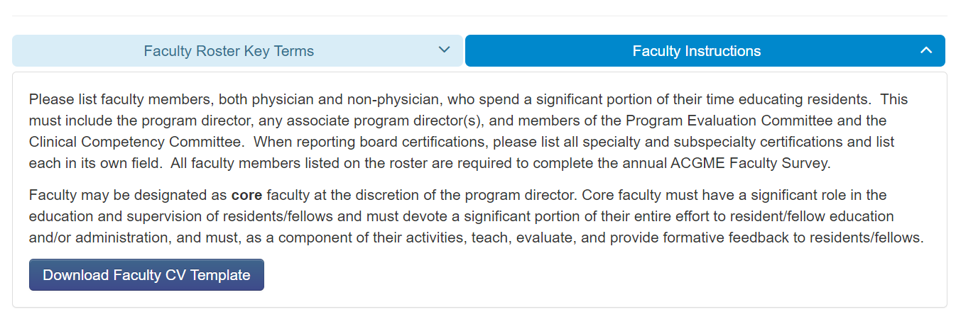
Faculty Roster
New for 2021 - All RC's updated instructions that will be the default display. Pathology example:

Slide 7
Faculty Roster
Don't forget FAQ's!
Board certification information
ABMS information pulled into ADS
Not automatic – use a double check. Is what you are entering matching the board data?
AOA certification is pending
License information
Most state medical board sites have expiration data
Links to the scholarly activity table
NEW 2021 – adding a column for peer-reviewed, non, PubMed indexed publications

Slide 8
COVID-19 Pandemic Questions
Two parts for 2021
1. Effect on the program. Data will be shared with the review committee.
2. Effect on health. Data not shared and not used for accreditation decisions.

Slide 9
Effect on Program
1. Effect on clinical and educational experiences by comparing to normal pre-March 2020 conditions.
- cancelled through significantly increased -
2. New. Effect on clinical activities (CCC, PEC and advising sessions)
3. New. Any resident extend training due to the pandemic

Slide 10
Effect on Health
Same health effect questions. Use July 1, 2020 through June 30, 2021 as the time frame.
New. Estimated percentage of fully vaccinated residents and faculty.

Slide 11
Tracking Scholarly Activity
This Photo by Unknown Author is licensed under CC BY-NC-ND
Quarterly updates from programs
Sending out email to all with more specific questions annually
Education during faculty meetings (importance of scholarly activity)
ADS – most frequent citation after work hours
Reputation of program/institution
Measure of educational quality

Slide 12
Block Diagram 101
Follow the instructions!
EM
RC's starting to incorporate required templates
Orthopedic Surgery
OB/GYN
TY
Is a typical schedule for one resident for the whole training period
Do not include vacation
Include notes for further clarification
This Photo by Unknown author is licensed under CC BY-NC-ND.

Slide 13
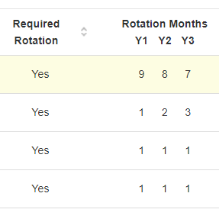
Participating Sites
To-Do List
Check sites table
Site Director Name
Miles/minutes
60 miles/60 minutes = remote site
EM – 30 miles/30 minutes
Rationales
PLA date

Slide 14
PSA - Letters of Notification
Only for those programs that are in continued accreditation
Pay attention to the areas for improvement or concerning trends
This Photo by Unknown author is licensed under CC BY-SA-NC.

Slide 15
Citation Response in Four Easy Steps!
Faculty Scholarly Activity
IV.D.2.a) Among their scholarly activity, programs must demonstrate accomplishments in at least three of the following domains: (Core)
Research in basic science, education, translational science, patient care, or population health
Peer-reviewed grants
Quality improvement and/or patient safety initiatives
Systematic reviews, meta-analyses, review articles, chapters in medical textbooks, or case reports
Creation of curricula, evaluation tools, didactic educational activities, or electronic educational materials
Contribution to professional committees, educational organizations, or editorial boards
Innovations in education

Slide 16
Scholarship Citation Example
The information provided to the Review Committee, and verified at the time of the site visit, did not demonstrate substantial compliance with the requirement. Specifically, there was a dearth of scholarship among the program. The program will need to provide documented evidence of scholarly output across the program, before the citation is removed.

Slide 17
Step 1
Acknowledge the citation in a neutral way
The program realizes that scholarship was not as robust as required and has implemented several plans to improve scholarly activity and dissemination.

Slide 18
Step 2
Summarize the steps taken to address the citation.
These plans included:
Providing clear expectations for faculty participation in scholarly activity through improved job descriptions, regular meetings and two hours of protected time each month for scholarly activities.
Hiring of a PhD researcher to provide education, opportunities, and support for scholarly activities.
Developing benchmarks for scholarship production and dissemination

Slide 19
Step 3
Provide documented data to support your efforts
Over the past academic year:
All faculty have given a Grand Round (name, date, topic and where given)
Half of our faculty presented a QI poster, with a resident, at the hospital research day (name, date, topic and where given)
Two faculty presented at the national society meeting (name, date, topic and where given)
Our resident survey showed improvement from 25% compliance (2020) to 65% compliance (2021) for the opportunities to participate in scholarly activities question.

Slide 20
Step 4
Provide status today
We have updated our faculty scholary activity table to reflect the improved numbers of activities. Currently, all faculty have projects that are on-going or in development. One faculty has submitted a paper for publication. We continue to work on improving and supporting scholarship for our faculty, and our residents.

Slide 21
Major Changes
It is critical to use this section wisely
Leadership Changes
program director, APD
Faculty Changes
losses & additions
Curriculum Changes
Significant changes to educational program
consider informing the RC – some require it, but all appreciate the heads up
Major impact events (i.e., a merger)
Addressing ACGME Survey Issues
Sections below 4.0 or items below 85% (check with your GME department for your sponsoring institution specifics)
AFIs – Review Committees want to see AFI addressed in Major Changes (per ACGME 2021 ADS presentation)
“This is the only opportunity to discuss issues with the Review Committee”
Presented by Partners in Medical Education, Inc. 2021

Slide 22
ACGME Resources
Program Directors Guide
Contains examples and further clarification.
Residency and Fellowship editions
Avoiding Common Errors in the ADS Annual Update
Block schedule
Responding to citations
Entering scholarly activity
(available at www.acgme.org)

Slide 23
Partners Resources
ADS Annual Update Worksheets
Major Changes Template
Suggested Timeline for updates
Strategies for ADS Updates Through the Year
Sample Email for Collecting Scholarly Activity

Slide 24
Wrapping Up!

Slide 25
Data Checklist for Sponsoring Institutions
Trainee/Faculty Scholarly Activity Reports
Placement Data, Diversity Data, QI/PS Data
Faculty Development Activities
Action Plans for Previous APE/Current APE
Letters of Notification from ACGME
ACGME Surveys
GMEC minutes
Other Reports
Save time hunting for info -
Use the ADS reports!
When working on Annual Update; start thinking about AIR

Slide 26
Data Checklist for Programs
Trainee/Faculty Scholarly Activity Reports
ITE Training Results
Board Examination Pass Rate
Placement Data, Diversity Data, QI/PS Data
Faculty Development Activities
Action Plans for Previous APE/Current APE
Letters of Notification from ACGME
ACGME Surveys
PEC minutes
Other reports – ADS reports!
when doing your annual update, start working on your APE

Slide 27
Keys to Success
Make part of your PEC agenda
It is your ONLY chance to provide the review committee information about your program
Use the annual update to get ahead of potential issues…address BEFORE the ACGME does
All parts of the update are important
This Photo by Unknown author is licensed under CC BY-NC.

Slide 28
Keys to Success
ADS updates should be in the back of your mind all year long
Annual Update data may trigger a site visit*
Upload supporting documentation, if pertinent
Remember – DIO must approve prior to submission
This Photo by Unknown author is licensed under CC BY-NC.
*Caniano,D., Martinwz,S.,Nace, C. & Hogan, S. (2021), Reasons for data-prompted site visits: Field staff findings and review committee decisions. Journal of Graduate Medical Education, 13(3), 447-454. https://doi.org/10.4300/JGME-D-21-00435.1

Slide 29
Questions??

Slide 30
Upcoming Live Webinar
Site Visits – What to Expect in 2021 Thursday, August 12, 2021 12:00pm – 1:00pm EST
Holistic Review Thursday, August 26, 2021 12:00pm – 1:00pm EST
A Day in the Life of a DIO
Thursday, September 9, 2021
12:00pm – 1:00pm EST
Resident Wellness in the Virtual World
Tuesday, September 21, 2021
Latest On-Demand Webinars
GME Grants and Funding Sources
Survey Research
Impactful AIR & APE – Bridging Data & Action
GMEC Checkups – QIPS Edition
ACGME Surveys – What Now?
Other Approaches to CCC & Evaluation
Lessons Learned from the Pandemic: Planning for the Next Disaster
Ask Partners – Spring Freebie
Digging for Data Part 3
How to Maximize Virtual Learning Part 2
Scholarly Work in Pandemic Times
How to Maximize Virtual Learning Par 1
NEW Faculty Development Series
15 Minutes to Effective Feedback
Toolbox for Teaching Millennials
Taking Supervision to the Next Level
Contact us today to learn how our Educational
Passports can save you time & money!
724-864-7320
www.PartnersInMedEd.com
Presented by Partners in Medical Education, Inc. 2021
30

Slide 31
Partners in Medical Education, Inc. provides comprehensive consulting services to the GME community.
Partners in Medical Education
724-864-7320 | info@PartnersInMedEd.com
Heather Peters, M.Ed, Ph.D
Heather@PartnersInMedEd.com
Christine Redovan, MBA, MLIS
Christine@PartnersInMedEd.com
www.PartnersInMedEd.com

