Slide 1
Creating Effective AIMs and Action Plans
Heather Peters, M. Ed, PhD
GME Consultant

Slide 2
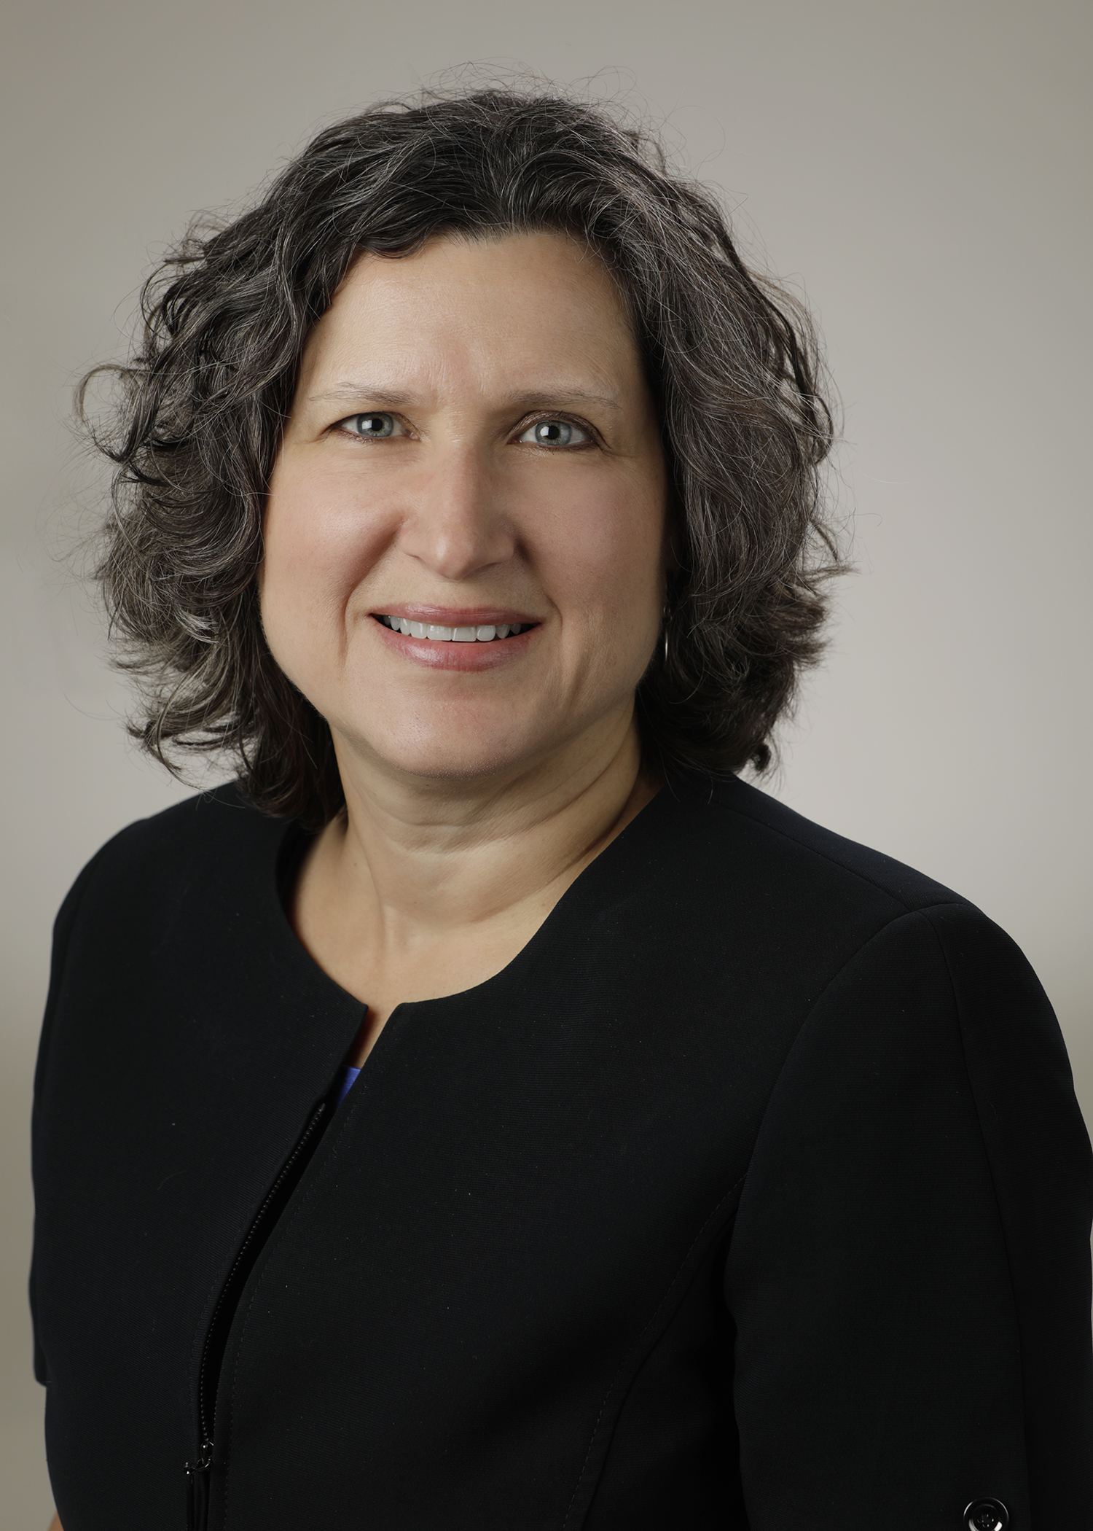
Introducing Your Presenter…
Heather Peters, M.Ed, Ph.D
GME Consultant
GME Director & DIO
Seasoned speaker at ACGME & subspecialty national meetings
Institutional and Program accreditation expertise
3 decades in education; Masters of Education in curriculum & evaluations, PhD concentration in secondary education & adult learning theories

Slide 3
Learning Objectives
Develop a “continuous program improvement” model using AIM statements and action plans
Define the requirements of the AIM statements for the current accreditation system
Webinar Activities:
Create measurable action plans
Evaluate AIM statements
Resources Provided to Webinar Participants:
Sample AIMs and action plans
Post-webinar discussion questions

Slide 4
Background and Intent: AIM Statements

Slide 5
Common Program Requirements Requirement for APE
In order to achieve its mission and train quality physicians, a program must evaluate its performance and plan for improvement in the Annual Program Evaluation.
Performance of residents and faculty members is a reflection of program quality, and can be used as metrics that reflect the goals that a program has set for itself.
The Program Evaluation Committee utilizes outcome parameters and other data to assess the program’s progress toward achievement of its goals and aims.
V.C.1.d) The Program Evaluation Committee must evaluate the program’s mission and aims…
AIMs
Mission

Slide 6
10-Year Schematic
Outcomes of the APE integrate into the 10-year Self-Study process*
*Background and Intent about Self-Study
AIMs & Vision of Program
SELF-STUDY
Continuous Improvement Model
2024
2025
2023
2022
2021
2020
2019
2017
2018
2016
ANNUAL PROGRAM EVALUATION ACTION PLANS

Slide 7
Where to start…
VISION
MISSION
AIMs
Broad...
Narrow…
Measurable…
Memorable…
Limited number…

Slide 8
AIM Statement Creation
Broad enough…
Narrow enough…
Short enough…
Measurable
3-4 AIMs
KEY POINT: It’s not about being BETTER. It’s about being DIFFERENT. You need to give candidates a reason to CHOOSE YOUR PROGRAM!

Slide 9
Activity: Evaluating & Revising AIM statements
Part 1: Sample AIM statements
Part 2: Revising AIM statements

Slide 10
Taking AIMs to the Next Level
AIM | How will it be measured? | Maintenance of Accreditation OR Stretch Goal? | Level of resource need (high, moderate, low)
Graduate residents who become community-based internists | Track the number of graduates who become community-based internists | Maintenance goal | Low

Slide 11
How to Use AIMs Day-to-Day
Using AIM statements in day-to-day operations of the residency program
Agendas
Reports
Walls
Residency Work Rooms
Website
Recruitment Material

Slide 12
ACTION PLANS
AIMs
Improvement plans
Action items

Slide 13
AIMs lead to Action Plans
APE Action Plan
Program AIMs
Action Item
Action Item
Action Item
This Photo by Unknown Author is licensed under CC BY-ND

Slide 14
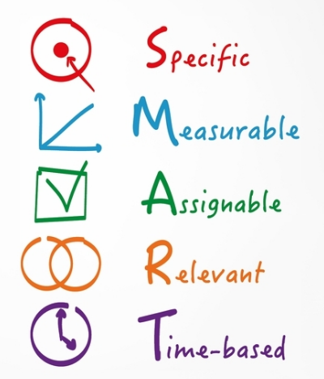
When Creating Action Plans
“Continuous improvement”
Establishing action items that are SMART
*
*Achievable, Attainable

Slide 15
Annual Program Evaluation
Curriculum
Outcomes from previous APE
ACGME letters of notification, citations, AFIs
Quality and safety of patient care
Aggregate trainee and faculty:
well-being
recruitment & retention
workforce diversity
engagement in QI and PS
scholarly activity
ACGME trainee and faculty surveys
written evaluations of the program
Aggregate trainee:
achievement of the Milestones
in-training exams
board pass and certification rates
graduate performance
Aggregate faculty:
evaluation
professional development

Slide 16
ACGME Requirements for Action Plans
discussed with trainees and faculty (PR V.C.1.e).(1))
submitted to the DIO (PR V.C.1.e).(2))
GMEC: Oversight of the ACGME-accredited program(s)’ APE and self-studies (IR I.B.4.a).(4))

Slide 17
Sample AP Table
Description of Intervention | APE Component | Data Resources | Person(s) Responsible | Expected Outcomes | Data Source(s) | Expected Completion Date
Description of Intervention | APE Component | Data Resources | Person(s) Responsible | Expected Outcomes | Data Source(s) | Expected Completion Date | Progress Reports | Status: Met Partially Met Needs Revision

Slide 18
Activity: Action Plan Development
Let’s look at the Sample AP Table
Practice:
Try to write some action plans of your own from either your program or your institution

Slide 19
Tracking Continuous Program Improvement
Review of sample tracking document
Best practices:
Update regularly
Incorporate into PEC agenda
Review at the mid-year to ensure you are staying on track

Slide 20
Wrapping Up!

Slide 21
Take Home Points
Quality AIMs lead to great action plans
Both AIMs and action plans need to be measurable so that you can track your progress in meeting them
Writing quality AIMs and action plans takes practice, practice, practice

Slide 22
Questions??

Slide 23
Upcoming Live Webinars
SI 2025 Part 2 of 4 : Changes on the Horizon Tuesday, March 5, 2019 12:00pm – 1:00pm EST
Ask Partners – Spring Freebie Thursday, March 21, 2019 12:00pm – 1:00pm EST
Understanding the CLE Tuesday, March 26, 2019 12:00pm – 1:00pm EST
Onboarding the New Program Director Tuesday, April 2, 2019 12:00pm – 1:00pm EST
On-Demand Webinars
New Institution – The Value of GME
Meet the Experts – Fall Freebie
Milestones – Beyond the CCC
Mentoring the GME Coordinator: The First 3 Years
2019 CPR Part 1 of 4: Overview
SI 2025 Part 1 of 4: Introduction & Overview
Onboarding the New Coordinator
2019 CPR Part 1 of 4: Overview
NEW Faculty Development Series
Contact us today to learn how our Educational
Passports can save you time & money!
724-864-7320
www.PartnersInMedEd.com
15 Minutes to Effective Feedback
23

Slide 24
Partners in Medical Education, Inc. provides comprehensive consulting services to the GME community.
Partners in Medical Education
724-864-7320 | info@PartnersInMedEd.com
Heather Peters, M.Ed, Ph.D
heather@PartnersInMedEd.com
www.PartnersInMedEd.com

