Slide 1
Partners Webinar Alert
Reminder…Because of the amount of individual logins for this webinar. Please DO NOT Unmute your Microphone after you enter this webinar.

Slide 2
An Interdisciplinary Approach – Breaking Down the Wall

Slide 3
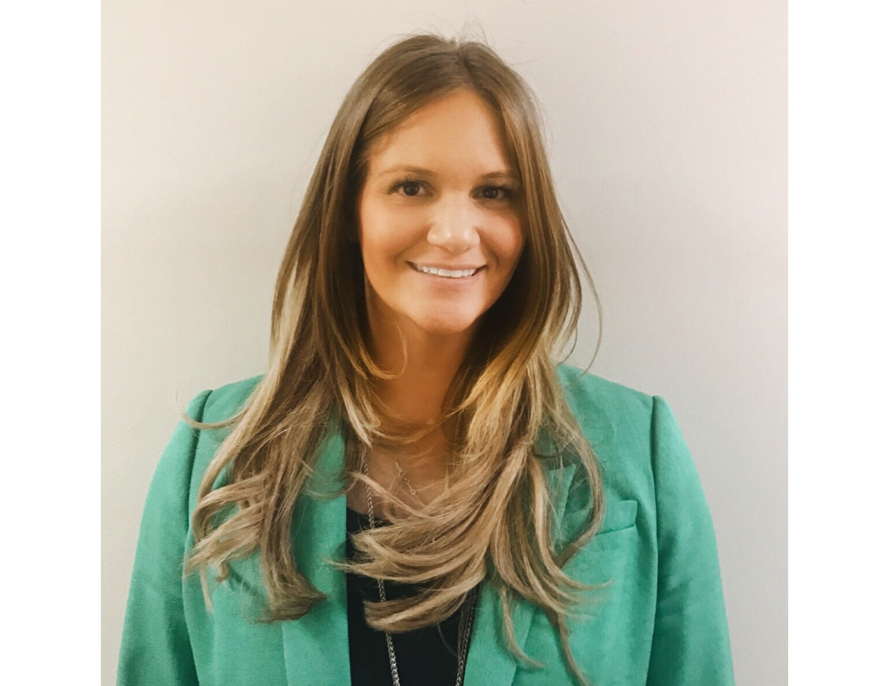
Introducing Your Presenter
Amy Lefkovic, MHA
Received her Bachelors Degree in Health Information Management from Kean University
Began her career in Graduate Medical Education (GME) at Hospital for Special Surgery as the Radiology Fellowship Program Coordinator
Received her Masters degree in Healthcare Administration from Seton Hall University
Continued her career in GME at Lutheran Medical Center as the OB/GYN Residency Coordinator
Is currently the Manager of GME and Academic Affairs at Staten Island University Hospital

Slide 4
Goals and Objectives
To review the requirements pertaining to working in interdisciplinary/interprofessional teams
To examine approaches to fulfilling the requirement
To determine ways in which to implement these approaches

Slide 5
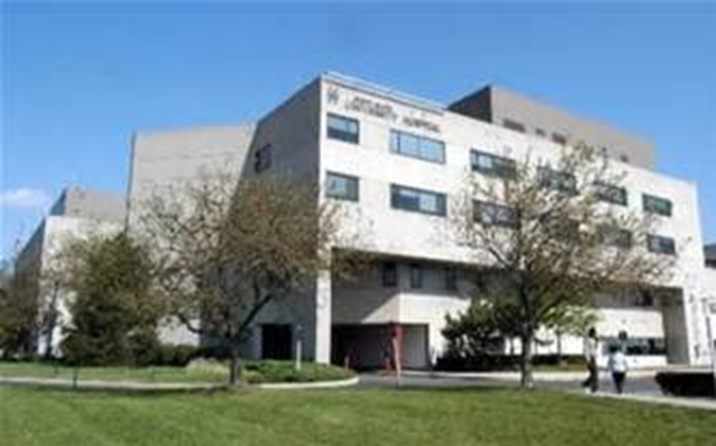
Staten Island University Hospital Northwell Health
Northwell Health
315 residents and fellows
16 programs

Slide 6
Requirements
Look at often
No pop quiz questions
ACGME faculty survey
ACGME resident survey

Slide 7
Requirements
Residents must demonstrate competence in:
Coordinating patient care across the health care
continuum and beyond as relevant to their
clinical specialty;

Slide 8
Background and Intent
Every patient deserves to be treated as a whole person. Therefore it is recognized that any one component of the health care system does not meet the totality of the patient's needs. An appropriate transition plan requires coordination and forethought by an interdisciplinary team. The patient benefits from proper care and the system benefits from proper use of resources.

Slide 9
Requirements
Working in interprofessional teams to enhance patient safety and improve patient care quality;
Patient Safety
The program must have a structure that
promotes safe, interprofessional, team-based
care.

Slide 10
Requirements
Education on Patient Safety
Programs must provide formal educational activities that promote patient safety-related goals, tools, and techniques.
Background and Intent: Optimal patient safety occurs in the setting of a coordinated interprofessional learning and working environment.

Slide 11
Requirements
Patient Safety Events
Residents must participate as team members in real and/or simulated interprofessional clinical patient safety activities, such as root cause analyses or other activities that include analysis, as well as formulation and implementation of actions.

Slide 12
Requirements
Engagement in Quality Improvement Activities
Residents must have the opportunity to participate in interprofessional quality improvement activities.

Slide 13
Requirements
Clinical Responsibilities, Teamwork, and Transitions of Care
Background and Intent: The changing clinical care environment of medicine has meant that work compression due to high complexity has increased stress on residents. Faculty members and program directors need to make sure residents function in an environment that has safe patient care and a sense of resident well-being. Some Review Committees have addressed this by setting limits on patient admissions, and it is an essential responsibility of the program director to monitor resident workload. Workload should be distributed among the resident team and interdisciplinary teams to minimize work compression.

Slide 14
Requirements
Teamwork
Residents must care for patients in an environment that maximizes communication. This must include the opportunity to work as a member of effective interprofessional teams that are appropriate to the delivery of care in the specialty and larger health system.

Slide 15
ACGME Surveys
Resident/Fellow Survey
Interprofessional teamwork skills modeled or taught
Faculty Survey
Interprofessional teamwork skills modeled or taught
Faculty higher than resident/fellow
Results low

Slide 16
Importance
Know the medicine, it is not enough
Big picture and aid in diagnosis
Can be overlooked so added to requirements

Slide 17
Importance
Educate residents
Educate faculty
Cant do it alone – all in this together
360 evaluations

Slide 19
Who Are They?
Nurses
Social workers
Nurse Practitioners
Physician Assistants
Respiratory therapist
Dieticians/dietary

Slide 20
Who Are They?
Social workers
Patient experience
Environmental services
Transporters
And so many more…

Slide 22
Different Pictures
Global
Daily
One patient
All patients

Slide 23
Global - GME
Doctors vs. Nurses – start at the beginning
Interdicisplinary Specialty Committee
Many ways
Specialty specific
Many specialties
Decide on attendees

Slide 24
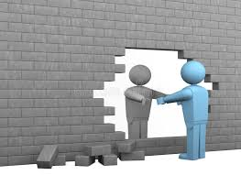

Slide 25
What We Did
Chief residents, nurse managers, GME and nursing leadership
Explain concept to all
Agenda
Ask ahead of time
Create based on previous knowledge

Slide 26
What We Did
Be prepared!
Safe place
Serve lunch

Slide 27
What We Did
Collaboration opens eyes
Protected time vs. nurses break
Provide signage
COMMUNICATION
Specialty specific
Hospital wide

Slide 28
What We Found
Already occurring in some specialties
Occurring but not together
Chairman even attend two different meetings
Change time to incorporate both
Communication initially, move on to patient care and quality improvement after
More friendly work environment – understanding of one another's daily goals

Slide 29
What We Did – Follow Up
Interdisciplinary committees will be formed for the major medical specialties e.g. Medicine, Surgery, Pediatrics, Obstetrics-Gynecology. The committees will include nursing leadership from the different clinical units and chief residents and/or senior residents from the relevant service. Committees will meet at least monthly and more frequently as needed to discuss issues related to physician-nursing collaboration. Minutes will be taken for this meeting by an individual designated by the committee.

Slide 30
What We Did – Follow Up
Hospital wide committee will convene quarterly and will include nurse managers, nursing leadership and chief residents. The focus of this committee will be hospital-wide issues, identification of best practices from the individual specialty committees and joint problem solving of challenges identified by individual committees. Minutes will be taken for this meeting by an individual designated by the committee.

Slide 31
Improving?
ACGME surveys
Publish
360 evaluations
Morale
Patient satisfaction

Slide 33
A Different Approach
Resident Quality Care Collaborative Council – interdisciplinary
Invite other departments – interprofessional
Quality Improvement project

Slide 34
Global - Hospital Finding
Pebble in shoe
Cancelled laboratory work
Initial meeting with laboratory
He said she said
Need to learn the process takes time
Collaborate with Director of Laboratory
EMR glitches!

Slide 35
Not a clinician??

Slide 36
Global - Share the Knowledge
CAUTI infections
Initial rates before and after
Create powerpoint
Share with environmental, dietary, dieticians etc.

Slide 37
Share the Knowledge
Learn something for patients and selves
What is a resident?
Change in process

Slide 38
Communicate This
Tell faculty
Bring to GMEC
Share results

Slide 39
Disadvantages
Initial meetings
Schedules
Lack of participation

Slide 40
Advantages
All work together
Increase patient safety
Increase quality improvement
Increase COMMUNICATION
Increase compliance

Slide 41
Decisions to be Made
Who should be involved?
Decide on project or work on existing one?
Oversight?

Slide 42
Reminder!
Don’t need to move mountains,
just need to work together

Slide 43
Upcoming Live Webinar Meet the Experts – Fall Freebie Thursday, November 19, 2020 12:00pm – 1:00pm EST
Working with Struggling Learners
Thursday, December 3, 2020 12:00pm – 1:00pm EST
DIO Role and Responsibilities: Keys to Success
Thursday, December 17, 2020 12:00pm – 1:00pm EST
How to Manage Virtual Site Visit Tuesday, January 5, 2021 12:00pm – 1:00pm EST
Latest On-Demand Webinars
Working with your Governing Board
Recognizing & Addressing Precursors of Burnout: The Value of Shame Resiliency Training to Support Resident Well-Being
Working with your IRB
Digging for Data II
Demystifying Diversity
Faculty Development Planning: Sponsoring Institution Role
ADS Annual Update: Best Practices
Graduate Medical Education Financing
Artificial Intelligence in Medicine: Its Impact on GME
Faculty Development – A More Specific Approach
NEW Faculty Development Series
15 Minutes to Effective Feedback
Toolbox for Teaching Millennials
Taking Supervision to the Next Level
Contact us today to learn how our Educational
Passports can save you time & money!
724-864-7320
www.PartnersInMedEd.com
Presented by Partners in Medical Education, Inc. 2020
43

Slide 44
Partners in Medical Education, Inc. provides comprehensive consulting services to the GME community.
Partners in Medical Education
724-864-7320 | info@PartnersInMedEd.com
Amy Lefkovic, MHA GME Consultant
Amy@PartnersInMedEd.com
www.PartnersInMedEd.com

