Slide 1
Annual Institutional Review
Presented by:
Christine Redovan, MBA
GME Consultant

Slide 2
Introducing Your Presenter…
Christine Redovan, MBA
GME Consultant
Seasoned Director of Medical Education and GME Operations
Accreditation and Management success for both ACGME & AOA Programs
ACGME-I Accreditation Expert
Successful Continued Accreditation & New Start-Up Implementation
Focused on continual readiness and offering timely and useful GME resources

Slide 3
Goals & Objectives
Develop measurable criteria that is meaningful for your institution
Learn effective strategies and techniques for GMEC engagement
Review best practices and examples from the field

Slide 4
Institutional Requirement I.B.5
I.B.5. The GMEC must demonstrate effective oversight of the Sponsoring Institution’s accreditation through an Annual Institutional Review (AIR). (Outcome)
I.B.5.a) The GMEC must identify institutional performance indicators for the AIR which include: (Core)
I.B.5.a).(1) results of the most recent institutional self- study visit; (Detail)
I.B.5.a).(2) results of ACGME surveys of residents/fellows and core faculty; and, (Detail)
I.B.5.a).(3) notification of ACGME-accredited programs’ accreditation statuses and self-study visits. (Detail)

Slide 5
Institutional Requirement I.B.5
I.B.5.b) The AIR must include monitoring procedures for action plans resulting from the review. (Core)
I.B.5.c) The DIO must submit a written annual executive summary of the AIR to the Governing Body. (Core)
Available at http://www.acgme.org/Designated-Institutional-Officials/Institutional-Review-Committee/Institutional-Application-and-Requirements

Slide 6
Why do we have to do the AIR?
Not only required for accreditation….but
It is a best practice for the institution to review itself
It sets the stage for future self-study activity
Demonstrates effective oversight of GME
Links the Annual Program Evaluation and Special Review requirements
Highlights strengths
Identifies areas for improvement

Slide 7
Institutional Performance Indicators
A Good Measure/Indicator …
Is quantitative
Is easy to understand
Encourages appropriate behavior
Is visible
Is defined and mutually understood
Is multidimensional
Uses economies of effort
Facilitates trust
Encompasses inputs and outputs
Measures what is important

Slide 8
Institutional Performance Indicators
Common Pitfalls
Not aligned with goals
Not actionable
Lacks follow up
Lacks documentation
Lacks benchmarking
Underestimation of data extraction

Slide 9
SMART Indicators
S
Specific
Relevant
Time-bound
Measureable
Attainable
M
A
R
T

Slide 10
SMART Indicators
Established
Easy to understand
Easy to use
Applicable to all institutions and programs
Useful in other areas of GME and other work we may be involved with
S
M
A
R
T

Slide 11
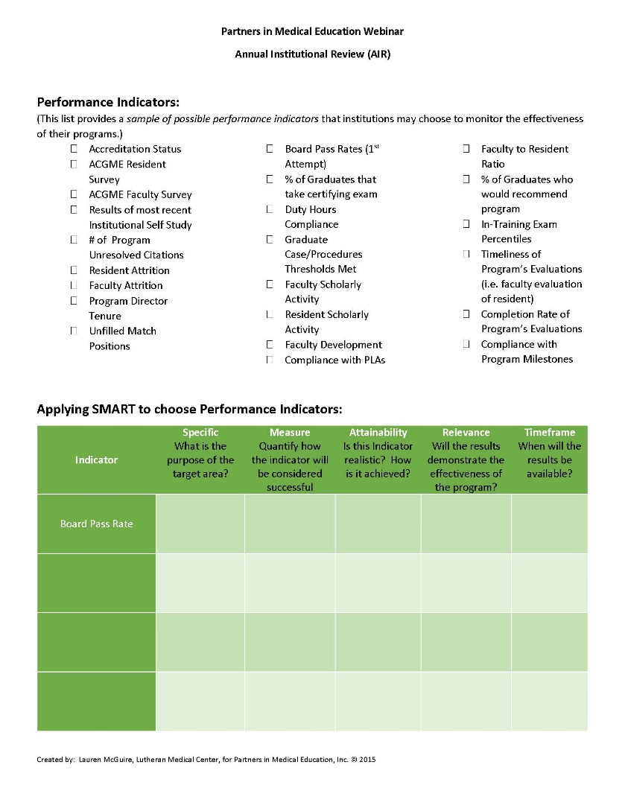
SMART Indicators
Refer to handout – Performance Indicators Worksheet

Slide 12
Institutional Performance Indicators
Lets work through some examples of popular institutional performance indicators:
Program Attrition
Scholarly Activity
Board Pass Rate
Resident Survey

Slide 13
SMART Indicators- Program Attrition
Indicator | Specific What is the purpose of the target area? | Measure Quantify how the indicator will be considered successful | Attainability Is this Indicator realistic? How is it achieved? | Relevance Will the results demonstrate the effectiveness of the program? | Timeframe When will the results be available?
Program Attrition | Measure turnover in program personnel and resident trainees | Maintain turnover rate of < 15% | Provide stable environment; faculty development | Low turnover indicates a positive learning environment | Annually during the program APE

Slide 14
SMART Indicators – Scholarly Activity
Indicator | Specific What is the purpose of the target area? | Measure Quantify how the indicator will be considered successful | Attainability Is this Indicator realistic? How is it achieved? | Relevance Will the results demonstrate the effectiveness of the program? | Timeframe When will the results be available?
Scholarly Activity | Scholarly Environment; Environment of Inquiry | Programs meets expected scholarly requirements | Support of scholarly activities in the form of time, funding and instruction | Continued accreditation; positive surveys | Annually during the program APE and annual program update

Slide 15
SMART Indicators – Board Pass Rate
Indicator | Specific What is the purpose of the target area? | Measure Quantify how the indicator will be considered successful | Attainability Is this Indicator realistic? How is it achieved? | Relevance Will the results demonstrate the effectiveness of the program? | Timeframe When will the results be available?
Board Pass Rate | Graduate Performance | Programs meets expected board pass rate | There is a national standard for board certification | Passing the boards is an indication of the educational and clinical curriculum of the training program | Annually

Slide 16
SMART Indicators – Resident Survey
Indicator | Specific What is the purpose of the target area? | Measure Quantify how the indicator will be considered successful | Attainability Is this Indicator realistic? How is it achieved? | Relevance Will the results demonstrate the effectiveness of the program? | Timeframe When will the results be available?
Downward trend in educational domain over two years | Indicator of general learning environment | At or above national average | National benchmark provided | Program maintains environment conducive for learning | Annually

Slide 17
Putting it all together
Data Analysis
Report
Action Plan
Executive Summary
Monitoring

Slide 18
Data Analysis
Data Visualization is key
Dashboards
Graphs
Tables
Arrows
Colors

Slide 19
Survey Dashboard
See handout – Sample Resident and Faculty Survey Results Spreadsheet

Slide 20
Data Analysis
Keep it simple and relevant
What does your institution want to see?
Graduation plans?
Percent retained in hospital? Local? Regional? State?
Number of citations?
Types of citations?
Number of peer-reviewed publications?
What makes sense for your institution?

Slide 21
Data Analysis
Must include
Institutional Self-Study results
Resident & Faculty Survey results
Notification of accreditation status and self-study visits
Performance indicators GMEC approved
Suggested items
Demographics (program, residents)
CLER results
Other data requested by administration/governing body
Anything useful to performing GMEC oversight

Slide 22
Data Analysis – CLER Data
Opportunity to link CLER data with institutional data
CLER focus areas related to resident and faculty survey domains
Are the results similar?
Positive or Negative
Is there a disconnect?
What are some reasons?

Slide 23
Action Plan
Goal | Measurable Steps | Attainable | Assigned to | Time & Expected Outcome
Provide funds to residents for research | Identify funds; develop application process; award funds through peer-review process | Use special funds for GME from alumni foundation | GME office; Research sub-committee | Increase resident publications by 10% in two years; Zero citations related to resident scholarly activity
Updates: 8/2/16 – funds identified and secured; committee formed 9/5/16 – committee developed application; to GMEC for discussion and approval

Slide 24
Report
Assign pieces to GMEC members; Assembly by DIO or GME Office
Length is whatever you need it to be to get the required information and your performance indicator data understood by the document readers.
Must include monitoring plans for the action plan.
Obtain feedback and final approval from the GMEC. Document in your minutes!
Publish your report to the institution to showcase achievements

Slide 25
Monitoring
SMARTER
Addition of Evaluate and Re-evaluate
Document in GMEC minutes
Frequency

Slide 26
Executive Summary
Stand alone document
Analyze and summarize main points
Make recommendation based on analysis
Length approximately 10% of document summarizing
May include as an introduction or piece of the report

Slide 27
Executive Summary
Questions to think about…
Who will read the report?
What is main theme?
Are there sections/divisions within main document that are more important than others?
Does the main document make a recommendation or suggest an action?
What are the benefits or consequences of the action?

Slide 28
Final Thoughts…
Perform a SWOT for a deeper view of strengths, weaknesses, opportunities and threats
Keep track of all of your AIR’s…you’ll need for self-study one day
Use your AIR to support your GME mission
Use program APE’s to feed the AIR
Use special reviews to feed the AIR
Use CLER data to feed the AIR

Slide 29
Upcoming Live Webinars
GME Finance – The Basics (2016 Update)
Thursday, October 13, 2016
12:00pm – 1:00pm EST
Maximizing Resident Forums
Tuesday, October 27, 2016
12:00pm – 1:00pm EST
What Every Coordinator
Needs to Know About NAS
Tuesday, November 1, 2016
12:00pm – 1:00pm EST “Meet the Experts” Fall Freebie
Thursday, November 17, 2016
12:00pm – 1:00pm EST
www.PartnersInMedEd.com
Partners® Snippets
On-Demand Webinars
GMEC Check-Up: Is your GMEC
meeting its responsibilities?
A Proactive Approach to Supervising Residents Improves Patient Safety
New Institutional Accreditation:
Let’s Get Started!
Dealing Effectively with the
Struggling Medical Learner
Special Review: Required and Useful
Osteopathic Recognition
Fatigue Management & Mitigation
Contact us today to learn
how our Educational Passports can save you time & money!
724-864-7320

Slide 30
Partners in Medical Education, Inc. provides comprehensive consulting services to the GME community.
Partners in Medical Education
724-864-7320 | info@PartnersInMedEd.com
Christine Redovan, MBA
christine@partnersinmeded.com
www.PartnersInMedEd.com

