Slide 1
AOA to ACGME Accreditation: Best Practices & Challenges
Tori Hanlon, MS, CHCP
Consultant

Slide 2
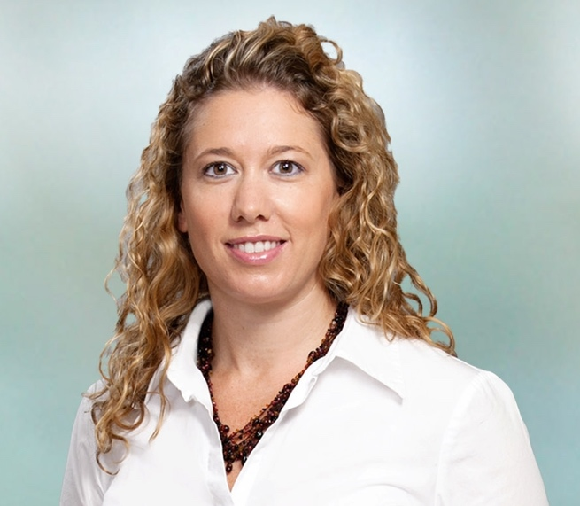
Introducing Your Presenter…
Tori Hanlon, MS, CHCP
GME Consultant
Over 13 years working in Medical Education
Bachelor’s in Health Services Administration
Master’s in Health Administration and Policy
Designated Institutional Official
Experienced in GME at a large academic medical center

Slide 3
Program Accreditation Deadlines
http://www.osteopathic.org/inside-aoa/single-gme-accreditation-system/Documents/Program%20deadline%20charts%203-18-16.pdf

Slide 4
Goals & Objectives
Understand the journey to and components of ACGME accreditation
Identify challenges institutions and programs have in transitioning from the AOA to the ACGME.
Evaluate best practices to achieving ACGME accreditation

Slide 5
Where to Start?
Read the ACGME requirements & FAQs
Read the application
Institutional or specialty-specific application (Word doc on ACGME website)
WebADS
Document uploads
Check certifying Board rules/requirements/regs
Conduct a gap analysis

Slide 6
Gap Analysis
Best Practice
ACGME Requirements
Desired results in order to be “substantially compliant”
Current Practice
Current state of affairs
Identified source
Resulting Gap
Needs
What needs to be done to move from current practice to best practice?

Slide 7
Application
START EARLY!!
Carefully read the instructions
Refer to the ACGME Requirements when answering questions
Answer questions thoroughly, but don’t give more information than needed
Document “plan in place” if you’re not doing something
Print out application in its entirety and READ IT

Slide 8
Site Visit (Pre to Initial)
Educate and inform residents and faculty on content of application
Update WebADS if needed
Provide clarification on what’s written in the application

Slide 9
Site Visit (Pre to Initial)
Be prepared to answer questions regarding the application and ACGME requirements
Don’t hide opportunities for improvement
Highlight program strengths
Point out any changes since the application to the site visitor

Slide 10
Site Visit (Initial to Continued)
“Substantial compliance”
Do what you said you were going to do
Address your citations & AFIs in WebADS Annual Update
Leverage the major changes section of WebADS

Slide 11
Site Visit (Initial to Continued)
Do something with your ACGME Resident & Faculty survey results & document it
Have at least 2 APEs/AIRs under your belt
Don’t be discouraged by lack of data in first couple
Use ACGME requirements, application & site visit documents

Slide 12
CPR Section VI
Patient safety
Quality improvement
Supervision & accountability
Professionalism
Well-being
Fatigue
Teamwork
Transitions of care
Clinical experience & education (formerly duty hours)

Slide 13
Citations
Block diagram
Evaluation forms
Participating sites
Faculty

Slide 14
Challenges
Understanding ACGME expectations
Lack of resources
“One man show”

Slide 16
Upcoming Live Webinars
Transitioning from Residency to Practice Thursday, March 1, 2018 12:00pm – 1:00pm EST Ask Partners – Spring Freebie Tuesday, March 20, 2018 12:00pm – 1:00pm EST Building a Scholarly Infrastructure at a Community Based Institution Thursday, March 29, 2018 12:00pm – 1:00pm EST
www.PartnersInMedEd.com
On-Demand Webinars The Millennial Learner
Quality Improvement: Are You Meeting the New Requirements 2017 Common Program Requirements Update Bullying in the Workplace
Meet the Experts - Fall Freebie
Self-Study…Have You Analyzed Your Data Yet? Creating a Robust Resident Evaluation System
Institutional Site Visit Prep Process
From APE to Self-Study… and Everything in Between
Contact us today to learn
how our Educational Passports can save you time & money!
724-864-7320

Slide 17
Partners in Medical Education, Inc. provides comprehensive consulting services to the GME community.
Partners in Medical Education
724-864-7320 | info@PartnersInMedEd.com
Tori Hanlon, MS, CHCP
tori@partnersinmeded.com
www.PartnersInMedEd.com

