Slide 1
APE Reconstructed: Meeting the New Requirements
Heather Peters, M. Ed, PhD
GME Consultant

Slide 2
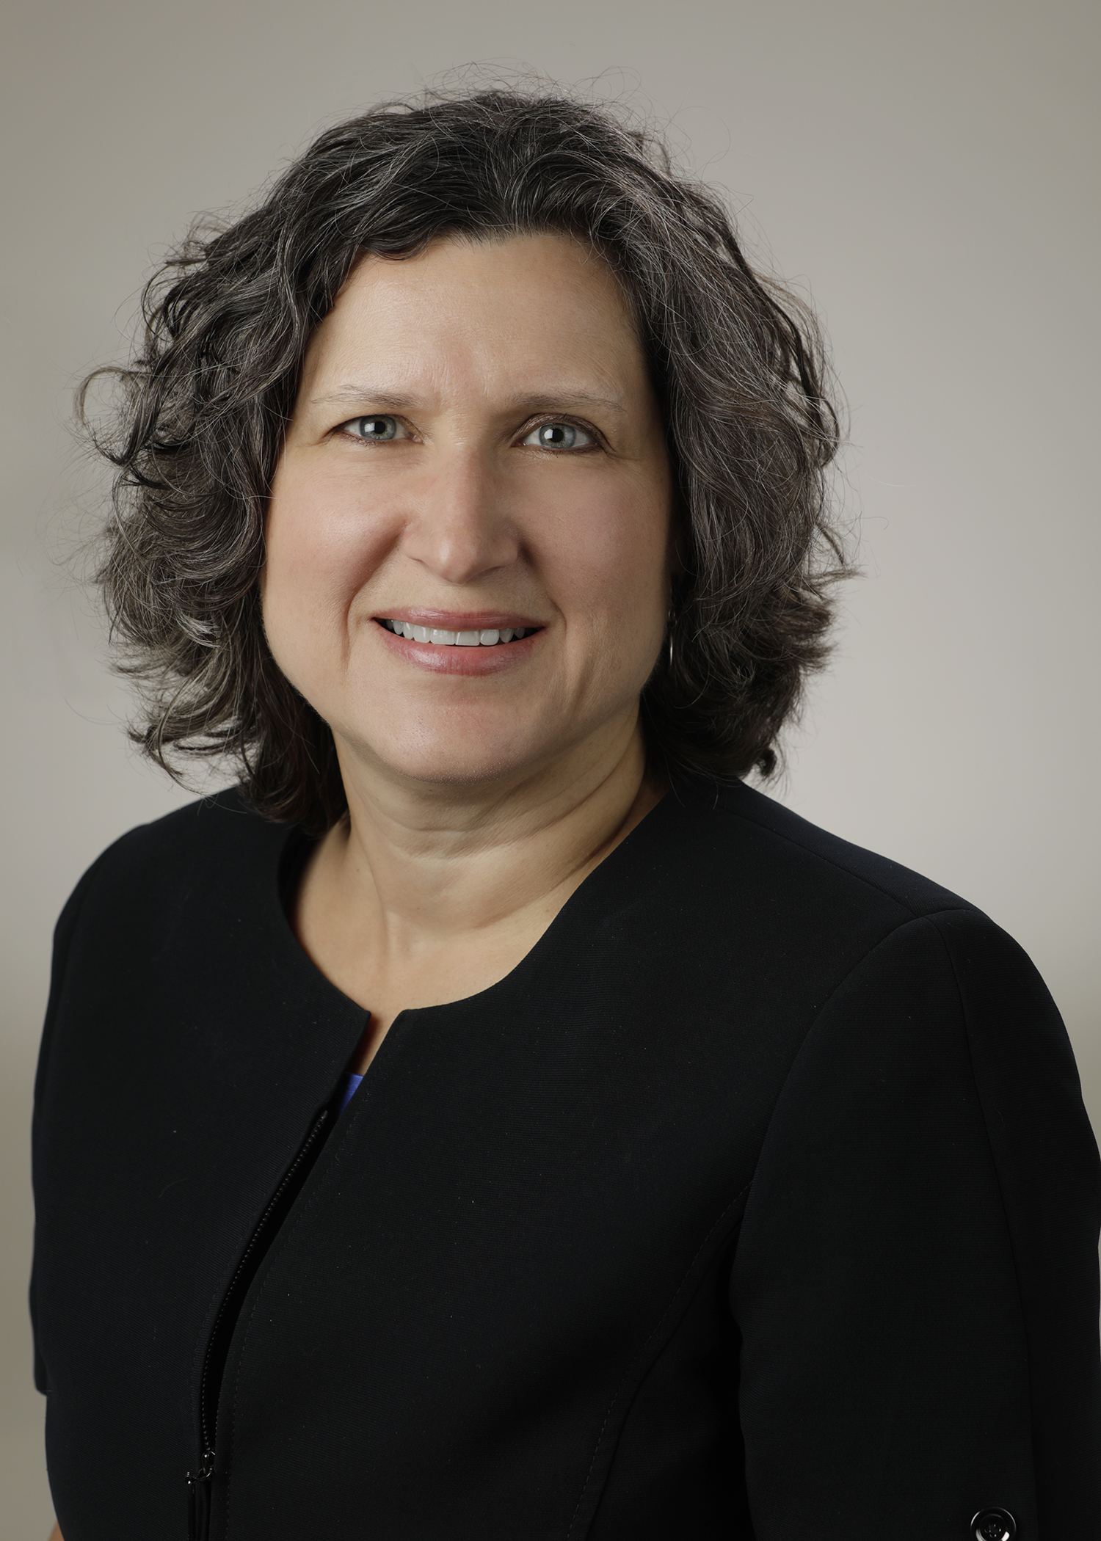
Introducing Your Presenter…
Heather Peters, M.Ed, Ph.D
GME Consultant
GME Director & DIO
Seasoned speaker at ACGME & subspecialty national meetings
Institutional and Program accreditation expertise
3 decades in education; Masters of Education in curriculum & evaluations, PhD concentration in secondary education & adult learning theories

Slide 3
Learning Objectives
Create an understanding of the changes
Review draft APE document for GMEC presentation
Discuss executive summary
Discuss timing of APE
Tools Provided to Participants:
Template for APE Report to the GMEC
Mission Statement & SWOT Worksheet

Slide 4
Annual Program Evaluation
Curriculum
Outcomes from previous APE
ACGME letters of notification, citations, AFIs
Quality and safety of patient care
Aggregate trainee and faculty:
well-being
recruitment & retention
workforce diversity
engagement in QI and PS
scholarly activity
ACGME trainee and faculty surveys
written evaluations of the program
Aggregate trainee:
achievement of the Milestones
in-training exams
board pass and certification rates
graduate performance
Aggregate faculty:
evaluation
professional development
Review Mission Statement
Conduct SWOT Analysis
Review Progress/Data on Aim Statements
Tool: Worksheet for Mission Statement & SWOT development

Slide 5
ACGME Requirements for Action Plans
discussed with trainees and faculty (PR V.C.1.e).(1))
submitted to the DIO (PR V.C.1.e).(2))
GMEC: Oversight of the ACGME-accredited program(s)’ APE and self-studies (IR I.B.4.a).(4))

Slide 6
Where to start…
Mission, AIMs, and SWOT
AIMs
SWOT
Strengths
Weaknesses
Opportunities
Threats
Broad...
Narrow…
Measurable…
Memorable…
Limited number…
MISSION
VISION

Slide 7
Mission, Aims, and SWOT
These are new requirements that grew out of the Self-study materials.
Strengths
Internal factors
Weaknesses
Internal factors
Opportunities
External
Threats
External
“Context of the educational program”
Link: ACGME Self-study documents: https://www.acgme.org/What-We-Do/Accreditation/Self-Study/Self-Study-Tools

Slide 8
Developing Aims
Key question: Where do we want this program to be in 10 years?
AIMS are aspirational – raise the bar
AIMS are measurable – will use future APEs to track how you are doing on your AIMS
AIMS are future-oriented – what might happen in your institution over the next decade that will affect your training program

Slide 9
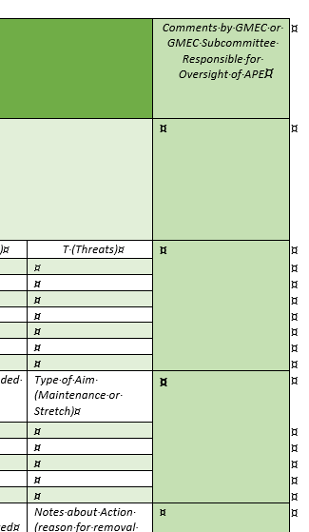
Form Design
Possibly less intimidating
Allows for each section to be reviewed and commented upon by the oversight entity (GMEC or Subcommittee of GMEC)
Easily amended (insert rows or delete rows)

Slide 10
Program Information
Section I: Program Information Program Mission, SWOT, Aim Statements, Previous APE Action Plans, and Current APE Action Plans
A. Program Mission
B. SWOT | S (Strengths) | W (Weaknesses) | O (Opportunities) | T (Threats)
Add rows as needed
C. Aim Statement Maximum of 5 | Current Aim | Measurement | Type of Support Needed (High, Medium and Low) | Type of Aim (Maintenance or Stretch)
D. Action plans from previous APE | Brief summary of action item | Measurement for action item | Status: Resolved, Continued or Removed | Notes about Action (reason for removal of continuation)
E. Action Plans from Current APE | Brief summary of action item | Measurement for action item | Person(s) Responsible | Notes about Action Plans

Slide 11
Accreditation Status
Section II: Accreditation Status
A. Letter of Notification | Date of LON: | Status: | Next Site Visit: | Self-study Date:
B. Citation Information | Brief summary of citation | New or Extended | Action plan for resolving citation | Person responsible for Action Plans
C. Areas for improvement | Brief summary of AFI | Action plan | Person responsible for Action Plans

Slide 12
Program Structure Review: Curriculum
Describe how you reviewed the curriculum
Which rotations/services had significant changes this past year?
Will you be adding or removing any rotations?
Section III: Review of Curriculum
Describe how you reviewed the curriculum
Which rotations/services had significant changes in the past year?
Will you be adding or removing any rotations on your block

Slide 13
Aggregate Reports of trainees/faculty
Type of Report | Data Source
Well-being* | ACGME Surveys
Recruitment* | Strategies Statistics: **Applied **Invited for Interview
Workforce* | Resident/fellow complement Faculty Institutional statistics
Engagement in QI | Quality improvement initiatives
Engagement in Patient Safety | Patient Safety Alert Statistics
Scholarly Activity | Institutional database for scholarly activity
*Newer items – may need to provide examples and guidance to programs

Slide 14
Aggregate Resident & Faculty Activity and Performance
A. Well-being | Items in the non-compliant range from ACGME Survey | Number of Well-being Issues during academic year (LOA, taken off rotations, and other well-being issues) | Number of referrals to EAP (not how many actually followed through) | Any well-being issues that were examined on the internal survey? What are the findings?
Residents/Fellows
Faculty
B. Recruitment/Retention
Recruitment | Discuss the recruitment strategies that you implemented this past year
Graduation/Attrition | 20__ | 20__ | 20__ | 20__
Residents who started the program 3 years ago
Residents who will graduate at the end of this academic year
% on-time graduation* *within 2 months = on-time
Comment on those residents who will not graduate on time due to resignation, medical or personal leave, academic extension or other reason.
C. Workforce Diversity
Provide details about each of the categories of workforce diversity | Program Match Statistics | Demographic make-up of your trainees | Demographic make-up of your faculty and administrative staff | Other diversity metrics

Slide 15
Aggregate Data Continued
D. Engagement in Quality Improvement
Describe how trainees are involved in initiatives for quality improvement, including education
Describe how faculty are involved in initiatives for quality improvement, including education
E. Engagement in Patient Safety
Describe how trainees are involved in patient safety, including education
Describe how faculty are involved in patient safety, including education
F. Scholarly Activity
 | % of graduates from previous year producing scholarly work in the past 12 months: | % of current trainees producing scholarly work in the past 12 months: | Number of PMID publications for either graduates or current trainees in the last 12 months: | Number of Abstracts presented/accepted at National Meetings:
Resident/Fellow Data
 | % of core faculty members who have produced scholarly work in the past 12 months: | % of all faculty producing scholarly work in the past 12 months: | Number of PMID publications for either core or non-core faculty:
 | Number of presentations & abstracts for faculty: | Number of trainees mentored for their scholarly work by either core or non-core faculty:
Faculty Data

Slide 16
ACGME Survey Data - Trainees
G. ACGME Survey Results
Trainee Survey Results | 2018 | 2019 | 2020 | Trend
Area | Put the score that you find at the top of your ACGME Survey |  |  | Up, Consistent, Down or Up and Down
Duty Hours
Faculty
Evaluation
Education Content
Resources
Patient Safety
Teamwork
Overall Evaluation of Program | Very Negative: Negative: Neutral: | Discuss Action Plans for Investigating Low Scores:
Concerning Trends: Discuss 3-year trends or significant drops in any one area
Action Plan for any Area that is (Each SI will need to create the cut-off threshold) | Area | Action Plan | Measure of Plan | Person(s) Responsible

Slide 17
ACGME Survey Data – Faculty
Faculty Survey Results | 20__ | 20__ | 20__ | Trends
Area | Put the score that you find at the top of your ACGME Survey |  |  | Up, Consistent, Down or Up and Down
Faculty Supervision & Training
Educational Content
Resources
Patient Safety
Teamwork
Overall Evaluation of Program | Very Negative: Negative: Neutral: | Discuss Action Plans for Investigating Low Scores:
Concerning Trends: Discuss 3-year trends or significant drops in any one area
Action Plan for any Area that is (Each SI will need to create the cut-off threshold) | Area | Action Plan | Measure of Plan | Person(s) Responsible

Slide 18
Written Evaluations of Program
Internal program evaluations
H. Written Evaluations of the Program (Internal) | Discuss findings from the trainee survey | Action plans | Discuss findings from the faculty survey | Action plans
When was the internal survey administered? __________________

Slide 19
Aggregate Trainee/Faculty
This Photo by Unknown Author is licensed under CC BY-NC-ND
Report | Notes/Source
Achievement of the Milestones | Milestone averages by milestone/training year (see sample)
In-training Exams | By training year – use the score that compares to their training year
Board Pass/Certification Rates | 3 year rolling average for first time takes
Graduate Performance | Statistics about: Number Employed Number in Further Training Number working in underserved areas
Report | Notes/Source
Evaluation Data
Professional Development | As educators: QI/PS: Practice-based learning: Diversity: Well-being:

Slide 20
Program Metrics
A. Achievement of Milestones
Trainee Milestone Averaged by Core Competency Area | PGY-1 | PGY-2 | PGY-3 | PGY-4
Patient Care
Medical Knowledge
Practice-Based Learning & Improvement
Systems-based Practice
Professionalism
Communication & Interpersonal Skills
B. Board Pass Rate/Certification Rate
 | 20__ | 20__ | 20__ | Trend
# of graduates over 3 years
# of examinees
# passing over 3 years
C. In-training Exam
State how the average for each training year compares to all those who take the exam (in the same training year) | PGY-1 | PGY-2 | PGY-3 | PGY-4

Slide 21
Program Metrics Continued
D. Graduate Performance
 | Job placement of graduates: | Fellowship placement of graduates: | Trends from exit interviews: | Trends from graduate surveys:
E. Faculty Evaluation | Statistics for Aggregate Faculty Evaluation | Lowest area on aggregate faculty evaluations | Action plans for improving this area on the faculty evaluations
F. Faculty Development | 20__ | 20__ | 20__
Education
Quality Improvement & Patient Safety
Fostering their Own and Resident Well-being
Patient care improvement based on practice-based learning
Based upon the review of sources of data related to the Professional Development, what are the action plans the PEC has in place to improve this area?

Slide 22
Final Comments
Section VII: Final Comments
Please provide narrative that will allow the GMEC to understand your program. This might include specifics from your program that you review in your APE but is not discussed in this report.

Slide 23
Program Specifics – What Will Help You Reach Your AIMs?
Resource Needs
Case log specifics
Didactics
Quality of rotations/services

Slide 24
Executive Summary
Pros | Cons
Easier to review | Is this oversight?
Program can highlight their key points | This allows for the program to cover up their deficiencies

Slide 25
Time of Year
This Photo by Unknown Author is licensed under CC BY-SA-NC
Time of the Year | Pros | Cons
End of the academic year | Allows AIR to be put together as soon as the academic year is over | The programs have a difficult time pulling everything together by the end of the academic year. Some of the data that programs need is not available until after June 30th
Summer | Same time as programs are pulling together info for ADS updates | Much of the same information for the ADS update and the APE report
Fall | Allows for ADS update to be completed first | Less likely to allow for major changes to program even when findings indicate these changes should be made
Winter | Provides more time for programs | Very confusing and less effective the farther away from the academic year that is being analyzed Too late to make major changes for current academic year

Slide 26
Recommended Appendices
Trainee/Faculty Scholarly Activity and List of Specific Scholarly Activities
ITE Training Results
Faculty Development Activities
Action Plans for Previous APE
Action Plans for Current APE
Letters from ACGME
ACGME Surveys

Slide 27
Wrapping Up!

Slide 28
Take Home Points
This is a form for the APE report to the GMEC, not the APE for the program
It will take time to refine the tool for your specific institution
Education of program administrators and program directors will be required

Slide 29
Questions??

Slide 30
Upcoming Live Webinars
Digging for Data 101 Thursday, January 23, 2020 12:00pm – 1:00pm EST
PEC: Best Practices Tuesday, February 4, 2020 12:00pm – 1:00pm EST
Research and Scholarly Process in a Nutshell: Getting Started Thursday, February 13, 2020 12:00pm – 1:00pm EST
On-Demand Webinars
Special Reviews – Helpful not Hurtful
2019 CPR Part 3 of 4: Section IV & Section V
GME Is Not Just GME
SI 2025 Part 4 of 4: Strategic Planning
Understanding Practice Data
CPR 2019 Part 4 of 4: Putting It All Together
Crafting “Top Notch” Goals, Objectives and Evaluations
Feedback – From the Top Down
Evolving Resident Well-Being
We All Need Scholar Activity, Including Coordinators
NEW Faculty Development Series
15 Minutes to Effective Feedback
Toolbox for Teaching Millennials
Taking Supervision to the Next Level
Contact us today to learn how our Educational
Passports can save you time & money!
724-864-7320
www.PartnersInMedEd.com
30

Slide 31
Partners in Medical Education, Inc. provides comprehensive consulting services to the GME community.
Partners in Medical Education
724-864-7320 | info@PartnersInMedEd.com
Heather Peters, M.Ed, Ph.D
heather@partnersinmeded.com
www.PartnersInMedEd.com

