Slide 1
Partners Webinar Alert
Reminder…Because of the amount of individual logins for this webinar. Please DO NOT Unmute your Microphone after you enter this webinar.

Slide 2
Artificial Intelligence in Medicine: Its Impact on GME
Heather Peters, M. Ed, PhD – GME Consultant
Tori Hanlon, MS, CHCP – GME Consultant
Presented by Partners in Medical Education, Inc. 2020

Slide 3
Introducing Your Presenter…
Introducing Your Presenter…
Heather Peters, M.Ed, Ph.D
GME Consultant
Tori Hanlon, MS, CHCP
GME Consultant
Over 13 years working in Medical Education
Bachelor’s in Health Services Administration
Master’s in Health Administration and Policy
Designated Institutional Official
Experienced in GME at a large academic medical center
Former GME Director & DIO
Seasoned speaker at ACGME & subspecialty national meetings
Areas of Expertise: GME Strategic Planning; Program Evaluation; and Faculty Development
3 decades in education; Masters of Education in curriculum & evaluations, PhD concentration in secondary education & adult learning theories
Presented by Partners in Medical Education, Inc. 2020

Slide 4
Learning Objectives
1. DISCUSS types of Artificial Intelligence (AI) requiring curriculum changes
Telehealth
Medical Information Explosion
Big Data
2. INVESTIGATE the impact of AI on the future of GME
How to weave AI into Core Competency Framework across specialties
How to teach educational agility and a new paradigm for change
Who will drive the AI development of the future
Hand-outs:
How to Leverage Journal Club to Meet Educational Requirements
Basics of Curriculum Development
Presented by Partners in Medical Education, Inc. 2020

Slide 5
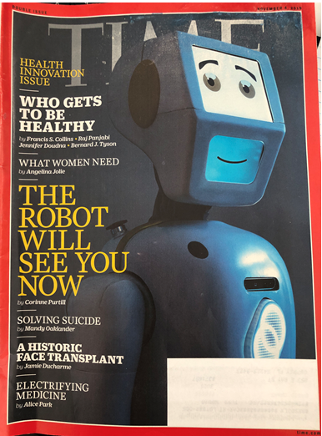
Presented by Partners in Medical Education, Inc. 2020

Slide 6
AI in Health Care
Faster and accurate diagnosis
Error reduction due to human fatigue
Assist and replace repetitive and labor-intensive tasks
Minimally invasive surgery
Reduce mortality rates
Scientific discipline that focuses on understanding and creating computer algorithms that can perform tasks that are usually characteristics of humans
Presented by Partners in Medical Education, Inc. 2020

Slide 7
Telehealth
Overcomes challenges of health service delivery
Enables cost-effectiveness
Improved access
Uses information and communication technologies to transfer medical information for the delivery of clinical and educational services
AI supplements telehealth by offering new models of care and support
Presented by Partners in Medical Education, Inc. 2020

Slide 8
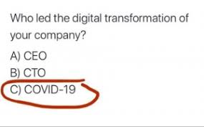
COVID-19
Prediction
Screening
Contact alerts
Diagnosis
Drug discovery
Presented by Partners in Medical Education, Inc. 2020

Slide 9
Challenges
Integration across different aspects of curriculum
EHR
Insurance companies
Faculty
Practical use of AI vs. understanding applicability
Presented by Partners in Medical Education, Inc. 2020

Slide 10
Medical Information Explosion
Estimated time of medical knowledge doubling
50 years (1950)
7 years (1980)
3.5 years (2010)
73 days (2020)
Presented by Partners in Medical Education, Inc. 2020

Slide 11
Curricular Changes
Information acquisition
Memorization
Knowledge management
Supervise AI tools
Manage data
Use AI applications to make informed decisions
Application to patient care
Presented by Partners in Medical Education, Inc. 2020

Slide 12
AI Applications
Hospital workflow
Wearable devices
Medical imaging and diagnosis
Therapy planning
Virtual assistants
Drug discovery
Presented by Partners in Medical Education, Inc. 2020

Slide 13
Big Data
SI2025
Organizations use large data sets of patient information to reveal patterns of individual health care. Insights gathered from this information are important tools for understanding and prediciting health care utilization.
Navigation of healthcare disparities as a result of differences in patient access to benefits of big data
Familiarity with build of big data systems & outputs they produce
Physician perspective = More work
Confront ethical issues that arise with use of big data that may conflict with established medical practice
Presented by Partners in Medical Education, Inc. 2020

Slide 14
PSA from Partners in Medical Education
ACGME Resource for Coordinators
Presented by Partners in Medical Education, Inc. 2020
14

Slide 15
2025 Faculty Roles
Diagnostic Assessor: Use data to identify performance gaps to individualize training
Learning Environment Designer, Engineer, Architect, and Implementer: Design “space” to optimize learning
Content Curator: Access, select, sequence, and deliver high-quality evidence-based content
Technology Adopter: Be an early adopter, fluent in selecting and using technology tools
Learner-Centered Navigator and Professional Coach: Guide learners to achieve identified performance targets
Clinician Role Model: Act as an exemplar for the various 2025 physician job roles
Simpson D, Marcdante K, Souza KH, Anderson A, Holmboe E. Job roles of the 2025 medical educator. JGME. 2018;10(3);243-246.
Presented by Partners in Medical Education, Inc. 2020

Slide 16
Concept:
Ensure that AI solutions are not masking larger systemic issues
Example: BP wearable devices.
Are we short-changing a disproportionate population (that is more prone to BP issues)?
Systems-Based Practice (Health Advocate*)
*CanMEDS: Canada’s Framework Definitions
Rampton V, Mittelman M. Goldhahn J. Implications of artificial intelligence for medical education. www.thelancet.com/digital-health. Vol.2; March 2020.
Presented by Partners in Medical Education, Inc. 2020

Slide 17
Concept: Understand the models behind the decision-making used in AI
Question: If Insurance industry drives the AI development, how will we be sure that they “objective” data is not influence by a cost bias?
Rampton V, Mittelman M. Goldhahn J. Implications of artificial intelligence for medical education. www.thelancet.com/digital-health. Vol.2; March 2020.
Presented by Partners in Medical Education, Inc. 2020

Slide 18
Example: Physicians must acknowledge the patient’s right to decide if the AI will benefit them, and provide necessary guidance and advice to support patient decisions
Professionalism (Professional)
Concept: Understand the models behind the decision-making used in AI
Rampton V, Mittelman M. Goldhahn J. Implications of artificial intelligence for medical education. www.thelancet.com/digital-health. Vol.2; March 2020.
Presented by Partners in Medical Education, Inc. 2020

Slide 19
Example: How to reconcile when the physician’s treatment plan does not follow the AI logarithm. How to provide the patient with the best medical care.
Communication & Interpersonal Skills (Collaborator)
Concept:
Empowers the patient, questioning the previous status of holders of exclusive knowledge
Rampton V, Mittelman M. Goldhahn J. Implications of artificial intelligence for medical education. www.thelancet.com/digital-health. Vol.2; March 2020.
Presented by Partners in Medical Education, Inc. 2020

Slide 20
Concept:
Work together with patients to understand the AI interpretation for the individual
Example: The home situation, a component or caring for the whole patient, may not be accessible to the AI technology
Rampton V, Mittelman M. Goldhahn J. Implications of artificial intelligence for medical education. www.thelancet.com/digital-health. Vol.2; March 2020.
Presented by Partners in Medical Education, Inc. 2020

Slide 21
AI Development – Which Door is it Behind?
Non-profit
Commerce
Government
Medicine
Insurance
Presented by Partners in Medical Education, Inc. 2020
Notes:
Back to the concept of big data.
Data is the starting point for AI. We need to invest in the creation and collection of data—while ensuring that the value created through the use of this data accrues to the individuals whose data it is. To protect and preserve the integrity of this data, we need trusted, responsible, inclusive legal and regulatory policies and a framework for governance.
Commercial companies cannot solve these problems alone—they need partnerships with government, academia and nonprofit entities. We need to make sure that our computer scientists, data scientists, medical professionals, legal professionals and policymakers have relevant training on the unique capabilities of AI and an understanding of the risks.

Slide 22
How can GME Join the AI Development Process
Develop an AI GME specialty
Recognize “AI Champions” among our learners
Develop AI Curriculum for GME programs
Diversity & Inclusion
Presented by Partners in Medical Education, Inc. 2020

Slide 23
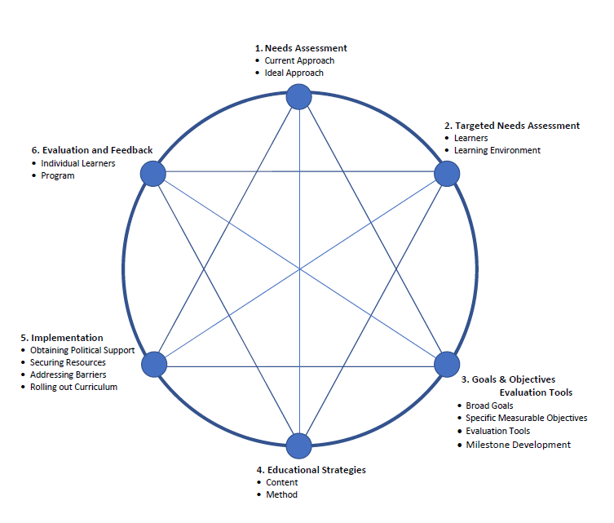
Medical Education Curriculum Framework
Adapted from Curriculum Development for Medical Education: A Six-step Approach. Editors: Thomas, PA; Kern DE; Hughes MT; Chen, BY. John Hopkins University Press; Baltimore, MD; 2016.
Presented by Partners in Medical Education, Inc. 2020

Slide 24
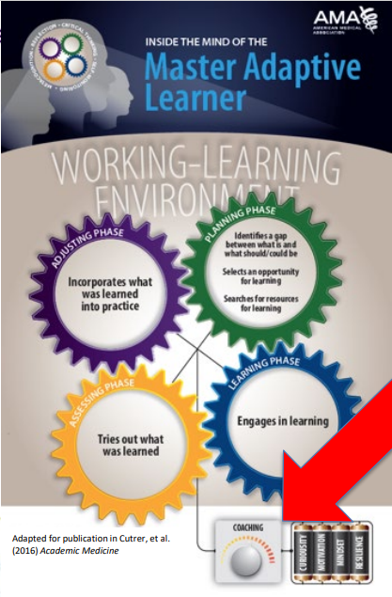
Presented by Partners in Medical Education, Inc. 2020

Slide 25
Presented by Partners in Medical Education, Inc. 2020
25

Slide 26
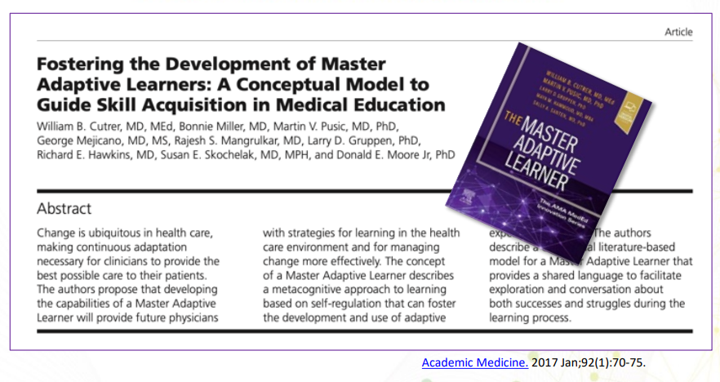
Presented by Partners in Medical Education, Inc. 2020

Slide 27
Practical Implementation of Adaptive Learning
V.A.1.d).(2) assist residents in developing individualized learning plans to capitalize on their strengths and identify areas for growth; and, (Core)
Patient Care Skills Needing Additional Opportunities | Discussion | Sites for Additional Opportunities | Goals for Patient Care Skill (Measurement) | Updates & Notes
Interviewing geriatric patients | Due to closure of nursing home sites due to COVID-19 regulations, the resident has been unable to complete required number of geriatric patient interviews | Simulation Geriatric patients in the wards | Interview geriatric patient according to specialty requirements (Patient Data gathering assessment – geriatric version)
Presented by Partners in Medical Education, Inc. 2020

Slide 28
References
Simpson D, Marcdante K, Souza KH, Anderson A, Holmboe E. Job roles of the 2025 medical educator. JGME. 2018;10(3);243-246.
Rampton V, Mittelman M. Goldhahn J. Implications of artificial intelligence for medical education. www.thelancet.com/digital-health. Vol.2; March 2020.
The looming end to the telehealth boom. Accessed on July 23, 2020 at https://www.mobihealthnews.com/news/looming-end-telehealth-boom.
Paranjape K, Schinkel M, Pandy RN, Car J, Nanyakkara P. Introducing Artificial Intelligence Training in Medical Education. JMIR Medical Education, Technology, Innovation and Openness in Medical Education. 2019 Jul-Dec; 5(2): e16048. Accessed on July 23, 2020 at www.mededu.jmir.org.
Lee K. COVID-19 will accelerate the AI health care revolution. Accessed July 2020 at https://www.wired.com/story/covid-19-will-accelerate-ai-health-care-revolution.
Miller G. AI and health care are made for each other. Time;19 Nov: Vol.194:18;59.
AMA Webinar – AMA Innovations in Medical Education Webinar Series: Fostering agility in learner: competency-based medical education and coaching to support master adaptive learners. Viewed August 3, 2020.
Presented by Partners in Medical Education, Inc. 2020

Slide 29
Final Thoughts…
With all the current requirements, it’s difficult to prepare for the future
Any strategic planning – hopefully in alignment with the organization – should consider the AI discussed in this email
We must create strategies to ensure that GME is at the FOREFRONT of these changes – not REACTING as they happen
Presented by Partners in Medical Education, Inc. 2020

Slide 30
Upcoming Live Webinar
Faculty Development – A More Specific Approach
Thursday, September 3, 2020 12:00pm – 1:00pm EST
GME Workforce Planning
Thursday, September 24, 2020 12:00pm – 1:00pm EST
Working with a Statistician on your Research Project
Thursday, October 8, 2020 12:00pm – 1:00pm EST Quality Improvements in GME: 5 years later
Thursday, October 22, 2020 12:00pm – 1:00pm EST
Latest On-Demand Webinars
Research and Scholarly Process in a Nutshell: Getting Started
Ask Partners – Spring Freebie Lessons Learned: Accepting Displaced Orphan Residents
Is your Coordinator Well Enough: Coordinators as Role Models of Wellness
Research Proposal Development: Tips for Success Working with your Governing Board
Recognizing & Addressing Precursors of Burnout: The Value of Shame Resiliency Training to Support Resident Well-Being
Working with your IRB
Digging for Data II
NEW Faculty Development Series
15 Minutes to Effective Feedback
Toolbox for Teaching Millennials
Taking Supervision to the Next Level
Contact us today to learn how our Educational
Passports can save you time & money!
724-864-7320
www.PartnersInMedEd.com
Presented by Partners in Medical Education, Inc. 2020
30

Slide 31
Partners in Medical Education, Inc. provides comprehensive consulting services to the GME community.
Partners in Medical Education
724-864-7320 | info@PartnersInMedEd.com
Heather Peters, M.Ed, Ph.D Heather@PartnersInMedEd.com
Tori Hanlon, MS, CHCP Tori@PartnersInMedEd.com
www.PartnersInMedEd.com
Presented by Partners in Medical Education, Inc. 2020

