Slide 1
Please Note…
Please make sure your Start Video is OFF when logging into the WebEx platform.
Here is what it should look like
ALSO
It is NORMAL to not hear any sound until the webinar starts at 12:00 noon EST.
Your phone line is muted, but you can always chat to the host, BJ Schwartz, if you have any questions or concerns during this time.

Slide 2
Ask Partners
Heather Peters, M.Ed, Ph.D Amy Durante, MHA
Cheryl Haynes, BA Christine Redovan, MBA, MLIS

Slide 3
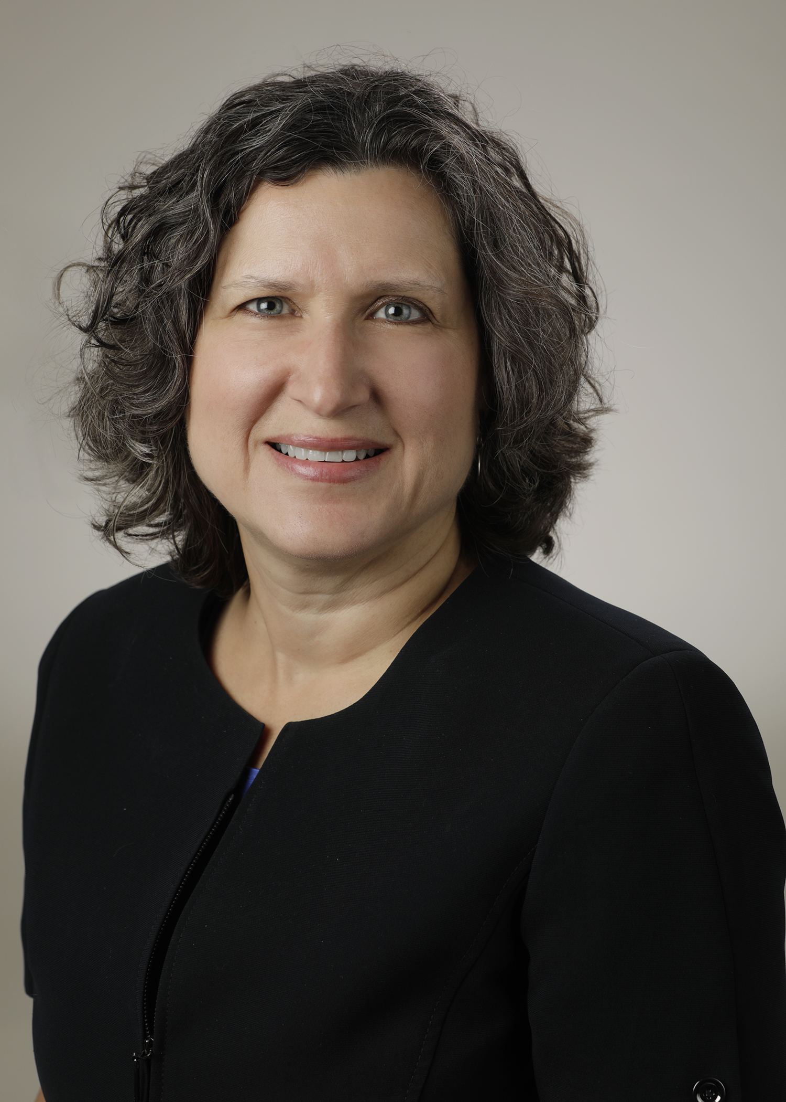
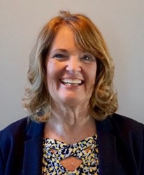
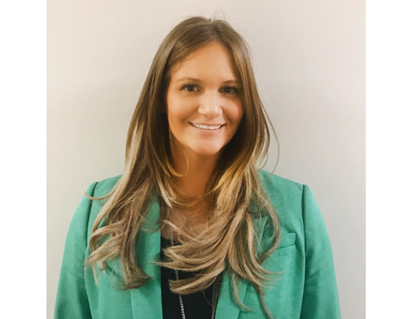
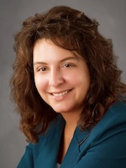
Introducing Your Presenters…
Heather Peters, M.Ed., PhD
GME Consultant
Cheryl Haynes, BA
GME Consultant
Amy Durante, MHA
GME Consultant
Christine Redovan, MBA, MLIS
GME Consultant
Heather is a seasoned GME consultant with 3 decades of educational experience.
Heather will be providing her key takeaways related to Effective Program Evaluation Committees (PEC).
Cheryl is a seasoned GME professional and consultant with 18 years of program administration experience.
Cheryl will be providing her key takeaways related to A Complaint to the ACGME: Now What Do I Do?
Amy is a seasoned GME professional and consultant with over 14 years of experience.
Amy will be providing her key takeaways related to Making the Most of Your Major Changes Section.
Christine is a seasoned GME consultant with 25 years of experience in medical education.
Chris will be providing her key takeaways related to Making Sense of Resident Written Comments.

Slide 4
Learning Topics
Effective Program Evaluation Committees
A Complaint from the ACGME? Now What Do I Do?
Making The Most of Your Major Changes Section
Making Sense of Resident Written Comments
Presented by Partners in Medical Education, Inc. 2023

Slide 5
Effective Program Evaluation Committees (PEC) Heather Peters, PhD
Presented by Partners in Medical Education, Inc. 2023

Slide 6
Context
Program Director One-day Course
Limited time so all items were high priority topics
One session on CCC and one on PEC

Slide 7
But, we’re meeting the requirements!
You want us to schedule another meeting?
High Quality Program
Substantial Compliance (Minimums)
Proactive
Reactive
Trainee-driven program improvement
Limited trainee voice
Diffused Leadership
Program Director Control over All Elements
Presented by Partners in Medical Education, Inc. 2023
7

Slide 8
Best Practices
Use the PEC to
Bring a controlled “trainee voice” to the program improvement process
Evaluate the program (particularly the curriculum throughout the year)
Monitor key compliance concerns (evaluations, work hours, procedures)
Train your next program director
Take pulse indicators several times throughout the year leading up to the ACGME survey
Identify future chief residents/faculty early in training
Keep the action items and ACGME survey concerns on the front burner all year long

Slide 9
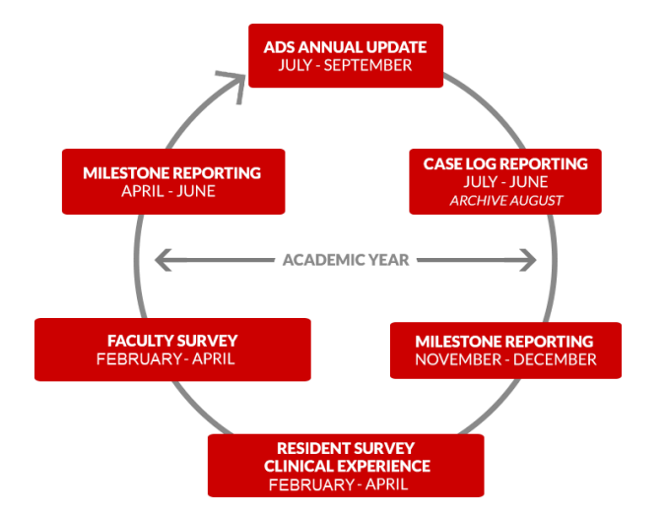
Annual ACGME Cycle
APE
PEC
PEC
CCC
CCC
PEC
PEC

Slide 10
A Complaint From the ACGME? Now What Do I Do?
Cheryl Haynes, BA
Presented by Partners in Medical Education, Inc. 2023

Slide 11
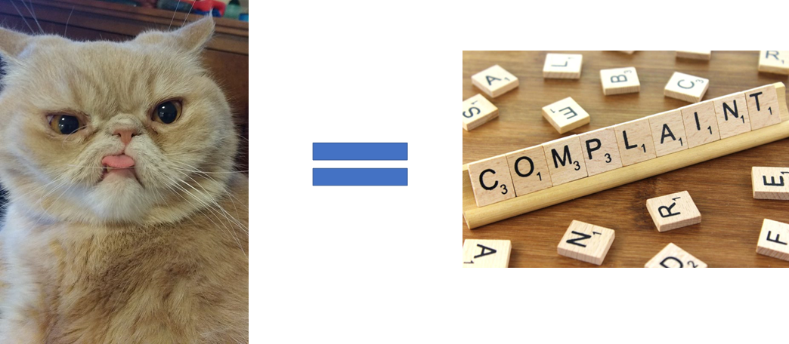

Slide 12
Reporting Avenue
ACGME Office of the Ombudsman
Impartial safe place to report concerns related to GME-related issues
Reports can be anonymous
Concerns do not go to the Review Committee
No impact on accreditation

Slide 13
ACGME Office of Ombudsman Process
Complaint received by Office of the Ombudsman
Office staff member reviews
Inquiry sent to DIO detailing concern
SI submits report to the O of O detailing process of investigation, findings and action plan.
May be transferred to
Office of Complaints

Slide 14
Reporting Avenue
ACGME Office of Complaints
While identities are protected as much as possible, complaints must be signed – ACGME will not act on anonymous complaints
Anyone with a concern for compliance can file a complaint
Complaints must
relate to accreditation compliance
address noncompliance that occurred in the current or previous academic year

Slide 15
ACGME Office of Complaints Process
Complaint is Received and Reviewed
Not Substantiated
Referred to the RC
Determined to be Egregious

Slide 16
Complaints Referred to the RC
Complaint Reviewed
Additional Information Requested
Request a Site Visit
No action Taken
Accreditation Decision or Citation

Slide 17
Determination of Possible Egregious Violation
Complaint Referred to President/CEO of ACGME
Requests Additional Information
Refers to RC
Requests a Site Visit
Takes No Action
Refers to ACGME Board
Accreditaiton Decision or Citation

Slide 18
What Do We Do??
Don't Panic
Read the Letter Carefully
Pay close attention to timelines & information requested
Understand what is being cited (IR's or PR's)
Communicate!!
With Institutional Leadership/Program Leadership
With Attorney
With your Supervisor
Clear your Calendar
Follow Instructions
Stay Calm
Reach out – number of complaints is on the rise – support is available

Slide 19
Recommended Reading

Slide 20
Making the Most of Your Major Changes Section Amy Durante, MHA

Slide 21
Read It!
Sponsoring Institution:
Provide a brief update explaining any major changes to graduate medical education, key personnel, or organizational structure within the sponsoring institution since the last academic year.
Programs:
Provide a brief update explaining any major changes and any other updates to the educational program in the last year, e.g. changes in program leadership and faculty, rotational changes, curricular innovations, program challenges, efforts to address issues identified in the annual ACGME surveys, and the impact of the COVID-19 pandemic on your resident/fellow education.

Slide 22
You Have It, Use It
Use all characters
~ 2,000 words
Never indicate no change since last academic year
Think like the ACGME

Slide 23
Sponsoring Institution Suggestions
GME leadership changes
New Programs
Closed Programs
Complement increases
ACGME survey action plans
Internal surveys
Special Reviews
Self-Study
Institutional Changes
Governing Body
C-Suite
New EMR
Faculty/coordinator development
QI/PS updates
Well-being updates
Policy revisions
GMEC structure/process
Anything for all

Slide 24
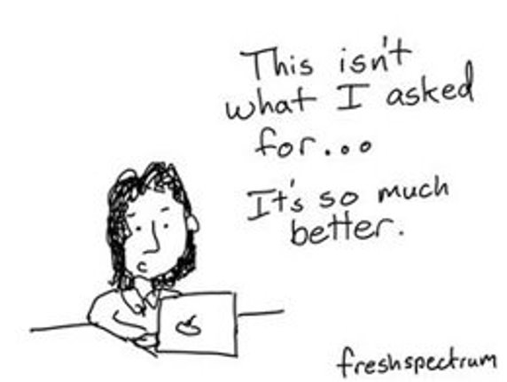
Program Suggestions
Changes in program leadership and faculty
Rotational changes
Curricular innovations
Program challenges
Efforts to address issues identified in the annual ACGME surveys
Impact of the COVID-19 pandemic
Any other updates
Sponsoring Institution changes/implementations
Special Reviews
Didactics
Work hours
Participating sites
Faculty development
Coordinator development
APE action items
Recruitment
Internal surveys

Slide 26
Tips and Tricks
Enter it when it happens
Keep a file for it
Keep a notebook
Review your previous GMEC minutes
Review your PEC minutes
Review your APE
Update from previous year

Slide 27
Importance
Your conversation with the ACGME
Your voice
Can avoid citations
Can assist with adverse action

Slide 28
Making Sense of Resident Written Comments
Christine Redovan, MBA, MLIS
Presented by Partners in Medical Education, Inc. 2023

Slide 29
Inspiration...
Based on 2023 ACGME Annual Educational Conference
SES080:
Providing Meaning to Numbers and Words
for your Program
Stanford Medicine
Ann Dohn, DIO & GME Director
Elizabeth Babalola, PhD
Jie Li, PhD
Pedro Tanaka, MD, PhD
This Photo by Unknown author is licensed under CC BY-SA.

Slide 30
Program Data
Quantitative
Qualitative
Answers what or how much
Can be counted or measured
ACGME Surveys
Work hours
ITE scores
Board pass rates
Answers why or how
Non-numerical; understand experiences or perspectives
Survey comments
Interviews
Evaluation comments

Slide 31
What to do with all those comments?
Verbatim
Summarize
Analyze
Not a good idea
Better; what we tend to do
Ideal

Slide 32
Example – Describe the feedback process in your program.
Some attendings are good; most do not provide any feedback. It is usually well after the rotation.
Attendings do not give recommendations on how to improve.
Few faculty let us be hands-on. This would provide opportunity for feedback and improvement.
Would like to get feedback every day; either good or bad.
We get no actionable feedback – read this paper, or here is a great video to help with a technique.
Written evals are meaningless. No suggestions are given. Evals are months later.

Slide 33
Step 1: Identify key words
Given Want to make sure residents receive feedback
Timely Looking to see if they get feedback/evaluations during and/or shortly after the rotation
Effective Is the resident able to use what is provided to him/her and improve

Slide 34
Step 2: Annotate
Some attendings are good; most do not provide any feedback. It is usually well after the rotation.
Attendings do not give recommendations on how to improve.
Faculty rarely do bedside rounds with us. This would provide opportunity for feedback and improvement.
Would like to get feedback every day; either good or bad.
We get no actionable feedback – read this paper, or here is a great video to help with a technique.
Written evals are meaningless. No suggestions are given. Evals are months later.

Slide 35
Step 3: Analyze/Themes
Given | 2
Timely | 3
Effective | 5

Slide 36
Step 4: Summarize
When asked to describe the faculty feedback process, the top resident concern was the effectiveness of the evaluations followed by timeliness.
Faculty development
Closer monitoring of completion rate
Combine with qualitative data to get the most benefit for program improvement.

Slide 37
Virtual Coaching Series
Program Directors – Next course starts in April 2023
GME Office – July 2023
Program Coordinators – Late in 2023
Includes:
6 one-hour interactive group sessions
2 one-on-one 30-minute individual sessions to problem-solve a concern
Limited enrollment for more interactivity
Course materials to include essential templates
Participation in a GME community network
To enroll, please visit:
https://partnersinmeded.com/virtual-coaching/

Slide 38
Upcoming Live Webinar
GMEC Best Practices
Thursday, March 30, 2023
Back to Basics for New Coordinators III
Thursday, April 6, 2023
Special Review – When to Trigger
Tuesday, April 18, 2023
I Have A Scholarly Idea, Now What Should I Do to Turn it Into a Research Project?
Thursday, May 4, 2023
Teaching & Evaluating Professionalism
Tuesday, May 23, 2023
DIO Mentoring
Thursday, June 1, 2023
Diverse Recruitment
Tuesday, June 13, 2023
Latest On-Demand Webinars
How Semi-Annual Evaluations Document, Educate, and Improve
Onboarding Residents
Developing Residency Budgets
Digging for Data V
Motivating Faculty to Mentor & Do Research
Meet the Experts – Fall Freebie
Lights, Camera…Zoom!
GME Educational Program Design II
Site Visits Are Coming!
SI 2025: 2022 Check Up
Back To Basics: Intermediate Topics for New Program Coordinators
GME Educational Program Design I
Contact us today to learn how our Educational
Passports can save you time & money!
724-864-7320
www.PartnersInMedEd.com
38

Slide 39
Partners in Medical Education, Inc. provides comprehensive consulting services to the GME community.
Partners in Medical Education
724-864-7320 | info@PartnersInMedEd.com
Heather Peters, M.Ed., Ph.D
Heather@partnersinmeded.com
Cheryl Haynes, BA
Cheryl@partnersinmeded.com
Amy Durante, MHA
Amy@partnersinmeded.com
Christine Redovan, MBA, MLIS
Christine@partnersinmeded.com
www.PartnersInMedEd.com

