Slide 1
”Ask Partners” Spring Freebie
Heather Peters, M.Ed, Ph.D Christine Redovan, MBA Tori Hanlon, MS, CHCP
Pam Royston, PhD

Slide 2
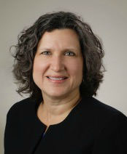
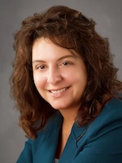
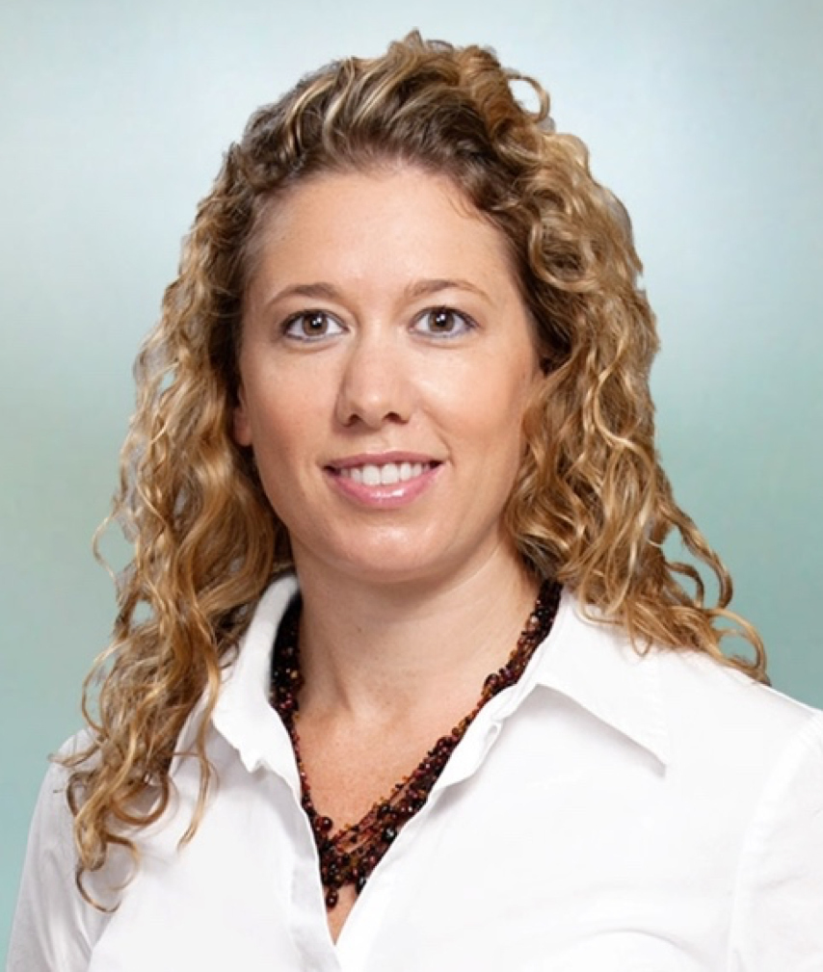
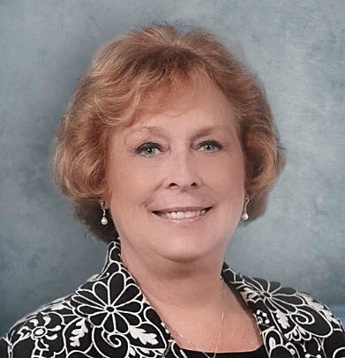
Partners Consulting Team
Heather Peters, M.Ed, Ph.D
GME Consultant
Christine Redovan, MBA
GME Consultant
Tori Hanlon, MS, CHCP GME Consultant
Pamela Royston, Ph.D
GME Consultant
GME Director & DIO
Seasoned speaker at ACGME & sub-specialty national meetings
Institutional and Program accreditation experience
3 decades in education; Masters of Education in curriculum & evaluations, PhD concentration in secondary education & adult learning theories
15+ years GME Operations, Accreditation and Management success
Focused on continual readiness and offering timely and useful GME resources
Over 13 years working in Medical Education
Bachelor’s in Health Services Administration
Master’s in Health Administration and Policy
Designated Institutional Official
Experienced in GME at a large academic medical center
GME Director & DIO
(GME) program analysis and strategic planning
GME Agreements and Contracts
Certified MBTI Consultant
New residency program development – pre-startup through implementation
GME policy development and integration with HR policy

Slide 3
CLER, Sponsoring Institution 2025 and Milestones 2.0
Heather Peters, M.Ed, Ph.D
DIO & GME Consultant

Slide 4
What Do Our Trainees Want?
Time with patients
Teamwork experiences
Decrease in non-clinical work
Supportive environments
Progressive autonomy

Slide 5
Scope of GME
800 Sponsoring Institutions
10,700 Training programs
150 Specialties
130,000 Residents/Fellows

Slide 6
Ultimate Goal of CBME
Curriculum
*Better Outcomes
Improved Clinician Experience
Competencies
*Lower
Costs
*Improved Patient Experience
Milestones
Assessment
High Functioning CLER
Quadruple Aim
Sponsoring Institution 2025

Slide 7
CLER 2014-2018
Statistics
50,000 faculty/program directors interviewed
1,000 CLER site visits
25,000 residents/fellows interviewed
Focus
Started with the MPSIs then onto the SPSIs
Uncover trends across Sis
Findings
Every SI is unique
Little integration of residents/fellows into the clinical teaching sites

Slide 8
RESOURCES & DOCUMENTS
CLER National Report of Findings 2016 (JGME 2016)
National Report of Findings 2016 Issue Brief No. 1: Executive Summary
National Report of Findings 2016 Issue Brief No. 2: Patient Safety
National Report of Findings 2016 Issue Brief No. 3: Health Care Quality
National Report of Findings 2016 Issue Brief No. 4: Health Care Disparities
National Report of Findings 2016 Issue Brief No. 5: Care Transitions
National Report of Findings 2016 Issue Brief No. 6: Supervision
National Report of Findings 2016 Issue Brief No. 7: Fatigue Management, Mitigation, and Duty Hours
National Report of Findings 2016 Issue Brief No. 8: Professionalism
Webinars on all of these topics are available at http://www.acgme.org/What-We-Do/Initiatives/Clinical-Learning-Environment-Review-CLER/Resources-and-Documents

Slide 9
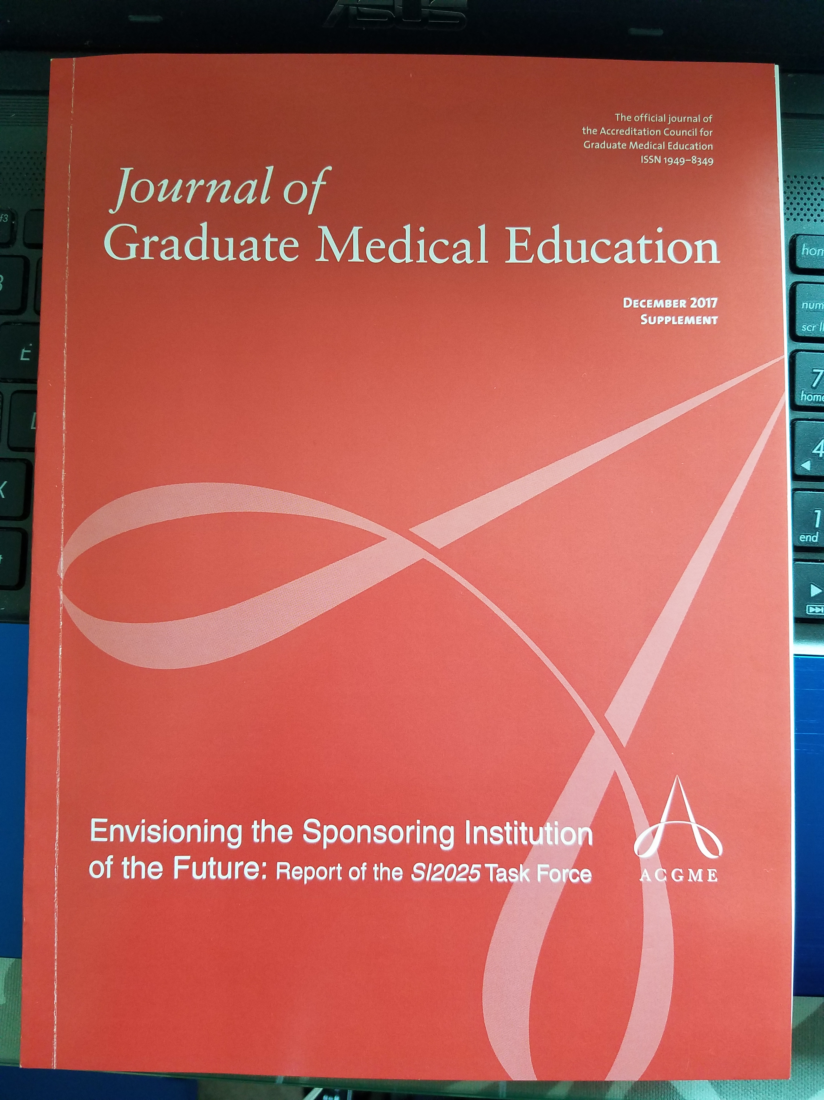
SPONSORING INSTITUTION 2025
Changing Health Care Needs
Changes in Health Care Delivery
Evolution in Health Care Systems
Evolution in the Role of the Physician
Evolution in the Role of Other Health Care Professionals
Evolution in Graduate Medical Education
Uncertainties in the Models for GME Funding; and
The Role of GME in the Continuum of Medical Education

Slide 10
WHY MILESTONES 2.0?
Too many subcompetencies
Language too complex
Too much in each milestones set
More people want to participate
Validity evidence is available

Slide 11
Teams. The next hot topic?
Christine Redovan, MBA
GME Consultant

Slide 12
Objectives & Goals
Learn about types of teams
Discover ideas for GME teams
List resources for teams
Based on the ACGME 2018 Annual Educational Conference Presentation GME and the Patient Care Dream Team given by Marjorie Wiggins, DNP, MBA, RN; John Duval, MBA; Catherine Kuhn, MD; and Lakshmana Swamy, MD, MBA.

Slide 13
What is a Team?
A group of people with a full set of complementary skills required to complete a task, job, or project. Team members
operate with a high degree of interdependence,
share authority and responsibility for self-management,
are accountable for the collective performance, and
work toward a common goal and shared rewards(s).
A team becomes more than just a collection of people when a strong sense of mutual commitment creates synergy, thus generating performance greater than the sum of the performance of its individual members.
Source: http://www.businessdictionary.com/definition/team.html

Slide 14
Teams in Medicine
Episodic – airplane crew, code blue
Long term – football team, clinical department
Partnership – interdisciplinary/interprofessional, patient care team
Concept of teaming

Slide 15
Characteristics of Teams
Trust
Common Purpose
Strength
Intentional
Complex
Adaptable
Functional
Cohesive

Slide 16
Ideas Shared
Value of GME
Peer-2-Peer Project (Dr. Kuhn)
SBAR
Intentional design
GMEC
Shadowing

Slide 17
Teams in GME
ACGME
PEC
CCC
APE
CLER
Self-Study
Proposed CPR – “…in partnership with…”
Partners in Medical Education

Slide 18
Resources
Team of Teams: New Rules of Engagement for a Complex World
SBAR - ihi.org
TeamSTEPPS - ahrq.gov
High Reliability - centerfortransforminghealthcare.org
Journal of Graduate Medical Education – jgme.org
Library
Your own institution
CLER Pathways, Common Program Requirements – agme.org

Slide 19
GME as a Strategic Asset to your Organization
Tori Hanlon, MS, CHCP
GME Consultant

Slide 20
Objectives &
Learn how GME leaders are creating value and bridging the gap between GME and their institution

Slide 21
Role of the DIO
Leader
Educator
Operator
Conceptualizer
Advocate

Slide 22
DIO EPA Competency
Competency: Promoting a Positive & Safe Learning Environment
Advocates for and secures funding for sufficient institutional resources…
Establishes policies & assigns resources to support residents in the work environment…
Facilitates an integrated approach to addressing the CLER pathways
Defines and implements institutional GME policies and programs that foster an environment of learning…
Advocates for and pursues action to ensure a nonpunitive environment…
Serves as a resource to residents, programs & others for achieving culture change and innovation to support improvements in the learning environment
https://www.aamc.org/download/441248/data/institutionalgmeleadershipcompetencies.pdf

Slide 23
GME Value
Resident/fellow clinical effort & work hours
Alumni network
Physician recruitment
GME funding
Academic environment/scholarly activity
Attending satisfaction
QI/PS

Slide 24
How?
AIR - strategic plan/goals
Insert yourself into institutional committees
Leverage CLER visits to help align organization’s strategic priorities and GME strategic priorities
Put it in numbers ($$$)
Resident QIPS workshop

Slide 25
Follow Me…
Twitter… @gmeTori
Linkedin… www.linkedin.com/in/tori-hanlon-9b2a3a6
YouTube… www.youtube.com/c/Partnersinmeded

Slide 26
*CPR - revived!
Pam Royston, PhD
GME Consultant
DIO/DME

Slide 27
Common Program Requirements
Six Sections
Institutions
Program Personnel and Resources
Resident Appointments
Educational Program
Evaluation
The Learning and Working Environment

Slide 28
Section I – V
The words in italics are statements of philosophy, background and intent.

Slide 29
Highlights Section I
I.B.2. Program Letters of Agreement
I.B.3 Program Director must have at least three years of documented educational and/or administrative experience
I.C. Diverse Workforce
I.D Resources

Slide 30
Highlights of Section II
II.A.2. Minimum program director support 20% FTE of non-clinical time
II.A.3 Program Director
must have at least three years of documented educational and/or administrative experience
Responsibilities include a curriculum addressing community needs and health disparities
Verification of residency education within 30 days of program completion

Slide 31
Highlights Section II
II.B. Faculty (Residency Version)
Formal faculty development
Core Faculty defined on role and not number of hours
Non-physician faculty member may be appointed as core faculty
Scholarly activity based on program as a whole and not individual core faculty
II.C. Program Coordinator
Minimum support for program coordinator is 50% FTE (Residency Version)

Slide 32
Highlights Section IV
IV.D. Scholarship
Activities must be in at least three of the following domains:
Research in basic science, education, translational science, patient care or population health
Peer-reviewed grants
Quality improvement and or patient safety initiatives
Systematic reviews, meta-analyses, review articles, text book chapters, or case reports
Creation of curricula, evaluations tools, didactic education activities or electronic educational materials
Professional committees, education organizations or editorial boards
Innovations in education

Slide 33
Highlights Section IV
IV.D. Scholarship
Must demonstrate dissemination of scholarly activity within and external to the program
Residents must participate in scholarly activity
Graduating resident’s should have a project that is disseminated

Slide 34
CPR’s - Revived!
Major revisions
Many more changes
Impacts all residency programs and fellowships
Impacts every program and will require modifications and changes!

Slide 35
Upcoming Live Webinars Building a Scholarly Infrastructure at a Community Based Institution Thursday, March 29, 2018 12:00pm – 1:00pm EST
ACGME Check–Up for Programs and Institution Tuesday, April 10, 2018 12:00pm – 1:00pm EST
Recruitment Strategies Thursday, April 26, 2018 12:00pm – 1:00pm EST
www.PartnersInMedEd.com
On-Demand Webinars
Self-Study…Have You Analyzed Your Data Yet? Creating a Robust Resident Evaluation System
Institutional Site Visit Prep Process
From APE to Self-Study… and Everything in Between
Healthcare Disparities in GME Institutions
AOA to ACGME Accreditation: Best Practices and Challenges
Contact us today to learn
how our Educational Passports can save you time & money!
724-864-7320

Slide 36
Partners in Medical Education, Inc. provides comprehensive consulting services to the GME community.
Partners in Medical Education
724-864-7320 | info@PartnersInMedEd.com
Heather Peters, M.Ed, Ph.D heather@PartnersInMedEd.com
Christine Redovan MBA christine@PartnersInMedEd.com
Tori Hanlon, MS, CHCP tori@PartnersInMedEd.com
Pamela Royston, Ph.D pam@PartnersInMedEd.com
www.PartnersInMedEd.com

