Slide 1
”Ask Partners” Spring Freebie
Heather Peters, M.Ed, Ph.D Christine Redovan, MBA Tori Hanlon, MS, CHCP
Pam Royston, PhD

Slide 2
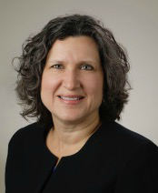
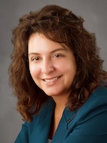
Partners Consulting Team
Heather Peters, M.Ed, Ph.D
GME Consultant
Christine Redovan, MBA
GME Consultant
Tori Hanlon, MS, CHCP GME Consultant
GME Director & DIO
Seasoned speaker at ACGME & sub-specialty national meetings
Institutional and Program accreditation experience
3 decades in education; Masters of Education in curriculum & evaluations, PhD concentration in secondary education & adult learning theories
Over 13 years working in Medical Education
Bachelor’s in Health Services Administration
Master’s in Health Administration and Policy
Designated Institutional Official
Experienced in GME at a large academic medical center
15+ years GME Operations, Accreditation and Management success
Focused on continual readiness and offering timely and useful GME resources

Slide 3
GME & Public Data
Christine Redovan, MBA
Graduate Medical Education Consultant

Slide 4
Inspiration
The following information is based on the presentation Using Public Data to Follow Graduates into Practice by Patrick M. Cocks, MD and Marc M. Triola, MD, given at the 2019 ACGME Annual Educational Conference.

Slide 5
Introduction
Track UME and GME experiences into clinical practice
Built on the concept of “The Education Data Continuum”
Utilized open, verified data sources
Had specific questions regarding their trainees

Slide 6
Questions Explored
Educational quality – do the graduates meet expectations and how do they compare with others?
Curriculum – what diagnoses are graduates seeing and what procedures are graduates performing?
Impact – what type of workforce did the program produce and what kinds of patients are they caring for?

Slide 7
Data Sources Used
AMA Masterfile for chosen UME/GME graduates
CMS Physician Compare: Directory & Quality
Medicare Part D Prescribing Data
CMS Utilization & Payment Data
NPI Database
State Physician Profile Information
State Department of Health
Internal data that is collected by GME or SI

Slide 8
Meaningful Measures
Important to pick what you can measure/compare
Is it relevant?
What will the results tell you?
What will you do with the results?
Align with your institutional priorities
Align with your population priorities
Ability to track, over time, clinical, administrative and financial data of your graduates

Slide 9
Lessons learned
It takes some time to obtain robust data
Standard practices may have changed
Practice influences are not captured
What is the data really measuring?
Some specialties are a better fit for this type of analysis; data is narrow
Data is inpatient heavy

Slide 10
Lessons learned
It is not a simple process from medical school to practice…there are many factors to take into account that cannot be ignored.
Who is accountable for the data…now that you know what you have?
Skeptics

Slide 11
My thoughts…
Unlimited potential and application to our GME programs
Aims/Missions/Curriculum
What are we really teaching? [hidden curriculum coming out?]
It would be fascinating to add in the effect of CME. Is this even possible to measure?
As data sources are discovered, made accessible, and developed, where can GME take advantage?

Slide 12
My thoughts…
Reaffirms teams, collaborations and partnerships to strengthen GME programs
QI person on GMEC – they understand the data
Big data is moving QI up a notch for GME

Slide 13
Resources
Cocks, P.M. & Triola, M.M. (2019, March). Using public data to follow graduates into practice, podium presentation at 2019 ACGME Annual Educational Conference, Orlando, FL.
NYU School of Medicine Institute for Innovation in Medical Education. (2016). Resources to track graduates using open data. Retrieved from https://iime.cloud/acgme.
National Academies of Sciences, Engineering, and Medicine. (2018). Graduate medical education outcomes and metrics: Proceedings of a workshop. Washington, DC: The National Academies Press, doi:10.17226/25003

Slide 14
Self-study Insights: Institutional & Program Perspectives
Tori Hanlon, MS, CHCP
Consultant

Slide 15
Institutional Self-study
Delay due to increased activity for IRC (new SIs and ensuring program self-study process added value)
10 pilot visits in 2020
Very small SIs will have modified self-study

Slide 16
Program Self-study
Understand how APE is connected to self-study
Program aims
Action (improvement) plans

Slide 18
Program self-study
Self-study is a strategic planning process
Where has the program been? | Review of APEs (sets direction)
Where is program now? | What does APE data tell you? (aligns priorities)
Where is program going? | How well is program meeting aims? (communicates mission/aims)

Slide 19
Program Aims
CPRs (eff. July 2019)
(IV.A.) The curriculum must contain the following educational components:
(IV.A.1.) a set of program aims consistent with the Sponsoring Institution’s mission, the needs of the community it serves, and the desired distinctive capabilities of its graduates;
(IV.A.1.a) The program’s aims must be made available to program applicants, residents, and faculty members.

Slide 20
Program Aims
Dynamic, not static
Measurable
Share aims
Align APE action plans to program aims (ask, “How does this affect our program aims”)

Slide 21
Action Plans

Slide 22
Action Plans
What is APE data telling you?
Measure
Monitor
Team effort
Requirements first
Beyond the requirements
“Next level”
Long term projects
Tackle chronic issues

Slide 23
Self-study Feedback
How well aims fit program
Achievement areas link to aims & operating environment (SWOT)
Use of data to measure outcomes
Stakeholder engagement

Slide 24
Nuggets of knowledge
Highlights from the 2019 ACGME Annual Educational Conference

Slide 25
Scholarly Activity
ALL FACULTY can count towards scholarly activity
There has to be a site director for all out rotations
The site director counts as faculty
Most of these rotations are with institutions that already do scholarly activity
Examples – pediatric surgery, transplant, pediatrics
Reference:
https://www.acgme.org/Portals/0/PDFs/Specialty-specific%20Requirement%20Topics/DIO-Scholarly_Activity_Faculty.pdf

Slide 26
Common Program Requirements
One-Year Fellowships now have separate Common Program Requirements!
All residents will need an Individual learning plan – Residency Common Program Requirements V.A.1.d).(2)
Verifications should be done within 30 days of program completion
Non-physicians can be core faculty
Board Pass Rate – the preceding three years of a program’s aggregate pass rate (first-time takers) must be higher than the bottom 5th percentile of the programs in that specialty - V.C.3a.

Slide 27
Institutional Oversight
Approximately 50% of institutional citations in a one year period were due to compliance with institutional oversight – 1B
GMEC minutes need to delineate the person representing patient safety
Annual review of stipends and benefits
Change in Program Director has to be approved by the GMEC
DIO may be asked for a letter indicating a change in Program director and SHOULD include the date GMEC voted
Need documentation of governing body receiving AIR

Slide 28
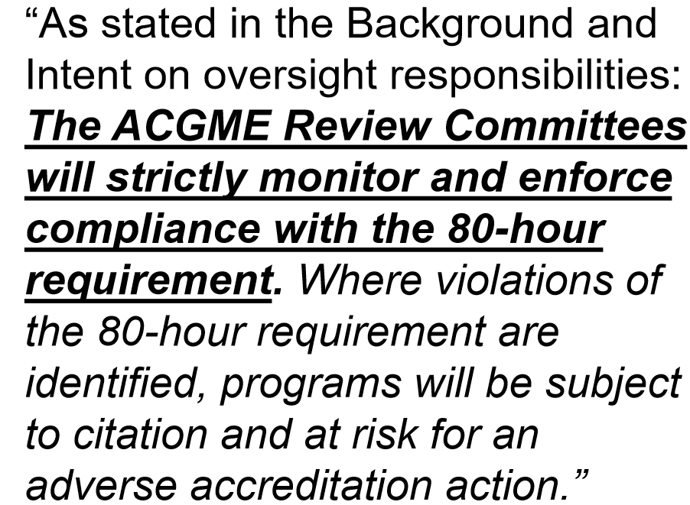
ACGME Resident Survey
Expect citations and reviews for programs where residents indicate they work over 80 hours a week!!!
Nasca letter Jan. 9th with this information

Slide 29
Program Specific
Ortho – most citations and AFI are based on procedures
Ortho – Anatomic areas less than 10th percentile will be a citation
Ortho – review resident logs!
IM – Expects to have information on AFI mentioned during the annual update under changes
EM – program must demonstrate presence of residents in other specialties to enhance the EM resident training

Slide 30
Strategic Planning in GME: Equipping institutions and programs for an unknown future
Heather Peters, M.Ed, Ph.D
Consultant

Slide 31
An Unknown Future…
2060
2050
2040
Will be training until past 2050
2030
2025
2019
Trainees starting in 2019

Slide 32
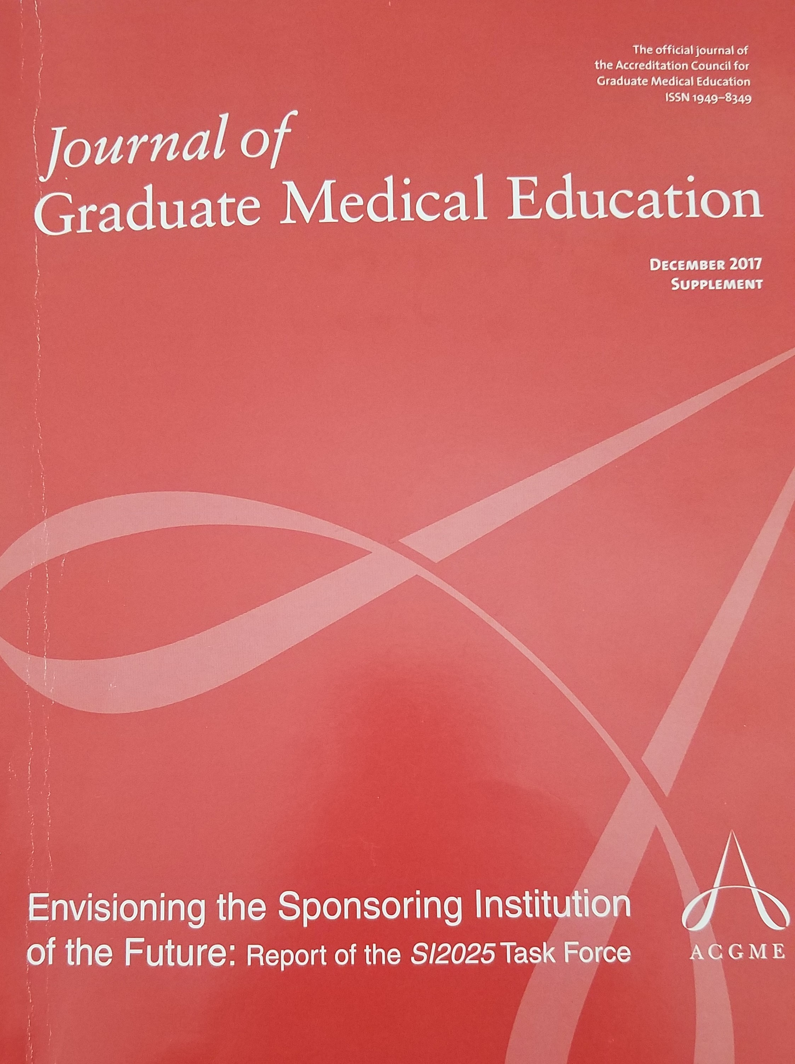
Have you read….
Envisioning the sponsoring institution of the future: Report of the SI2025 Task Force

Slide 33
Changes on the Horizon
Evolving Roles
Physicians
GME
Changing
Health care delivery systems
Payment models
Health Care Team composition

Slide 34
What you can do NOW
READ
Revise APE Templates
Guide the development of AIM statements
Scaffold program leadership
Strategic Planning

Slide 35
APE Template Revisions
curriculum
outcomes from previous APE
ACGME letters of notification, citations, AFIs
quality and safety of patient care
aggregate trainee and faculty:
well-being
recruitment & retention
workforce diversity
engagement in QI and PS
scholarly activity
ACGME trainee and faculty surveys
written evaluations of the program
Aggregate trainee:
achievement of the Milestones
in-training exams
board pass and certification rates
graduate performance
Aggregate faculty:
evaluation
professional development
Action Plan:
discussed with trainees and faculty
submitted to the DIO

Slide 36
AIM Statement Creation
Broad enough…
Narrow enough…
Short enough…
Measurable
3-4 AIMs
KEY POINT: It’s not about being BETTER. It’s about being DIFFERENT. You need to give candidates a reason to CHOOSE YOUR PROGRAM!

Slide 37
Scaffold the program leadership
Measurement of outcomes
Advancing evaluation processes
Tracking graduate performance

Slide 38
Strategic Planning for GME organizations
A strategic plan deals with issues that cannot and will not be dealt with by operating the program or department in a business-as-usual manner.
Strategic plans require leadership and inventive thinking and assume higher risks, leading to higher rewards.

Slide 39
Rationale
CLER Findings 2018
Most GME Sponsoring Institutions do not participate or are not part of the CLE’s strategic planning
Accreditation
It’s easy to get bogged down in all the many accreditation tasks in today’s GME environment. Without a strategic approach, you risk burn-out of administration and wasted time
Spending time developing a strategic 5-10 year plan will help guide decisions about
the institution,
your programs,
the curriculum,
recruitment and more
within a framework that can adapt as the future becomes reality

Slide 40
Partners Consulting

Slide 41
Online Education

Slide 42
Faculty Development Modules

Slide 43
Upcoming Live Webinars
Understanding the CLE Tuesday, March 26, 2019 12:00pm – 1:00pm EST
Onboarding the New Program Director Tuesday, April 2, 2019 12:00pm – 1:00pm EST
CPR 2019 Part 2 of 4: Section I & Section II Thursday, April 18, 2019 12:00pm – 1:00pm EST
SI 2025 Part 3 of 4: GME Evolution, Funding & Future Tuesday, May 7, 2019 12:00pm – 1:00pm EST
On-Demand Webinars
New Institution – The Value of GME
Meet the Experts – Fall Freebie
Milestones – Beyond the CCC
Mentoring the GME Coordinator: The First 3 Years
2019 CPR Part 1 of 4: Overview
SI 2025 Part 1 of 4: Introduction & Overview
Onboarding the New Coordinator
2019 CPR Part 1 of 4: Overview
NEW Faculty Development Series
Contact us today to learn how our Educational
Passports can save you time & money!
724-864-7320
www.PartnersInMedEd.com
15 Minutes to Effective Feedback
43

Slide 44
Partners in Medical Education, Inc. provides comprehensive consulting services to the GME community.
Partners in Medical Education
724-864-7320 | info@PartnersInMedEd.com
Heather Peters, M.Ed, Ph.D heather@PartnersInMedEd.com
Christine Redovan MBA christine@PartnersInMedEd.com
Tori Hanlon, MS, CHCP tori@PartnersInMedEd.com
www.PartnersInMedEd.com

