Slide 1
ACGME Complaints & Sponsoring Institution Self-Study
Heather Peters, M.Ed, Ph.D -- GME Consultant

Slide 2
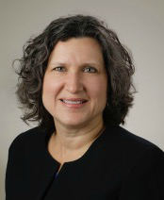
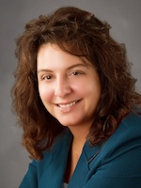
Partners Consulting Team
Heather Peters, M.Ed, Ph.D
GME Consultant
Christine Redovan, MBA
GME Consultant
GME Director & DIO
Seasoned speaker at ACGME & sub-specialty national meetings
Institutional and Program accreditation experience
3 decades in education; Masters of Education in curriculum & evaluations, PhD concentration in secondary education & adult learning theories
15+ years GME Operations, Accreditation and Management success
Focused on continual readiness and offering timely and useful GME resources

Slide 3
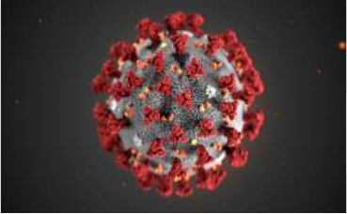
COVID-19: What does this mean for GME??
Prolonged absenteeism among non-healthcare providers will cripple GME programs – are you ready?
How can you communicate with your trainees and program personnel in case of an emergency related to COVID-19?
Are your trainees prepared to deal with COVID-19 questions from their patients? Are your faculty?

Slide 4
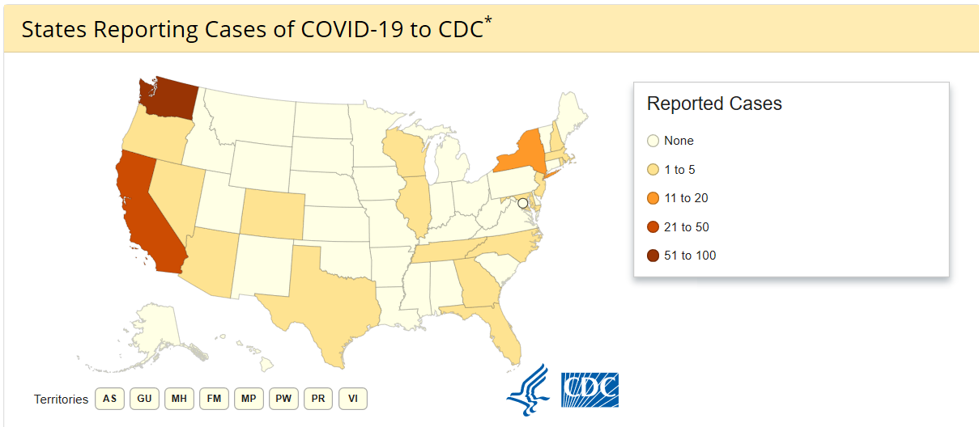
As of Sunday, March 8th…

Slide 5
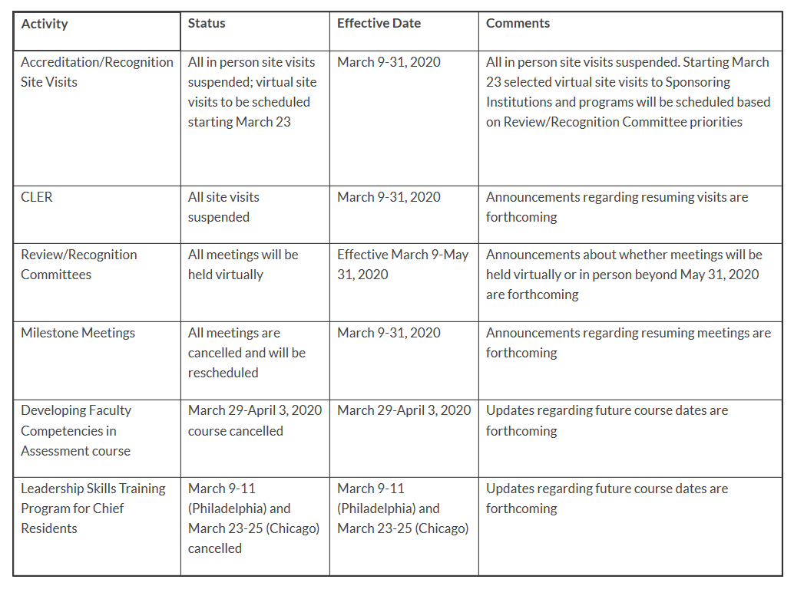
ACGME UPDATE

Slide 6
ACGME Advises
Keep abreast of these two websites:
CDC (https://www.cdc.gov/coronavirus/2019-ncov/index.html)
NEJM (https://www.nejm.org/coronavirus?query=main_nav_lg)
Review your GME Disaster Policy & Phone Trees for Emergencies
Provide simulation for responding to COVID-19 emergencies
Education

Slide 7
One Day an Email Arrives…
A complaint has been filed…

Slide 8
Where is this Information Located?

Slide 9
Types of Complaints
Informal
Formal

Slide 10
What happens next?
Letter will discuss the issues and ask for an internal investigation with a follow-up report.
Varies:
Site Visit
Request for more information
Other

Slide 11
Don’t panic! Prepare!
Read ACGME website pages
Follow the directions on the email letter
Conduct a special review if the complaint warrants it

Slide 12
Artificial Intelligence
Christine Redovan, MBA, MLIS -- GME Consultant

Slide 13
Artificial Intelligence
Inspired by closing plenary session, ACGME 2020 Annual Educational Conference. February 29, 2020.
Towards High Performance Medicine with Deep Empathy
Presenter: Eric Topol, MD, Founder & Director, Scripps Research Translational Institute

Slide 14
What is Artificial Intelligence (AI)?
“It is the science and engineering of making intelligent machines, especially intelligent computer programs.” (John McCarthy)
“…these software ‘make decisions which normally require [a] human level of expertise’ and help people anticipate problems or deal with issues as they come up.” (Subhenda, S. & Vijay, J.F., 2013)

Slide 15
Three Qualities of AI
Intentionality
Intelligence
Adaptability
(West. D. & Allen, J. (2018, April 24). How artificial intelligence is transforming the world. Center for Technology Innovation; The Brookings Institution. Retrieved from brookings.edu)

Slide 16
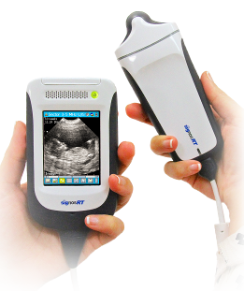
AI and Medicine
AI to assist physicians; not replace them
Give more personal time with patients
Provide the compassion that hardware cannot
Detect Disease
Scans of everything
Fast, accurate and detailed
Costly in the beginning
Decreases over time
Personal/in-home use

Slide 17
AI in Medicine Examples
AI-assisted robotic surgery
Automated administrative tasks
Image analysis
Retinal scans
Facial scans
Fitness trackers
Personal scanners

Slide 18
Thoughts for GME
Effect on medical knowledge
Who is going to teach?
How to incorporate?
Social detriments of health
Medical education continuum
Regulation
Data management

Slide 19
To ponder…
Dr. Topol posed a question to the audience:
Why use a stethoscope (200-year-old technology) when you can use your smart phone to scan, share and interpret the data…with the patient…in real time?

Slide 20
References
McCarthy, J. (n.d.) What is AI? Retrieved from http://jmc.stanford.edu/artificial-intelligence/what-is-ai/index.html
Fjeld, J., Achten, N., Hilligoss, H., Nagy, A., & Srikumar, M. (2020, January 15). Principled artificial intelligence: Mapping consensus in ethical and rights-based approaches to principles for AI. Berkman Klein Center Research Publication No. 2020-1. Retrieved from http://dx.doi.org/10.2139/ssrn.3518482

Slide 21
References
Kornfield, M. (2020, February 24). The health 202: Artificial intelligence use is growing in the U.S. health-care system. The Washington Post. Retrieved from washingtonpost.com

Slide 22
Sponsoring Institution Self-Study
Heather Peters, M.Ed, Ph.D -- GME Consultant

Slide 23
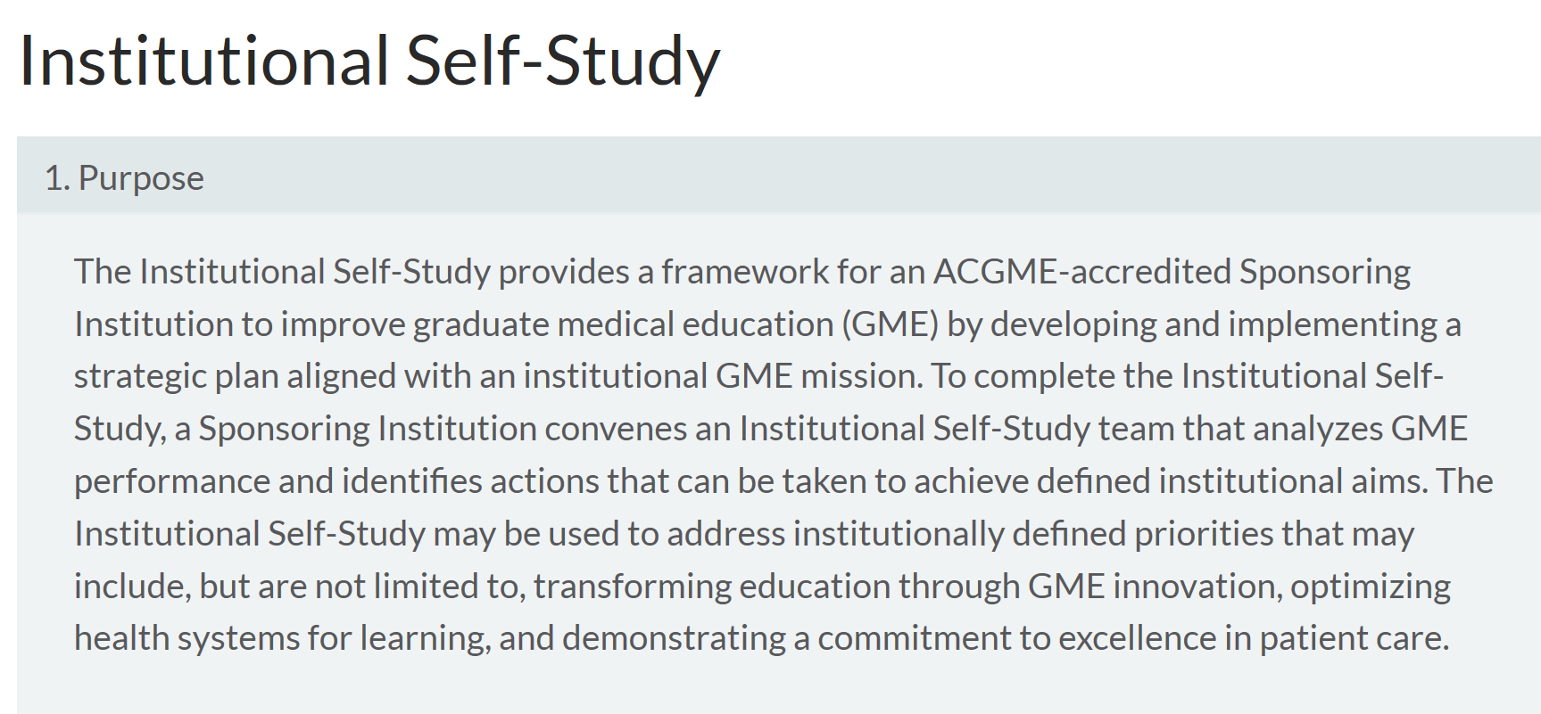

Slide 24
Self-Study Committee
Required:
(1) the DIO;
(2) one or more peer-selected residents/fellows; and
(3) a representative of the Sponsoring Institution’s senior administration.
Other Members:
GMEC members
Program directors
Program coordinators
Central GME
Other team members may be added to ensure that the Institutional Self-Study represents the perspectives of multiple institutional GME stakeholders.

Slide 25
Steps in the Process
Self-study – Phase 1
Analysis of Institutional Performance
AIR for past 3-5 years
CLER Reports
Program self-studies
SWOT (optional)
Institutional Aims
Self-study Summary
Summary of Achievements
Self-study – Phase 2
10-year Accreditation Site Visit
Summary of achievements

Slide 26
Time Frame for SI Self-Study
Self-study Starts
Self-study summary form due – 6 months
10-year Accreditation Site Visit – 24 months

Slide 27
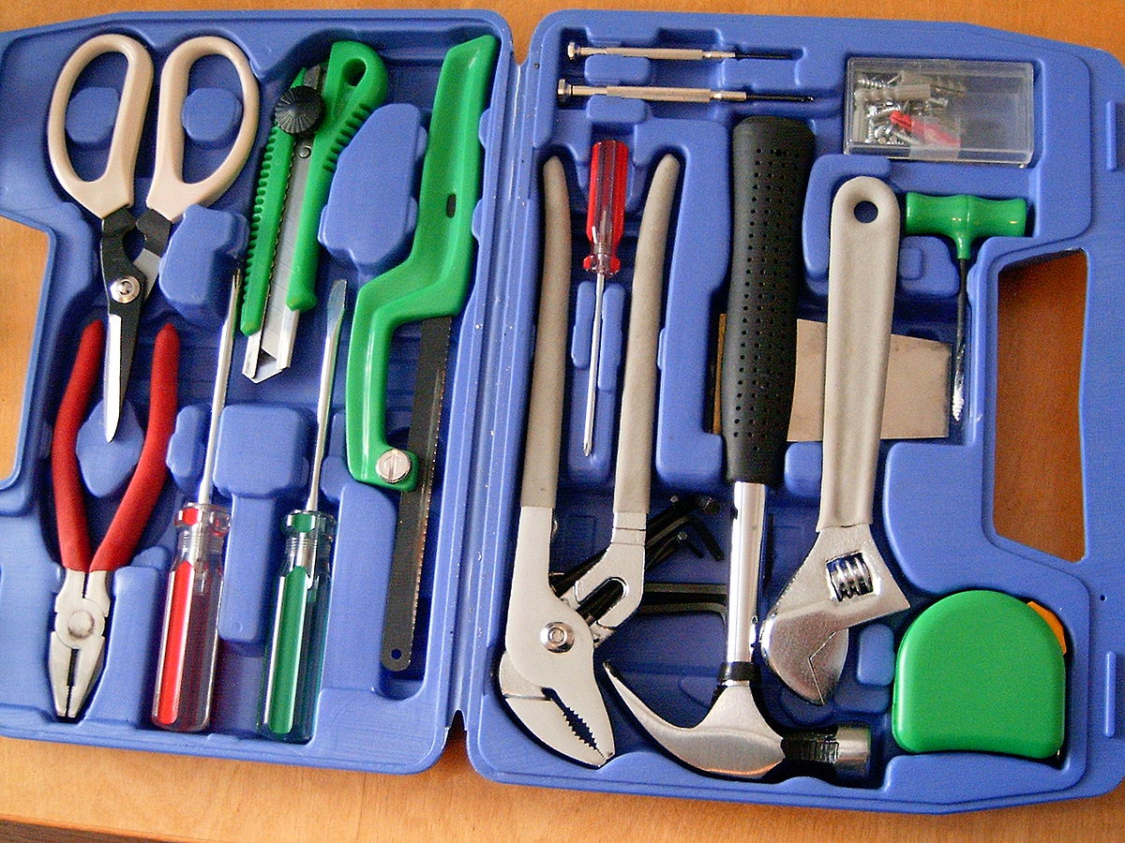
Hand-outs for SI Self-Study
https://www.acgme.org/Designated-Institutional-Officials/Institutional-Review-Committee/Institutional-Self-Study
SI Self-study Summary Form
SI Self-Study Overview

Slide 28
Diversity
Christine Redovan, MBA, MLIS -- GME Consultant

Slide 29
Research in Diversity
Inspired by plenary session, ACGME 2020 Annual Educational Conference. February 28, 2020.
Does Diversity Matter for Health?
Presenter: Owen Garrick, MD, Bridge Clinical Research

Slide 30
Main Question
Do African American men increase preventive care when randomly assigned to a black, male doctor?

Slide 31
Background
Black men in the U.S. have highest burden of disease and death. The gap is driven by preventable measures.
Black men related better to other black men in the labor force and in education.
Mixed results in health care.
Recruited patients from the local barbershop and flea markets.
Trusted space in the community
Provided incentives

Slide 32
Measures
- Randomly assigned a non-black or a black doctor.
- Doctors to convince their patients to obtain preventive care: BMI, BP, DIA, CHO, FLU
- Incentivized the flu vaccine.

Slide 33
Mechanisms
Communication (di-directional) – saw a difference
Quality (training, experience, ratings) – no difference
Effort (time spent w/patient) – no difference
Discrimination (selection difference) – no difference

Slide 34
What the study showed
Communication was key.
Black doctors tended to speak about non-health issues or personal issues
Black doctors took more notes
If patient was skeptical; black doctors tended to mitigate that skepticism or mistrust
Overall, black doctors were able to increase their patients agreeing to the tests
Value of diversity in health care is strengthened

Slide 35
Why this matters to GME
Recruitment
We know we need to match our residents to our community. This study is showing that doctors who are like, familiar with and engaged in the community have a positive effect on their patients

Slide 36
Get Involved
Early interactions with learners – grade school, middle school, high school, college
Become familiar with medical school admission standards
How can we remove some of the barriers?
Advocate for trust and communication
Do your own research; use the data to demonstrate better patient outcomes

Slide 37
Upcoming Live Webinars
Lessons Learned: Accepting Displaced Orphan Residents Thursday, March 24, 2020 12:00pm – 1:00pm EST
Is your Coordinator Well Enough: Coordinators as Role Models of Wellness Thursday, April 9, 2020 12:00pm – 1:00pm EST Research Proposal Development: Tips for Success Thursday, April 23, 2020 12:00pm – 1:00pm EST
On-Demand Webinars
Feedback – From the Top Down
Evolving Resident Well-Being
We All Need Scholar Activity, Including Coordinators
Preparing for the 10 Year Site Visit
Meet the Experts – Fall Freebie
Jump Start Your GMEC
Creating a Diverse Workforce
APE Reconstructed
Digging for Data 101
PEC: Best Practices
NEW Faculty Development Series
15 Minutes to Effective Feedback
Toolbox for Teaching Millennials
Taking Supervision to the Next Level
Contact us today to learn how our Educational
Passports can save you time & money!
724-864-7320
www.PartnersInMedEd.com
37

Slide 38
Partners in Medical Education, Inc. provides comprehensive consulting services to the GME community.
Partners in Medical Education
724-864-7320 | info@PartnersInMedEd.com
Heather Peters, M.Ed, Ph.D
Heather@PartnersInMedEd.com
Christine Redovan, MBA, MLIS
Christine@PartnersInMedEd.com
www.PartnersInMedEd.com
Presented by Partners in Medical Education, Inc. 2020

