Slide 1
Nuggets of Knowledge
Tori Hanlon, MS, CHCP - GME Consultant

Slide 2
Introducing Your Presenter…
Tori Hanlon, MS, CHCP
GME Consultant
Over 13 years working in Medical Education
Bachelor’s in Health Services Administration
Master’s in Health Administration and Policy
Designated Institutional Official
Experienced in GME at a large academic medical center

Slide 3
ACGME CPRs
Focused revision review and comment by March 31, 2021
Program Coordinator Time/Support
Program Director Time/Support
Core Faculty Time/Support
3

Slide 4
Program Director Time
Current | Proposed | Reasoning
PD minimum 0.2 FTE non-clinical time | No minimum FTE; PD provided adequate support based on program size and configuration | 0.2 FTE more than needed for small programs, so no minimum in CPRs across specialties.
*Each RC will determine appropriate minimum for each specialty, based on factors including program size, # of participating sites, Case Log requirements, and other factors impacting administrative workload *Flexibility in how PD support is provided; Examples of support may include but are not limited to, salary support, supplemental compensation, EVUs, or relief time from other professional duties.
4

Slide 5
Core Faculty Time
Current | Proposed | Reasoning
RC may further specify requirements regarding support for CF | RC may further specify requirements regarding dedicated time for CF | Lack of consensus among specialties regarding need to define “dedicated time” for CF.
*ACGME Committee on Requirements to develop guidance for RCs to use in creation of specialty-specific requirements related to dedicated time for CF *CF participate in clinical and non-clinical activities. Examples of non-clinical activities include, but are not limited to, resident recruitment/interviews, didactic instruction, mentorship, simulation, ACGME Faculty Survey, committee participation (CCC, PEC)
5

Slide 6
Program Coordinator Time
Current | Proposed | Reasoning
PC minimum 0.5 FTE for administration of program; RC may further specify minimum dedicated time | PC provided dedicated time and support adequate for administration of program based upon size and configuration; RC must further specify minimum dedicated time | 0.5 FTE more than needed for small programs
*ACGME Committee on Requirements to develop guidance for RCs to use in creation of specialty-specific requirements related to PC minimum dedicated time
6

Slide 7
Accreditation Data System
Faculty Roster
Changes coming this month to Non-Physician Faculty data collection
Review faculty roster
Board certification and license dates
Faculty assigned to correct site
Minimum # CF + Site Directors + faculty for core content areas
Scholarly activity
Board-eligible faculty CANNOT be core faculty
Check faculty requirements, faculty roster instructions in ADS & specialty FAQs

Slide 8
ADS Documents
Policies
Program-specific
Updated w/ changes to requirements
PLAs
Update with change in PD, Site Director and content/duration of experience
Includes DIO signature
Evaluations
Semi-annual must include review of Milestones, case logs, clinic patients
360 evaluation forms must include peer, patient, self, and other health care professionals (nursing, clinic staff, medical students, etc.)
Read specialty FAQs for further policy content
G&O attached
Final evaluation must include updated language, “demonstrated knowledge, skills, and behaviors necessary to enter autonomous practice”
Supervision policy – include circumstances in which residents must contact faculty

Slide 9
Block Diagram
Use most current specialty template from ACGME website
Must have a key if using abbreviations
Make sure block diagram includes all curricular and rotational experiences as written in your specialty requirements. It must be clear to site visitor and RC.
Be careful of vacation time and impact on time requirement of educational experiences.

Slide 10
Random Nuggets
If applying for a new program, provide historical data if volumes due to COVID insufficient
DIO needs to review information entered into ADS in order to effectively demonstrate “oversight”
Keep good documentation of QI engagement

Slide 11
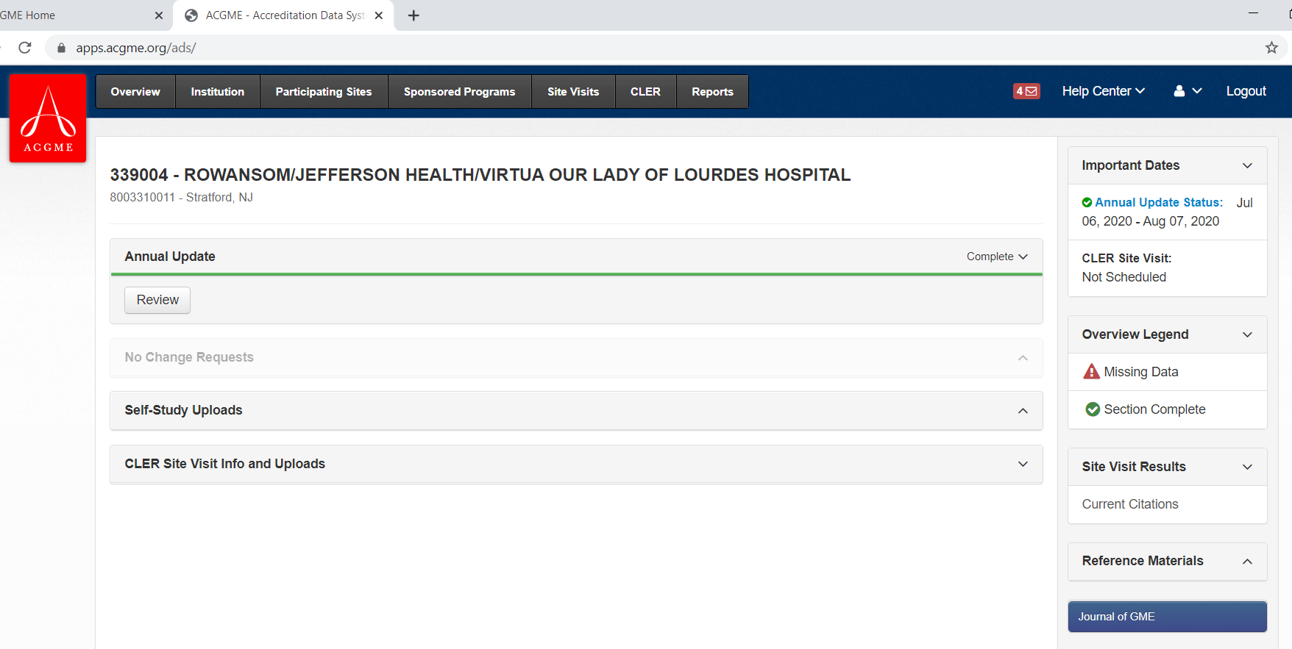

Slide 12
Reports in ADS
Report | Benefit/Use
Program Director Changes | ACGME looks at this; include in AIR
Program History Summary | Program timeline by academic year of site visit, RC meeting, accreditation decision, and citation activity; useful for APE and self-study
List of Sites Affiliated with this Sponsor | All programs’ participating sites; GMEC oversight of participating sites
Program Case Log Graduate Statistics | National numbers of resident procedure/case volume; compare your program to national data; “ideal” for establishing and assessing national policy related to resident practical experiences.

Slide 13
Reports in ADS
Report | Benefit/Use
List of Institutions and Programs Affiliated with this Institution | All programs’ participating sites listed by site; GMEC oversight of participating sites
List of Programs Rotating Through an Institution | List of other programs identifying your SI as a participating site in ADS
Program Citation Summary | Lists citation categories, # of citations in each category and which programs have citation; LISTS ONLY CITATION CATEGORIES IRC WILL FOCUS ON; Use in AIR
Faculty & Resident Scholarly Activity Data | 2 separate downloads; scholarly activity by faculty organized by scholarly activity type; use in APEs and AIR

Slide 14
CLER Update
Presented by Partners in Medical Education, Inc. 2021
14

Slide 15
CLER Site Visits
“Regular” CLER site visits on hold – expected to resume in 2022
Special CLER COVID virtual site visits being conducted in 2021 for a random sample of Sis
Approx. 300 SIs (representative of region and # of core programs)
Assess impact of COVID-19 on CLE and impacts likely to be sustained over next 2 years

Slide 16
CLER COVID Site Visit
No SI in ACGME Emergency Categorization will be contacted
4-8 weeks notice
Allowed 3 passes, 1 of which may be a “COVID surge pass” in which SI will not re-contacted for 2 months
CLER COVID site visit does not replace regular CLER visit BUT SIs will still have a minimum of 18 months between visits regardless of whether a COVID or regular site visit

Slide 17
Diversity & Inclusion
Presented by Partners in Medical Education, Inc. 2021
17

Slide 18
D&I Challenge
Have each of your GME programs set ONE diversity/inclusion/equity goal (action plan) as part of their next APE
What kind of goal?
Provide DEI education
Measure trainee perceptions
Collect data on applicants
Start conversations/Town Halls

Slide 19
Data Prompted Site Visits
Christine Redovan, MBA, MLIS -- GME Consultant

Slide 20
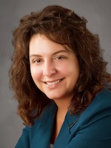
Introducing Your Presenter…
Christine Redovan, MBA, MLIS
GME Consultant
Seasoned Director of Medical Education and GME Operations
Accreditation and Management Expert For New and Established Institutions and Programs
ACGME-I Accreditation Expert
Successful GME Start-Up Implementation
Focused on Continuous Accreditation Readiness. Data Mining, and Useful GME Resources
20+ years GME experience

Slide 21
All RC’s look at…
Attrition of leadership, faculty, residents/fellows
Resident and faculty annual surveys
Faculty and resident/fellow scholarly activity
First-time board pass rate
Clinical experience; case logs
Failure to enter complete updates
Accuracy of updates, including faculty roster with board certification and licensure

Slide 22
What triggers a site visit?
Each RC sets its own threshold for compliance
Data, citations, or if no improvement seen in next data cycle could trigger a focused or full site visit
Resident and faculty survey results
Main trigger?
RESIDENT SURVEYS!!

Slide 23
2015-2020 Field Staff Study
312 programs had a data prompted site visit (DPSV)
131 surgery
122 medical
59 hospital
214 - one DPSV
98 – more than one

Slide 24
Single DPSV’s
84% of RC’s listed Resident Survey as the trigger
51% was sole reason
Other reasons:
Case logs (30% of surgery programs)
First-time board pass rate (28% of hospital programs)
Faculty survey (42 programs)
Resident, fellow and/or faculty scholarly activity (mainly hospital and surgery programs)

Slide 25
Most Frequent Areas of Survey
Duty hours
Faculty supervision
Feedback after assignments
Opportunities for scholarly activity
Raising concerns without fear
How many of your surveys show non-compliance or declining compliance in these areas?

Slide 26
Single DPSV Findings
Site visitor confirmed RC concerns in majority of programs
34% identified new/potential areas of concern
Average of 2.4 citations issued after DPSV
18% had a special review

Slide 27
Status Today
Of the 214 single DPSV programs:
167 – Continued Accreditation
37 – Continued Accreditation with warning
4 – Continued Accreditation without outcomes
3 – Probation
2 – Voluntary withdrawal
1 – Accreditation withdrawn by RC

Slide 28
What about repeat DPSV?
There were 98 programs that repeat DPSV.
98% due to resident survey
45% listed as only reason
Other reasons
Same as first DPSV… but also:
Attrition of faculty and/or residents

Slide 29
2nd DPSV Findings
51% of programs made a PD change
3% had a special review before first DPSV; 20% had a special review before second DPSV
Confirmed RC concerns
New issues identified in 56% of programs
Continued/chronic problems
identified in 92% of programs

Slide 30
Status Today
Of the 98 repeat DPSV programs:
69 – Continued Accreditation
19 – Continued Accreditation with warning
1 – Continued Accreditation without outcomes
2 – Probation
2 – Voluntary withdrawal
5 – Accreditation withdrawn by RC

Slide 31
What does this all mean?
Resident Survey is the most frequent trigger for a DPSV
Successive years of not meeting requirements leads to less favorable accreditation status
Failure to resolve chronic issues has an impact on accreditation status
Attrition is noticed and taken seriously by RC’s
GMEC oversight plays an important role in program accreditation

Slide 32
GMEC Oversight
No program is immune to having a site visit due to data review
DIO review of annual data update
GMEC review of resident/faculty survey
Special reviews appeared to improve the outcomes of data prompted site visits
GMEC Oversight
Program Success

Slide 33
Reference
Caniano, D, Martinez, S, & Nace, C. (2021). Reasons for data-prompted site visits: Field staff findings and review committee decisions. [Oral presentation]. ACGME Annual Educational Conference. [Virtual Experience.]

Slide 34
Special Reviews
Presented by Partners in Medical Education, Inc. 2021

Slide 35
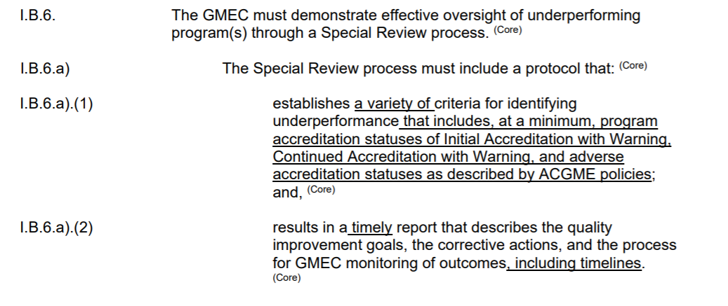
New IR Language
Effective 7/2021

Slide 36
Criteria
Only select what you can measure
Focus on high yield metrics
Tie to AIR indicators
Tie to APE reports
Identify problems early
Educate programs
Before a site visit

Slide 37
Process
Streamline
Use of focused reviews
What is the best way to obtain information?
Follow up with difficult issues
Update your Special Review Policy

Slide 38
Educate
A tool for GME oversight
Helpful, not hurtful
Let programs request if feeling things are getting a little out of control or if they can’t find the source of concerns or issues

Slide 39
Reference
Best, J, Rumack, C, & Fair, J. (2021). Special reviews: When you still haven’t found what you’re looking for. [Oral presentation]. ACGME Annual Educational Conference. [Virtual Experience.]

Slide 40
Strategic Planning in GME
Heather Peters, MEd, PhD -- GME Consultant

Slide 41
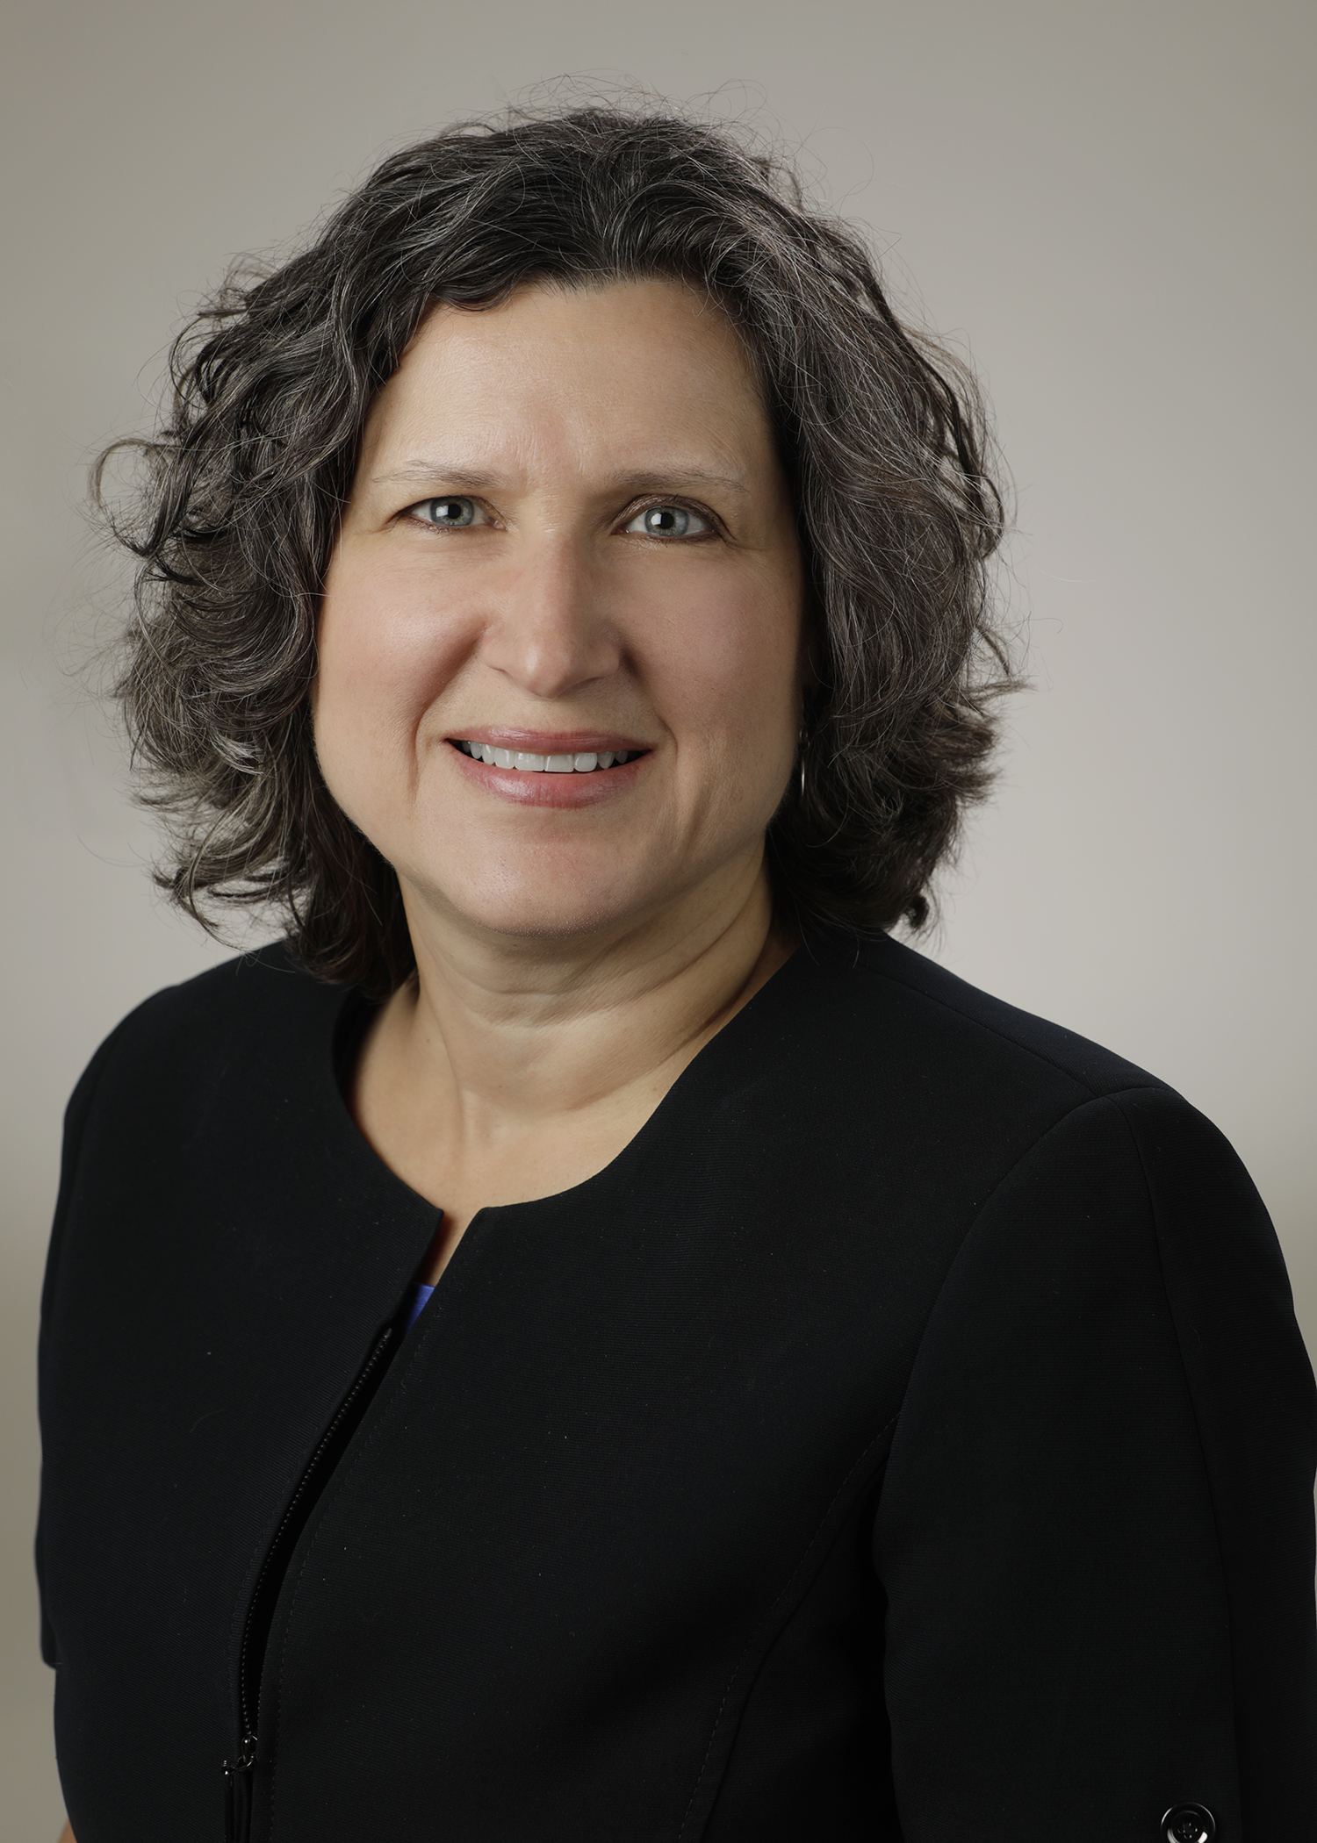
Introducing Your Presenter…
Heather Peters, M.Ed, Ph.D
GME Consultant
Former GME Director & DIO
Seasoned speaker at ACGME & subspecialty national meetings
Areas of Expertise: GME Strategic Planning; Program Evaluation; and Faculty Development
3 decades in education; Masters of Education in curriculum & evaluations, PhD concentration in secondary education & adult learning theories

Slide 42
COVID-19: What does this mean for GME??
Prolonged absenteeism among non-healthcare providers will cripple GME programs – are you ready?
How can you communicate with your trainees and program personnel in case of an emergency related to COVID-19?
Are your trainees prepared to deal with COVID-19 questions from their patients? Are your faculty?

Slide 43
Long-term vision…really?
Putting out fires
Building excellent educational programs

Slide 44
Nasca Address about ACGME Strategic Planning
Slide from ACGME Annual Education Conference Presentation - 2021

Slide 45
Continuous Compliance for Sponsoring Institutions
CLER
Institutional-level
Institutional Planning
AIR
Special
Review
GMEC
Self-Study
Letters of Notification
Program-level
Self-Study
Surveys
Requirements
APEs

Slide 46
Benefits of Strategic Planning
01
02
03
04
05
Reduces Risk
Improves processes and outcomes
Improves communication
Identifies
problems early
Provides time
for correction

Slide 47
Strategic Plan Cycle
What kind of graduates do we desire? Traits? Skills? Attitudes?
Tool: Quality Measures for GME Programs
Desired Outcomes
Annually, review goals, measures, contingency plans, and strategies.
Recalibrate
MISSION
Articulated Goals
AND
Measures
GOALS take work and time
They must be measurable in order to track in your AIR
Scenarios
AND
Strategies
Contingency
Plans
What if there is another pandemic? Natural disaster? The GME system breaks down?
Imagining different futures is difficult, but a necessary part of developing agile strategies

Slide 48
Upcoming Live Webinar
Lessons Learned from the Pandemic: Planning for the Next Disaster Thursday, April 8, 2021 12:00pm – 1:00pm EST
Other Approaches to CCC & Evaluation Thursday, April 27, 2021 12:00pm – 1:00pm EST
ACGME Surveys – What Now? Thursday, May 6, 2021 12:00pm – 1:00pm EST
GMEC Checkups – QIPS Edition Thursday, May 25, 2021 12:00pm – 1:00pm EST
Latest On-Demand Webinars
ADS Annual Update: Best Practices
Graduate Medical Education Financing
Artificial Intelligence in Medicine: Its Impact on GME
GME Workforce Planning
Working with a Statistician on your Research Project
Quality Improvement in GME: 5 years later
An Interdisciplinary Approach – Breaking Down the Wall
Meet the Experts – Fall Freebie
Working with Struggling Learners
DIO Role and Responsibilities: Keys to Success
NEW Faculty Development Series
15 Minutes to Effective Feedback
Toolbox for Teaching Millennials
Taking Supervision to the Next Level
Contact us today to learn how our Educational
Passports can save you time & money!
724-864-7320
www.PartnersInMedEd.com
48

Slide 49
Partners in Medical Education, Inc. provides comprehensive consulting services to the GME community.
www.PartnersInMedEd.com
Tori Hanlon, MS, CHCP
Tori@PartnersInMedEd.com
Christine Redovan, MBA, MLIS
Christine@PartnersInMedEd.com
Heather Peters, Med, PhD
Heather@PartnersInMedEd.com

