Slide 1
Please Note…
Please make sure your Start Video is OFF when logging into the WebEx platform.
Here is what it should look like
ALSO
It is NORMAL to not hear any sound until the webinar starts at 12:00 noon EST.
Your phone line is muted, but you can always chat to the host, BJ Schwartz, if you have any questions or concerns during this time.

Slide 2
Ask Partners - Spring Freebie
Presented by:
Heather Peters, M.Ed, Ph.D
Carmela Meyer, MBA, Ed.D
Cheryl Haynes, BA
Christine Redovan, MBA, MLIS

Slide 3
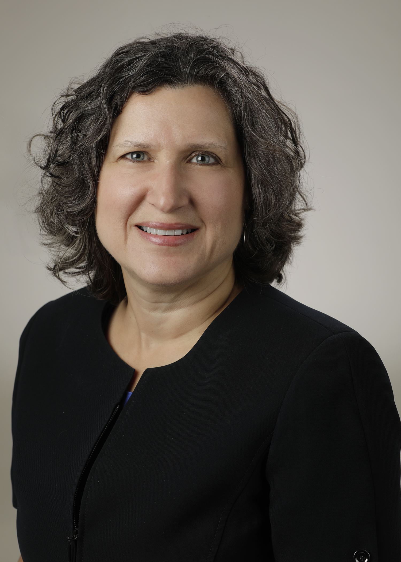
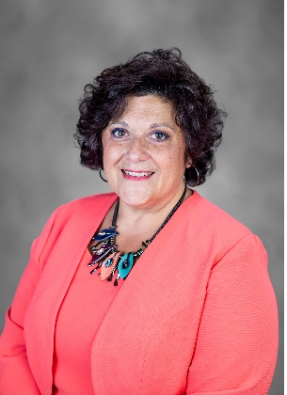
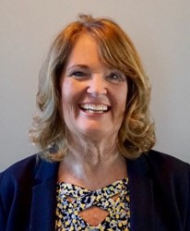
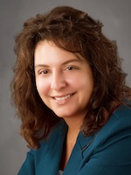
Introducing Your Presenters…
Heather Peters, M.Ed., PhD
GME Consultant
Carmela Meyer, MBA, Ed.D
GME Consultant
Cheryl Haynes, BA
GME Consultant
Christine Redovan, MBA, MLIS
GME Consultant
Heather is a seasoned GME consultant with 3 decades of education experience.
Heather will be providing her key takeaways related to considerations for GME strategic planning.
Carmela is a seasoned GME professional and consultant with over 25 years of experience in medical education, with a strong background in GME finance.
Carmela will be providing her key takeaways related to federal policy.
Cheryl is a seasoned GME professional & consultant with 18 years of program administration experience, & 7 years in developing education curriculum for coordinators.
Cheryl will provide her key takeaways and updates for site visits.
Christine is a seasoned GME consultant with 25 years of experience in medical education.
Chris will be providing her key takeaways related to using data in GME.

Slide 4
Learning Objectives
Discuss how the ACGME Strategic Planning will affect GME
Review the funding opportunities that are on the horizon for GME
Review best practices for successful site visits
Understand how diversity data is collected and used by ACGME & NRMP

Slide 5
ACGME Strategic Planning and its Impact on Local GME
Heather Peters, M.Ed, PhD

Slide 6
Nasca Address about ACGME Strategic Planning

Slide 7
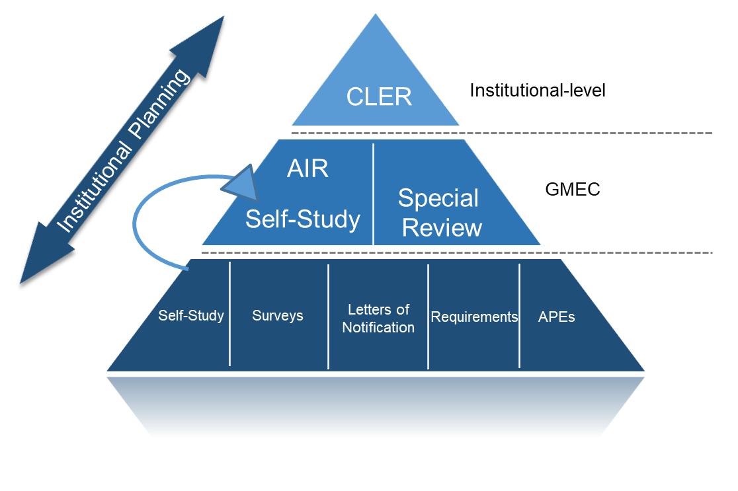
Continuous Compliance for Sponsoring Institutions

Slide 8
Local GME Implications

Slide 9
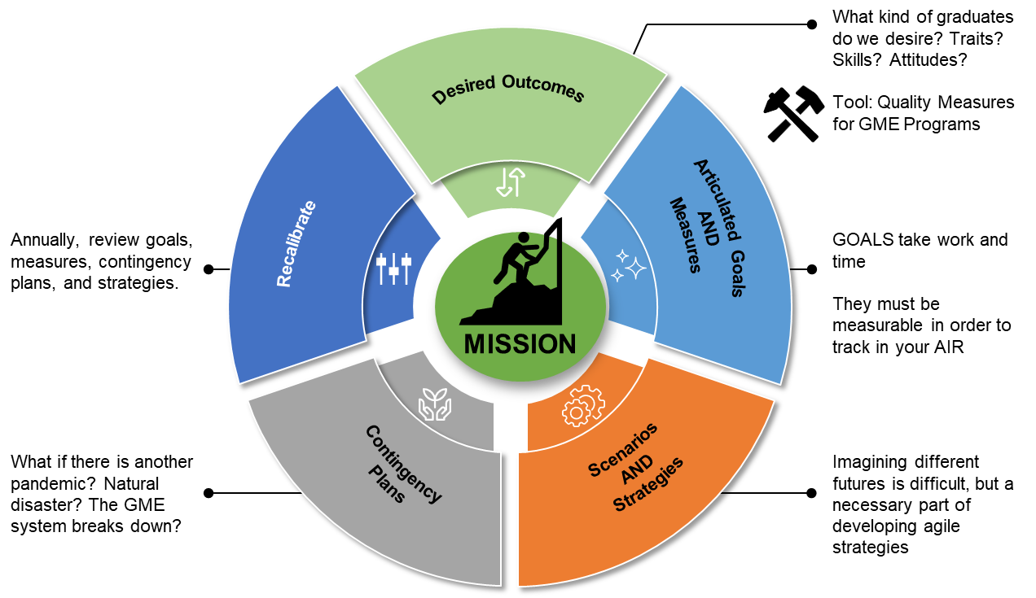
Strategic Plan Cycle

Slide 10
Public Policy
Carmela Meyer, MBA, Ed.D

Slide 11
Consolidated Appropriations Act of 2021
Fix for artificially low Medicare cap due to resident rotations - reset cap
Reset PRA
Change in rural training track rules
1,000 new Medicare-funded residency positions

Slide 12
CAA of 2021 - New slots
Overview
GME cap raised to provide for 1,000 new residency positions, effective FY 2023
Separate round of applications for each year
Applications submitted through MEARiS
Hospitals must be over the cap
Must increase # positions by # slots awarded
Must demonstrate likelihood of filling slots
Payment
Reimbursed using hospital’s PRA for DGME and adjustment factor for IME
CMS is studying the distribution of positions and where the residents go beyond residency - reporting requirements ???

Slide 13
CAA of 2021 -
Changes to rural training
Added flexibility for hospitals to develop rural-urban partnerships
Requirement that the program be newly established has been removed
Hospitals are eligible for temporary exemption from 3-year rolling average rule for hospitals creating new programs

Slide 15
What’s on the Horizon
Build Back Better Act (BBB)
500 new VA residency positions
4,000 new CMS-funded residency slots
Additional THCGME funding opportunities
(expansion and increase the PRA)
Additional CHGME funding
Establishing new medical schools in underserved areas
Palliative Care Medicine residency programs
Maternal health - high priority right now
Maternal health equity grants
Collaborative learning models to improve health outcomes
Digital tools to improve maternal health outcomes

Slide 16
4,000 new CMS-funded residency positions
Specialty Prioritization:
25% PC or OB/Gyn
15% Psychiatry, Palliative Care, Pain, Sleep
2,000 positions per year - separate round of applications
Similar prioritizations for qualifying hospitals as RTTs

Slide 17
J-1 Visa Bill
Grant Residency for Additional Doctors (GRAD) Act – Directs the State Department to establish a position March-June whose sole purpose is to address J-1 GME visa applications.
Conrad State 30* and Physician Access Reauthorization Act – Extends the Conrad State 30 program, which allows states to request J-1 visa waivers for foreign physicians
The Conrad 30 waiver program allows J-1 foreign medical graduates (FMGs) to apply for a waiver of the 2-year foreign residence requirement upon completion of the J-1 exchange visitor program.

Slide 18
Site Visits:
Lessons Learned
Cheryl Haynes, BA

Slide 19
When??
Institutional Self-Study and 10-Year Site Visits are on track.
Program Self Study and 10-Year Site Visits are postponed.

Slide 20
How??
Site visits may be on zoom or in person, ACGME will determine and include in your notification.
If your institution does not allow zoom, notify ACGME when you submit blackout dates for alternatives.

Slide 21
Who?
Letter of Notification
Choose your Team
Plan and prepare

Slide 22
Coaching is not only allowed, but recommended
Review program requirements
Share survey results & action plan from PEC
Consider how faculty and residents will respond - don’t assume they know anything
Do a Mock Site Visit

Slide 23
Make Certain the Pieces Fit
Info in common application matches the specialty application
Descriptions match Block Diagram
Faculty match sites

Slide 24
Common Errors
Make sure you follow instructions
Faculty certifications should be up to date
Faculty Scholarly Activity - include activities only within the last 5 years.

Slide 25
Common Errors
Supervision Policy -
progressive responsibility per PGY
how to contact supervising physicians,
not just when

Slide 26
Common Errors
Institutional Level - more than 50% of citations from IR 1.B Graduate Medical Education Committee

Slide 28
GME Diversity Data
Christine Redovan, MBA, MLIS

Slide 29
Inspiration
Based on SES 030 Converting Data to Information in GME Diversity, virtual presentation, April 2022 ACGME Educational Conference.
ACGME DEI Data by William McDade, MD, Phd, Chief Diversity, Equity and Inclusion, ACGME
One Institution's Experience by Anita K. Blanchard, MD, former Associate Dean for Graduate Medical Education/DIO, University of Chicago Medicine
Converting Data to Information in GME Diversity by Donna L. Lamb, DHSc, MBA, BSN, President & CEO, NRMP.

Slide 30
ACGME Diversity Standards
CPR I.C
IR III.B.8
The program, in partnership with its Sponsoring Institution, must engage in practices that focus on mission-driven, ongoing, systematic recruitment and retention of a diverse and inclusive workforce of residents, fellows (if present), faculty members, senior administrative staff members, and other relevant members of its academic community. (Core)
The Sponsoring Institution, in partnership with each of its programs, must engage in practices that focus on ongoing, mission-driven, systematic recruitment and retention of a diverse and inclusive workforce of residents/fellows, faculty members, senior administrative staff members, and other relevant members of its GME community. (Core)

Slide 31
We provide data…
Annual program update
Resident roster
Resident/faculty surveys
Complaints/concerns
Cause of incomplete/unsuccessful training
Milestones
Board certification rate
This Photo by Unknown Author is licensed under CC BY

Slide 32
…that ACGME assesses
Generate resources for the GME community
Support RC is assessing compliance
Improve survey and application questions
Trend data
Data mine
Hypothesis-driven research
This Photo by Unknown Author is licensed under CC BY-NC-ND

Slide 33
Future directions @ ACGME
Updating to a standard demographic nomenclature
Faculty demographics
Learning what matters and how to measure
This Photo by Unknown Author is licensed under CC BY-SA
More shared resources
Funded initiatives

Slide 34
NRMP and diversity
NRMP Data Book
Characteristics of applicants - broad and by specialty (2014 professional profile began)
Characteristics of programs
January 2020 - introduced primary source demographics
September 2021 - primary source voluntary data collection (86% opted in)
February 2022 - fellowships

Slide 35
Future directions @ NRMP
Pair demographic data w/ranking and match data
Provide high level reports, released after a minimum of two match cycles
This Photo by Unknown Author is licensed under CC BY-SA
Why does this matter?
Assess the extent of DEI
See relationship between applicants and decisions
Look at patterns across specialties
Link demographics to match outcomes

Slide 36
Real world application
Dr. Blanchard used ERAS & NRMP data to create a dashboard for each program
Looked at non-UiM and UiM applicants; produced a heat map of ranks:
UiM vs. non-UiM
Matched or not
Medical school or affiliate
Top 25 medical schools
This Photo by Unknown Author is licensed under CC BY-SA

Slide 37
Real world application
Tracked where the non-matched went
Incorporated GME and program level initiatives
In one year increased UiM from 14% to 24%
Paper accepted by JGME

Slide 38
Resources
Accreditation for Graduate Medical Education - acgme.org
National Resident Matching Program - nrmp.org
Journal of Graduate Medical Education - jgme.org

Slide 39
Upcoming Live Webinar
ADS 2022: Part I
Thursday, April 28, 2022
The ABCs of GMEC: Part II
Thursday, May 19, 2022
Here We Grow Again – And With Our Community
Tuesday, May 24, 2022
ACGME Complaint Letter: Now What?
Thursday, June 9, 2022
JEDI Warriors in GME: Guardians of Justice, Equity, Diversity, and Inclusion
Thursday, June 23, 2022
Latest On-Demand Webinars
Moral Injury in Healthcare
Streamlining Your Special Review
Getting to the Next Stage - Program Improvement I
Digging for Data IV
Back to Basics – GME for New Coordinators
Leveraging RMS Technology for the Medicare Cost Report
Meet the Experts – Fall Freebie
A Successful Coordinator? You Must Be C-C-Crazy!
Planning and Tracking Scholarly Activity
GME Financing: The Basics, the Strategies, and the Upcoming Changes
The Role of Coaching
Faculty Development Series
15 Minutes to Effective Feedback
Toolbox for Teaching Millennials
Taking Supervision to the Next Level
Contact us today to learn how our Educational
Passports can save you time & money!
724-864-7320
www.PartnersInMedEd.com
Presented by Partners in Medical Education, Inc. 2022
39

Slide 40
Partners in Medical Education, Inc. provides comprehensive consulting services to the GME community.
Partners in Medical Education
724-864-7320 | info@PartnersInMedEd.com
Heather Peters, M.Ed., PhD
Heather@partnersinmeded.com
Carmela Meyer, EdD
Carmela@partnersinmeded.com
Cheryl Haynes
Cheryl@partnersinmeded.com
Christine Redovan, MBA, MLIS
Christine@partnersinmeded.com
www.PartnersInMedEd.com

