Slide 1
”Ask Partners – Spring Freebie”
Heather Peters, M.Ed, Ph.D GME Consultant Christine Redovan, MBA GME Consultant Tori Hanlon, MS, CHCP GME Consultant

Slide 2
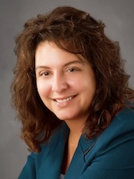
Partners Consulting Team
Heather Peters, M.Ed, Ph.D
GME Consultant
Christine Redovan, MBA
GME Consultant
Tori Hanlon, MS, CHCP GME Consultant
GME Director & DIO
Seasoned speaker at ACGME & sub-specialty national meetings
Institutional and Program accreditation experience
3 decades in education; Masters of Education in curriculum & evaluations, PhD concentration in secondary education & adult learning theories
15+ years GME Operations, Accreditation and Management success
Focused on continual readiness and offering timely and useful GME resources
Over 11 years working in Medical Education
Bachelor’s in Health Services Administration
Master’s in Health Administration and Policy
Director of Medical Education and Designated Institutional Official
Experienced in GME at a large academic medical center

Slide 3
Sponsoring Institutions & ACGME Meeting Trends
Heather Peters, M.Ed, Ph.D GME Consultant

Slide 4
Goals
Discuss updates and timeline regarding changes to Sponsoring Institution accreditation standards and Sponsoring Institution Self-Studies
Note trends of ACGME Meeting: Scenario planning, Imagining the future for our current trainees, Revisions to the Common Program Requirements, Trainee and Faculty well-being and Lean Six Sigma Concepts

Slide 5
ACGME Accredited Sponsoring Institutions by Number of Sponsored Programs
n = 792
534 Sponsoring Institutions have 1-5 Programs
Notes:
One of the data slides shown at the ACGME meeting in Dr. Nasca’s address provided some interesting data for sponsoring institutions. While we tend to think that there are quite a few large academic medical centers with multiple programs, the reality is that of the 792 sponsoring institutions, over 500 of them have 1 to 5 programs. This means that if you are a small sponsoring institution you are certainly not in the minority. There are a lot of you out there. This is one of the many key factors that will be taken into account as the IRC rewrites the institutional requirements. Before, single program sponsoring institutions were subsumed into their specialty. For example, if you are a single program sponsoring institution with a family medicine program, you would have been reviewed by the family medicine RC for both the program requirements and the SI requirements. That is no longer the case. Now you are reviewed by the IRC, whether you have 1 program or over 100 programs. And you will be held to the same standard.

Slide 6
130 Osteopathic Sponsoring Institutions
Open Application
34
6
Pre-Accreditation
Continued Pre-Accreditation
20
69
Initial Accreditation
Continued Accreditation
1

Slide 7
Evolution of the Role of the Sponsoring Institution
1982: ACGME Begins
1995: IRC Created
2011: Revision of ACGME Bylaws
2018-2019: Revision of Institutional Requirements
Notes:
1982: The ACGME recognized that residency and fellowship programs would benefit from a larger organizational structure
1995: The ACGME Board of Directors chartered and IRC for the purpose of recognizing the SI through formal review
Shift
the SI has become the entity that overseas and supports its accredited programs
2011: A revision of the ACGME Bylaws included a new ACGME function: to review and revise the criteria by which SIs and their educational outcomes, are evaluated.
SI are challenged to adapt to rapid transformations in the health care system and changes along the continuum of medical education

Slide 8
Annual Review, 2016-2017
Included 632 Sponsoring Institutions
Includes single-program SIs for the first time
Excludes SIs with Initial Accreditation or Pre-Accreditation
Types of Annual IRC Review: April 2017
Consent Agenda: 599 (94.8%)
IRC Review without Clarifying Information or Site Visit: 2 (0.3%)
Clarifying Information: 14 (2.2%)
Site Visit: 17 (2.7%)
Identified SIs with indicators
One or two IRC members work with the Executive Director on screening for every program not on consent agenda
Assess for
Need for clarifying information
Need for site visit

Slide 9
Annual Review of Sponsoring Institution (IRC)
Sponsor History Summary
Sponsor History Details with Citations and Complaints
Institutional Data from ADS
Summary of Program-specific Citations (Attachment 1)
Scholarly Activity (summary)
Personnel Change (CEO, DIO and PD Changes)
Institutional-level Resident/Fellow Survey
Institutional-level Faculty Survey
Annual Data Reporting Summary (compliance rate for programs)
Most Recent Institutional Notification Letter
Other Correspondence from IRC
Site Visit Report with Addenda

Slide 10
Annual Cycle for the IRC
Winter Meeting
New application reviews
Annual review underway
“Advancement” topic discussions
Winter Meeting
Fall Meeting
New application reviews
Accreditation reviews
Fall Meeting
IRC
Spring Meeting
Spring Meeting
New application reviews
Annual accreditation decisions
Consent agenda

Slide 11
IRC 2017 and Beyond…
Revision of Institutional Requirements
5
2
Revision of “Initial Institutional Application”
4
Promotion of provider well-being
Reduction of burden for GME leaders
3
Development of self-study process
1
Further revision of ADS Institutional Update

Slide 12
Revisions to IRs 2018-2019
IRC plus other stakeholders
Multiple phases of revision and implementation
Adapt to Common Program Requirements revisions
Sponsoring Institution 2025
Clinical Learning Environment Review (CLER) Program

Slide 13
Institutional Self Study
Currently learning from self-study pilot visits at the program level
Template for institutional self-study (2017-2018)
Key Points:
Notice to begin self-study process will be sent to DIO nine (9) months before due date
Self study will be followed 12 to 18 months later by a FULL ACCREDITATION site visit
Assess compliance with Institutional Requirements and not Self Study goals)
IRC self study review will assess Sponsoring Institutions’ achievement of self-defined goals

Slide 14
ADS Update
APEs
July
Nov
Dec
Jan
Feb
Aug/Sept/Oct
March
April
May
June
GMEC
GMEC
Annual Review
Aug-Jan
NAS
Continuous
Institutional
Accreditation
R/F
Survey
CLER
CLER
AIR
Site
Visit
Clarifying
Information
GMEC
GMEC
Program LONs

Slide 15
Trends at ACGME
Glimpsing the Future…

Slide 16
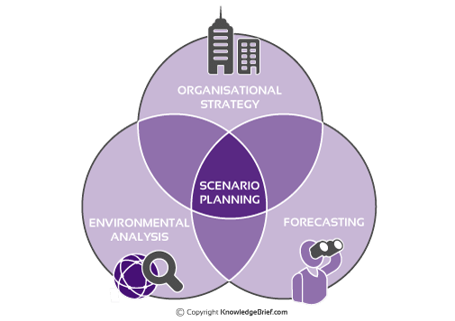
Scenario Planning
Definition: A strategic approach used to explore and understand the potential future of an organization. It works by describing a small number of scenarios, by creating stories how the future may unfold, and how this may affect an issue that confronts the organization.

Slide 17
Imagining Medical Education in 2030

Slide 18
Revisions to Section VI of the Common Program Requirements July 2017 and Beyond
Patient Safety/Quality Improvement
Professionalism
Well-being & Fatigue Mitigation
Teamwork
Transitions in Care
Clinical Experience and Education
Supervision
Notes:
Of course, the Common Program Requirements were mentioned multiple times throughout the conference. Dr. Nasca announced at 9:05 on Friday morning that an email had gone out to all program directors, DIOs and other GME leaderships that the proposed revisions to the common program requirements had been approved by the ACGME Board of Directors.
If you have not looked at the changes that will begin to go into effect starting July 2017, I strongly encourage you to do so very soon. The new clinical experience and education requirements (FKA duty hours) will impact your schedules for the upcoming year as there are new guidelines for PGY-1s.
Partners will have a webinar in the fall to discuss the implications of the revisions for both the programs and the sponsoring institutions. So stay tuned for more guidance on these important changes

Slide 19
DMAIC Diagram PowerPoint Template
Lean Six Sigma Methodology
DEFINE
ANALYZE
CONTROL
DEFINE
ANALYZE
CONTROL
MEASURE
IMPROVE
MEASURE
IMPROVE

Slide 20
Trainee & Faculty Well-Being
Evolving the Triple Aim to the Quadruple Aim
Population Health
Population Health
Experience
of Care
Provider
Well-Being
Experience of Care
Per Capita Cost
Per Capita Cost

Slide 21
Trainee & Faculty Well-Being
ACGME’s Commitment:
Sponsor Physician Well Being Conference for 4 years
Board-designated Task Force on Physician
Well-Being
Maintain focus at ACGME’s Annual
Educational Conference
Co-Sponsor National Academy of
Medicine Learning Collaborative
Partner with other
organizations
Notes:
ACGME’s Commitment:
Sponsor Physician Well Being Conference for 4 years
Board-designated Task Force on Physician Well-Being
Maintain focus at ACGME’s Annual Educational Conference
Co-Sponsor National Academy of Medicine Learning Collaborative
Partner with:
AAMC in seeking further national opportunities
Coalition for Physician Accountability
National Coalition for Improvement in the Clinical Learning Environment (NCICLE)

Slide 22
ADS Improvements & Scholarly Activity Notes from the ACGME Annual Education Meeting March 2017
Christine Redovan, MBA
GME Consultant

Slide 23
Goals & Objectives
Discover the latest updates to the Accreditation Data System (ADS)
Use of Glassick's Six Standards for Scholarly Work

Slide 24
Accreditation Data System
General Information
All information is electronic
Data is very secure
Preferred browser is Chrome
Programs
155 on warning
33 on probation

Slide 25
Accreditation Data System
Semi-new
Single login to access multiple programs
Up to 2 program director logins
Up to 2 institutional coordinator logins
Announcements on main page. Read them!
Searchable common program requirements

Slide 26
Accreditation Data System
New features of ADS
Annual reporting time frames are becoming more compressed
IRC update due August 18
DIO annual update summary for all of their programs along with associated data
Major changes section includes improvements and other items of significance

Slide 27
Accreditation Data System
New Features of ADS
Citations automatically now include the last time you updated your response. Update all the time!
Download my Data
All boards now report aggregate data to the ACGME. RC’s are very focused on board data.
Milestone summary reports. Currently in talks with residency management systems. Only out from ACGME.
Fellowship may retrieve core milestone reports for verification purposes

Slide 28
Accreditation Data System
New Features of ADS
ACGME surveys
Minor changes in 2018 to align with new CPR’s
More major changes in 2019. Looking more to add questions are wellness and other areas. Nothing too dramatic – will negate the trends,.
Survey spreadsheets in Excel and PDF form
Case Logs
RC’s look very closely at case logs (if applicable)
Will get a red highlighting on screen when a graduate is not meeting minimum requirements
Scholarly Activity (clarification)
Follows the faculty regardless of where it was completed.

Slide 29
Scholarly Activity
Faculty Rubric
Resident Rubric
PubMed – count
Abs/Post/Pres – 1 pt
Other – 1 pt
Chapter/Text – 1 pt
Grants – count
Leadership – 1 pt/yes
Teaching – 1 pt/yes
PubMed – count
Abs/Post/Pres – 1 pt
Chapter/Text – 1 pt
Research – 1 pt/yes
Teaching – 1 pt/yes

Slide 30
Scholarly Activity
Three years of aggregated data
56% of faculty have PubMed ID or other form of scholarly activity
36.7% of programs have one or more faculty with no scholarly activity over three years
Looked at the core programs
88.3% of PubMed ID belong to faculty
6.4% of PubMed ID belong to graduating residents
5.3% of PubMed ID belong to both
Not a lot of overlap

Slide 31
Scholarly Activity
Feedback to ACGME suggested that the ACGME believes that non-PubMed indexed articles are less valued.
NOT TRUE. ACGME believes all scholarly activity is relevant

Slide 32
Scholarly Activity
Proposed additional categories. Not approved, currently in discussion for faculty:
QI leadership, assessment, reporting, supervising, MOC activities
Teaching through distant learning or Med Ed Portal
Proposed additional categories. Not approved, currently in discussion for residents:
Publication in non-peer reviewed or peer-reviewed non- NLM recognition
Development of educational materials

Slide 33
Scholarly Activity
Glassick’s Six Standards of Scholarship
Clear Goals
Adequate preparation
Appropriate methods
Significant results
Effective presentation
Reflective critique
Glassick, C.E, Huber, M.T. & Maeroff, G. (1997). Scholarship assessed. San Francisco, CA: Jossey–Bass
Glassick, C.E. (2000). Boyer’s expanded definitions of scholarship, the standards for assessing scholarship, and the elusiveness of the scholarship of teaching. Academic Medicine 75(9), 877-880.

Slide 34
Scholarly Activity
We should use Glassick’s work as a guide to review and critique all forms of scholarship
AAMC Educational Scholarship Guide: https://www.mededportal.org/download/190392/data/educational_scholarship_guide.pdf

Slide 35
Program Self-Study
Tori Hanlon, MS, CHCP
GME Consultant

Slide 36
Objectives
Provide a self-study timeline for programs
Examine self-study best practices as presented at the ACGME Annual Conference
Review lessons learned from programs who have completed self-studies

Slide 37
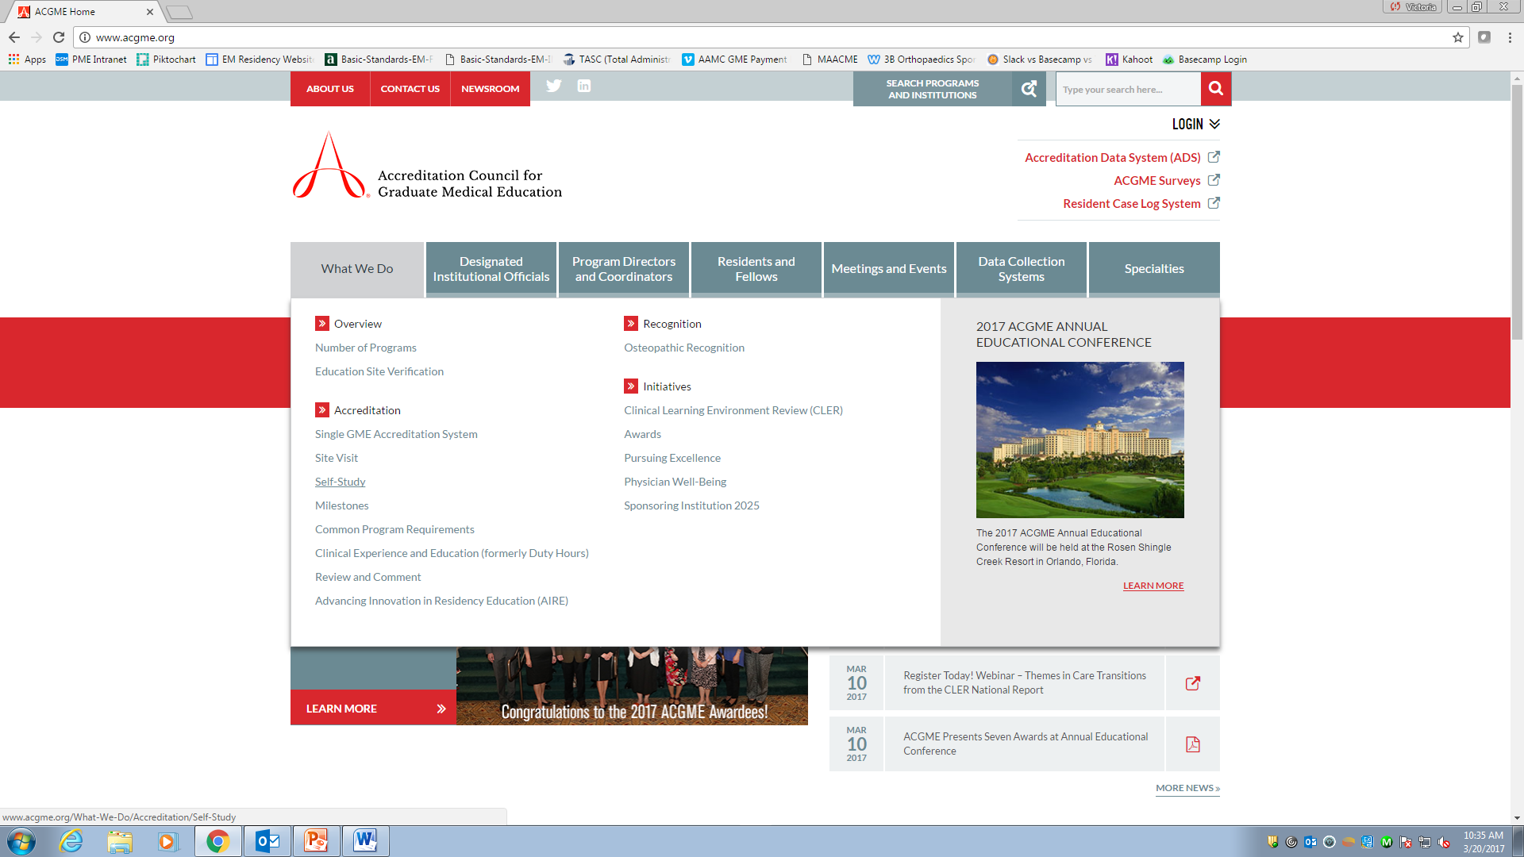

Slide 38
Self-Study Timeline
July 2017
Begin self-study prep
July 2018
Self- study due
Nov 2019
10 year SV

Slide 39
Self-Study Process & Timeline
Month 1 | Form self-study group
Months 2-3 | Create working plan for self-study group (include this timeline) Review process Set meeting dates Determine data points
Month 4 | Develop/discuss program aims
Months 5-6 | Collect data
Month 7 | Conduct SWOT Analysis
Months 8-9 | Data analysis
Months 10-11 | Confirm findings with stakeholders & complete self-study summary
Month 12 | Submit self-study document to ACGME

Slide 40
Best Practices
Diversify your self-study group
Review the self-study process and the ACGME self-study document FIRST
Engage stakeholders early in a discussion of program aims

Slide 41
Program Aims
How would you sell your program to someone?
What is special about your program?
What kind of residents are you training?
Where do your residents come from?
What skills/strengths do residents bring with them?
What are you training your residents to do when they graduate?
What kinds of jobs or future training do residents choose after graduation?
What population does your program serve?

Slide 42
Best Practices
Review program aims periodically
Use program aims for recruitment
Develop an APE tracking sheet
Maintain data collection templates in real time
Survey residents from other programs
Incorporate SWOT analyses into APE process

Slide 43
Lessons Learned
Start early
Collaborate
Develop program aims NOW
Self-study = QI
Be honest in your SWOT

Slide 44
Gifford, K, Guralnick, S & Rakowsky, A. (2017, March). The ACGME Self-Study: How to use this process to make you the best you can be. SES061 ACGME Annual Educational Conference, Orlando, FL.
Guralnick, S et al. (2015). The ACGME Self-Study – An Opportunity, Not a Burden. Journal of Graduate Medical Education, (7)3, 502-505.

Slide 45
Upcoming Live Webinars
ALERT! JUST ADDED Dissecting the ICE Bundle: Defining Instruction, Curricula, and Evaluation in a Systems-based Context
Thursday, March 30, 2017
12:00pm – 1:00pm EST Institutional Readiness in NAS Tuesday, March 2, 2017
12:00pm – 1:00pm EST Using #Social Media and Technology in #GME Thursday, April 20, 2017
12:00pm – 1:00pm EST
www.PartnersInMedEd.com
Partners® Snippets
On-Demand Webinars
Documentation and Coding to Teaching Physicians Keeping up with Institutional NAS Requirements
New Program Accreditation. Let’s get Started
GME Finance – The Basics (2016 Update)
Maximizing Resident Forums
What Every Coordinator Needs to Know about NAS
CLER
Contact us today to learn
how our Educational Passports can save you time & money!
724-864-7320

Slide 46
Partners in Medical Education, Inc. provides comprehensive consulting services to the GME community.
Partners in Medical Education
724-864-7320 | info@PartnersInMedEd.com
www.PartnersInMedEd.com

