Slide 1
Please Note…
Please make sure your Start Video is OFF when logging into the WebEx platform.
Here is what it should look like
ALSO
It is NORMAL to not hear any sound until the webinar starts at 12:00 noon EST.
Your phone line is muted, but you can always chat to the host, BJ Schwartz, if you have any questions or concerns during this time.

Slide 2
Back to Basics: GME for New Coordinators
Presented by: Cheryl Haynes, BA
Christine Redovan, MBA, MLIS

Slide 3
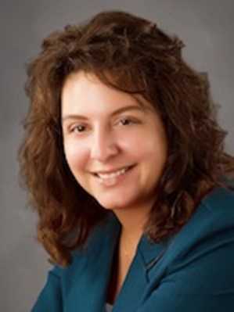
Introducing Your Presenters…
Cheryl Haynes, BA
GME Consultant
Christine Redovan, MBA, MLIS
GME Consultant
Worked in GME for 21 years, 18 of which in program administration & also served as institutional coordinator
Has experience in curriculum and faculty development Seasoned speaker for ACGME, ACOFP, AAFP & AFMA
Served on the Board of Directors, Association of Family Medicine Administration
Has published research related to coordinator well-being.
22+ years program and institution GME administration experience including training and continuing education for new program coordinators, directors and support staff

Slide 4
Learning Objectives
Understand the role of the ACGME and the language it uses.
Differentiate Common and Specialty requirements.
Know what resources to bookmark and have readily available.
Review the basic ACGME annual reporting requirements.

Slide 5
Accreditation Council for Graduate Medical Education
Sets the standards of U.S. graduate medical education programs and the institutions that sponsor them.
Renders accreditation decisions based on compliance with these standards.

Slide 6
Review Committee
A group comprised of volunteers that
sets accreditation requirements
reviews programs for compliance
determines accreditation status

Slide 7
Sponsoring Institution
the organization that assumes ultimate financial and academic responsibility for GME programs consistent with the ACGME Institutional Requirements.
ACGME will assign an identifying
code

Slide 8
SI - Structure
Designated Institutional Official – DIO
Graduate Medical Education Committee – GMEC
Specific requirements detailed in I.B.
https://www.acgme.org/globalassets/pfassets/institutionalrequirements/800_institutionalrequirements_2021v2.pdf.

Slide 9
Program Structure
Must have a PD
Must have sufficient number of faculty to train and supervise all residents
Must have a Program Coordinator
ACGME will assign a 10-digit identifying code

Slide 10
Common Program Requirements
The ACGME requirements that apply to all specialties and subspecialties within a specific category.
Common Program Requirements (Residency): Applicable to all residency programs and Transitional Year programs.

Slide 11
Specialty-Specific Program Requirements
Determined by specialty review committee
Further defines/details requirements per specialty

Slide 12
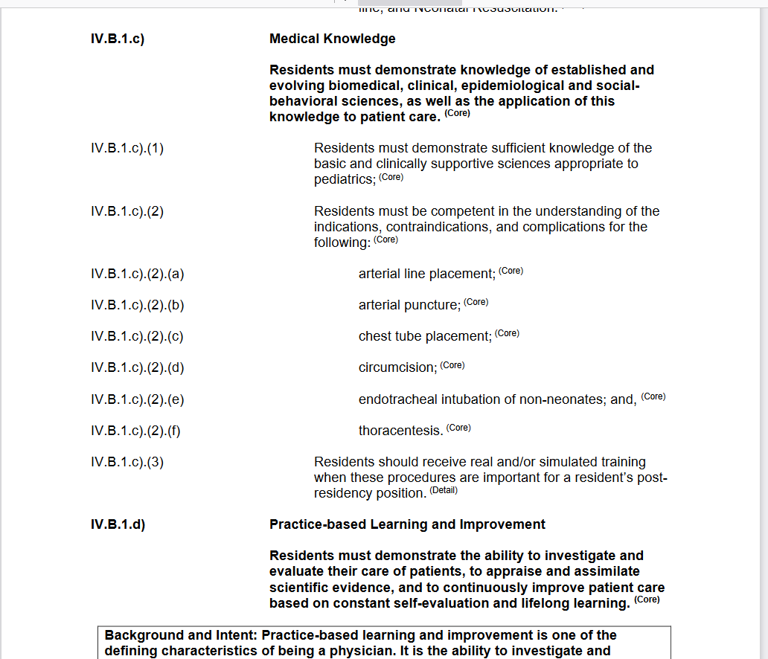
Common/Specialty Distinction

Slide 13
Bookmark It
Common program requirements: https://www.acgme.org/what-we-do/accreditation/common-program-requirements/
CPR Specialty: https://www.acgme.org/specialties/
(Bookmark Your Specialty)
PD Guide: https://www.acgme.org/program-directors-and-coordinators/welcome/program-directors-guide-to-the-common-program-requirements/

Slide 14
Changes/Updates
Always check the effective date
Proposed changes are released for review and comment prior to going into effect
Changes typically take effect July 1 upcoming year
“Tracked Changes” copy is always provided, with details

Slide 15
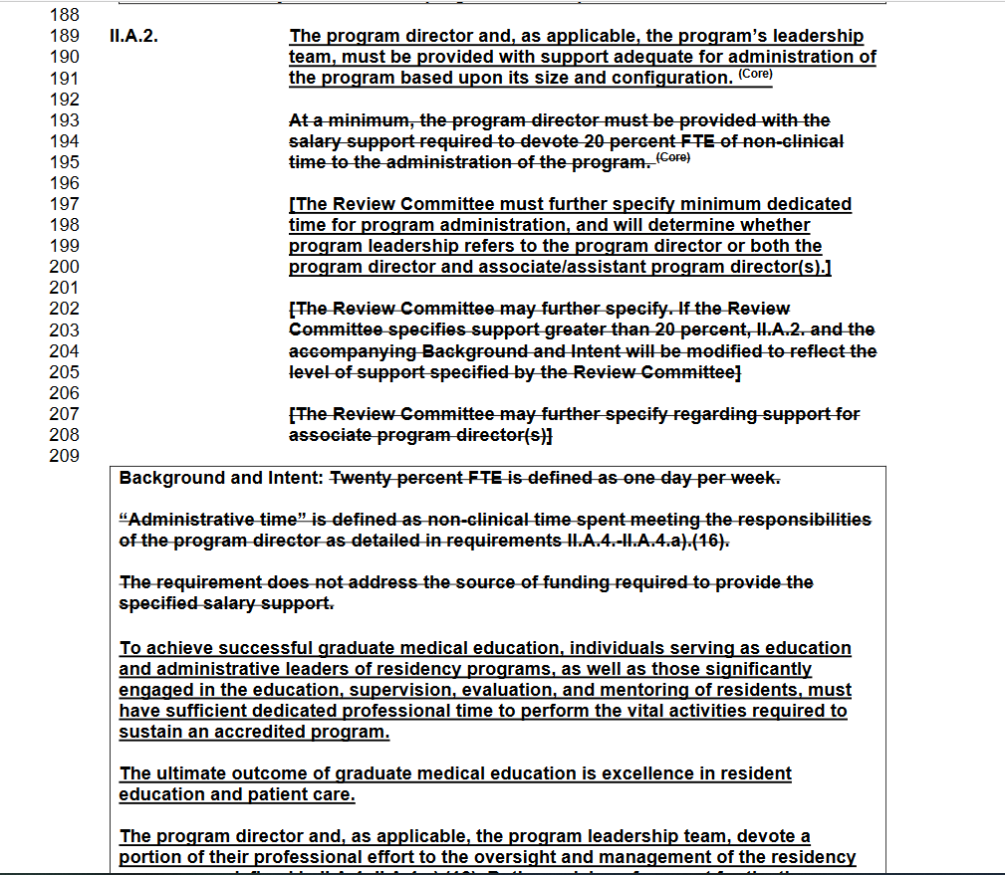

Slide 16
Learning the Language
ACGME Glossary of Terms
https://www.acgme.org/globalassets/pdfs/ab_acgmeglossary.pdf

Slide 17
Core/Detail
Core: Statements that define structure, resource, or process elements essential to every graduate medical educational program.
Detail: Statements that describe a specific structure, resource, or process, for achieving compliance with a Core Requirement.

Slide 19
Must/Should
Must: A term used to identify a requirement which is mandatory or done without fail.
Should: A term used to designate
requirements so important that
non-substantial compliance must be justified.

Slide 20
Practice Sites
Practice Site - a site other than the Sponsoring Institution at which residents have required educational experiences.
Each practice site requires a Program Letter of Agreement (PLA)
Details in CPR I.B.2

Slide 21
Documentation
If it isn’t documented, it didn’t happen
Web-based residency management software package
Pay close attention to IV.C. Curriculum Organization and Resident Experiences – “Bean Counting”

Slide 22
Evaluations - Resident
Rotations/Assignments
Milestones
Annual/Semi-Annual
Final Evaluation

Slide 23
Milestones
Milestones: performance levels residents are expected to demonstrate skills, knowledge, and behaviors in the six Core Competencies.
Professionalism
Patient Care & Procedural Skills
Medical Knowledge
Practice-based Learning and Improvement
Systems-Based Practice
Interpersonal & Communication Skills

Slide 24
Evaluations - Faculty
Must be evaluated at least annually
Must include written, anonymous and confidential evaluations by the residents
Clinical Performance
Engagement
Faculty Development
Evaluation
Teaching
Scholarship

Slide 25
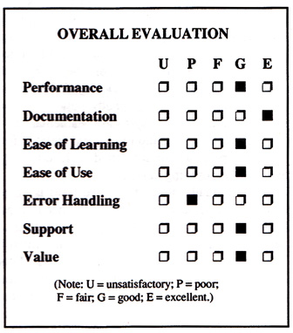
Evaluations - Program
Program Evaluation Committee (PEC)
Conducts Annual Program Evaluation
Responsibilities detailed in CPR V.C.

Slide 26
Maximum Work Hours
Specific rules detailed in CPR VI.F.1
(specialty specifics may apply)
Assure residents are documenting
Monitor compliance

Slide 27
Annual Reporting
Accreditation Data System - ADS
https://apps.acgme.org/connect/login?ReturnUrl=%252fconnect%252f
username & password issued to PD by ACGME
Coordinators use their own login credentials

Slide 28
Annual Reporting
Citation
Citation responses
Scholarly Activities
Faculty
Resident
Major Changes
Faculty roster update
Resident roster update
Block Diagram
Basic questions
Case Logs (some specialties)

Slide 29
Annual Letter of Notification
The official communication from a Review or Recognition Committee that provides
status/actions.
Statuses defined in Appendix 1 of the Glossary of Terms
https://www.acgme.org/globalassets/documents/common-resources/keystandard.pdf
Citation - Notice of failure to substantially comply with a particular requirement.

Slide 30
ADVICE
Cultivate a good working relationship with your PD and Chiefs
Join specialty administrative association
GME Program Administrators/Educators FB group
Find a mentor (make sure they understand your job)

Slide 31
More Advice
Everything changes
It’s ok to say “I don’t know”
Look it up
Take care of yourself

Slide 32
Q & A

Slide 33
Upcoming Live Webinar
Leveraging RMS Technology for the Medicare Cost Report
Thursday, February 17, 2022
The ABCs of GMEC: Part II
Thursday, March 10, 2022
Getting to the Next Stage – Program Improvement II
Thursday, March 24, 2022
Ask Partners – Spring Freebie
Tuesday, April 12, 2022
ADS 2022: Part I
Thursday, April 28, 2022
Latest On-Demand Webinars
Meet the Experts – Fall Freebie
A Successful Coordinator? You Must Be C-C-Crazy!
Planning and Tracking Scholarly Activity
GME Financing: The Basics, the Strategies, and the Upcoming Changes
The Role of Coaching
Resident Wellness in the Virtual World
A Day in the Life of A DIO
Site Visits – What to Expect in 2021
ADS Update 2021
GME Grants and Funding Sources
Survey Research
Impactful AIR & APE – Bridging Data & Action
Faculty Development Series
15 Minutes to Effective Feedback
Toolbox for Teaching Millennials
Taking Supervision to the Next Level
Contact us today to learn how our Educational
Passports can save you time & money!
724-864-7320
www.PartnersInMedEd.com
Presented by Partners in Medical Education, Inc. 2022
33

Slide 34
Partners in Medical Education, Inc. provides comprehensive consulting services to the GME community.
Partners in Medical Education
724-864-7320 | info@PartnersInMedEd.com
Cheryl Haynes, BA
Cheryl@partnersinmeded.com
Christine Redovan, MBA,MLS
Christine@partnersinmeded.com
www.PartnersInMedEd.com

