Slide 1
Please Note…
Please make sure your Start Video is OFF when logging into the WebEx platform.
Here is what it should look like
ALSO
It is NORMAL to not hear any sound until the webinar starts at 12:00 noon EST.
Your phone line is muted, but you can always chat to the host, BJ Schwartz, if you have any questions or concerns during this time.

Slide 2
Back to Basics: Intermediate Topics for New Coordinators
Presented by: Cheryl Haynes, BA
Christine Redovan, MBA, MLIS

Slide 3
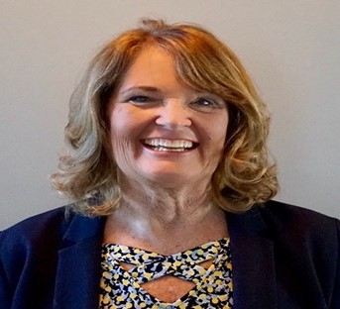
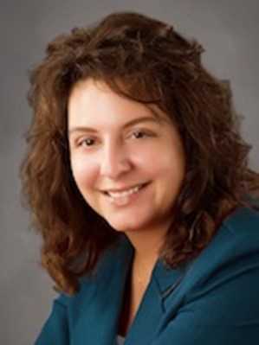
Introducing Your Presenters…
Cheryl Haynes, BA
GME Consultant
Christine Redovan, MBA, MLIS
GME Consultant
Worked in GME for 21 years, 18 of which in program administration & also served as institutional coordinator
Has experience in curriculum and faculty development Seasoned speaker for ACGME, ACOFP, AAFP & AFMA
Served on the Board of Directors, Association of Family Medicine Administration
Has published research related to coordinator well-being.
22+ years program and institution GME administration experience including training and continuing education for new program coordinators, directors and support staff

Slide 4
Learning Objectives
Understand the academic year GME cycle
Discuss and apply proven techniques for time and data management
Utilize existing resources for program development and improvement

Slide 5
GME Cycle(s)
Traditional Academic Year: July – June
IRIS Reporting: varies, based on hospital cost report
Fiscal Year: Varies
Evaluation Cycle
Application & Interview Cycle

Slide 6
GME CYCLES

Slide 7
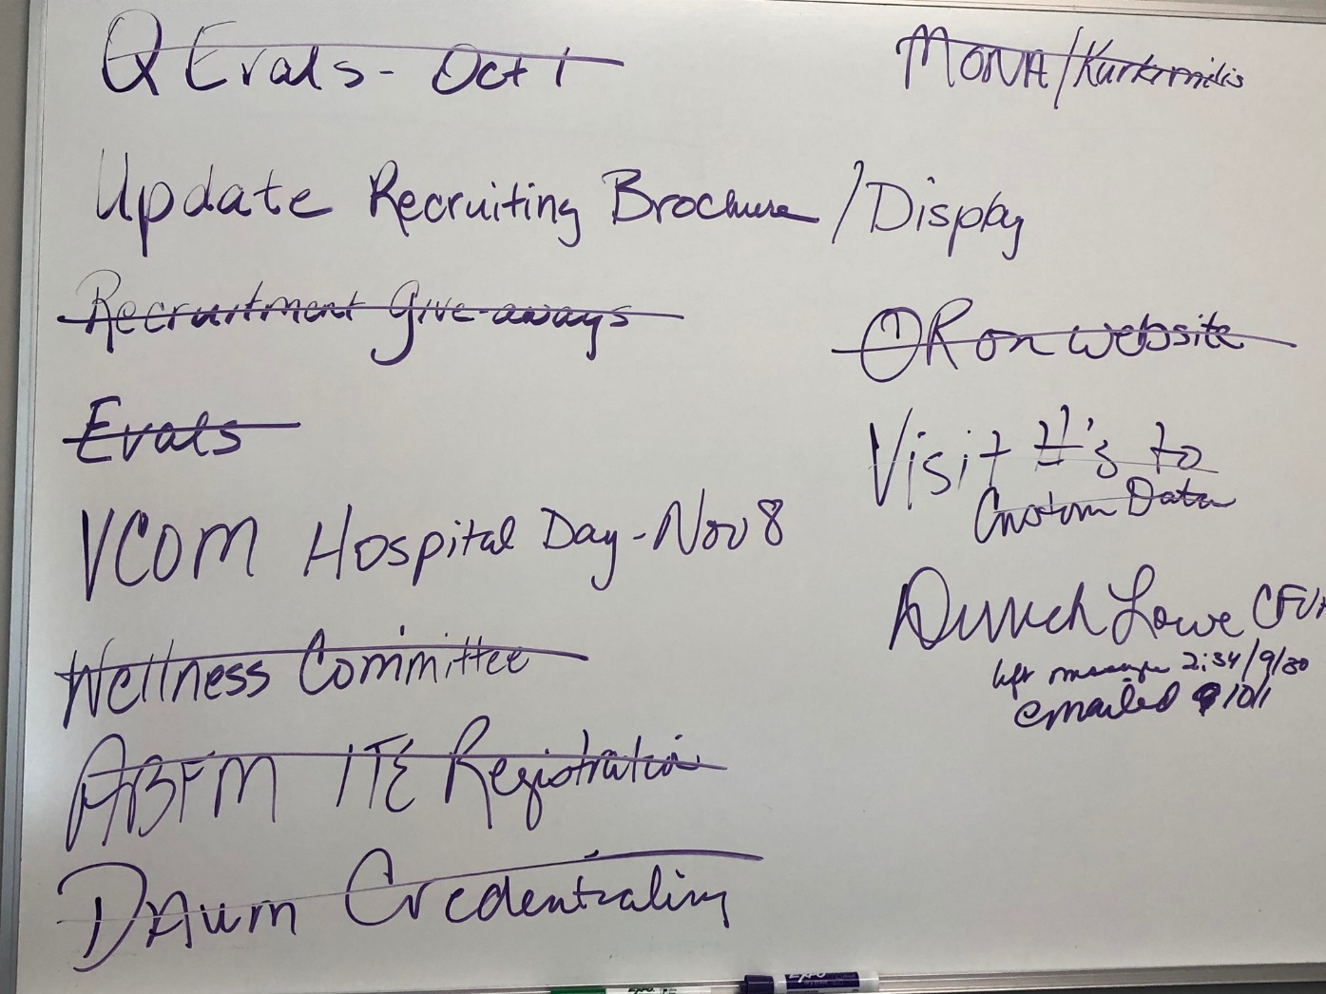
Organizational Techniques
Reminders
White Board
Wall Calendar
Color Coding
Working in the future
Work with your GME Office, not against them

Slide 9
Residency Timeline
Disclaimer: This is a template only. Adjust per your specialty and your institution.
July | August | September | October | November | December | January | February | March | April | May | June
GMEC Meeting
CCC & Milestones
GMEC Meeting
GMEC Meeting
CCC & Milestones
WebADS Annual Updates
Register for NRMP
GMEC Meeting
Residency Interviews
NRMP Rank List Due
Match Week
ABMS Board Exams
PGY3 Out-Processing
Final Summative w/PD
Certify in ABMS
State Board/ Licensing
Clearance Forms
Optional Exit Interview w/HR
NRMP Opens
Register for Specialty Conf or ACGME
Register for ERAS
PGY-3
ABMS Exam Registration
Create Block Schedule
GME Track / FREIDA
NRMP and AAMC Fees
APE
ITE
In-Training Exam Registration
IRIS Reports to hospital
Bi-Annual Resident Eval of Faculty
ACGME Program Fee
Chief Elections
Chief Conference
Website/
Recruiting Material Updates
NRMP Quota Change due by 1/31
Graduation Planning
Check matched evals
Resident Contract Renewals
Orientation Planning & Onboarding
Resource Renewals
Specialty Educational Conference
Research Symposium
Bi-Annual Resident Eval of Faculty
Move these tasks to the appropriate time per your institution or program:
Resident Manual/Policy Updates
Resident & Faculty Eval of Program
Orientation Begins
PEC Meetings
Budget
Retreat Planning
Retreat
360 Evals
Graduation
Update Evals and Curriculum per PEC
ONGOING: License Renewals, class support meetings, Practice Management meetings

Slide 10
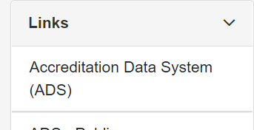
July - September

Slide 11
Resident Matching Programs

Slide 12
Best Practices
PEC meetings = Information for ADS
Scholarly activity template from the ACGME website
Use ADS print out to track updates
GME Track
Complete by July due date so you are eligible for August FREIDA update
FREIDA
Update program information throughout the year
NRMP
READ the match agreement, policies, code of conduct

Slide 13
October - December

Slide 14
Best Practices
GME Finance and Funding
https://www.acgme.org/globalassets/pdfs/funding-for-graduate-medical-education-5.3.2022.pdf
https://www.cms.gov/Medicare/Medicare-Fee-for-Service-Payment/AcuteInpatientPPS/DGME
Partner’s Passport Webinar
Looking Behind the Curtain of CMS Reporting, Carmela Meyer, MBA, EdD

Slide 15
Best Practices
Clinical Competency Committee
make sure members know your residents
smaller committees mean shorter meetings
yes, your PD can be a member
document, document, document!

Slide 16
Best Practices
Specialty-specific in-training exam
Check your specialty certifying board for deadlines & requirements
Specialty Certifying Exam
Monitor exam requirements/progress
Put deadlines on senior residents’ calendars
Monetary consequences

Slide 17
Best Practices
Resident Evaluation of Faculty
If residents complete these at the end of each rotation, hold aggregate reports to assure anonymity

Slide 18
October - December

Slide 19
Share the Interview Schedule
Block 5
October 21 – November 17, 2019
Mon | Tue | Wed | Thu | Fri | Sat | Sun
21 ABFM ITE NF/Med Team | 22 | 23 | 24 ABFM ITE | 25 | 26 | 27
28 * | 29 * | 30 | 31 * Halloween | 1 | 2 | 3
4 * | 5 * | 6 | 7 * | 8 Retreat VCOM Hospital Day | 9 | 10
11 * Veterans Day | 12 * | 13 | 14 * | 15 | 16 | 17

Slide 20
January - March
Quota Changes
Rank Order List
Match Day
Contract Renewal
ACGME Annual Conference

Slide 21
Best Practices
Follow NRMP (or other match) deadlines to the tee. There is no grace period.
Review notes on what worked well and what did not for pre-planning graduation and orientation.
Prepare for any residents that may not receive a contract.
Know your program policy
Know your institutional policy
Read the due process policy; pay attention to protocol and due dates
ASK FOR HELP!

Slide 22
April - June

Slide 23
April

Slide 24
Best Practices
Have a system that works for you!
Team approach (be the Captain)
Be like Santa – make your lists and check them twice!!

Slide 25
May

Slide 26
June

Slide 27
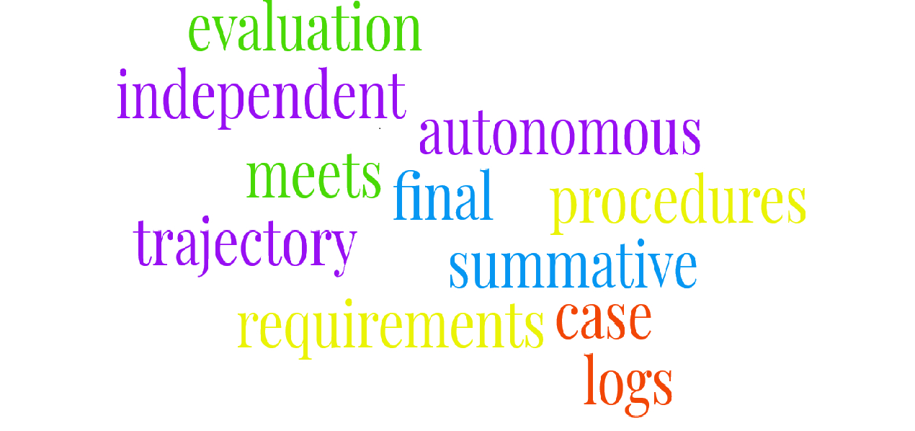
Best Practice
Don’t forget to check the language in the current CPR for the Final Summative Eval!!!

Slide 28
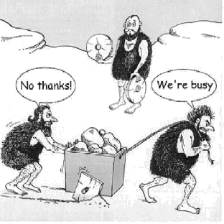
Use Your Resources!

Slide 29
Internal Resources
Other Coordinators
Coordinator Meetings
GME Office
DIO
Program Director
Associate Program Director
Chief Residents

Slide 30
Best Practices PD/PC Relationship
Set regular weekly meetings
Discuss upcoming deadlines
Identify barriers
Needed resources
Inform PD of unexpected roadblocks
Communicate!!!

Slide 31
External Resources
ACGME Program Director’s Guide to the CPR
ACGME Learn
Partner’s Passport Series
Specialty-Specific Administrator/Coordinator Groups

Slide 32
Professional Development
ACGME Conference
Specialty-Specific Conferences
AHME Conference
RMS system conference

Slide 33
Bookmark It!
Program Director’s Guide to the CPR
https://dl.acgme.org/learn/course/the-program-directors-guide-to-the-common-program-requirements-residency-ebook/interactive-handbook/e-book
PD’s Guide to Fellowships
https://fliphtml5.com/iegvn/egfe
ERAS Timeline
https://www.aamc.org/services/eras-institutions/program-staff/timeline
Main Match Timeline
https://www.nrmp.org/match-calendars/master-calendar/

Slide 34
Q & A

Slide 35
Upcoming Live Webinar
Sponsoring Institution 2025: 2022 Check-up
Thursday, October 6, 2022
Site Visit Are Coming!
Thursday, October 20, 2022
GME Educational Program Design II
Thursday, November 3, 2022
Lights, Camera…Zoom!
Thursday, November 17, 2022
Meet the Experts – Fall Freebie
Tuesday, November 29, 2022
Motivating Faculty to Mentor & Do Research
Thursday, December 8, 2022
Latest On-Demand Webinars
Wellness is a Team Sport
Looking Behind the Curtain at CMS Reporting
ADS 2022: Part II
Scholarly Activity – Starting the Year Off Right
JEDI Warriors in GME: Guardians of Justice, Equity, Diversity, and Inclusion
ACGME Complaint Letter: Now What?
Here We Grow Again – And With Our Community
The ABCs of GMEC: Part II
ADS 2022: Part I
Ask Partners – Spring Freebie
Getting to the Next Stage – Program Improvement II
Faculty Development Series
15 Minutes to Effective Feedback
Toolbox for Teaching Millennials
Taking Supervision to the Next Level
Contact us today to learn how our Educational
Passports can save you time & money!
724-864-7320
www.PartnersInMedEd.com
Presented by Partners in Medical Education, Inc. 2022
35

Slide 36
Partners in Medical Education, Inc. provides comprehensive consulting services to the GME community.
Partners in Medical Education
724-864-7320 | info@PartnersInMedEd.com
Cheryl Haynes, BA
Cheryl@partnersinmeded.com
Christine Redovan, MBA,MLS
Christine@partnersinmeded.com
www.PartnersInMedEd.com

