Slide 1
Building a Scholarly Activity Infrastructure at a Community-Based Institution
Heather Peters, M.Ed., Ph.D
GME Consultant
Partners in Medical Education

Slide 2
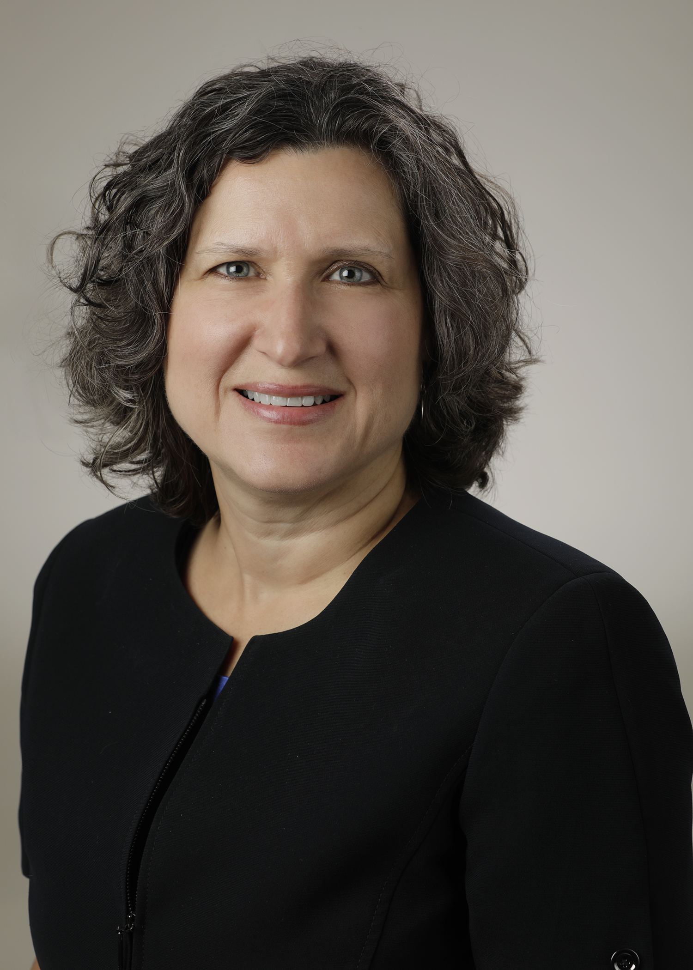
Introducing Your Presenter…
Heather Peters, M.Ed, Ph.D
GME Consultant
DIO & GME Specialist
Seasoned speaker at ACGME & sub-specialty national meetings
Areas of Expertise: Institutional and Program accreditation experience; Strategic planning; Annual Program Evaluation processes; Evaluation processes; and more
3 decades in education; Masters of Education in curriculum & evaluations, PhD concentration in secondary education & adult learning theories

Slide 3
Learning Goals
Explore the community-based sponsoring institution’s challenges when building a scholarly activity infrastructure to meet ACGME expectations
Discuss possible solutions for overcoming challenges to the community-based institution
Provide references for further exploration on this topic

Slide 4
Scholarly Activity Citation …every program’s/institution’s worst nightmare

Slide 5
Scholarly Activity Citation
You received an inadequate scholarly activity citation from your RC.
A progress report is requested in six months in which you are asked to outline the steps that have been taken by the program to address the deficiency.
When you meet with the faculty, they tell you that they are too busy to do research. Several also state that they haven’t done research since residency and frankly don’t know how to do it anymore.
Now what….??

Slide 6
Possible Action Items
Ask your DIO, Chair to free up faculty time
Review the definition of scholarly activity with faculty
Make sure CQI and other clinical projects are taken into account
Ask nationally-prominent friends to invite faculty members to provide lectures and participate in research projects
Ask your faculty members to become involved in regional and national committees

Slide 7
Scholarly Activity Requirements
IV.D.1.a) The program must demonstrate evidence of scholarly activities consistent with its mission(s) and aims (Core)
IV.D.1.c) The curriculum must advance residents’ knowledge and practice of the scholarly approach to evidence-based patient care (Core)
Elements of a scholarly approach to patient care include:
Asking meaningful questions…
Challenging the evidence…
Dissemination of scholarly learning…
Improving resident learning…

Slide 8
Faculty Scholarly Activity
IV.D.2.a) …efforts in at least three of the following domains: ^{(Core)}
Research…
Peer-reviewed grants
QI/PS initiatives
Systematic reviews, chapters, case reports
Creation of curricula, evaluation tools, electronic educational materials
Contribution to professional committees, editorial boards…
Innovations in education
IV.D.2.b).(1) Faculty participation in grand rounds… ^{(Outcome)}
IV.D.2.b).(2) Peer-reviewed publication… ^{(Outcome)}

Slide 9
Resident & Fellows
IV.D.3.a) Residents must participate in scholarship. Each graduating resident should have a scholarly activity that is disseminated as further described in IV.D.2.b).(1) or IV.D.2.b.(2). ^{(Core)}
The Review Committee may further specify

Slide 10
Rationale
Scholarly activity is used by RCs as a proxy to:
Demonstrate that faculty have the skills to analyze and utilize new knowledge
Demonstrate that the program has the ability to teach those skills to residents
Demonstrate that an environment of scholarship exists

Slide 11
The Context…

Slide 12
Types of Sponsoring Institutions (SI)
New SI pursuing accreditation of new or existing program(s)
Single-program SI
Small or medium-sized SI based at a medical center or hospital (2-39 programs)
Large of very large SI based in a medical center or hospital (40+ programs)
SI organized as a consortium or osteopathic postgraduate institute (OPTI)
SI based in a medical school
SI based in ambulatory setting(s)
SI outside of the United States

Slide 13
Sponsoring Institution Size

Slide 14
Motivations for Developing GME in Community-Based Institutions (CBIs)
Address physician shortage
Focus on Primary Care
Broadened patient base
Political considerations
SCHOLARLY ACTIVITY

Slide 15
Why the struggle?
CBI Faculty don’t see scholarly activity as a priority
CBIs vs Academic Medical Centers (AMCs)
Question: Should CBIs be held to the same standard as AMCs?
Promoting Scholarship at Regional Campuses Students; William Cathcart-Rake, MD; Michael Robinson, PhD; Journal of Regional Medical Campuses, Vol. 1 (2018) DOI: https://doi.org/10.24926/jrmc.v1i1.999

Slide 16
Possible Solutions…

Slide 17
SOLUTION #1
Redefine Scholarship

Slide 18
Boyer’s Definition
4 Elements of Scholarship…
Discovery – typically meaning research
Integration – giving meaning to isolated facts, putting knowledge in perspective
Application – using knowledge to solve consequential problems
Service/teaching
Boyer’s
Elements of Scholarship

Slide 19
Glassick’s Criteria
6 criteria
Clear goals
Adequate preparation
Appropriate methods
Significant results
Effective presentation
Reflective critiques

Slide 20
SOLUTION #2
Promoting Scholarly Activity by Faculty
Time for analysis…

Slide 21
Analyzing the Issue
Knowledge
Why are Faculty not producing scholarly activity?
Mindset
Disincentives

Slide 22
How to Motivate Faculty
Importance of scholarship for the accreditation and recognition of the GME program/institution

Slide 23
How to Motivate Faculty
Provide faculty development to assist those that are interested, but unsure how to start

Slide 24
How to Motivate Faculty
Not limited to research; can be service and teaching projects

Slide 25
How to Motivate Faculty
Public recognition of faculty academic achievements
Congratulations on your study! We are so proud of your work!

Slide 26
How to Motivate Faculty
Financial disincentives/incentives

Slide 27
How to Motivate Faculty
Reward and recognize faculty engaged in various scholarly activities in addition to teaching awards

Slide 28
Taking Inventory
Identifying those with expertise in your CBI
Specialists; Fellowship-trained
Faculty with interest in scholarly activity
Medical school mentors/faculty
Nursing education
Medical Library; Librarians
Quality

Slide 29
SOLUTION #3
Focus on Research Topics that are suited to the Community-Based Institution
Clinical research
Quality improvement
Educational projects

Slide 30
All Faculty…
Should develop a list of questions related to their practice
Answers can lead to…
Case reports
Quality improvement studies
Medical education innovation reports

Slide 31
SOLUTION #4
How to motivate residents…
Multidisciplinary Advisory Committee
Define and articulate a goal
Establish plan/procedure
Avoid fishing expeditions
Strategize
Keep pressure on

Slide 32
Key Points
Administration needs to
Reward faculty scholarly activity
Value clinical service & teaching
Scholarly Activity not limited to traditional research

Slide 33
References
Promoting Scholarship at Regional Campuses Students; William Cathcart-Rake, MD; Michael Robinson, PhD; Journal of Regional Medical Campuses, Vol. 1 (2018) DOI: https://doi.org/10.24926/jrmc.v1i1.999
ACGME Data Resource Book, Academic Year 2016-2017 http://www.acgme.org/About-Us/Publications-and-Resources/Graduate-Medical-Education-Data-Resource-Book
Building a Scholarly Activity infrastructure in a community-based institution; ACGME AEC 2018; Catherine Caronia, MD; New York Medical College.
New Program Directors: Workshop Scholarly Activities; ACGME AEC 2018; Mary Lieh-Lai, MD; Senior Vice President, Medical Accreditation.

Slide 34
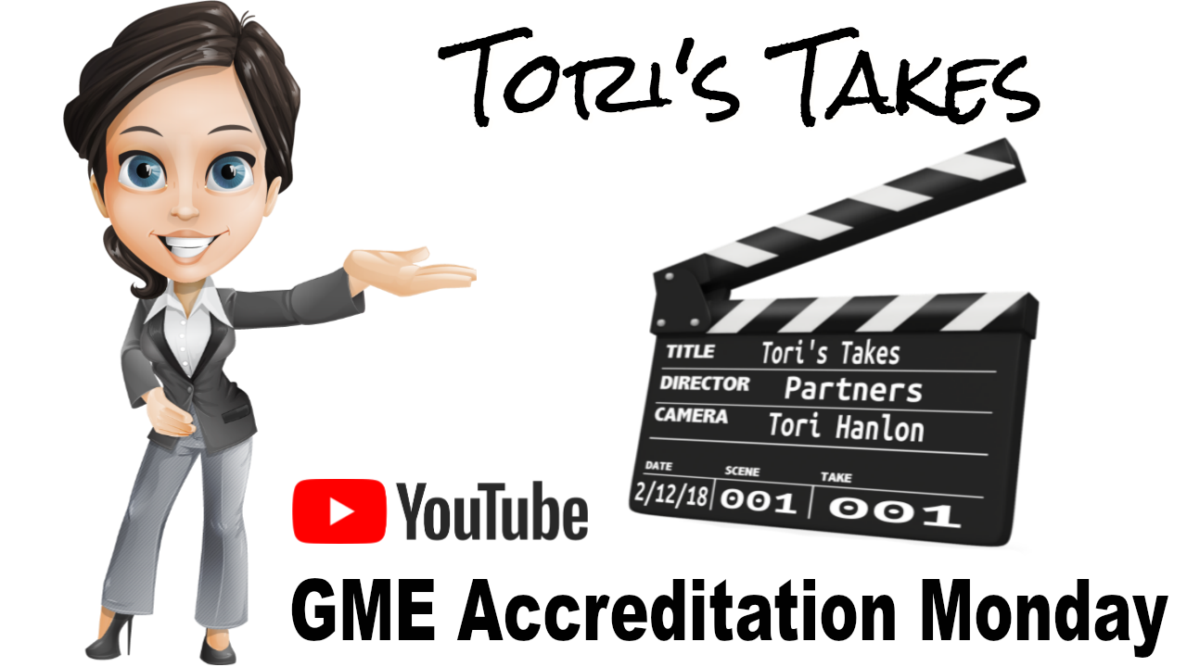
Upcoming Live Webinars ACGME Check-Up for Programs and Institutions Tuesday, April 10, 2018 12:00pm – 1:00pm EST
Recruitment Strategies Thursday, April 26, 2018 12:00pm – 1:00pm EST
CLER Thursday, May 3, 2018 12:00pm – 1:00pm EST
Journey from Initial Accreditation to Continued Accreditation Tuesday, May 22, 2018 12:00pm – 1:00pm EST Resident Remediation Thursday, June 7, 2018 12:00pm – 1:00pm EST
www.PartnersInMedEd.com
On-Demand Webinars Self-Study…Have You Analyzed Your Data Yet? Creating a Robust Resident Evaluation System
Institutional Site Visit Prep Process
From APE to Self-Study… and Everything in Between
Healthcare Disparities in GME Institutions
AOA to ACGME Accreditation: Best Practices and Challenges
Transitioning from Residency to Practice
Contact us today to learn
how our Educational Passports can save you time & money!
724-864-7320

Slide 35
Partners in Medical Education, Inc. provides comprehensive consulting services to the GME community.
Partners in Medical Education
724-864-7320 | info@PartnersInMedEd.com
Heather Peters, M.Ed, Ph.D heather@PartnersInMedEd.com
www.PartnersInMedEd.com

