Slide 1
Sponsoring Institution: The First 2 Years
Heather Peters, M. Ed, PhD
GME Consultant

Slide 2
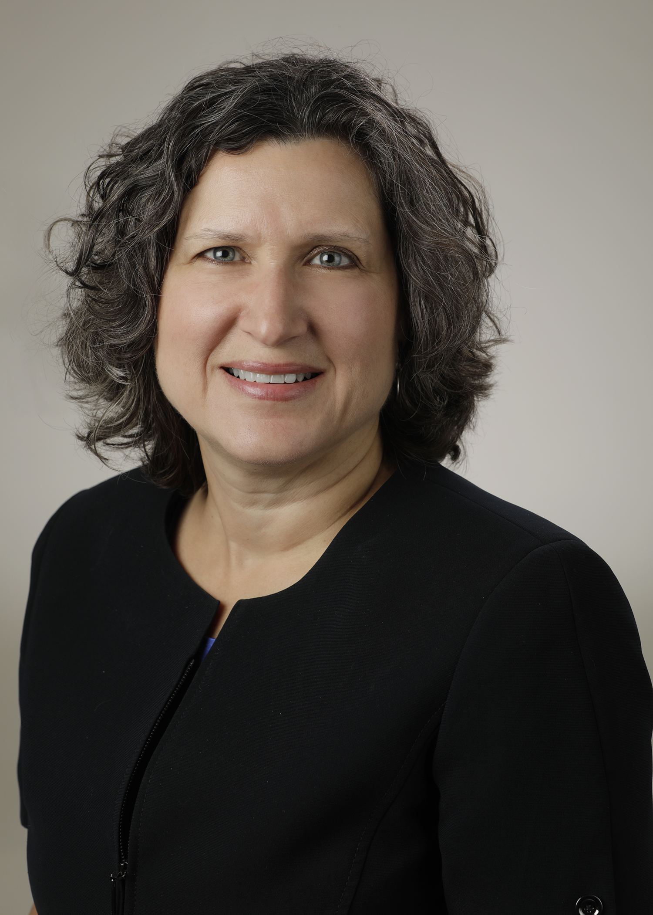
Introducing Your Presenter…
Heather Peters, M.Ed, Ph.D
GME Consultant
GME Director & DIO
Seasoned speaker at ACGME & subspecialty national meetings
Institutional and Program accreditation expertise
3 decades in education; Masters of Education in curriculum & evaluations, PhD concentration in secondary education & adult learning theories

Slide 3
Learning Agenda
Outline accreditation process for the Sponsoring Institution
Discuss build-out of GMEC and Sponsoring Institution infrastructure
Develop an understanding of connections that are vital to GME growth and development, including preparing for CLER visits
Review the preparations needed for the 2 year site visit from ACGME
Presented by Partners in Medical Education, Inc. 2019

Slide 4
Starting the Application
Application (2-3 months)
GMEC Minutes & Membership
1. Policies
2. Statement of Commitment
3. ORG Charts
IRQ (WebADS)
Presented by Partners in Medical Education, Inc. 2019

Slide 5
GMEC Development
Graduate Medical Education Requirements
Read about it in the Institutional Requirements
Talk to other training sites
On-Demand (Partners®) Webinars
Citations for not meeting all the requirements even though you only have a few meetings’ worth of minutes
Tool: GMEC Requirements Tracking Document
Presented by Partners in Medical Education, Inc. 2019

Slide 6
IRQ – Describing your Proposed SI
Details about:
Organizational structure
Ultimate authority – Board of ____
Timeline for proposed programs
Patient Safety
Quality Improvement
Professionalism
GMEC Structure, including subcommittees
Presented by Partners in Medical Education, Inc. 2019

Slide 7
Policies
Most of the required policies do not have to be included in the original application, however you need to write them because you will need them
Look for samples from other institutions
MedEd Portal (AAMC.org): database of policies
Vet them through Legal/HR – opportunity for education about residency programs/residents
These are included with the application:
AIR Process
Special Review Process
Supervision
Presented by Partners in Medical Education, Inc. 2019

Slide 8
ORG Charts
Governing Body
GMEC
DIO
Programs
Presented by Partners in Medical Education, Inc. 2019

Slide 9
Statement of Commitment
Signed by the Governing Board
Signed by DIO
Signatures dated
Frequent citations for not following directions on this document
Presented by Partners in Medical Education, Inc. 2019

Slide 10
Cautions
Don’t go too fast
Start your GMEC as soon as you start thinking about having a sponsoring institution
Hire a DIO and GME Director/Manager before you start the application
TIP: Have GMEC members review the application before submission.
Presented by Partners in Medical Education, Inc. 2019

Slide 11
GMEC
Role
Responsibilities
Oversight of programs
Oversight of CLE (Clinical Learning Environment)
Voting
Minutes
Tracking Responsibilities
Presented by Partners in Medical Education, Inc. 2019

Slide 12
Infrastructure Development
Scholarly Activity
Personnel Development
Physical Resources
Program Development
GME Department (DIO & Director/Manager of GME)
Program Directors
Coordinators
Faculty
Faculty
Residents
Call Rooms
Work Rooms
Clinic space
Office space
OR/Simulation
Technology
Educational Spaces
Application
Hiring PD/Faculty
Finance/Budget
TOOL: Project Tracking Document Sample
TIP: Project Managers are very beneficial at this stage
Presented by Partners in Medical Education, Inc. 2019

Slide 13
Personnel Development
GME Department
DIO
GME Director/Manager
Program Directors
Coordinators
Faculty
Core
Faculty
Presented by Partners in Medical Education, Inc. 2019

Slide 14
Resources
Educational Spaces (conference rooms, computer labs)
Call rooms – account for all the possible nighttime residents at the build-out of all programs
Resident workrooms
Continuity Clinics/Clinic space
Office spaces (chief residents, faculty, program directors, coordinator, GME staff)
Technology (Residency Management Systems for evaluations & schedules; computers for services; computers for offices
Specialty Specific: EM; General Surgery; Orthopedics
Lactation spaces
Disabilities accommodations in the physical plant
Presented by Partners in Medical Education, Inc. 2019

Slide 15
Program Development
Hiring
Program Directors
Faculty
Coordinator
Application
Educational program = Block Diagram
Specialty Information
Evaluations
Policies
Faculty Roster
Develop/Coordinate Resources
Physical
Technology
Presented by Partners in Medical Education, Inc. 2019

Slide 16
Scholarly Activity
IRB
Research Department
Champions for Scholarly Activity
Support for Scholarly Activity
Faculty
Residents
Coordinators
TIP: Lobby for Research Director to support the Scholarly Activity Build-out
Presented by Partners in Medical Education, Inc. 2019

Slide 17
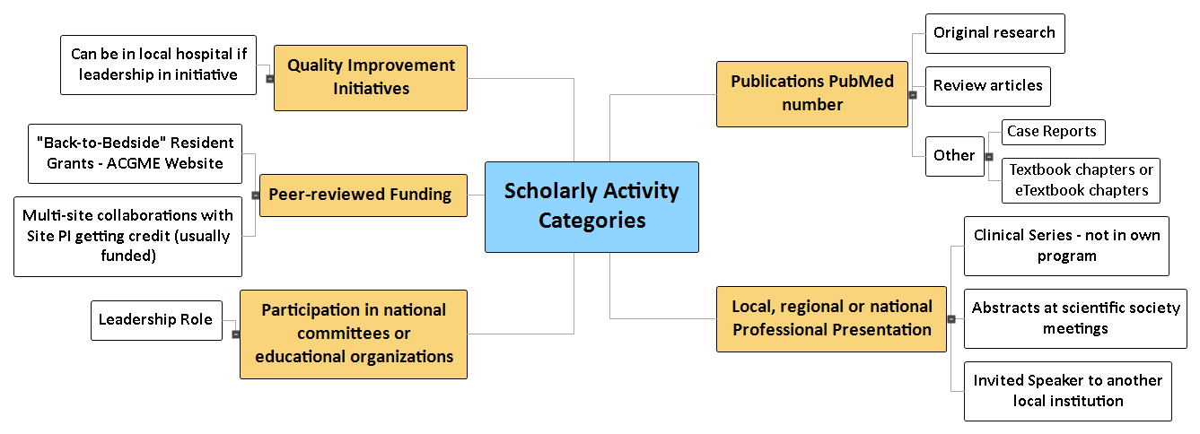
Scholarly Activity Categories
Presented by Partners in Medical Education, Inc. 2019

Slide 18
Education & Connection
C-Suite
CMO
CNO
COO
Clinical Departments
Nursing
Radiology
Pharmacy
Non-Clinical Departments
Medical Library
Human Resources
Employee Health
Legal
Risk
TIP: Include representatives on GMEC to expand the conversation and lead to better GME-Organization connections
Presented by Partners in Medical Education, Inc. 2019

Slide 19
Clinical Learning Environment Concepts
Integration of GME into organization
READ! READ! READ!
Visits will start after you receive “continued accreditation”
Health Care Quality & Health Care Disparities
Patient Safety
Supervision
Care Transitions
Professionalism
Wellbeing
Presented by Partners in Medical Education, Inc. 2019

Slide 20
Two Year Site Visit
ORG Charts
GMEC Minutes & GMEC Membership
Policies
Interviews:
DIO
GMEC
Program Directors
C-Suite
Presented by Partners in Medical Education, Inc. 2019

Slide 21
Take Home Points
Sponsoring Institutions are complex entities
Webinars
Conferences (ACGME, AHME)
ACGME.org (CLER, Well-being, Site Visits)
Journal of GME (JGME)
Requirements (Institutional, Common, Program)
Building relationships in the first 2 years is key to long-term sustainability
“You don’t know what you don’t know”
Get help from those who have gone ahead…
Presented by Partners in Medical Education, Inc. 2019

Slide 22
Upcoming Live Webinars
Special Reviews: Helpful not Hurtful Thursday, June 6, 2019 12:00pm – 1:00pm EST 2019 CPR Part 3 of 4: Section IV & Section V Tuesday, June 18, 2019 12:00pm – 1:00pm EST
GME is Not Just GME Tuesday, July 9, 2019 12:00pm – 1:00pm EST
SI 2025 Part 4 of 4: Strategic Planning Thursday, July 18, 2019 12:00pm – 1:00pm EST
On-Demand Webinars
2019 CPR Part 1 of 4: Overview
SI 2025 Part 1 of 4: Introduction & Overview
Onboarding the New Coordinator
2019 CPR Part 1 of 4: Overview
AIMs and Action Plans
SI 2025 Part 2 of 4: Changes on the Horizon
Ask Partners – Spring Freebie
Understanding the CLE
Onboarding the New Program Director
NEW Faculty Development Series
Contact us today to learn how our Educational
Passports can save you time & money!
724-864-7320
www.PartnersInMedEd.com
15 Minutes to Effective Feedback
22

Slide 23
Partners in Medical Education, Inc. provides comprehensive consulting services to the GME community.
Partners in Medical Education
724-864-7320 | info@PartnersInMedEd.com
Heather Peters, M.Ed, Ph.D
heather@partnersinmeded.com
www.PartnersInMedEd.com

