Slide 1
CLER
PARTNERS IN MEDICAL EDUCATION, INC.
Presented by: M. Shirley Meade
GME Consultant

Slide 2
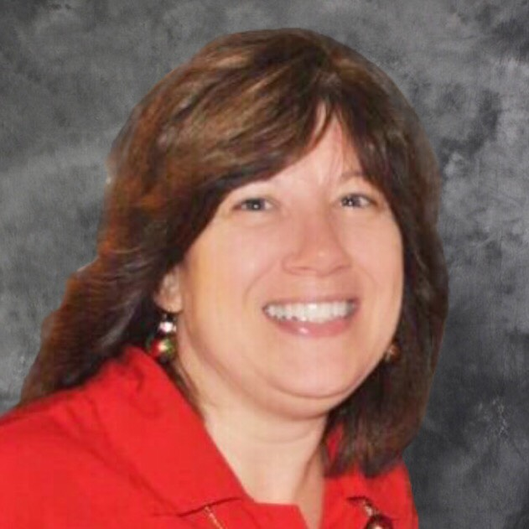
Introducing Your Presenter…
M. Shirley Meade
GME Consultant
Over 25 years of Graduate Medical Education (GME) experience.
Began career as a Program Coordinator in Internal Medicine at a University Hospital.
Has worked in the Institution office with the Designated Institution Official (DIO) in a University Hospital and in a Suburban Hospital spanning 15 years.
Is currently the Operations Manager of GME and Medical Education at Abington
Hospital - Jefferson Health.

Slide 3
Objectives and Goals
Understand and prepare your Institution for a CLER visit
Identify opportunities for improvement

Slide 4
CLER Visit
The Accreditation Council for Graduate Medical Education (ACGME) recognizes the public's need for a physician workforce capable of meeting the challenges of a rapidly evolving health care environment.
The ACGME has responded to this need by implementing the CLER program as a part of its Next Accreditation System. The CLER program is designed to provide US teaching hospitals, medical centers, health systems, and other clinical settings affiliated with ACGME-accredited institutions with periodic feedback that addresses the following six focus areas: patient safety; health care quality; care transitions; supervision; clinical experience and education (formerly duty hours) and fatigue management and mitigation; and professionalism.
Source: http://www.acgme.org/What-We-Do/Initiatives/Clinical-Learning-Environment-Review-CLER

Slide 5
WHY?
FOCUS AREAS assess sponsoring institutions (SI) in the following focus areas:
Patient Safety
Health Care Quality
Care Transitions
Supervision
Clinical Experience and Education (formerly duty hours)
Fatigue Management, Mitigation
Professionalism

Slide 6
CLER Visit
Source: http://www.acgme.org/What-We-Do/Initiatives/Clinical-Learning-Environment-Review-CLER

Slide 7
CLER Visit
Length of site visit
CLER site visits are short-notice visits.
The only accreditation requirement associated with this new program is that each SI must undergo a CLER visit every 24 to 36 months to maintain accreditation.
Black out dates

Slide 8
WHO?
CEO and DIO (required)
Chief Medical Officer (CMO)
Chief Nursing Officer (CNO)
Chair and Resident member of the GMEC
Chief Operating Officer (COO)
Chief Financial Officer (CFO)
Dean of affiliated medical school

Slide 9
Preparation with Site Visitor
DIO will work out details for agenda with the site visitor
Upload Pre-Visit Background documentation to ADS
Organizational charts
Supervision policy
Duty hour policy
Care transitions policy
Patient safety protocol/strategy
Quality and safety committee membership rosters
DIO’s most recent annual report to the SI governance

Slide 10
Preparation with Hospital
Communication is key.
Peer selected residents PGY2’s and above, residents for Rounding
Meeting room logistics
Security Badges
Meal and snacks
Parking

Slide 11
Preparation with Hospital
ID badges for the site visitors
Safety Call (informational)
Tours for Rounding
CLER Team
Internal team includes: DIO, Patient Safety & Quality Officer, Vice President, Chief of Staff Office, Regulatory Director, Residency Coordinator, Department Administrative Director, GME staff
What work does the internal CLER Team do?

Slide 12
Hospital Staff Preparation
Who are the site visitors and why?
Getting everyone to know the language:
Programs, Physicians, Residents,
Nursing, Staff, and Others.
HANDOUT #1 (Pocket Cards)
Focus areas
Does everyone know what are you doing?

Slide 13
Successful Tips & Pearls of Wisdom
If you don’t understand a question – ask for clarification. If asked a question more than once, don’t automatically think you are wrong and change your answer.
Avoid words such as “usually” and “sometimes” or “well I do ….”
Answer only what is asked. Don’t volunteer additional information.
Allow the site visitor to ask follow-up questions

Slide 14
Successful Tips & Pearls of Wisdom
It is OK to say “I don’t know, but I’ll find out” and get the information for them! If you are not sure, don’t guess!
Don’t speak to another department’s process. Offer to get a representative from that department to come speak with the surveyor.
Be honest.

Slide 15
CLER Report and National Findings
The feedback provided by the CLER program is designed to improve how clinical sites engage resident and fellow physicians in learning to provide safe, high quality patient care.
What do you do with the information?
Read the report and compare to National Findings
Who do you share this information with?
What action plans do you develop?
HANDOUT #2 (Assessment)

Slide 16
Education
Know the ACGME CLER REQUIREMENTS

Slide 17
Continuous Work
ACGME CLER website & Pathways to Excellence
CLER Team
GMEC Agenda
AIR
APE
Program Directors, Physicians, Coordinators, Residents, Management Team includes Nursing Directors and Managers

Slide 18
Questions?

Slide 19
Upcoming Live Webinars
Project Management
Tuesday, December 13, 2016
12:00pm – 1:00pm EST Initial ACGME Accrediation? Now What?
Thursday, January 12, 2017
12:00pm – 1:00pm EST ABC’s of Remediation
Thursday, January 26, 2017
12:00pm – 1:00pm EST The Stress Free Recipe: Dealing with Burnout
Tuesday, February7, 2017
12:00pm – 1:00pm EST
www.PartnersInMedEd.com
Partners® Snippets
On-Demand Webinars
GMEC Check-Up: Is your GMEC
meeting its responsibilities?
A Proactive Approach to Supervising Residents Improves Patient Safety
New Institutional Accreditation:
Let’s Get Started!
Dealing Effectively with the
Struggling Medical Learner
Special Review: Required and Useful
Osteopathic Recognition
Fatigue Management & Mitigation
Contact us today to learn
how our Educational Passports can save you time & money!
724-864-7320

Slide 20
Partners in Medical Education, Inc. provides comprehensive consulting services to the GME community.
Partners in Medical Education
724-864-7320 | info@PartnersInMedEd.com
www.PartnersInMedEd.com

