Slide 1
Improving Teamwork in Graduate Medical Education
Pamela Royston, PhD
Consultant

Slide 2
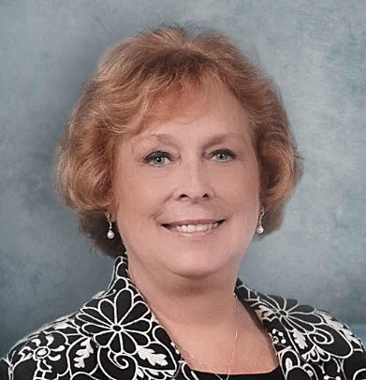
Introducing Your Presenter…
Pamela Royston, Ph.D
DIO, GME & Finance Expert
Over 25 years experience in medical education, both undergraduate and graduate
Institutional, Program, FQHC start-up and maintenance
National Speaker GME Accreditation and Financing
Ph.D - A.T. Still University

Slide 3
Learning Objectives
To identify the characteristics of effective and ineffective teams
To examine the motivations and roles of team members
To understand stages of team development
To consider expectations placed on work teams and obstacles to effectiveness
To identify and practice the skills that enable members of a team to work together successfully

Slide 4
Why team work?
Together Everyone Achieves More
Never doubt that a small group of thoughtful, committed people can change the world: indeed it is the only thing that ever has. Margaret Mead
Innovation is simply group intelligence having fun
Tom Peters

Slide 5
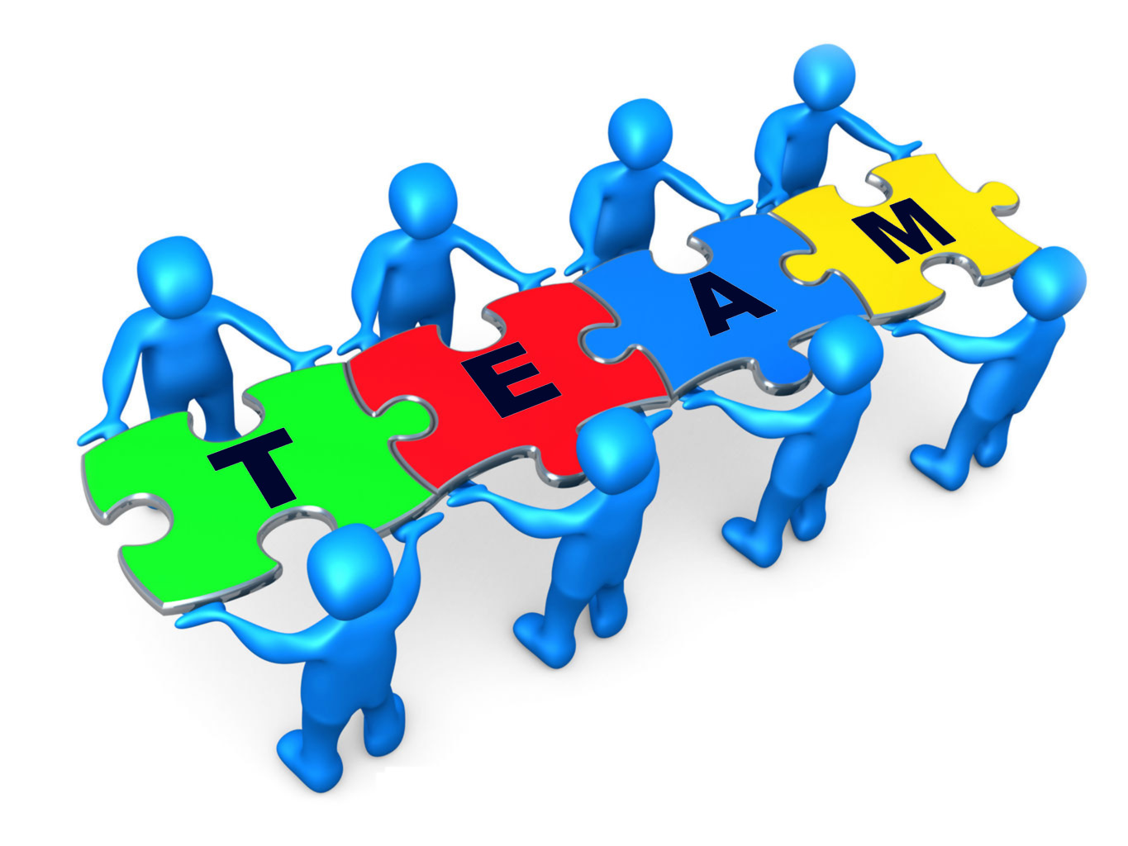
What is teamwork?
How would you define it?
What do we think of as the qualities of a good team?

Slide 6
What makes an effective team?
Basic Elements of Effectiveness:
Shared goals
Good Communication & Social Skills
Positive Interdependence: We instead of me
Individual Accountability/ Personal Responsibility
Group Processing
Processes for Conflict Resolution

Slide 7
Motivation Maters
Think about how your teams work- why are people there?
Are some salaried and some hourly?
Do they represent primary care programs, surgical programs, or fellowships?
Is there potential for conflict because of this?
How can this be dealt with?

Slide 8
Team Roles
Action Oriented Roles | Shaper | Challenges the team to improve.
 | Implementer | Puts ideas into action.
 | Completer Finisher | Ensures thorough, timely completion.
People Oriented Roles | Coordinator | Acts as a chairperson.
 | Team Worker | Encourages cooperation.
 | Resource Investigator | Explores outside opportunities.
Thought Oriented Roles | Plant | Presents new ideas and approaches.
 | Monitor-Evaluator | Analyzes the options.
 | Specialist | Provides specialized skills.
http://www.belbin.com/about/belbin-team-roles/

Slide 9
Stages of Team Development
Forming
Storming
Norming
Performing

Slide 10
Stages of Team Development
Forming
Storming
Norming
Performing

Slide 11
Stages of Team Development
Forming
Storming
Norming
Performing

Slide 12
Stages of Team Development
Forming
Storming
Norming
Performing

Slide 13
Stages of Team Development
Forming
Storming
Norming
Performing

Slide 14
Building a Team
How to help your team:
get acquainted and feel comfortable with their fellow members
develop ground rules and norms for the team
communicate and work cooperatively
facilitate the sharing of information and expectations between members
begin trusting each other

Slide 15
Basic Team Skills
The following features are fundamental to good teamwork:
trust: making sure you meet all commitments and maintain confidentiality when required
coaching: using your skills, knowledge and experience to assist others or ask for help
sharing information: to assist others do their job
flexibility: show a willingness to cooperate and help others when possible
good manners: doing small, simple things, eg. thanking colleagues for their help

Slide 16
Listening Responsively
Listening is part of assertive behavior: ·
Aggressive: always talks·
Assertive: listens and talks appropriately·
Passive: always listens
How can you use questions to check that you have understood?

Slide 17
Speaking Confidently
Team members contribute with honesty and integrity even though they disagree.
Be confident - but consider what you say may be crucial or may be wrong.
‘Play the ball but not the person’ - disagree with an idea not the person who thought of it.
Acknowledge other people’s ideas and contributions and build on them.
Speak with enthusiasm not emotion.

Slide 18
Conflict Resolution
Because of an inability to resolve conflict the team may splinter and sub-groups may form.
Anticipate conflict, know why it arises and have personal and team strategies to deal with it.
Importance of protocols to manage conflict and other problems
"Don't blame the people. Blame the system"

Slide 19
GME Teamwork - Ideas
Standardization of work
Naming conventions
Files
Evaluations
Semi-annual reviews
Annual Program Review
Recruitment
ERAS
Interviews
Applicant communication
On-boarding
Check lists
Contracts

Slide 20
GME Teamwork - Ideas
Standardization of work
Orientation
Graduation
Meetings – agendas and notes
Coordinator Development
Wellness
Best practices
Dissemination of conference information
Quality Improvement Projects – Dissemination

Slide 21
Focus on Team Goal
During formation start with “why”!
We are committed to providing outstanding support and learning environment for our residents/fellows!

Slide 22
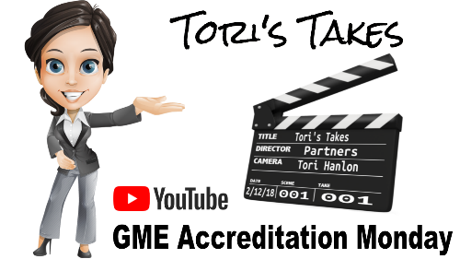
On-Demand Webinars
Ask Partners - Spring Freebie
Building a Scholarly Activity Infrastructure at a Community Based Institution
ACGME Check-Up for Programs and Institutions
Recruitment Strategies
CLER
Journey from Initial Accreditation to Continued Accreditation
Resident Remediation
DIO Competencies
Upcoming Live Webinars
Responsiveness to Diverse Patient Populations Thursday, August 2, 2018 12:00pm – 1:00pm EST
Demystifying the Resident and Faculty ACGME Survey Thursday, August 16, 2018 12:00pm – 1:00pm EST
Oversight of the Clinical Learning and Working Environment Tuesday, August 28, 2018 12:00pm – 1:00pm EST
www.PartnersInMedEd.com
Contact us today to learn
how our Educational Passports can save you time & money!
724-864-7320

Slide 23
Partners in Medical Education, Inc. provides comprehensive consulting services to the GME community.
Partners in Medical Education
724-864-7320 | info@PartnersInMedEd.com
Pam Royston, PhD, Consultant
Pam@PartnersInMedEd.com
www.PartnersInMedEd.com

