Slide 1
CPR 2019 Part 4 of 4: Putting It All Together
Christine Redovan, MBA -- GME Consultant
Heather Peters, M. Ed, PhD -- GME Consultant

Slide 2
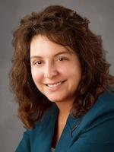
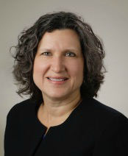
Partners Consulting Team
Christine Redovan, MBA
GME Consultant
Heather Peters, M.Ed, Ph.D
GME Consultant
GME Director & DIO
Seasoned speaker at ACGME & sub-specialty national meetings
Institutional and Program accreditation experience
3 decades in education; Masters of Education in curriculum & evaluations, PhD concentration in secondary education & adult learning theories
15+ years GME Operations, Accreditation and Management success
Focused on continual readiness and offering timely and useful GME resources

Slide 3
Learning Objectives
Provide Best Practices for the following sections:
Faculty Roster
Clinical Sites
Faculty Development Topics
Diversity Questions
Scholarly Activity
Discuss GME Databook (ACGME)

Slide 4
Two Three Versions: 1 Resident and 2 Fellow
Developed to address inherent differences between specialty (core) and sub-specialty (fellowship) training
Residency version for all core specialties – regardless of length of training
Fellowship version for subspecialties – two or more years length of training
Fellowship version for subspecialties – one year length of training
Intent is the same; difference is mainly operational in nature
Notes:
1

Slide 5
Implementation Table from ACGME
Guidance from ACGME for Sections I-V
July 1, 2019
July 1, 2020
Different tables for residents & fellows
Use as inventory tool: Good way to document what you have/need for each program.
Section VI has its own table of implementation dates:
July 1, 2017
July 1, 2019
Link: https://www.acgme.org/What-We-Do/Accreditation/Common-Program-Requirements

Slide 6
CPR Section VI Update: Supervision Policy & Site Visits
Policies and Procedures for residents at each training site
Supervision policies for each site
We are starting to see this request for NEW programs. Unclear if this will also apply to 10 year, or other types of site visits.

Slide 7
Faculty Roster

Slide 8
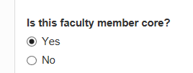
Identifying Core Faculty
What is the new definition of core faculty?
Core Faculty:
Core faculty members must have a significant role in the education and supervision of residents and must devote a significant portion of their entire effort to resident education and/or administration, and must, as a component of their activities,
teach,
evaluate, and
provide formative feedback to residents.
They support the program leadership in
developing,
implementing,
assessing curriculum, and
assessing residents’ progress toward achievement of competence in the specialty.
Core faculty members should be selected for their broad knowledge of and involvement in the program, permitting them to effectively evaluate the program.
Notes:
How strategically do we need when determining core faculty?
Will the ratio reporting be as important?

Slide 9
Faculty Tab Pull-Down (ADS):
Add Faculty
View Faculty Roster
Scholarly Activity
Manage Core Faculty
All faculty must:
Be role models of professionalism
Demonstrate commitment to the delivery of safe, quality, cost effective, patient-centered care
Demonstrate a strong interest in the education of residents
Devote sufficient time to the educational program to fulfill their supervisory and teaching responsibilities
Administer and maintain an educational environment conducive to educating residents
Regularly participate in organized clinical discussions, rounds, journal clubs, and conferences
Pursue faculty development designed to enhance their skills at least annually
Establish and maintain an environment of inquiry and scholarship
Notes:
The first 3 tabs were there previously. The new one is the “manage core faculty”
This allows you to select core faculty in a more expedient manner than to go into each faculty profile to click the option for core faculty.

Slide 10
Adding Faculty Members
This the interface for adding new faculty members.
Caution: When putting a faculty in the system for the first time, be careful about spelling and capitalization – mistakes in names are difficult to fix and require contacting the ACGME ADS once submitted.

Slide 11
View Faculty Roster
This is on the top of the roster. Be sure to read the sections for more details about the various aspects of the faculty roster. There are important directions that often get overlooked.
These buttons are very useful. The Reorder button puts the faculty in the correct order. This is a “quick sort” and you have to remember to SAVE to get back to the faculty roster
The PRINT button creates a table that allows you to view certain info about the faculty. It’s much easier to see where there might be possible issues.

Slide 12
Updating Board Certification Dates
The best options:
Get training from someone else your specialty on how to find the most current certification info on the Board of ___ website
Contact your institution’s medical staff office and ask them
Contact the faculty member – last resort

Slide 13
Clinical Sites

Slide 14
What’s new for 2019?
Site Director (make sure on roster!)
PLA date (make sure within past 10 years)
Lactation facilities
Accommodations for disabilities
This Photo by Unknown Author is licensed under CC BY-SA

Slide 15
Tips from the field
Site descriptions
Why are the residents going there?
Include board certified faculty, patient volume and variety, any related accolades
Show the rationale
Number of months at site
MUST match the block schedule
MUST match the PLA

Slide 16
Examples
Bad: The resident goes there for peds.
Good: Residents rotate at this site for 2 months of their training for general pediatrics. The outpatient clinic houses 20 board-certified general and specialty pediatricians that see over 50,000 pediatric patients each year. Patients range from routine visits to patients dealing with acute and chronic disease related to treatments and/or genetic diseases. Faculty will supervise residents at all times. The hospital has won the best pediatric quality outcome award for the past 10 years.

Slide 17
Faculty Development Topics

Slide 18
Annual Faculty Reviews
TIP: Work with other programs and the SI to meet the extensive faculty development requirements
Clinical teaching abilities
Engagement with the educational program
Participation in faculty development
Clinical performance
Professionalism
Scholarly activities
Faculty Development:
as an educator
as supervisors of their residents and their own well-being
as patient safety and quality improvement drivers
As patient outcome improvement drivers based on their practice-based learning and improvement efforts

Slide 19
Sample Activities
Educators | Well-being | QI/PS | PBL | Inclusion
“Providing effective Feedback” (Faculty Retreat, April 19) “Teaching to the Generations” (Faculty Retreat, April 19) | Presentation about resident well-being program was provided at the Specialty Medical Group monthly meeting (January 19) Events attended by faculty & residents: annual picnic; welcome bar-b-cue | Error Prevention Training is required for all faculty at ABC hospital (18-19) | Review of clinical pathways during departmental meetings Evidence-based Medicine Forum (IPE Day May 19) | Diversity and Inclusion Snippet (Faculty Meeting, March 19) All faculty who participated in recruitment interviews participated in a discussion about diversity awareness and sensitivity (Fall 18)

Slide 20
Diversity
This Photo by Unknown Author is licensed under CC BY-NC

Slide 21
Diversity Questions
Diversity in Recruiting:
Giving priority to locals in recruitment processes
“Future physician” pipelines
Medical student clerkships (4th year)
Creating mission statements that commit to the concept of diversity and/or representing your patient population
Specific states have funding for diversity (i.e., CA; Song Brown funding)
Community activities to promote a connection to the region
Tracking underrepresented minorities as part of the APE – required by ACGME
Diversity of Personnel:
Recruit natives from your area that reflect the diversity of the patient population
Committees of the program/GMEC that have wide representation of healthcare careers (interprofessional) and reflect the patient population
TOOL: Johns Hopkins Diversity Wording
http://web.jhu.edu/dlc/resources/statements_diversity_inclusion/index.html

Slide 22
Diversity Examples
University of Virginia
UC Davis
AAMC – Diversity 3.0 Learning Series
This Photo by Unknown Author is licensed under CC BY-NC

Slide 23
Scholarly Activity

Slide 24
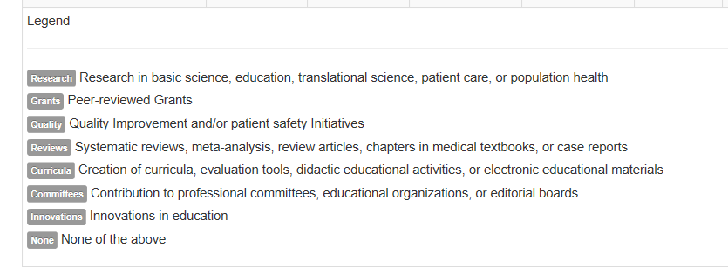
Scholarly Activity ADS Table
TIP: Create an email template that asks questions that elicit responses that fit in the ACGME ADS categories (see template)

Slide 25
Gathering and Housing Scholarly Activity
Discussion Topic
Now that programs have to provide scholarly activity for ALL faculty, new paradigms need to be discussed:
Using residency management systems to house scholarly activity
Creating internal database for scholarly activity
Educate faculty, program coordinators, and program directors about the domains of scholarly activity

Slide 26
ACGME Data Resource Book

Slide 27
ACGME Data Resource Book
Concise GME reference book
Available at acgme.org
No cost
Electronic editions from 2007 to present
Source: GME Data Resource Book. Retrieved from https://acgme.org/About-Us/Publications-and-Resources/Graduate-Medical-Education-Data-Resource-Book

Slide 28
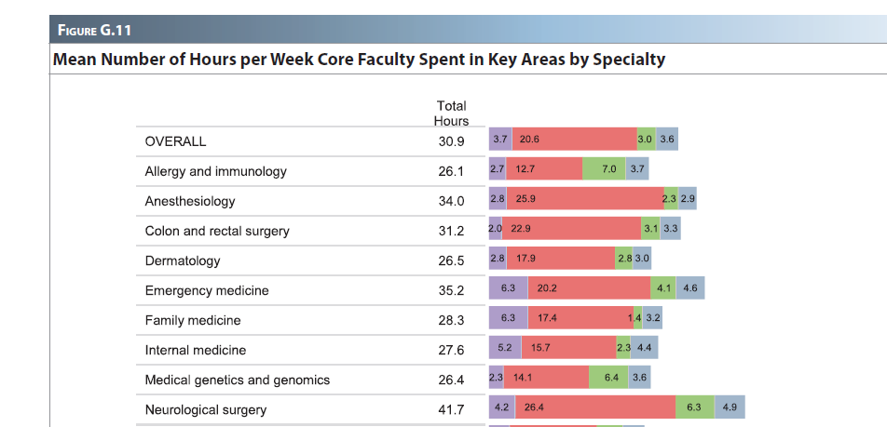
Faculty Hours Example
Source: GME Data Resource Book. Retrieved from https://acgme.org/About-Us/Publications-and-Resources/Graduate-Medical-Education-Data-Resource-Book

Slide 29
Diversity Example
Source: GME Data Resource Book. Retrieved from https://acgme.org/About-Us/Publications-and-Resources/Graduate-Medical-Education-Data-Resource-Book

Slide 30
Diversity Example
Source: GME Data Resource Book. Retrieved from https://acgme.org/About-Us/Publications-and-Resources/Graduate-Medical-Education-Data-Resource-Book

Slide 31
Diversity Example
Source: GME Data Resource Book. Retrieved from https://acgme.org/About-Us/Publications-and-Resources/Graduate-Medical-Education-Data-Resource-Book

Slide 32
Diversity Example
Source: GME Data Resource Book. Retrieved from https://acgme.org/About-Us/Publications-and-Resources/Graduate-Medical-Education-Data-Resource-Book

Slide 33
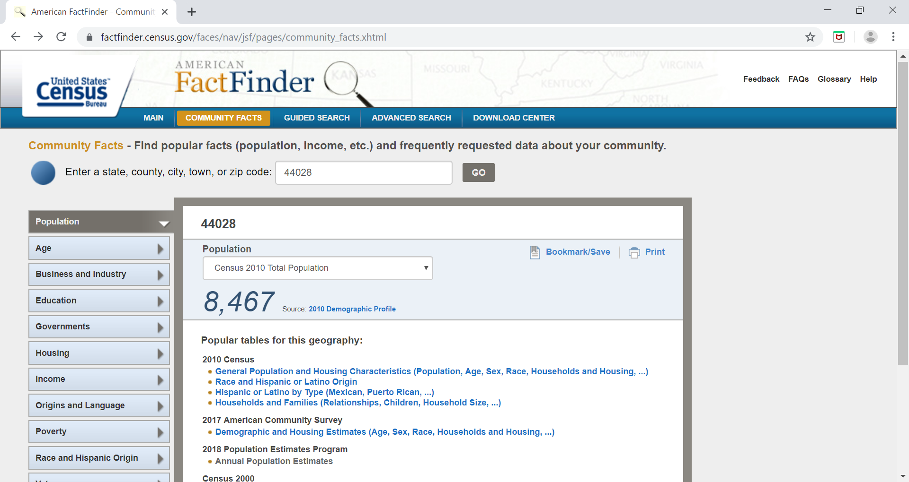
Diversity Example
Source: US Census Bureau. Retrieved from https://factfinder.census.gov

Slide 34
Take-Aways

Slide 35
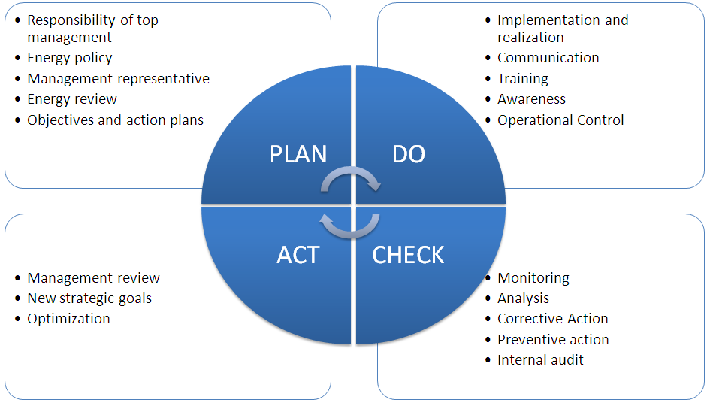
Final Thoughts…
Organization is key
Keep up with the data and tracking
Take small steps along the way
Use PDCA for any new things you try
Write up your experiences; share with GME community
Prepare for more changes coming…
This Photo by Unknown Author is licensed under CC BY-SA

Slide 36
Questions??

Slide 37
Upcoming Live Webinars
Crafting “Top-Notch” Goals, Objectives and Evaluations Thursday, September 12, 2019 12:00pm – 1:00pm EST
Feedback – From The Top Down Tuesday, September 17, 2019 12:00pm – 1:00pm EST
Evolving Resident Well-Being Tuesday, October 8, 2019 12:00pm – 1:00pm EST
We All Need Scholarly Activity, Including Coordinators Thursday, October 24, 2019 12:00pm – 1:00pm EST
On-Demand Webinars
2019 CPR Part 1 of 4: Overview
Aims and Action Plans
SI 2025 Part 2 of 4: Changes on the Horizon
Ask Partners – Spring Freebie
Understanding the CLE
CPR 2019 Part 2 of 4: Section I & Section II
SI 2025 Part 3 of 4: GME Evolution, Funding & Future
Building Your Sponsoring Institution – The First 2 Years
Special Reviews – Helpful not Hurtful
2019 CPR Part 3 of 4: Section IV & Section V
NEW Faculty Development Series
15 Minutes to Effective Feedback
Toolbox for Teaching Millennials
Contact us today to learn how our Educational
Passports can save you time & money!
724-864-7320
www.PartnersInMedEd.com
37

Slide 38
Partners in Medical Education, Inc. provides comprehensive consulting services to the GME community.
Partners in Medical Education
724-864-7320 | info@PartnersInMedEd.com
Heather Peters, M.Ed, Ph.D heather@PartnersInMedEd.com
Christine Redovan MBA christine@PartnersInMedEd.com
www.PartnersInMedEd.com

