Slide 1
Creating a Diverse Workforce
Pam Royston, PhD
Consultant

Slide 2
Introducing Your Presenter…
Pamela Royston, Ph.D
DIO, GME & Finance Expert
Over 25 years experience in medical education, both undergraduate and graduate
Institutional, Program, FQHC start-up and maintenance
National Speaker GME Accreditation and Financing

Slide 3
Learning Objectives
Discuss the need for a diverse workforce
Analyze data
Build an infrastructure that supports diversity
Develop partnerships to attract and build a diverse workforce
Assess diversity plan and progress

Slide 4
ACGME Common Program Requirements
“The program, in partnership with its Sponsoring Institution, must engage in practices that focus on mission-driven, ongoing, systematic recruitment and retention of a diverse and inclusive workforce of residents, fellows (if present), faculty members, senior administrative staff members, and other relevant members of its academic community.”^{I.C}

Slide 5
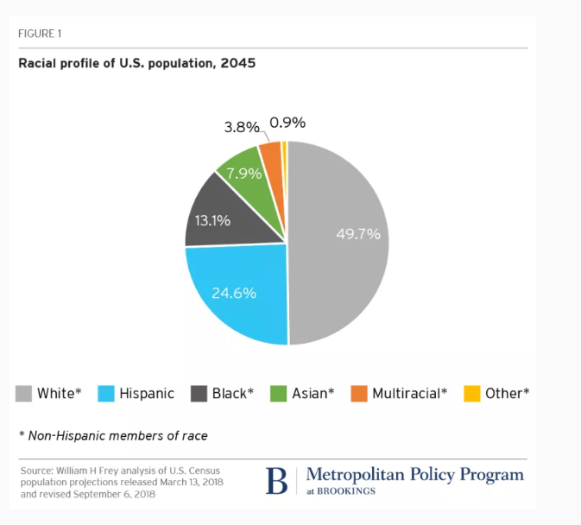
Changing Demographics

Slide 6
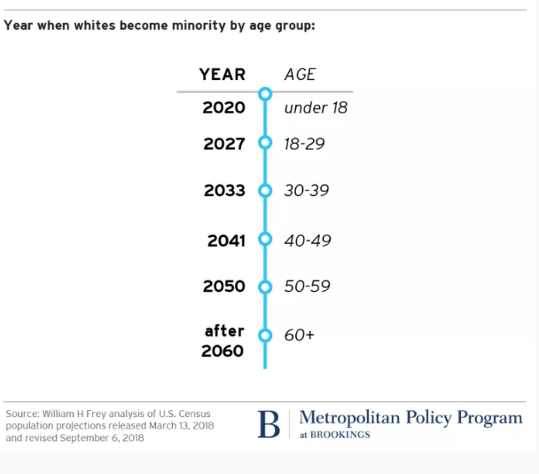
“Minority White” Changes Differ by Age

Slide 7
Health Care Should Be
Safe
Effective
Patient-Centered
Timely
Efficient
Equitable

Slide 8
Patient-Centered Care
Incorporates respect for patients’ values, preferences, and expressed needs
Is highly customized and incorporates cultural competence

Slide 9
Linking Patient-Centered Care to Diversity
What is the make up of your community?

Slide 10
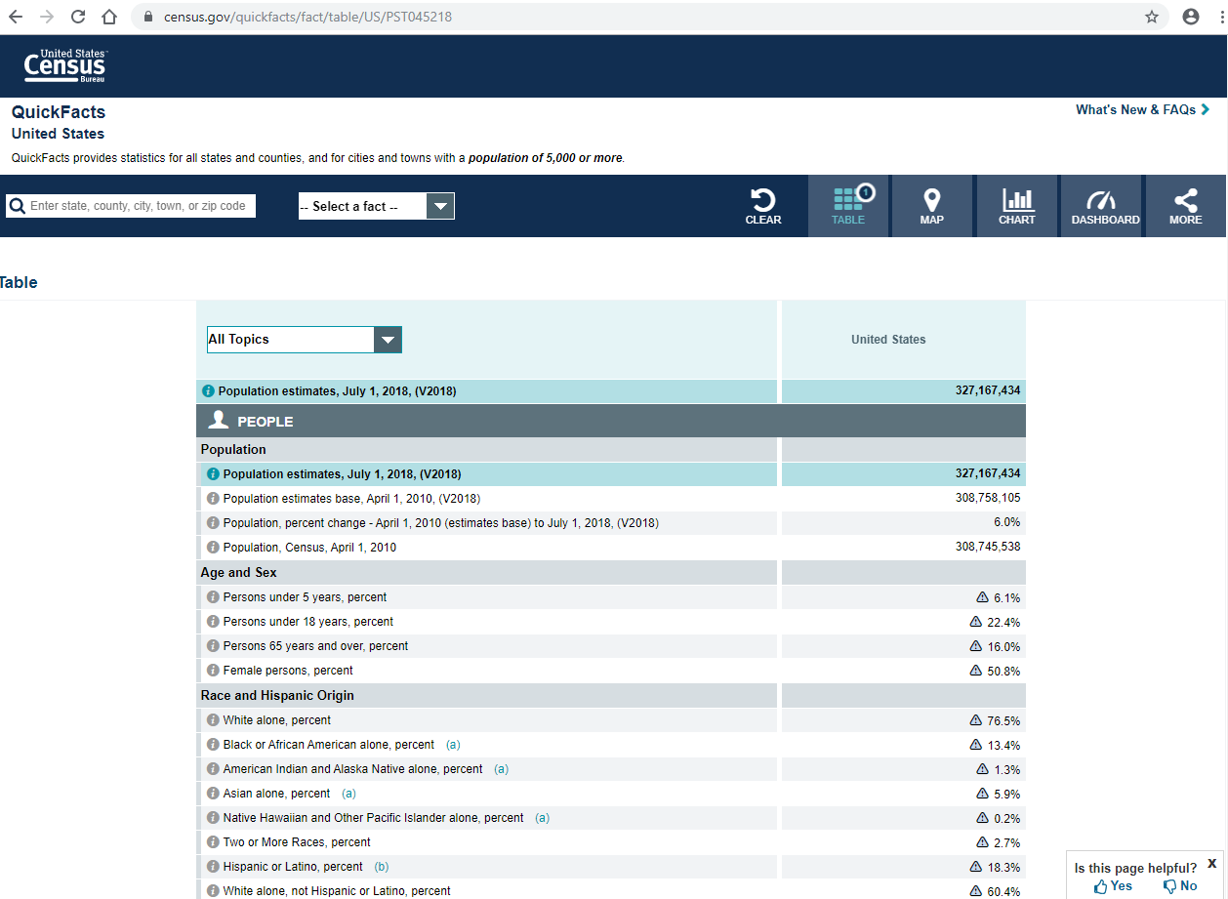
Census Data -https://www.census.gov/quickfacts/fact/table/US/PST045218

Slide 11
Drill Down for Data
Select your county

Slide 12
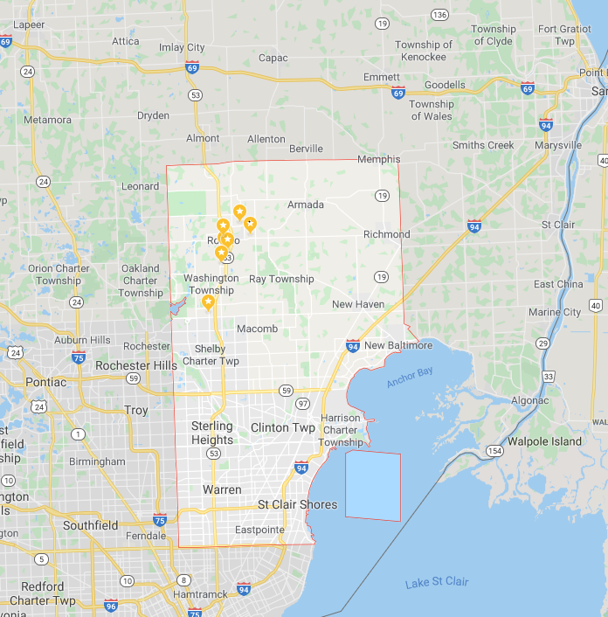
Community Data - Macomb County, Michigan

Slide 13
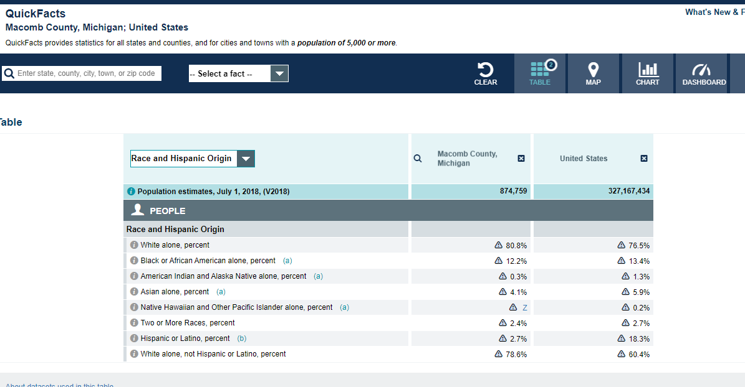
Quick Facts – Macomb County

Slide 14
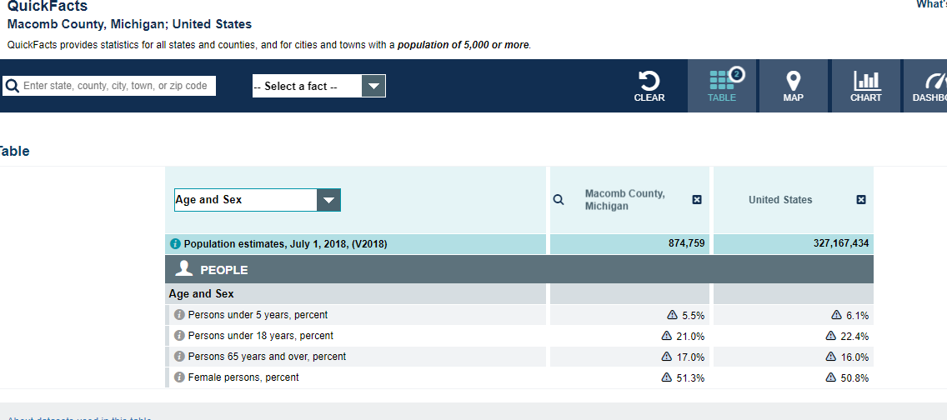
Quick Facts – Macomb Age & Sex

Slide 15
Quick Facts- Macomb

Slide 16
What happens if census data is not enough?
Search other sources:
Chamber of Commerce
County Departments
Health Department
Planning Commission

Slide 17
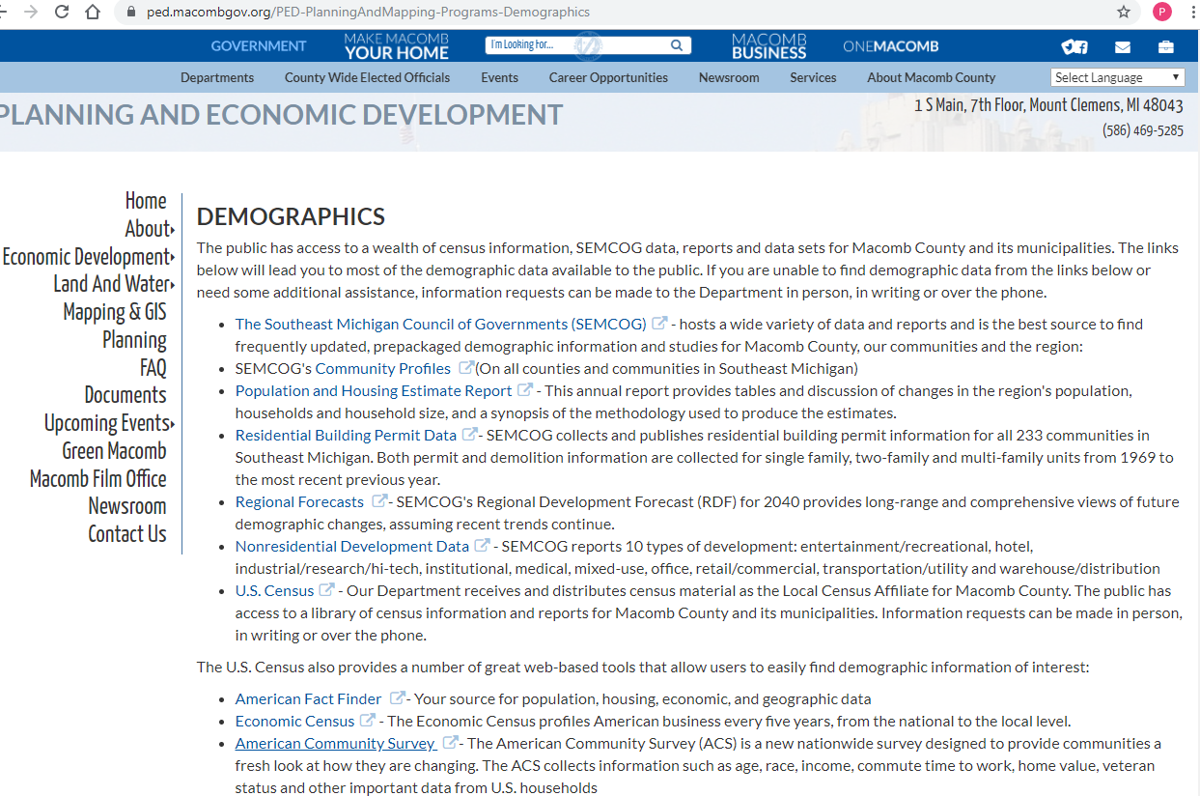
Macomb County - Data

Slide 18
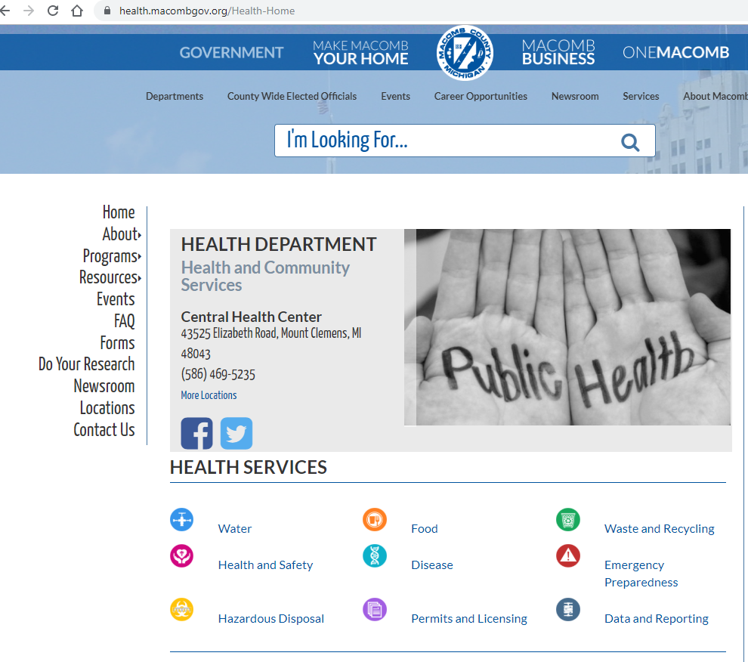
County Data

Slide 19
Linking Community Data to you Institution
Medical Staff – 468 active
58% Male
42% Female
86% White
9.6% Black
3.8% Asian

Slide 20
Residency / Program Data
Diversity | N/A [ ] | 2016-17 | 2017-18 | 2018-19
As part of the new Common Program Requirements, how will you address creating a diverse workforce? | % Male
 | % Female
 | % DO
 | % MD
 | % White
 | % Black
 | % Hispanic

Slide 21
Supporting Diversity
Discuss at GMEC
Data
Unconscious bias
Exclusion
Standing agenda item – resident diversity team

Slide 22
Supporting Diversity
Create Sense of Belonging
Female surgeons group/club
Minority group/club
LGBT group/club
Resident diversity team
Educational activities
Cultural Potlucks
Discussion about end and beginning of life events
Gender bias issues

Slide 23
Partnering for Diversity
Medical School Partnership
Interviewing
Pre-undergrad programs
SSTRIDE at Florida State University

Slide 24
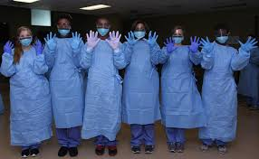
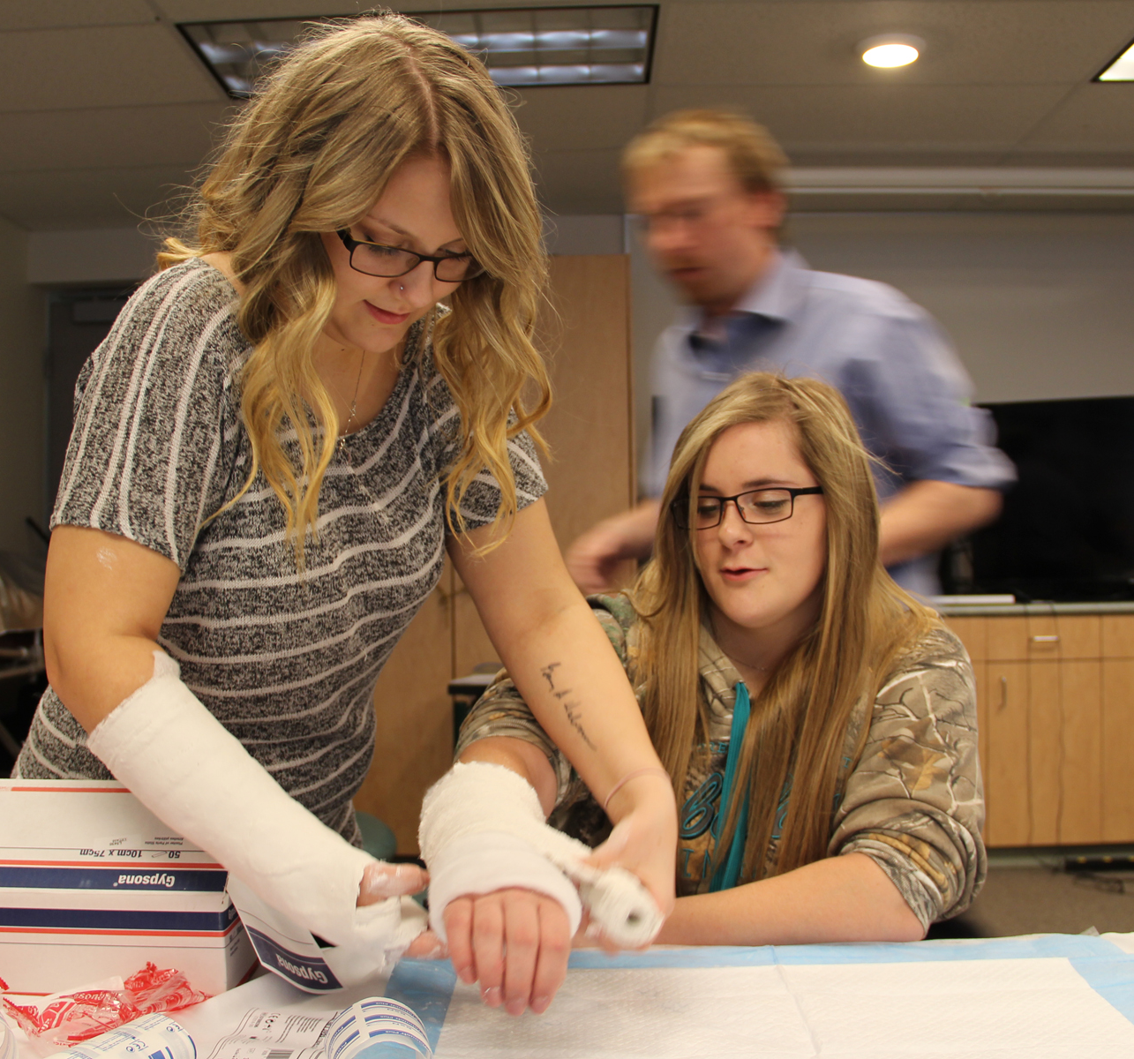
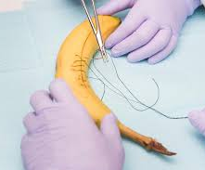
Partnering with High Schools
High school enrichment and mentoring programs
Casting clinic
Suturing clinic
Gowning clinic
Resident mentoring
Simulation centers
Assisting at free clinics

Slide 25
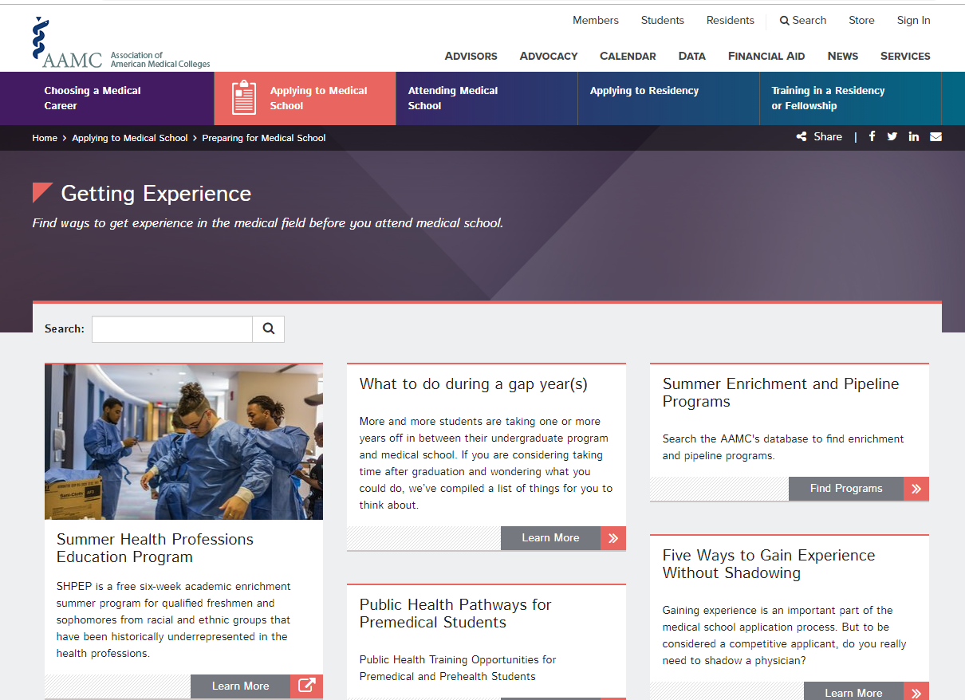
Partnering with Undergraduate Program

Slide 26
Partnering with the Community
Cultural Associations
Caribbean Cultural Organization
Chaldean
Chinese
Finnish Center Association
German
Islamic
Italian
North American Indian Assoc.
Korean
Polish

Slide 27
Recruitment Faculty & Resident
Review data of community
Review data of medical staff and program
Create a culture of diversity
Acceptance
Support
Create achievable goals
Increase females in surgery
Increase minorities as reflected in you community profile
Provide one high school enrichment experience

Slide 28
Review Plan
Include diversity in Annual Program Evaluation
Summarize data and present to GMEC
GMEC
Support diversity plan including achievable goals
Establish formal mentoring
Support Residency Diversity Committee – Standing item on agenda

Slide 29
Upcoming Live Webinars
APE Reconstructed Tuesday, January 7, 2020 12:00pm – 1:00pm EST
Digging for Data 101 Thursday, January 23, 2020 12:00pm – 1:00pm EST
PEC: Best Practices Tuesday, February 4, 2020 12:00pm – 1:00pm EST
On-Demand Webinars
Special Reviews – Helpful not Hurtful
2019 CPR Part 3 of 4: Section IV & Section V
GME Is Not Just GME
SI 2025 Part 4 of 4: Strategic Planning
Understanding Practice Data
CPR 2019 Part 4 of 4: Putting It All Together
Crafting “Top Notch” Goals, Objectives and Evaluations
Feedback – From the Top Down
Evolving Resident Well-Being
We All Need Scholar Activity, Including Coordinators
NEW Faculty Development Series
15 Minutes to Effective Feedback
Toolbox for Teaching Millennials
Taking Supervision to the Next Level
Contact us today to learn how our Educational
Passports can save you time & money!
724-864-7320
www.PartnersInMedEd.com
29

Slide 30
Partners in Medical Education, Inc. provides comprehensive consulting services to the GME community.
Partners in Medical Education
724-864-7320 | info@PartnersInMedEd.com
Pamela Royston, Ph.D
pamela.royston@partnersinmeded.com
www.PartnersInMedEd.com

