Slide 1
Creating a Robust Resident Evaluation System
Heather peters, M.Ed., PhD
GME Specialist
Partners in Medical Education Consultant

Slide 2
OBJECTIVES
Analyze your current resident evaluation systems
Discuss 360-degree evaluations (composition and best practices)
Develop a more in-depth understanding of the ACGME milestones
Explain the how the CCC and PEC are part of the evaluation system
Contemplate next steps on the journey to creating robust evaluation systems

Slide 3
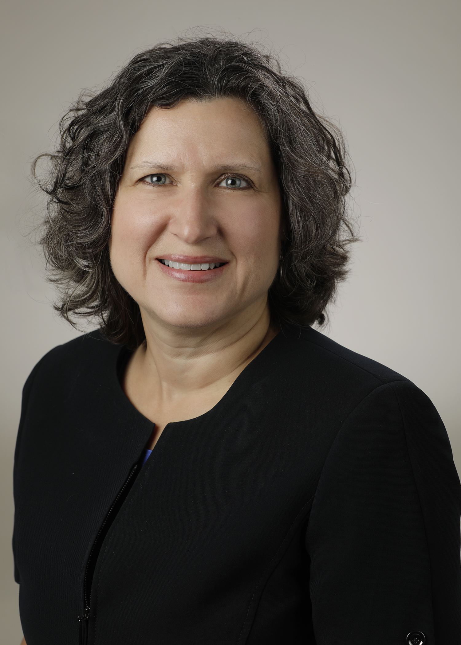
Introducing Your Presenter…
Heather Peters, M.Ed, Ph.D
GME Consultant
DIO & GME Specialist
Seasoned speaker at ACGME & sub-specialty national meetings
Areas of Expertise: Institutional and Program accreditation experience; Strategic planning; Annual Program Evaluation processes; Evaluation processes; and more
3 decades in education; Masters of Education in curriculum & evaluations, PhD concentration in secondary education & adult learning theories

Slide 4
EVALUATION SYSTEM ANALYSIS

Slide 5
PROGRAM ANALYSIS
Comprehensive
Validity
Efficiency

Slide 6
SAMPLE EVALUATION TABLE
Department Name: | PC | MK | PR | CIS | PBLI | SBP | Evaluators
End-of-Rotation Evaluations (by faculty) | X | X | X | X | X | X | Faculty
Ancillary Evaluations |  |  | X | X |  |  | Nurses PA NP
Patient Evaluations |  |  | X | X |  |  | Patients
Peer Evaluations | X | X | X | X | X | X | Peers
Self-Evaluations | X | X | X | X | X | X | Self
In-Training Exam |  | X |  |  |  |  | Other
Mini-CEX | X | X | X | X | X | X | Faculty

Slide 7
SHIFTING EVALUATION PARADIGMS
VARIABLE | STRUCTURE & PROCESS-BASED | COMPETENCY-BASED
Driving force for curriculum | Content—knowledge acquisition | Outcome—knowledge acquisition
Driving force for process | Teacher | Learner
Path of learning | Hierarchical (teacher—student) | Non-hierarchical (student –teacher)
Responsibility for content | Teacher | Student and teacher
Goal of educational encounter | Knowledge acquisition | Knowledge application
Typical assessment tool | Single subjective measure | Multiple objective measure (“evaluation portfolio”)
Assessment tool | Proxy | Authentic (mimics real tasks of profession)
Setting for evaluation | Removed (gestalt) | “In the trenches” (direct observation)
Evaluation | Norm-referenced | Criterion-referenced
Timing of assessment | Emphasis on summative | Emphasis on formative
Program completion | Fixed time | Variable time
Shifting paradigms: from Flexner to competencies. Acad Med 77(5):361-367; 2002

Slide 8
NEWER TOOLS
Point of Care
Mock Codes
TOC Evaluations

Slide 9
360 DEGREE EVALUATIONS “Multisource”
Definition: feedback regarding an employee's behavior from a variety of points of view (subordinate, lateral, and supervisory)
Purpose: use of 360-degree feedback helps to improve employee performance because it helps the evaluated see different perspectives of their performance

Slide 10
MULTISOURCE EVALUATIONS
Trainee
Self
Peer
Patient
Ancillary
Faculty

Slide 11
EVALUATION TABLE
Department Name: | PC | MK | PR | CIS | PBLI | SBP | Evaluators
End-of-Rotation Evaluations (by faculty) | X | X | X | X | X | X | Faculty
Ancillary Evaluations |  |  | X | X |  |  | Nurses PA NP
Patient Evaluations |  |  | X | X |  |  | Patients
Peer Evaluations | X | X | X | X | X | X | Peers
Self-Evaluations | X | X | X | X | X | X | Self
In-Training Exam |  | X |  |  |  |  | Other
Mini-CEX | X | X | X | X | X | X | Faculty

Slide 12
BEST PRACTICES
Beware of “halos” and “horns”
Trend 360-evaluations
Look at multiple ways
Ensure validity
Include traditional performance appraisals

Slide 13
BEWARE OF…
A
B
PARADOX OF ROLES
PARADOX OF GROUP PERFORMANCE
C
D
Measurement Paradox
Paradox of rewards

Slide 14
REFLECTION POINT
Multisource Evaluations
NOVICE: My program has started using multisource evaluations recently
BEGINNER: My program has used multisource evaluations for several years but we don’t always use the data to inform CCC meetings
INTERMEDIATE: Our multisource evaluations are reviewed for “halos and horns” and the comments are trended. Data from multisource evaluations are “weighted” so that the number of evaluations does not skew the results
EXPERT: At my institution I am the expert on multisource evaluations and how to use the data in an appropriate manner.

Slide 15
SELF & PEER EVALUATIONS
Self
Peer

Slide 16
CHALLENGES
Purpose – should be explicit to learners
Should contribute to summative assessment -- CAUTION
Moderation.
Unfair/inappropriate evaluations
Well-defined, publicly-available assessment criteria
Skill development

Slide 17
REFLECTION POINT
Self & Peer Evaluations
NOVICE: My program has been talking about peer/self evaluations but hasn’t implemented them
BEGINNER: My program has used self/peer evaluations and started to incorporate the data in the CCC review
INTERMEDIATE: My program uses the data from self/peer and now we starting to scrutinize the questions that we ask to be sure they provide the data that is useful to the CCC process
EXPERT: Our peer/self evaluations are tied to the rotations (senior to junior on service) and integral to our overall evaluation system

Slide 18
MILESTONES

Slide 19
Developmental Progression or Set of Milestones
Sub-competency
PC1. History (Appropriate for age and impairment)
Level 1 | Level 2 | Level 3 | Level 4 | Level 5
Acquires a general medical history | Acquires a basic physiatric history including medical, functional, and psychosocial elements | Acquires a comprehensive physiatric history integrating medical, functional, and psychosocial elements Seeks and obtains data from secondary sources when needed | Efficiently acquires and presents a relevant history in a prioritized and hypothesis driven fashion across a wide spectrum of pages and impairments Elicits subtleties and information that may not be readily volunteered by the patient | Gathers and synthesizes information in a highly efficient manner Rapidly focuses on presenting problem, and elicits key information in a prioritized fashion Models the gathering of subtle and difficult information from the patient
Milestone

Slide 20
CORE COMPETENCY TRAITS TABLE
PC (Patient Care) | MK (Medical Knowledge) | PROF (Professionalism) | ICS (Interpersonal & Communication Skills) | PBLI (Practice-Based Learning & Improvement) | SBP (Systems-Based Practice)
Problem prioritization | Differential diagnosis | Reliability | Communication with patients/parents | Self-directed learner | Teamwork
Information gathering/History taking | Interpretation of data | Responsibility | Communication with peers | Response to feedback | Recognition of system errors
Management plan | Knowledge of tests & procedures | Respect | Communication with interprofessionals | Critical reading skills | Cost containment
Procedural skills | Clinical knowledge | Teamwork | Communication within interprofessional teams | Teaching skills | Transitions of care
Consultant requests |  | Responsiveness (including texts, pages, emails) | Documentation | Point-of-care learning | Ability to navigate the healthcare system
Information synthesis |  | Record completion |  |  | Advocates for patients

Slide 21
CLINICAL COMPETENCY COMMITTEE
Current Tools used to inform Milestones
Tools to Transition in July-Dec 2017
Tools to Transition in Jan-June 2018
End-of-Rotation Evaluations
In-House
Testing
OpLogs
Patient Evaluations
Faculty Comments
Simulations
ITE
Nursing Evaluations
Student Evaluations
Clinical Competency Committee
Peer Evaluations
Prof Resp:
Eval Comp
Conf Att
Self
Evaluations
Operative/
Procedural
Forms
Assessment of Milestones

Slide 22
EVALUATIONS: CCC & PEC
CLINICAL COMPETENCY COMMITTEE
Use evaluations to determine the milestone level of each resident
Identify when the evaluations are not informing the milestones
PROGRAM EVALUATION COMMITTEE
Determine what evaluations should be assigned to gather the correct data for CCC
Create evaluations when specific milestones are not informed

Slide 23
MILESTONES TO EPAs
Identify core activities
Describe their functions
Develop a curriculum
Domains of
Competence
Competencies
Milestones
EPAs
PR1
PR2
PR3
Does
P
C
M
K
PR4
PR5
PR6
Shows how
I
C
S
P
R
PC1
PC2
PC3
Knows how
P
B
L
I
S
B
P
PC4
PC5
PC6
Knows
MK1
MK2
MK3

Slide 24
REFLECTION POINT
What level of milestone implementation describes you?
NOVICE: Just starting with milestones
BEGINNER: Have incorporated the milestones and CCC into program over the past year
INTERMEDIATE: Have integrated multiple evaluation methods that inform the CCC about milestones
EXPERT: I have mastered milestones and am looking for some ways to help my faculty/leadership understand milestones better

Slide 25
Academic Year Overview
PEC Review of Evaluation Program
Early review of PGY-1s & Transfers
Faculty Discussions
Compile MS Data
CCC Meeting #1
Faculty Discussion
Compile MS Data
CCC Meeting #2

Slide 26
NEXT STEPS
WHAT WOULD MAKE MY PROGRAM’S EVALUATIONS MORE ROBUST?

Slide 27
HOW ROBUST IS YOUR EVALUATION SYSTEM?
NOVICE: Just starting to get an understanding of my program’s evaluation system
BEGINNER: My program’s evaluation system is developed but I am not sure about its comprehensiveness, validity or efficiency
INTERMEDIATE: My program’s evaluation system is exemplary (comprehensive, valid and efficient)
EXPERT: My program’s evaluation system embodies best practices and I am often called upon to help other programs

Slide 28
A-HA MOMENTS

Slide 30
Upcoming Live Webinars Institutional Site Visit Prep Process Tuesday, January 9, 2018
12:00pm – 1:00pm EST
From APE to Self-Study… and Everything in Between Tuesday, January 23, 2018
12:00pm – 1:00pm EST
Healthcare Disparities in GME Institutions Thursday, February 8, 2018 12:00pm – 1:00pm EST
AOA to ACGME Accreditation: Best Practices and Challenges Tuesday, February 20, 2018 12:00pm – 1:00pm EST
www.PartnersInMedEd.com
Partners® Snippets
On-Demand Webinars
Can I Do That? Becoming an Integral Member of the GME Education Team - INST
Getting the Most Out of Your Resident Interview – INST APE for New Programs & AOA Transitional Programs The Millennial Learner
Quality Improvement: Are You Meeting the New Requirements 2017 Common Program Requirements Update Bullying in the Workplace
Meet the Experts - Fall Freebie
Contact us today to learn
how our Educational Passports can save you time & money!
724-864-7320

Slide 31
Partners in Medical Education, Inc. provides comprehensive
consulting services to the GME community.
Partners in Medical Education
724-864-7320 | info@PartnersInMedEd.com
Heather Peters, M.Ed, Ph.D
heather@partnersinmeded.com
www.PartnersInMedEd.com

