Slide 1
Critical Components of Your Institutional Application
PARTNERS IN MEDICAL EDUCATION, INC.
Presented by:
Lauren McGuire, MBA, C-TAGME

Slide 2
Introducing Your Presenter…
Lauren McGuire, MBA, C-TAGME
Administrative Director of Undergraduate and Graduate Medical Education
Hands-on experience obtaining and maintaining accreditation
In-depth understanding to complete and review Institutional/Program site visit documentation in addition to coordinating and preparing for site visits

Slide 3
Learning Objectives
Identify the appropriate pathway for Osteopathic Institutions to apply for ACGME approval
Assess the Pros and Cons of being an 'Early Converter' to ACGME accreditation
Apply for Pre-Accreditation Status
Understand the ACGME process for the review of Institutional Applications
Interpret the Institutional Requirements as they apply to the questions on the Institutional Application
Prepare and submit the Institutional Application

Slide 4
AOA Programs
Single Accreditation System
ACGME
ACGME Programs

Slide 5
Sounds Great….
What’s the Catch?

Slide 6
June 30, 2020
Must Achieve ACGME Initial Accreditation
All AOA Institutions
All AOA Programs
AOA Will No Longer Accredit GME programs

Slide 7
What is Pre-Accreditation?
A new term created under the ACGME, AOA, AACOM Agreement
Indicates that the program is undergoing the accreditation process
Remains under AOA approval during process
Institutions/Programs are granted pre-accreditation status upon submission of application

Slide 8
Ineligible for Pre-Accreditation Status?
Programs that Receive AOA Initial Approval After July 1, 2015 are not eligible for Pre-Accreditation Status.
AOA Programs whose:
Sponsoring Institution does not have ACGME Accreditation
Sponsoring Institution has not submitted the Institutional Application and been granted “Pre-Accreditation Status”

Slide 9
Pros and Cons of Early Adapters

Slide 10
PROs
AOA Faculty
ADS Annual Update
ACGME Fellowships
Milestones
CONs
OPTI Sponsoring Institution
Case Log Reporting
AOA
Co-Director
Resident & Faculty Surveys

Slide 11
Early Adapter PROs
AOA Certified faculty acceptable
D.O. graduates from programs with pre-accreditation status will be able to apply to ACGME advanced training programs
OPTIs are eligible to serve as a sponsoring institution if in compliance with ACGME institutional requirements.
Co-Directors are acceptable (must have one AOA certified Program Director and one ABMS Program Director appointed)
AOA Faculty
ACGME Fellowships
OPTI Sponsoring Institution
AOA
Co-Director

Slide 12
Early Adapter Cons Be Prepared for…
ADS Annual Update
Web-based system that collects data on institutional and program performance on an annual basis
“A logical trajectory of professional development in essential elements of competency…”
Reporting of resident case volume and diversity to achieve specialty specific minimum thresholds
ACGME administered surveys that collect anonymous feedback from your residents and faculty
Milestones
Case Log Reporting
Resident & Faculty Surveys

Slide 13
Clinical Learning Environment Review
Clinical Learning Environment
Quality
Safety
Health Care Disparities
Faculty Development

Slide 14
6 Focus Areas of CLER
Professionalism
Duty Hours Oversight
Supervision
Transitions in Care
Quality Improvement
Patient Safety

Slide 15
Flow of CLER Site Visit
Initial Meeting: Leadership
CPS/CQO Meeting
Walk Around I
Walk Around II
Walk Around III
Resident Meeting
Core Faculty Meeting
PD Meeting
Exit Meeting: Leadership

Slide 16
Pathways to Obtain ACGME Approval

Slide 17
AOA Programs with Matriculated Residents As of July 1, 2015
Sponsoring Institution Applies for ACGME Pre-Accreditation
Program Applies for ACGME Pre-Accreditation
Program Compliance is Assessed with Current ACGME Program Standards with AOA Exceptions*
*AOA Co-Director and Faculty Acceptable

Slide 18
AOA Approved, No Matriculated Residents As of July 1, 2015
Sponsoring Institution Applies for ACGME Pre-Accreditation
Program Applies for ACGME Pre-Accreditation
Program Compliance is Assessed with Current ACGME Program Standards

Slide 19
Programs with Initial AOA Approval After July 1, 2015
Program Cannot Apply for Pre-Accreditation
Must Follow Standard New Program Route for ACGME Accreditation

Slide 20
Let’s Begin the Application Process…

Slide 21
Intent to Apply for Institutional Accreditation
Upon submission:
Grants the DIO access to the ACGME WebADS online system!

Slide 22
Who is your Institution's DIO?

Slide 24
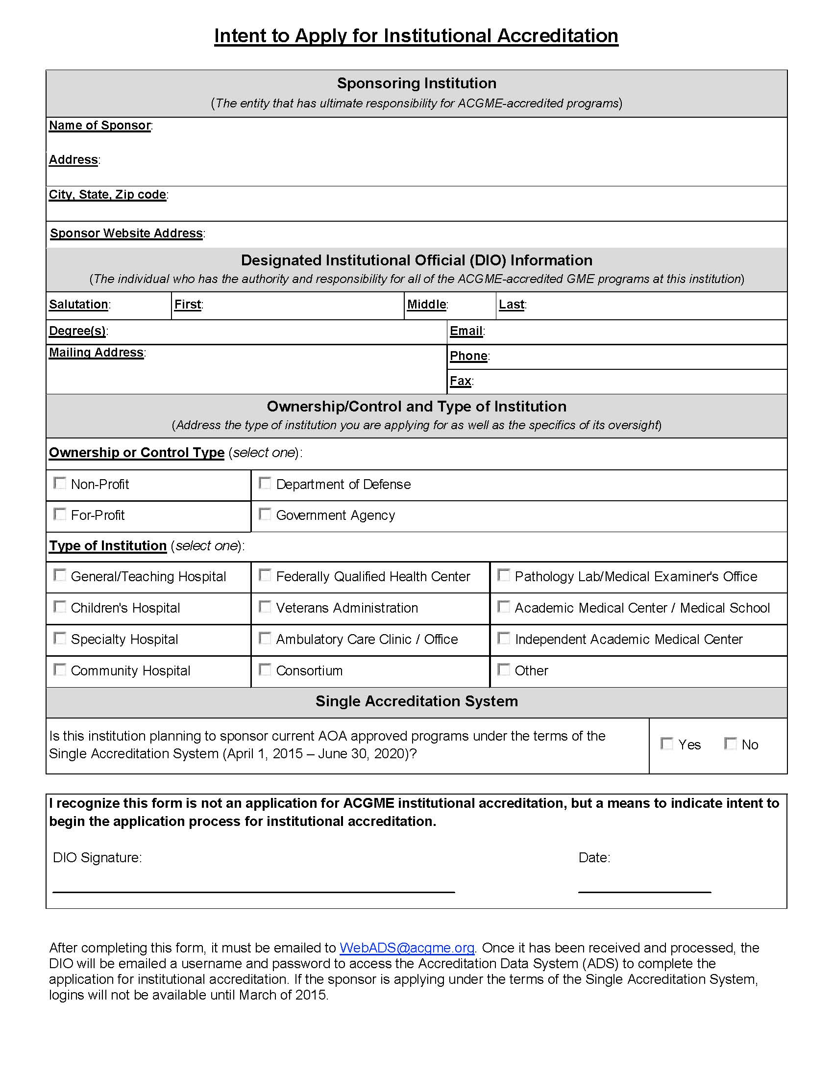
Email to:
WebAds@acgme.org
Login available starting March of 2015

Slide 25
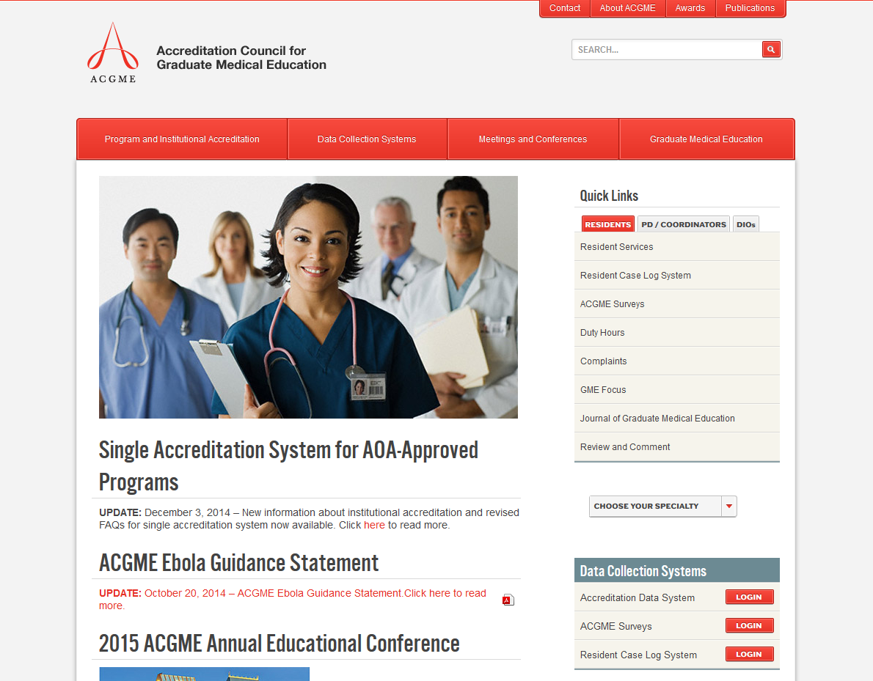
www.acgme.org

Slide 26
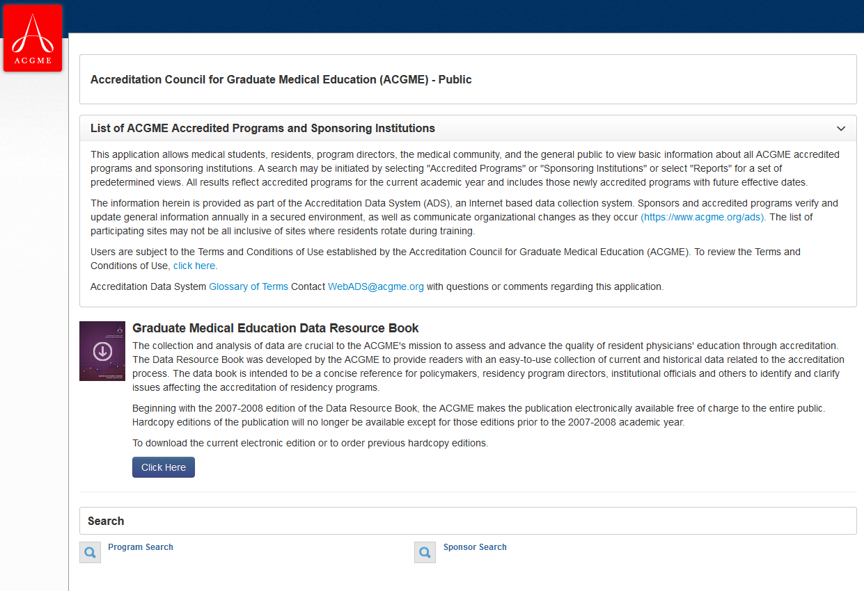
www.acgme.org/ads/public

Slide 27
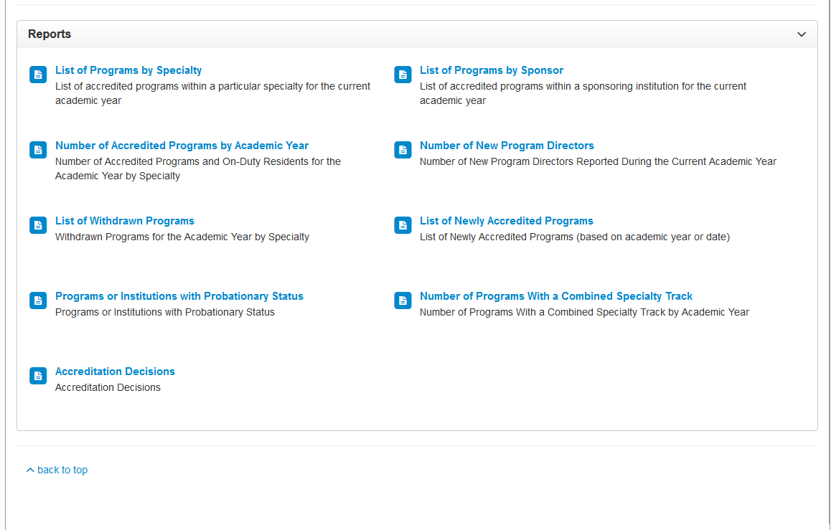
www.acgme.org/ads/public

Slide 28
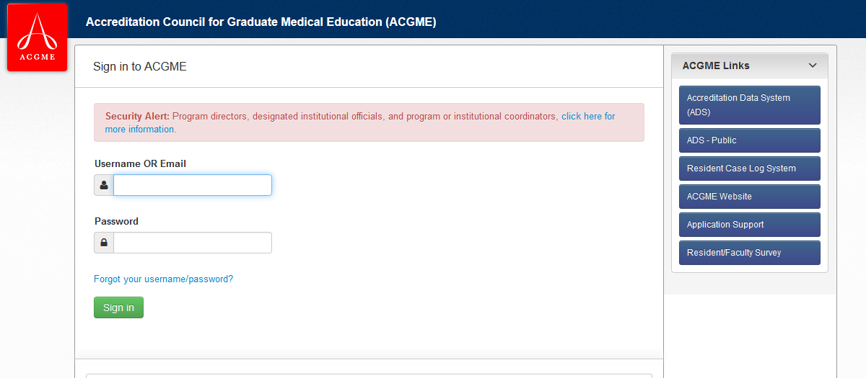
www.acgme.org/ads/login

Slide 29
Institutional Application
Pre-Course Work

Slide 30
Graduate Medical Education Committee
Requirements
Meets at least quarterly each academic year
Composed of voting and non-voting members that play an integral role in GME
Includes Resident Representation
Must have a Quality Improvement Officer or designee represented
Maintain meeting minutes

Slide 31
Graduate Medical Education Committee
Responsibilities
Oversight of accreditation statuses, changes in program structure, etc.
Quality of the Learning Environment
Quality of educational experiences that lead to measurable outcomes
Compliance with institutional, common and specialty requirements
ACGME Annual Program Evaluations (APE)
Performance indicators and oversight of the Annual Institutional Review (AIR)

Slide 32
Annual Program Evaluation (APE) Common Program Requirement V.C.2
...the program must document formal, systematic evaluation of the curriculum at least annually and is responsible for rendering a written APE:
Resident performance
Faculty development
Graduate Performance
Program Quality
Progress on Previous Year’s Action Plans
Written Action Plan for Current Year

Slide 33
Annual Institutional Review (AIR) Institutional Requirements I.B.5
The GMEC must demonstrate effective oversight of the Sponsoring Institution’s accreditation through an Annual Institutional Review (AIR)
The AIR must include monitoring procedures for action plans resulting from the review.
The DIO must submit a written annual executive summary of the AIR to the governing body.

Slide 34
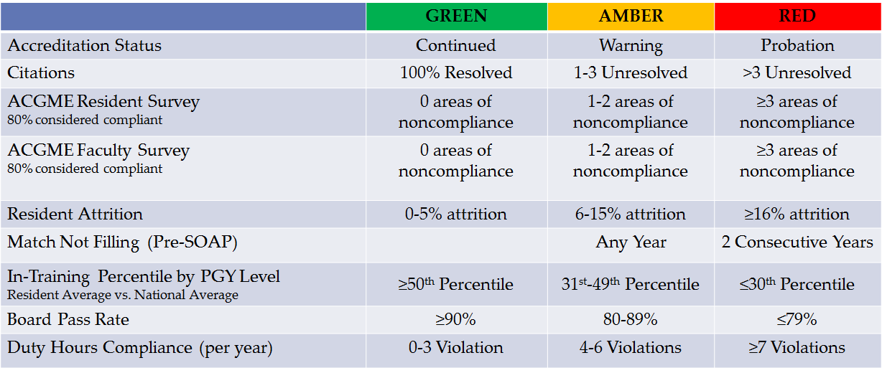
Establish Performance Criteria

Slide 35
Special Review Process Institutional Requirement I.B.6
The GMEC must demonstrate effective oversight of underperforming programs through a Special Review Process
GMEC Special Review
Identifies underperforming programs as per GMEC criteria
Results in a report that describes:
Quality improvement goals
Corrective actions
Process for monitoring outcomes
Similar to “Internal Reviews”

Slide 37
What Must be Reviewed for Compliance?
Update Institutional Policies and Procedures
Examples:
Institutional Commitment to GME
Resident/Fellow Recruitment
Contract Renewal/Promotion Policies
Resident Forum, Organization, Town hall (i.e. House Staff Association)
Institutional Duty Hour Standards

Slide 38
Duty Hour Regulations
AOA Standard | ACGME Standard
PGY-1s can be assigned 24 consecutive hours | PGY-1s cannot work more than 16 consecutive hours
Residents must have at least 12 hours free of duty after 20-24 consecutive hours of duty | Intermediate residents and above must have at least 14 hours free of duty after 24 consecutive hours of duty
Upon completing a duty period of at least 12 but less than 20 hours, a minimum period of 10 hours off must be provided. | Residents should have 10 hours, and must have eight hours, free of duty between scheduled duty periods.
Residents in the ER shall work no longer than 12 hour shifts with no more than 30 additional minutes allowed for transfer of care | Residents in the ER shall work no more than 12 hour shifts followed by 12 hours off –including transition time. No additional time is allowed for Transition time.

Slide 39
Who Should be Involved?
DIO
GME Office
Program Directors
Quality Improvement Representatives, Risk Management
Cultural Competence: Healthcare Disparities
EMR Experts
…there is no limit…

Slide 40
The Institutional Application
How to Approach the Questions

Slide 41
GMEC Institutional Requirement(s) I.B.2.a)-b)
Your GMEC must meet at least 4 x per academic year
who are the members
Describe what components of the Learning Environment are monitored, discussed, reviewed, etc.
If your institution will have GMEC Subcommittees:
must include a peer selected resident member
All actions taken by subcommittees must be approved by GMEC (and documented in the full GMEC minutes)

Slide 42
GMEC Institutional Requirement(s): I.B.5.b)
Identify performance indicators that the institution (GMEC) will monitor and track for each program
Identify what will be considered as noncompliance and/or underperforming values
Identify when a program will have to undergo a “Special Review”
Who will monitor a program’s action plan/progress
How often will the results, monitoring be reported into the GMEC?

Slide 43
Institutional GME Infrastructure and Operations GMEC Institutional Requirement(s) II.A.1, II.A.3.
Describe the institution’s commitment to providing the salary necessary for the DIO and GME Office
Institution encourages and provides resources for professional development, ongoing education for DIO and GME
How will your GME Office be staffed and what support will they offer your ACGME programs?

Slide 44
Institutional GME Infrastructure and Operations GMEC Institutional Requirement(s) IIB.1-5
Salary support and protected time that will be offered to Program Directors (PD)?
Is a Program Coordinator required? If not, who will provide administrative support to the PD?
Do the Requirements require Associate Program Directors, Core Faculty? Will the institution supply salary support and protected time?
What other resources will be available to aid Program Directors, Coordinators?

Slide 45
Resident/Fellow Forum Institutional Requirement(s) II.C
Describe resident forum
Resident representatives from all sponsored ACGME programs
Discuss issues with work and learning environment
Raise concerns without fear of intimidation or retaliation
Access to GME leadership outside of Program
Opportunity to meet without program and/or institutional leadership present

Slide 46
Resident/Fellow Learning & Work Environment Institutional Requirement(s) III.A., III.B.1.a)-b), III.B.4.b)
Reporting Systems
Describe several systems that are in place at the program, GME, and institutional levels for residents to report concerns
How are these issues addressed? Escalated?
How do the residents receive closure on their issues(s)?
System to report near-misses, unsafe conditions?

Slide 47
Resident/Fellow Learning & Work Environment Institutional Requirement(s) III.B.2.a)-b)
Patient Safety & Quality Improvement
How are the Hospital Goals and Quality Improvement Initiatives shared with the Residents?
How are residents incorporated into the Quality Initiatives?
How engaged are residents during Fact-Findings, Root Cause Analysis? M&M Conferences?
How do the residents know if their patient treatment plans, disease management and healthcare disparities are addressed?

Slide 48
Resident/Fellow Learning & Work Environment Institutional Requirement(s) III.B.5.a)-b)
Duty Hours Monitoring
No specifics as to how often Duty Hours Compliance must be monitored
Sample 4-week intervals
Ensure that Institutional Duty Hour Policy adheres to ACGME and State standards
Document monitoring and actions plans during GMEC
Fatigue Management and Mitigation
Education on Duty Hours and Fatigue

Slide 49
What Happens After You Hit Submit?
Review Committee (RC) will assess the application for compliance with the ACGME requirements
Letter of Notification (LoN) will indicate Accreditation Status
Site Visit within 2 Years to received Continued Accreditation

Slide 50
What if Your Institution is Denied Initial Accreditation?
Remain in Pre-Accreditation Status
Programs Cannot Obtain Initial Accreditation Status
Submit an updated Application addressing all Citations
May prompt a Site Visit

Slide 51
2015 Timeline
February
Intent to Apply for Institutional Accreditation
March
April
Identify AOA Programs Eligible for ACGME Accreditation
Access to Accreditation Data System (ADS)
Program Directors Granted Access to ADS
July
Programs Can Submit Application for ACGME Accreditation
Under Pre-Accreditation Status Must Comply with Annual ACGME Reporting
Submit Initial Institutional Application Through ADS

Slide 52
Who Will You Be?

Slide 54
ACGME Conference Feb 26- Mar 1, 2015 San Diego, California
Thursday Feb 26: Pre-Conference for Osteopathic Programs and Institutions

Slide 55
Partners’ Online Education
Upcoming Live Webinars
Direct Observation – Why? What? How?
Thursday, February 19, 2015
12:00pm – 1:30pm EST
Discussion of Generation Silent
to Generation Millennial
Tuesday, March 10, 2015
12:00pm – 1:30pm EST
Ask Partners – Spring Freebie
Thursday, March 19, 2015
12:00pm – 1:00pm EST
AOA: Program Readiness
Thursday, April 2, 2015
12:00pm – 1:30pm EST
Visit our website to see the rest of our Spring 2015 Schedule!
www.PartnersInMedEd.com
On-Demand Webinars
Self-Study Visits
Introduction to GME for
New Program Coordinators
Milestones & CCCs
GME Financing – The Basics
Single Accreditation System
The IOM Report
Institutional Requirements: What’s New?
Contact us today to learn
how our Educational Passports can save you time & money!
724-864-7320

Slide 56
Partners in Medical Education, Inc. provides comprehensive consulting services to the GME community. For more information, contact us at:
724-864-7320
Info@PartnersInMedEd.com
www.PartnersInMedEd.com

